Slide 1
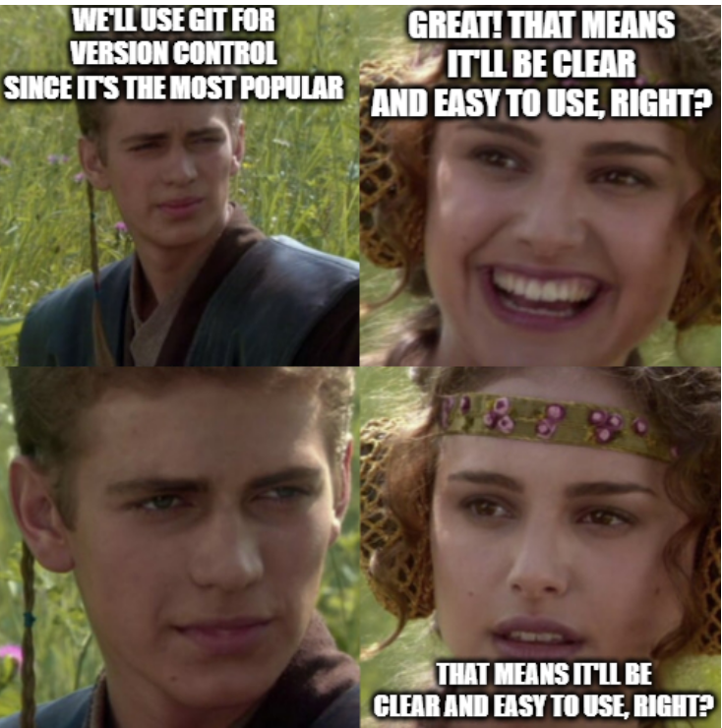
Git
Code/Astro 2025

Slide 2
Source Control (also called Version Control)
System for tracking changes in files
Why use source control?
Legacy versions of the code
Revert to old versions
Why was it working before?
Collaborative work
Our recommendation: Use source control any time you are programming, even if it is just for yourself (and not just code!)

Slide 3
Demo: Introduction to Git
In the demo, you will learn how to:
Make a git repository in GitHub and “copy” it to your local machine
Add and edit files in the repo
Resolve conflicts between the remote version and local version of your files
[If time] Remove changes you don’t want to keep
Don’t try to type along with me as we walk through the demo. We’ll have time at the end to work on the demo in groups.

Slide 4
Group Activity (10 mins)
Break up into groups
Work together to reproduce the steps of the demo. Ask for help if you need it!
If time:
Choose a group member. Everyone clone the demo repo of that member, and then try to edit the same file and push to the repo. Can you resolve any conflicts that arise?
NOTE: To push to the same repository, the repository creator will need to add others as collaborators. To do this from the repo’s homepage:
Settings -> Collaborators -> Add People (next to Manage Access)

Slide 5
Git Commands
> git push
Sends new commits to remote repo
> git pull
Grabs new commits from remote repo
> git diff [file]
Print difference between local and remote version of file
> git checkout [file]
Get most recent commit version of file, overwrite any local changes
> git stash
Save a copy of local changes, but not as a commit (allows you to update local repo from remote)
> git stash pop
Add back local changes to files that were previously stashed away
> git clone [URL]
Clones repo to your computer
> git status
Notes file changes in local repo and/or differences between local and remote repos
> git add [file]
Adds changes from file to next commit
> git commit
Creates commit from staged changes
A README of the demo can be found on the codeastro github page under Day1/git_intro

Slide 6
Helpful Practices To Avoid Merge Conflicts
Always “git pull” from origin before working on a code
“git commit” and “git push” changes early and often! The smaller units these changes are, the easier they are to work with
If applicable: coordinate with collaborators as to what section of code you are working on, to avoid multiple folks working on the same area at the same time

Slide 7
Extra Slides

Slide 8
Source Control Flavors
Basic source control: copy the entire folder and name it “OLD_v3”
Better than nothing, but quickly becomes difficult to work with
File synchronization software: Dropbox, Google drive, other cloud storage, etc..
Good for tracking a mix of different file types
Specific for code development: git, svn, mercurial, team foundation
Git is the most popular in astronomy software development (and nearly everywhere)

Slide 9
Making a git repository
Git repo: any folder with a .git folder inside of it
git init
Turns the folder you are in into a git repo (by making the .git folder) with zero commits
git clone url
Downloads a repository from a url (e.g., the one from Github)
Generally, I do this: I make a new repo on Github and then download it
I recommend always to use the HTTPS url
git status
Gives you the state of your current repository
Demo: download ASTRON441 repo

Slide 10
Making a set of changes
A commit is a set of changes made to the repository
A history of changes is defined by the sequence of commits
How to make a commit
git add [file]
Adds any new changes from [file] to the next commit
Can be run multiple times (even on the same file)
git commit –m “[description]”
Makes a new commit that consists of all the added changes
Description should be a short phrase that summarizes the commits changes
Commits are free, so try to make commits small and modular
Demo: make change to ASTRON 441 repo

Slide 11
Synchronize Changes Online
Need a service like Github, Bitbucket, etc to store your Git repo (remote repo)
Goal: your laptop and remote repo are consistent with commits
Git has ways of resolving conflicts, but don’t make it hard on yourself
git push
Sends new commits you made to online repo
git pull
Grabs new commits from remote repo onto your machine (i.e. updates your download of the code)
Demo push, edit code on Github, and pull

Slide 12
Conflicts 🦇👻🕸️🎃🐈‍⬛
When two commits edit the same parts of the code
Git doesn’t know how to code, can only merge commits when non-overlapping
Git push will not work if it creates a conflict – you must pull and fix
Git pull will not work if you edited a file (but have not made a commit with those new changes) and try to pull commits that also edit the same file
General system to follow:
Make changes to your files
Make commits for those changes
git pull
Fix any conflicts if needed
git push
Demo: conflict in ASTRON 441 repo

Slide 13
What if I don’t want to save my changes?
git checkout filename
Reverts the file back to the version from the latest commit, removing any uncommited stages
Undo changes and then update your local repo
git checkout myfile.py
git pull
Demo: make change locally and undo it

Slide 14
But what if I like my changes but I don’t want to commit my changes just yet?
git stash
Saves all edits of a file, stashes them away elsewhere, and reverts files to version from last commit
git stash apply
Reapplies the most recently stashed changes to your current repo
[IMPORTANT]: If there are conflicts, will create merge conflicts
Preserve your uncommited changes but also updating your repo
git stash
git pull
git stash apply
Demo: stashing and unstashing changes

