Slide 1

Department of Computer Science and Engineering
(Cyber Security)
SUBJECT: Web Programming
PROJECT: KrX Studio — Modern Digital Studio Website
TECHNOLOGIES: HTML, CSS, JavaScript, React, Vite
NAME: Krishna Kumar J
REG NO: 241901505

Slide 2
ABOUT THE INDUSTRY
Websites help businesses establish an online presence, communicate their services, build credibility and connect with customers.
A well-built site turns a studio’s identity and services into an experience visitors can explore, trust and act on.
Responsive Web Design
Layouts adapt to desktop, tablet and mobile devices.
1
Interactive Experiences
Animations and interface interactions improve engagement.
2
Relevance to Web Programming
Frontend technologies combine structure, styling and interaction to create usable, responsive websites.
Digital Business Presence
Websites showcase services and let customers send inquiries.
3
KrX Studio | Krishna Kumar | [INSERT YOUR REGISTER NUMBER] | 2 / 8

Slide 3
PROBLEM STATEMENT / OBJECTIVE
Problem Statement
Objectives of KrX Studio
1
Limited Online Presence
Businesses need professional websites to present their identity and services.
Present the studio and its services through a modern website
Provide responsive layouts for different screen sizes
2
Inconsistent User Experience
Poorly structured websites can be difficult to use on different devices.
Use interactive components and animations to enhance the experience
Provide clear calls to action and a project inquiry form
3
Low Engagement
Unclear navigation makes it hard to explore services or send inquiries.
Organize the frontend with reusable React components and clean CSS
KrX Studio | Krishna Kumar | [INSERT YOUR REGISTER NUMBER] | 3 / 8

Slide 4
TOOLS AND TECHNOLOGIES
Re
FRONTEND
React
JS
LANGUAGE
JavaScript / JSX
H5
STRUCTURE / STYLING
HTML5 and CSS3
Reusable components for the website interface and sections.
Client-side interaction, component logic and dynamic behavior.
Page structure, responsive layouts, typography and visual styling.
Vi
TOOLING
Vite
GS
ANIMATION
GSAP
W3
BACKEND
Web3Forms
Development server and frontend production build process.
Interactive animations for the website interface.
Sends project inquiry submissions via an external form service.
KrX Studio | Krishna Kumar | [INSERT YOUR REGISTER NUMBER] | 4 / 8

Slide 5
SYSTEM ARCHITECTURE AND IMPLEMENTATION
1. Browser UI
HTML, React components, JavaScript and CSS
2. Interaction
Navigation, responsive controls, animations
3. Inquiry Form
Project inquiry form connected to Web3Forms
4. Vite Build
Vite builds the frontend for static hosting
Website Modules
Responsive Implementation
Hero section introducing the studio
Services section describing the offerings
Navigation and interactive visual effects
Project inquiry and contact functionality
Reusable React components
CSS media queries and responsive layouts
Client-side animation and interaction effects
Form integration and production build verification
KrX Studio | Krishna Kumar | [INSERT YOUR REGISTER NUMBER] | 5 / 8

Slide 6
WEBSITE STRUCTURE AND SECURITY
Website Structure
Security and Quality
React components
JavaScript / JSX
1
Environment configuration: Keep the Web3Forms access key in a Vite environment variable.
CSS styles
Static assets
2
Repository hygiene: Exclude local .env files and build artifacts from version control.
Vite build
Web3Forms
3
External links: Use rel="noopener noreferrer" when opening links in new tabs.
The website uses a React/Vite frontend and an external service for inquiry form submissions.
4
Input handling: Validate required inquiry fields and show clear submission feedback.
5
Testing: Verify navigation, form behavior, responsive layouts and production builds.
KrX Studio | Krishna Kumar | [INSERT YOUR REGISTER NUMBER] | 6 / 8

Slide 7
PROJECT OUTCOME
01
01
03
01
Digital Studio Website
React + Vite Frontend
Target Device Classes
Inquiry Form Integration
Skills Gained
Future Scope
React component-based frontend development
HTML, CSS and JavaScript for interactive interfaces
Responsive web design and layout implementation
Debugging, testing and production build verification
Improve accessibility and cross-browser testing
Expand services and add verified portfolio projects
Improve inquiry form validation and handling
Optimize performance and maintainability
KrX Studio | Krishna Kumar | [INSERT YOUR REGISTER NUMBER] | 7 / 8

Slide 8
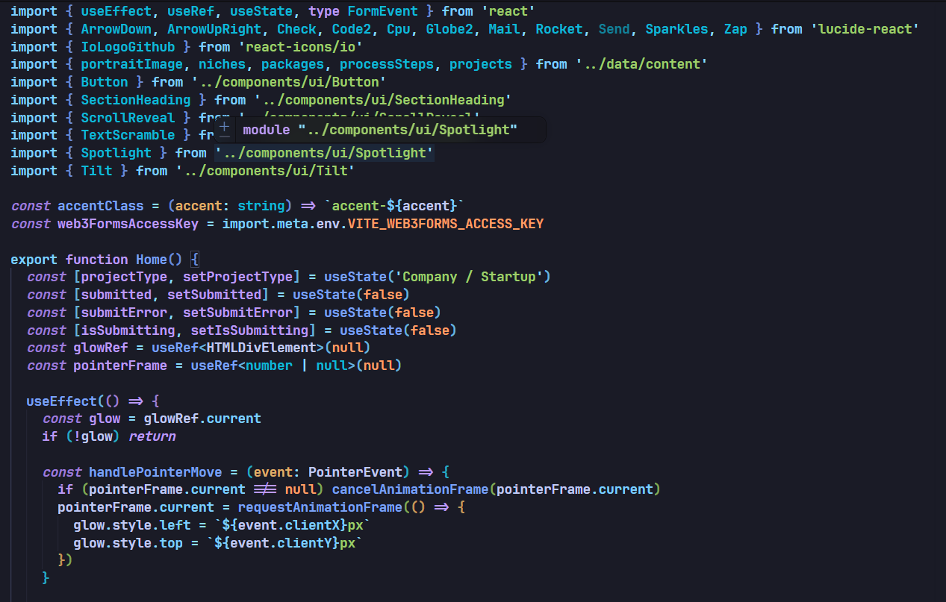
SOURCE CODE

Slide 9
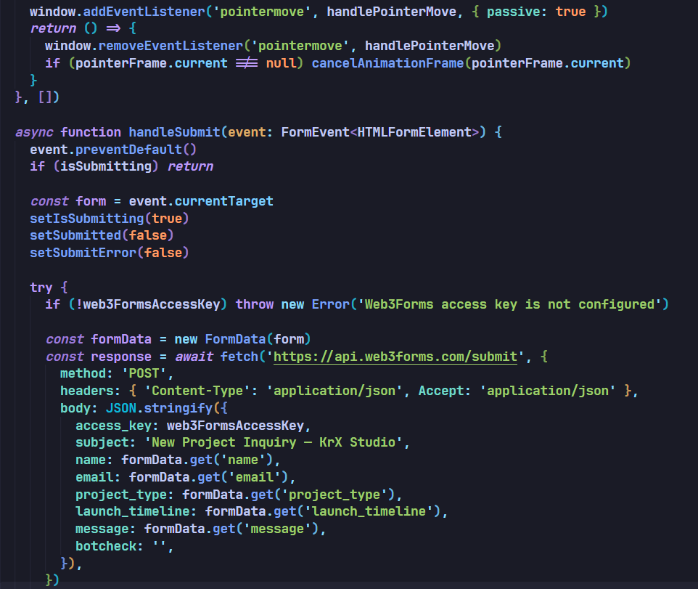
SOURCE CODE

Slide 10
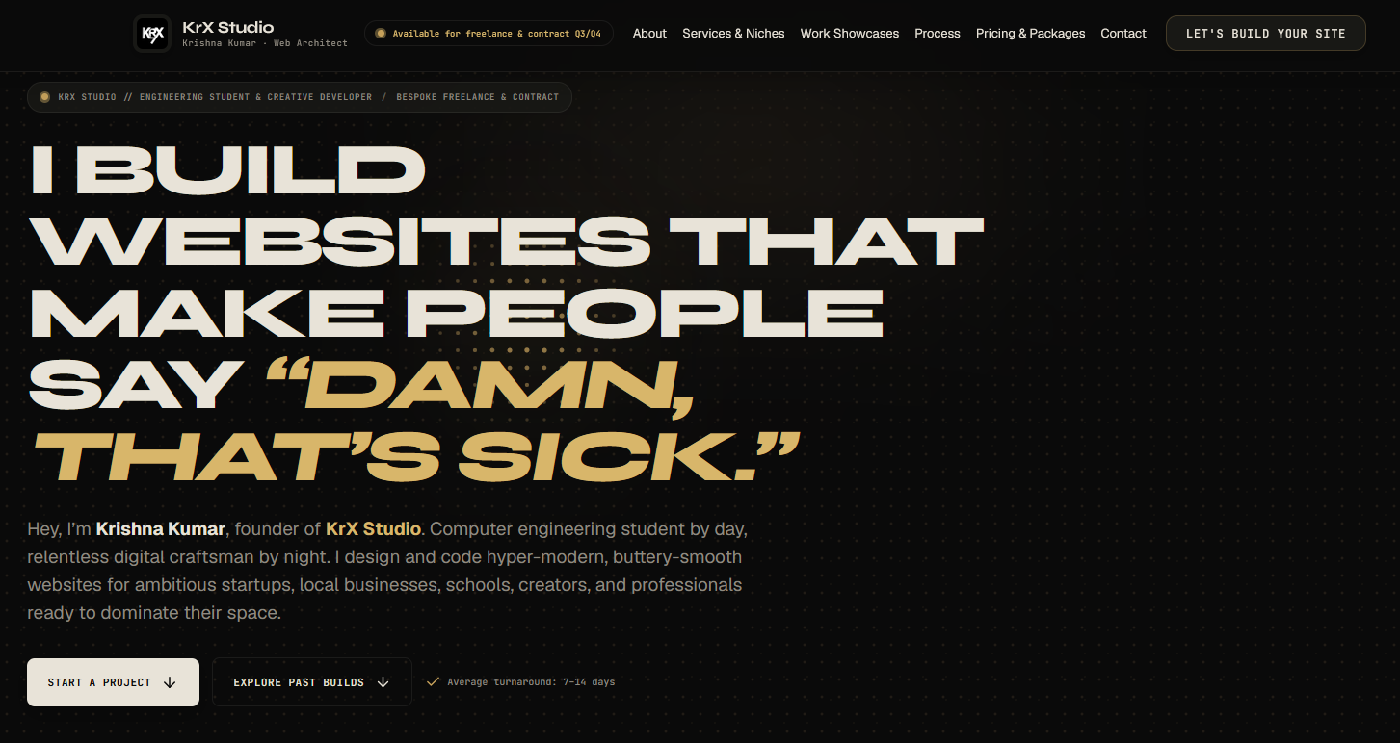
WEBSITE OUTPUT

Slide 11
CONCLUSION
Key Takeaways
Thank You
Krishna Kumar
241901505
KrX Studio demonstrates how HTML, React, JavaScript and CSS can be used to create a modern digital studio website.
Responsive layouts and interactive visual effects help deliver a consistent browsing experience across devices.
The inquiry form connects visitors to the studio through Web3Forms, and the frontend uses reusable components.
KrX Studio | Krishna Kumar | [INSERT YOUR REGISTER NUMBER] | 8 / 8

