Slide 1
E - KNOWLEDGE WIRELESS HEALTH CARE SYSTEM

Slide 2
Its main feature is to provide the browser to get appointments from a doctor through internet instead of going there and fixing an appointment.

Slide 3
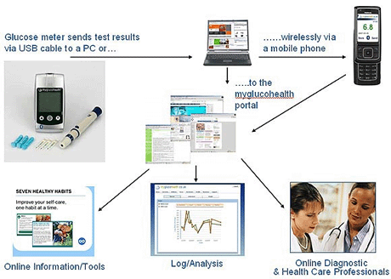

Slide 4
It has 4 Main Modules, They are
        Patient Module.
        Doctor Module.
        Administrator Module.
        General User Module.

Slide 5
This project contains single centralized database. That database contains the nine tables.
The tables are
Hospital table>> General Prescription table>> Patient table>> Doctor table>> Appointment table>> Recommended Hospital table>>Administrator table>> Account table>> Feed back table.

Slide 6

PATIENT MODULE:
We allow every user to register freely at any time.
After registration the user can Login to this site with his/her Unique Id.
The user can fix Appointment with a particular doctor by specifying the time.
A patient visit the doctor at specified timing as per the appointment timing.
Patients can cancel their appointments within a time limit.

Slide 7

DOCTOR MODULE:
Every Doctor will have their own unique Id and Password.
After they logged into this site. From there by choosing the link, they can see their appointments.
After attending the patient, the Doctor selects a particular patient Id for prescription.
For some patient, the Doctor may need to recommend some other Hospitals for future treatments.

Slide 8
ADMINISTRATOR MODULE:
After filtering the invalid data, the Doctor Details will be uploaded in Health Consulting System site.
Before uploading they will send mail to the Doctor’s E-mail ID about his/her Id and Password.
The Administrator can view the Account information and can also view the feedbacks given by different users of this site.
The Administrator is the one, who updates latest Health Tips provided in this site.

Slide 9
GENERAL USER MODULE:
Users are those who have not registered in this site. They can view general information about the Doctors.
They view the Health Tips.
They can give their suggestion about this site.
They can register themselves and become a member of Health Consulting System.

Slide 10
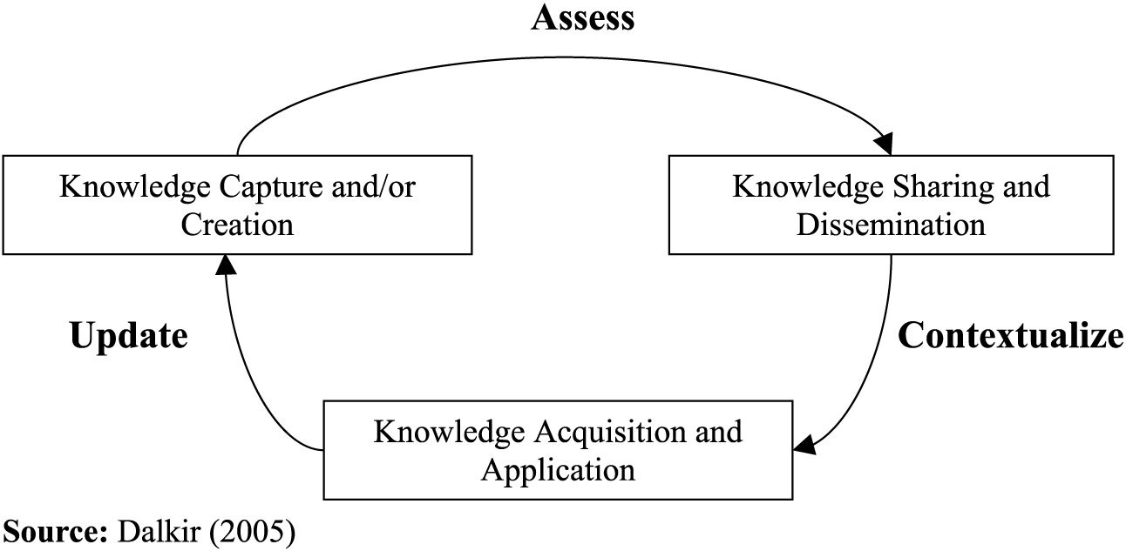

Slide 11
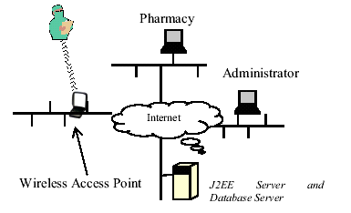
Overall architecture of the wireless prescription system

Slide 12
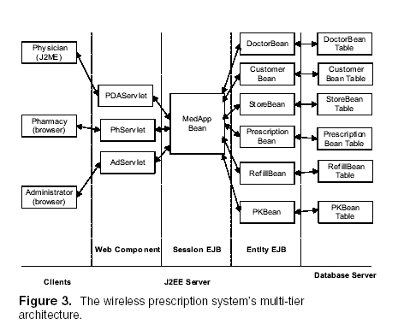

Slide 13
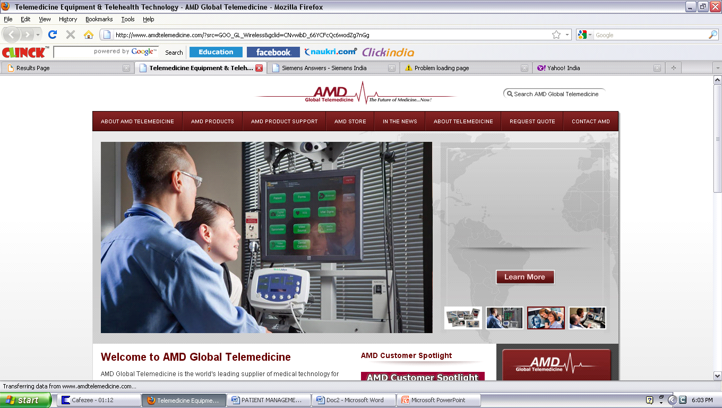

Slide 14
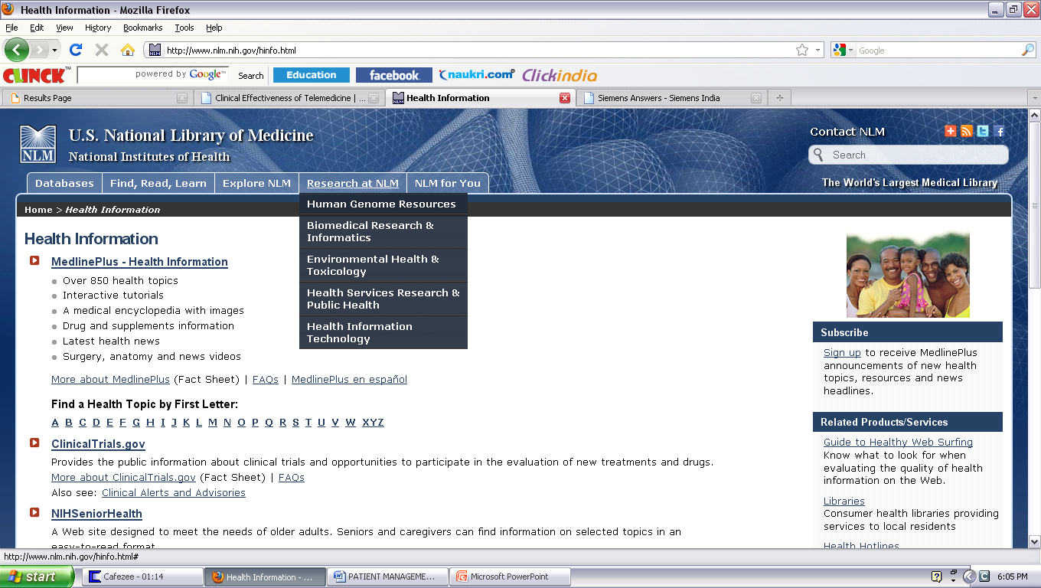

Slide 15
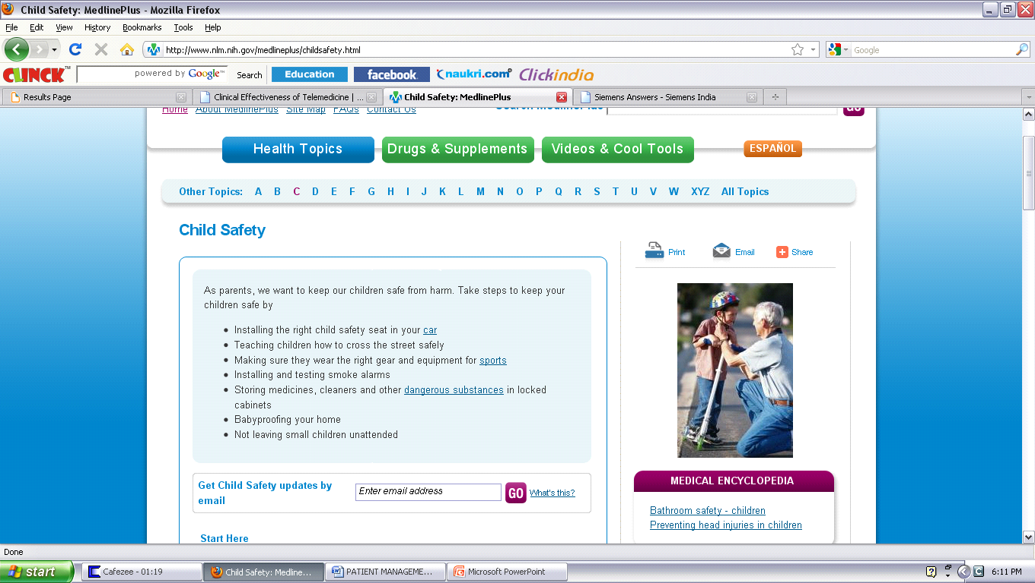

Slide 16
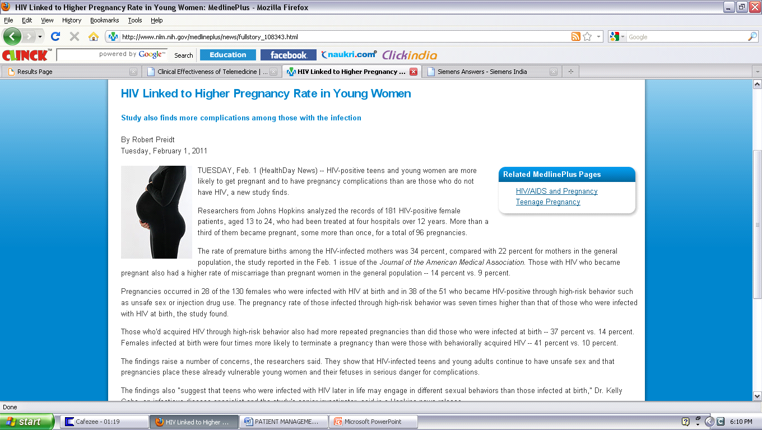

Slide 17
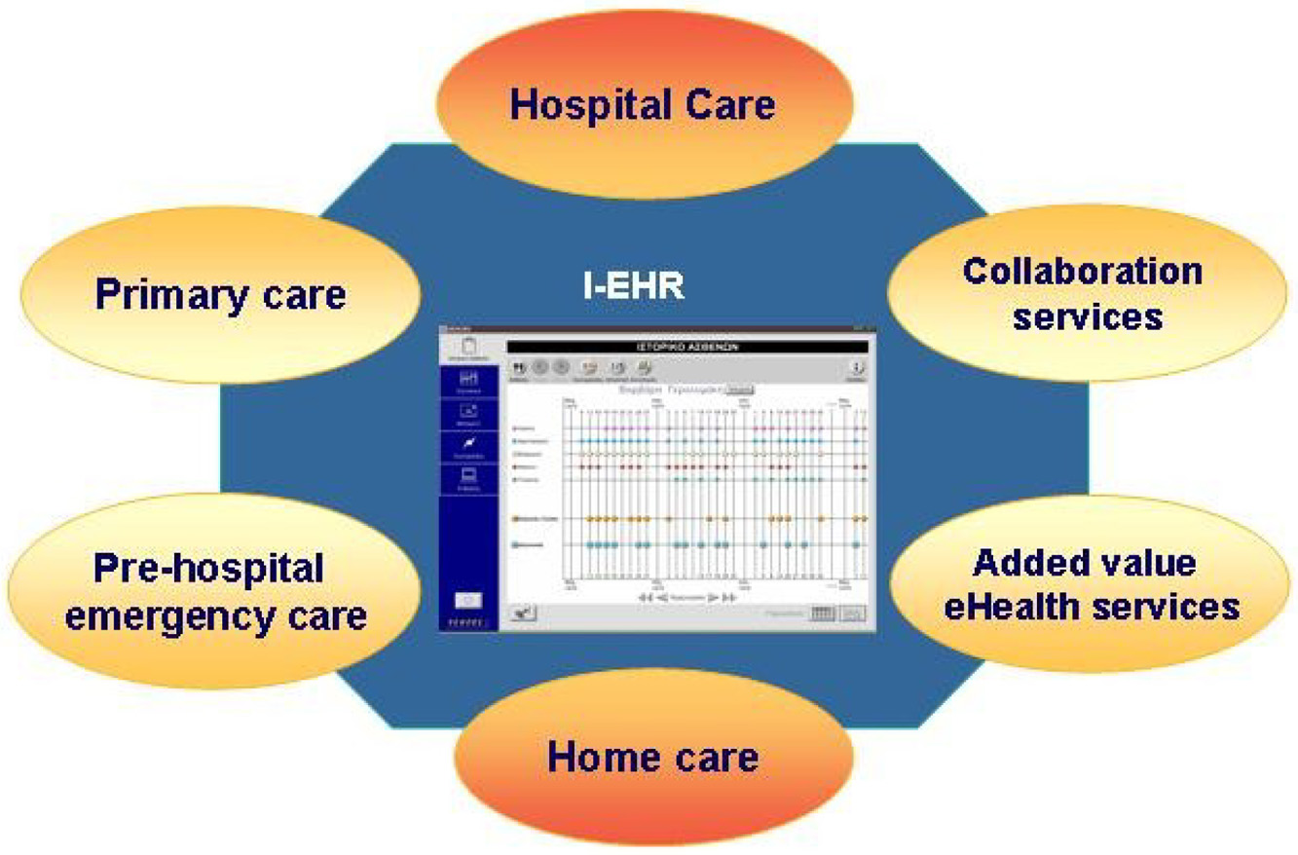

Slide 18
EXISTING SYSTEM
we find that there are a lot inconveniences, so we proposed a new system that will overcome all the drawbacks in the existing system by considering the following factors:
Time Consumption
Inefficiency
Cost Consumption

Slide 19
PROPOSED SYSTEM
Eliminate the drawbacks in the existing system and to increase the performance of the existing system.
Reliable
Secure
Well efficient
Update everyday new incoming changes
Less cost
Eliminate time delay

Slide 20
This project is mainly developed to overcome the problems in the existing system by introducing more enhanced and efficient features.
Thank you!

