Slide 1
A-PRISM / THE REPLAY BOTTLENECK
01
Tracker warm-up is not sensor calibration
300 logs / 20 workers
Where continuity breaks
Worker 1 | scored segment
ADC / Range FFT
↓
Doppler FFT / CFAR
Worker 2 | warm-up + scored segment
↓
CDC / Beamforming
Worker 20 | warm-up + scored segment
↓
AF alignment
One preceding log can initialize track state.
Calibration eligibility and history need a separate policy.
↓
RDU / EKF tracker
400 frames at 20 Hz = 20 s, not 20 min.
Replay must restore the slowest state upstream of the scored output.

Slide 2
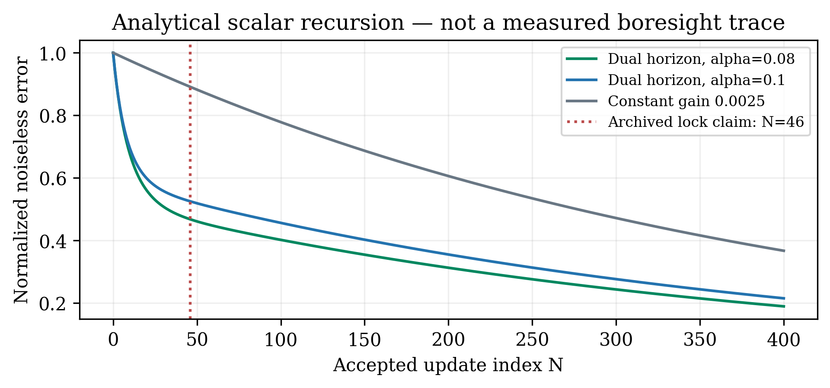


A-PRISM / PAPER 1 / FAST INITIALIZATION
02
Fast adaptation + provenance-aware preflight
Dual-horizon schedule
Kf = 0.05 | Ks = 0.0025
α = 0.08 proposal; 0.10 wrapper default
Preflight: bind seed to sensor, quality and epoch.
Archived example: azimuth −1.145°.
Analytical recursion, not a measured lock trace.
46 frames / 2.3 s is an archived claim.
A valid historical seed can remove estimator warm-up; online lock still needs validation.
Notes:
Integration boundary: wrapper exposes gain telemetry and caps deadband counts at 50; the archived change does not replace the buried DABB recursion. A lock guarantee needs the actual accepted-update stream and scoring criterion.

Slide 3


A-PRISM / PAPER 2 / SPECULAR TRACKING
03
Use the reflection — in the correct receiving frame
Physical path and image geometry
Covariance-aware assimilation
s
p
q
Do not count a reused observation twice.
Assimilated XOR suppressed, within the scan.
s*
Example: rays (30, −4) and (30, +4).
Untransformed bearing mismatch: 15.189°.
Bounded gating ≠ a safety guarantee.
Full coupled covariance exceeds scalar hooks.
Image methods are equivalent after the frame transform; covariance and ownership matter.

Slide 4
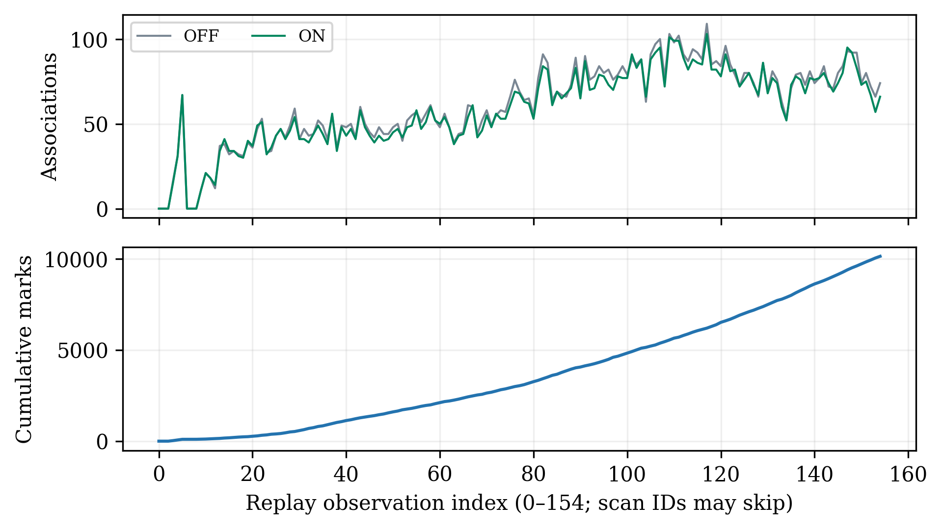
A-PRISM / EVIDENCE / NEXT MILESTONE
04
155 replay records — traceable counters, clear limits
Measured instrumented replay
Valid detections
71,779
Associations OFF → ON
9,478 → 9,131
Assimilation marks
10,130
Records with marks
151 / 155
Next: ground-truth replay + DSP integration.
Paper 1 / Paper 2 + IDF drafts; venue dates pending.
RMSE 1.969 → 0.651 m and 99.6% recall:
reported benchmarks; not verified by these CSVs.
Counters are reproduced; fleet accuracy needs independent truth and a complete scoring pipeline.
Notes:
Host archival report: 40/40 checks in OFF and ON. Equal pass counts do not prove bit-identical production output. Association deltas are not labeled false positives. Velocity changes are not velocity errors. Recorded 0.910/3.743 m/s shifts are archive reports.

