Slide 1
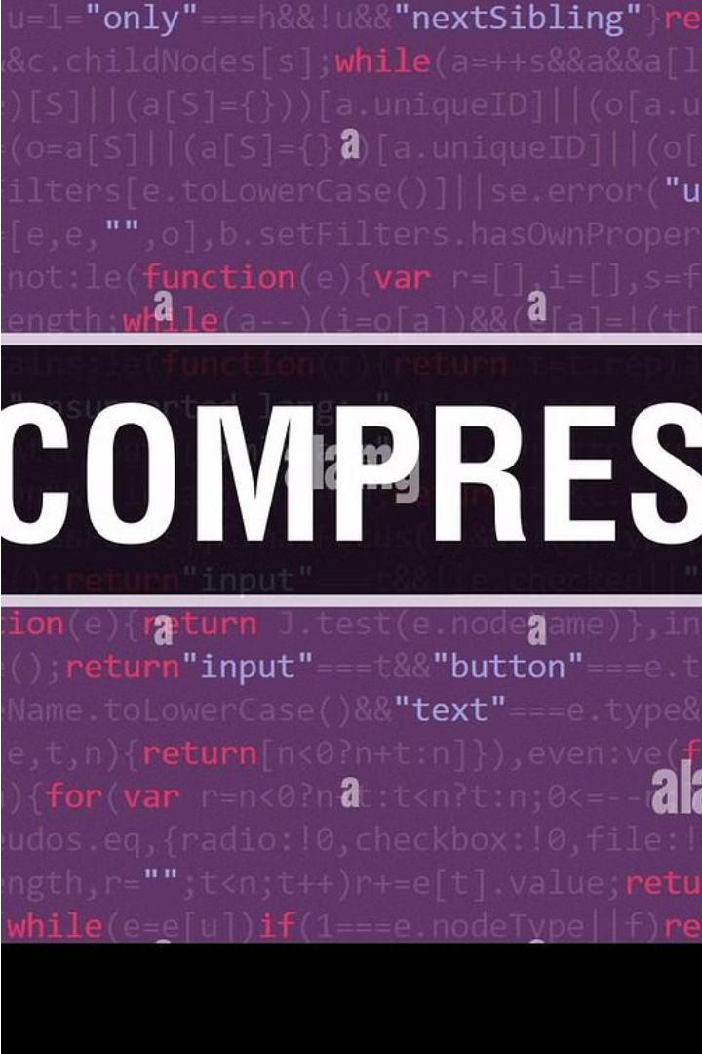
Examining Wavelet Transform and Huffman Coding for File Compression
This work explores the effectiveness of wavelet transform and Huffman coding for achieving high file compression ratios while preserving the perceptual quality of voice transmissions. The demand for efficient data handling systems drives the need for advanced compression techniques.
Presented by, Krishnakumar Balachandra Bhat Vadiraj B Hayagreeva Gururaj Deepak Todurkar B R Manoj

Slide 2

Demand for Effective File Compression Methods
Massive Data Volumes
Bandwidth Limitations
The exponential growth in digital content creation and storage requirements has led to an increasing need for effective file compression methods.
Efficient compression is crucial for delivering high-quality voice and multimedia transmissions over limited bandwidth networks.
Storage Optimization
Compression techniques can significantly reduce storage requirements, enabling more data to be stored on limited physical media.

Slide 3
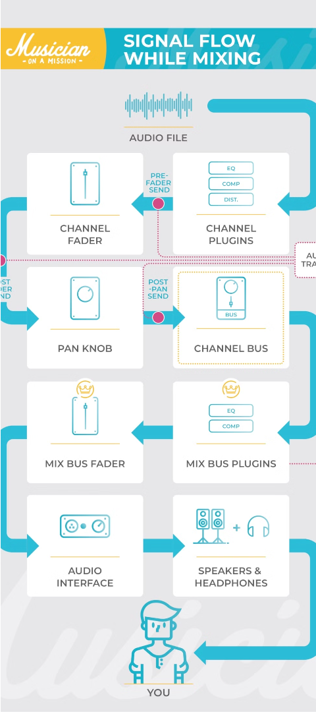
Speech Signal Transformation: Using Wavelet Transform
1
Signal Decomposition
The speech signal is decomposed into different frequency subbands using the wavelet transform, capturing both time and frequency information.
2
Multi-Resolution Analysis
The wavelet transform provides a multi-resolution representation of the signal, allowing for selective compression of different frequency components.
3
Efficient Encoding
The transformed signal can be efficiently encoded using techniques like Huffman coding, achieving high compression ratios.

Slide 4

Perceptual Quality Preservation: Maintaining Consistency in Voice Transmissions
1
Preserving Spectral Information
2
Optimizing Bit Allocation
3
Subjective Evaluation
The wavelet transform preserves the spectral characteristics of the speech signal, ensuring that the perceptual quality is maintained after compression.
The system allocates more bits to the perceptually important frequency subbands, while compressing the less significant components, to maintain the overall voice quality.
The compressed speech samples are evaluated through subjective listening tests to ensure that the perceptual quality remains consistent with the original, uncompressed signal.

Slide 5



Experimental Setup and Evaluation Metrics
Speech Signal Acquisition
Compression Algorithms
Evaluation Metrics
Compression ratios and subjective perceptual quality assessments are used to measure the effectiveness of the proposed techniques.
High-quality speech samples are recorded in a controlled environment for the experiments.
The wavelet transform and Huffman coding are implemented and applied to the speech samples.

Slide 6
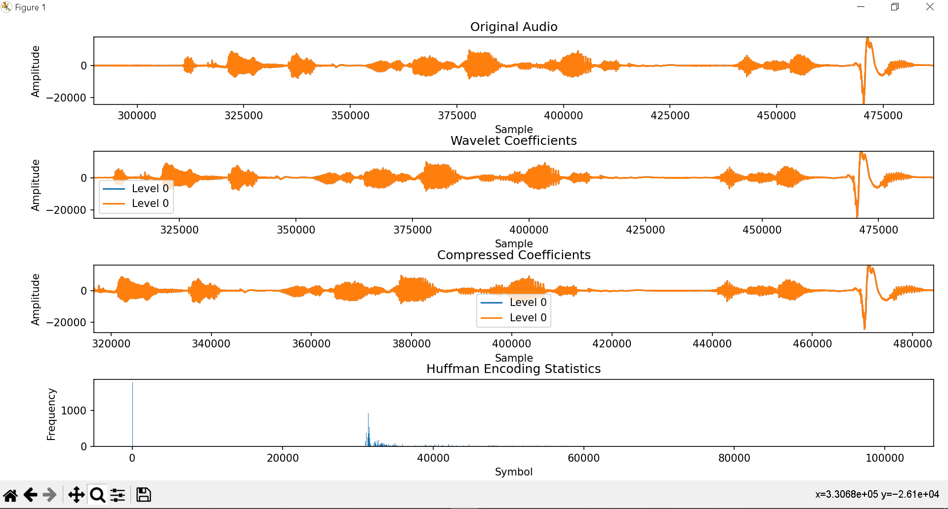
output Wave Form
Compression ratios and subjective perceptual quality assessments are used to measure the effectiveness of the proposed techniques.
High-quality speech samples are recorded in a controlled environment for the experiments.
The wavelet transform and Huffman coding are implemented and applied to the speech samples.

Slide 7
Results and Discussion: Compression Ratios and Perceptual Quality
Compression Ratios
Perceptual Quality
Tradeoffs
The combined wavelet transform and Huffman coding approach achieves high compression ratios, significantly reducing the file sizes while preserving the perceptual quality.
Subjective listening tests confirm that the compressed speech samples maintain a high level of perceptual quality, with minimal degradation compared to the original uncompressed signals.
The system balances the compression efficiency and perceptual quality, allowing for customization based on the specific requirements of the application.

Slide 8



Conclusion and Future Directions
Effective Compression
Future Enhancements
Wide Applicability
The proposed method of combining wavelet transform and Huffman coding achieves high compression ratios while maintaining the perceptual quality of voice transmissions.
Exploring advanced signal processing techniques and machine learning algorithms to further optimize the compression and quality preservation processes.
The techniques presented in this work can be applied to various multimedia data compression scenarios, beyond just speech signals.

Slide 9
Huffman Coding: Achieving High Compression Ratios
Variable-Length Encoding
Optimal Code Trees
Effective Compression
The algorithm constructs an optimal prefix code tree, ensuring that no codeword is a prefix of any other codeword, resulting in high compression ratios.
By combining wavelet transform and Huffman coding, the system can achieve significant file size reduction while preserving the perceptual quality of voice transmissions.
Huffman coding is a lossless compression algorithm that assigns variable-length codes to input characters based on their frequency of occurrence.

