Slide 1
8/5/2024
GEN7 HTML and decoder updates Discussion

Slide 2
Agenda
Gen7 Versions
GEN7 Log variants
Gen7 Sensors
Gen7 Detections Properties and detection counts between versions
Gen7 Decoder code walkthrough
Decoder Repo info and build comments
HTML Gen7 Code walkthrough
Docker Testing procedure for all customer testing
Smoke-test Testing procedure for all customer testing

Slide 3
Platform GEN7 Versions
GPO_GEN7
V1
(TI)
V2
(NXP)
RNA
CEER

Slide 4
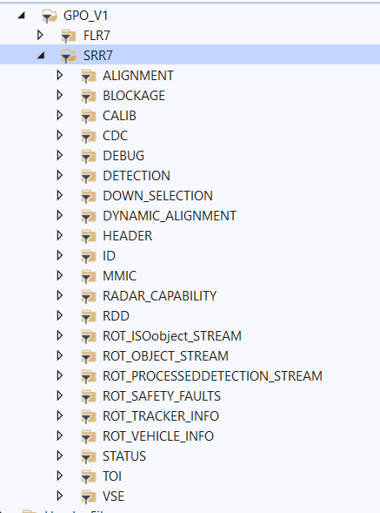
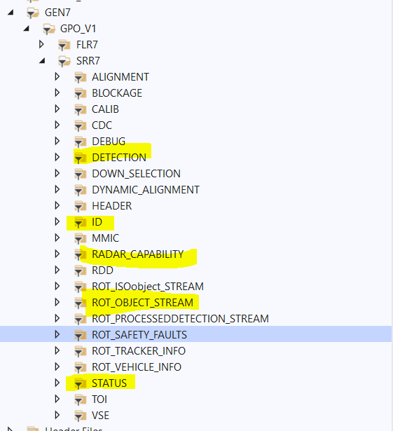
Total number of streams present in GPO_V1:
Streams used for Plotting implementation in HTML:

Slide 5
GEN7 Log variants and Sensors
For stream versions >= 100 – Standalone
For stream versions <100 – Satellite
GPO_GEN7_V1 consists of SRR7P and FLR7 sensor.
SRR7P are 4corner radars(RL,RR,FR,FL) and FLR7 is front sensor.
GEN7 Log Variants
Standalone
Satellite
Dets + tracker
Only detections

Slide 6
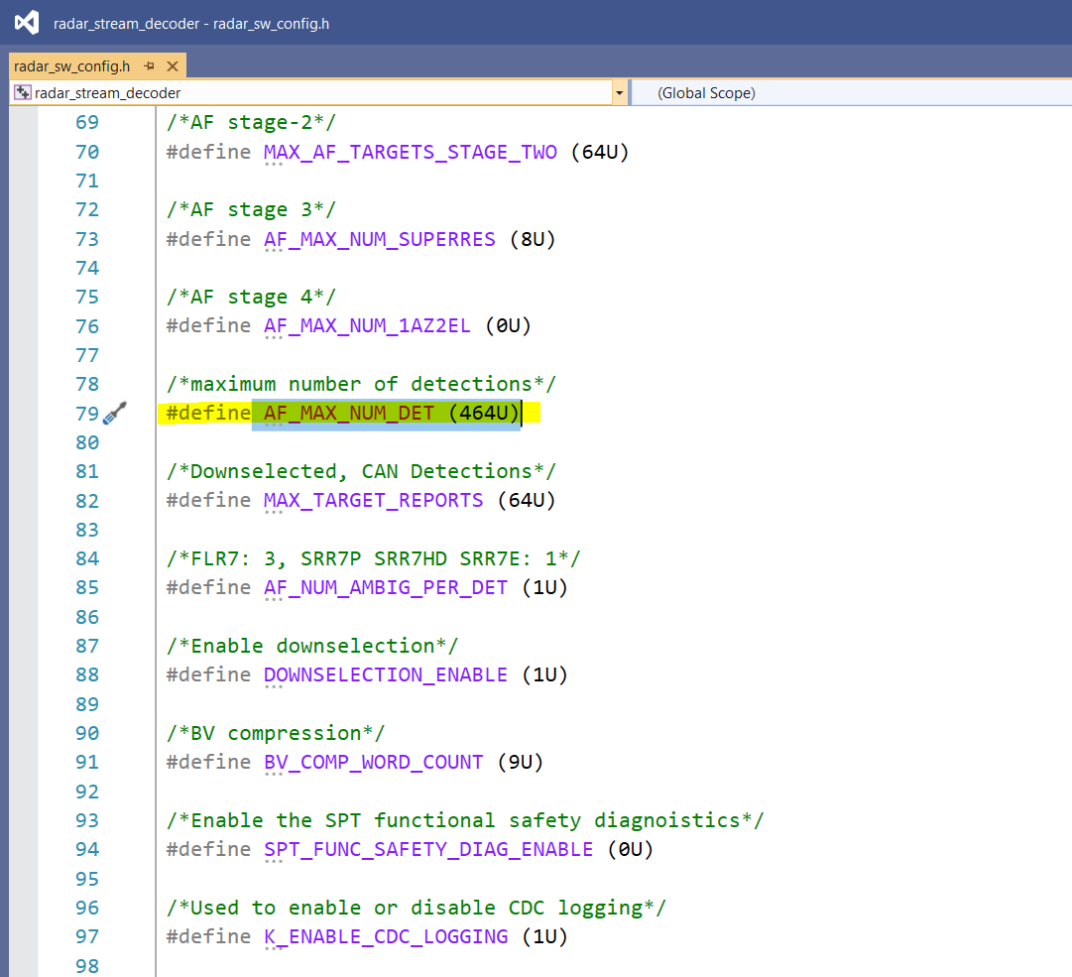
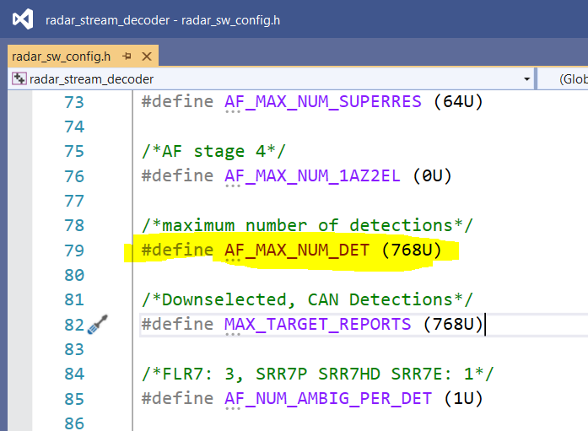
Gen7 Detections Properties and detection counts between versions
Maximum number of detections for standalone variant:
Maximum number of detections for satellite variant:

Slide 7
Decoder Repository and Build commands
Binary Repository: 10028634_01_SRR_RESIM_Release
Code Repository: 10030156_03_RESIM_Stream_Decoder
Build commands:
In Linux:
cmake -DCMAKE_BUILD_TYPE=DEBUG -DBUILDCONFIGTYPE=SIL ..
cmake -DCMAKE_BUILD_TYPE=RELEASE -DBUILDCONFIGTYPE=SIL ..
In Windows:
cmake -DCMAKE_BUILD_TYPE=DEBUG -DBUILDCONFIGTYPE=SIL -G "Visual Studio 16 2019" ..
cmake -DCMAKE_BUILD_TYPE=RELEASE -DBUILDCONFIGTYPE=SIL -G "Visual Studio 16 2019" ..

Slide 8
Gen7 Decoder code walkthrough

Slide 9
HTML Gen7 Code walkthrough

Slide 10
Docker Generation Steps for HTML Tool
Steps:
step1: Create Binaries folder and copy all bin and dlls
step2: check for already available docker images and delete html image
step2.1 #to list docker images
docker images
step2.1 #remove already available HTML docker images
docker rmi [imageidofhtml] -f
step3 : open Docker Generator tool from release repo
Path of docker generation tool:/home/dl5bj5kh3/wkspaces/Release_Repo/RESIM_Toolset/PYTHON_Tool/python_exe/Docker_Generator/
step4 : open DocGen using command prompt
4.1 sudo ./DocGen
password :aPTIV@123
step5 : docker generatiom steps
step5.1 : DockerFor(dropdown)-->select Tools
step5.2 : Selectname(dropdown)-->select html
step5.3 : provide Major,Minor,Patch of tool (Example 2.1.0)
step5.4 : Browse upto one folder previous to Binaries(created in step1) and select OK
step5.5 : Build button at right bottom will be highlighted, select build button.
step5.6 : wait till docker generation is complete
(right top of tool --> three yellow dots -->indicate generation inprogress)
(right top of tool --> three green dots -->indicate generation completed)
step6 : Folder Docker_To_Run will be generated and locked by default, use below command to remove lock
sudo chmod 777 -v Docker_To_Run
sudo chmod 777 -v resim_tool_html.simg
sudo chmod 777 -v INPUT_LOGS
sudo chmod 777 -v OUTPUT_DIR

Slide 11
Docker Testing Steps For HTML Tool
[Info]
[Info 1] Docker_To_Run folder will have following
resim_tool_html.simg( singularity image)
resim_tool_html.tar ( docker image)
INPUT_LOGS
OUTPUT_DIR
[Info 2] Use resim_tool_html.simg for testing in Linux PC
############################################################
Step1 : copy HTMLConfig.xml(ensure required setting done) and HTMLINputs.Json(ensure required files available in PC) to Docker_To_Run Folder
step2 : command for running singularity
singularity exec ./resim_tool_html.simg /RUN_HTML.sh HTMLConfig.xml HTMLInputs.json /home/dl5bj5kh3/wkspaces/10030156_HTML/ResimulationTool/SOURCE/ApplicationProjects/ResimHTMLReport/output
Step3 : Tool will run and generate HTML report in the path you provided in arguments(/home/dl5bj5kh3/wkspaces/10030156_HTML/ResimulationTool/SOURCE/ApplicationProjects/ResimHTMLReport/output)

Slide 12
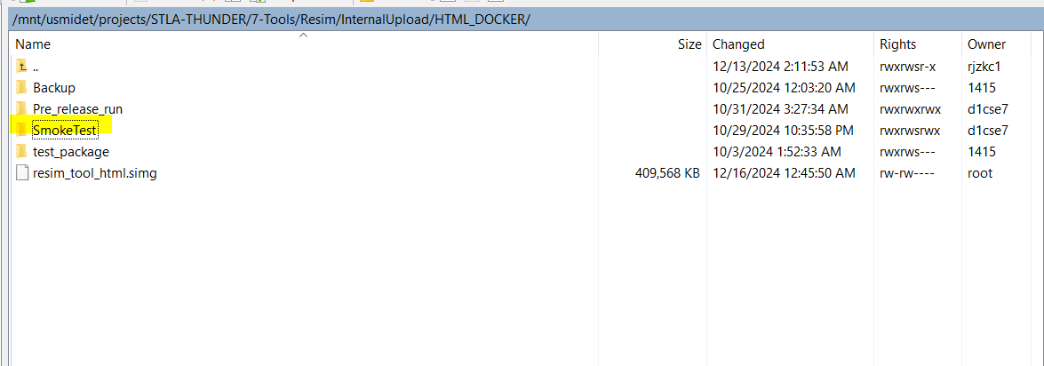
Smoke-test Testing procedure for all customer testing
Server Details:
Get Access to the below Servers for running the tool on HPCC->
Southfield: IP- 10.192.224.131
Krakow: IP- 10.234.56.125
Smoke Test Details:
Path for the Config, input and output logs:
/mnt/usmidet/projects/STLA-THUNDER/7-Tools/Resim/InternalUpload/HTML_DOCKER/SmokeTest

Slide 13
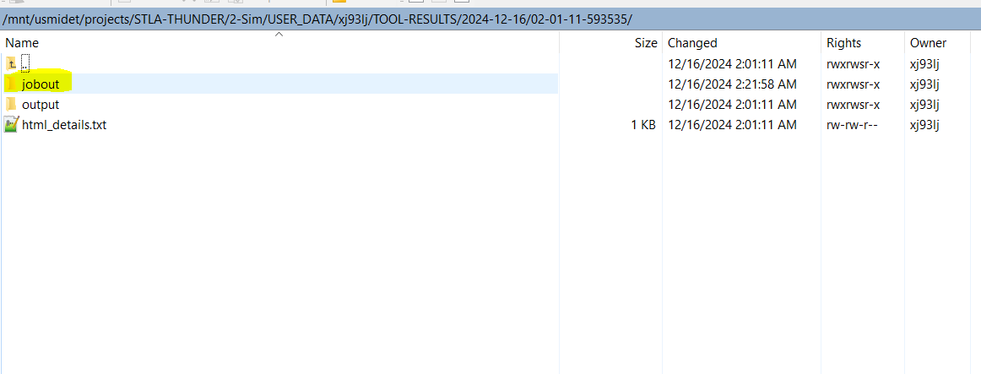
Login to southfield server via putty.
Change directory to- cd /mnt/usmidet/projects/STLA-THUNDER/2-Sim/USER_DATA/xj93lj/script
3. Run command for GEN7 customer:
./html_smoketest.sh /mnt/usmidet/projects/STLA-THUNDER/7-Tools/Resim/InternalUpload/HTML_DOCKER/test_package/resim_tool_html.simg gen7
4. Run command for GEN6 customer:
./html_smoketest.sh /mnt/usmidet/projects/STLA-THUNDER/7-Tools/Resim/InternalUpload/HTML_DOCKER/test_package/resim_tool_html.simg gen6
Sample Output path where jobout is generated:
/mnt/usmidet/projects/STLA-THUNDER/2-Sim/USER_DATA/xj93lj/TOOL-RESULTS/2024-12-13/06-39-27-685015

Slide 14
Smoke Test Run DEMO

Slide 15
Thank you.

