Slide 1
8/5/2024
HTML SMOKE TEST

Slide 2
Agenda
Docker Testing procedure for all customer testing
Smoke-test Testing procedure for all customer testing

Slide 3
Docker Generation Steps for HTML Tool
Steps:
step1: Create Binaries folder and copy all bin and dlls
step2: check for already available docker images and delete html image
step2.1 #to list docker images
docker images
step2.1 #remove already available HTML docker images
docker rmi [imageidofhtml] -f
step3 : open Docker Generator tool from release repo
Path of docker generation tool:/home/dl5bj5kh3/wkspaces/Release_Repo/RESIM_Toolset/PYTHON_Tool/python_exe/Docker_Generator/
step4 : open DocGen using command prompt
4.1 sudo ./DocGen
password :aPTIV@123
step5 : docker generatiom steps
step5.1 : DockerFor(dropdown)-->select Tools
step5.2 : Selectname(dropdown)-->select html
step5.3 : provide Major,Minor,Patch of tool (Example 2.1.0)
step5.4 : Browse upto one folder previous to Binaries(created in step1) and select OK
step5.5 : Build button at right bottom will be highlighted, select build button.
step5.6 : wait till docker generation is complete
(right top of tool --> three yellow dots -->indicate generation inprogress)
(right top of tool --> three green dots -->indicate generation completed)
step6 : Folder Docker_To_Run will be generated and locked by default, use below command to remove lock
sudo chmod 777 -v Docker_To_Run
sudo chmod 777 -v resim_tool_html.simg
sudo chmod 777 -v INPUT_LOGS
sudo chmod 777 -v OUTPUT_DIR

Slide 4
Docker Testing Steps For HTML Tool
[Info]
[Info 1] Docker_To_Run folder will have following
resim_tool_html.simg( singularity image)
resim_tool_html.tar ( docker image)
INPUT_LOGS
OUTPUT_DIR
[Info 2] Use resim_tool_html.simg for testing in Linux PC
############################################################
Step1 : copy HTMLConfig.xml(ensure required setting done) and HTMLINputs.Json(ensure required files available in PC) to Docker_To_Run Folder
step2 : command for running singularity
singularity exec ./resim_tool_html.simg /RUN_HTML.sh HTMLConfig.xml HTMLInputs.json /home/dl5bj5kh3/wkspaces/10030156_HTML/ResimulationTool/SOURCE/ApplicationProjects/ResimHTMLReport/output
Step3 : Tool will run and generate HTML report in the path you provided in arguments(/home/dl5bj5kh3/wkspaces/10030156_HTML/ResimulationTool/SOURCE/ApplicationProjects/ResimHTMLReport/output)

Slide 5
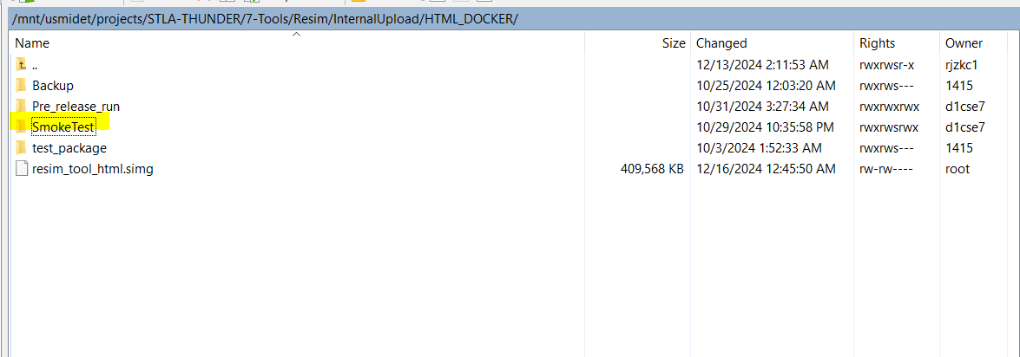
Smoke-test Testing procedure for all customer testing
Server Details:
Get Access to the below Servers for running the tool on HPCC->
Southfield: IP- 10.192.224.131
Krakow: IP- 10.234.56.125
Smoke Test Details:
Path for the Config, input and output logs:
/mnt/usmidet/projects/STLA-THUNDER/7-Tools/Resim/InternalUpload/HTML_DOCKER/SmokeTest

Slide 6
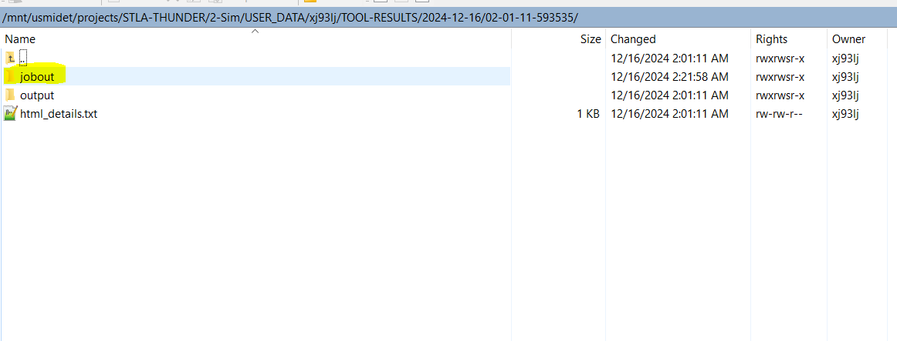
Login to southfield server via putty.
Change directory to- cd /mnt/usmidet/projects/STLA-THUNDER/2-Sim/USER_DATA/xj93lj/script
3. Run command for GEN7 customer:
./html_smoketest.sh /mnt/usmidet/projects/STLA-THUNDER/7-Tools/Resim/InternalUpload/HTML_DOCKER/test_package/resim_tool_html.simg gen7
4. Run command for GEN6 customer:
./html_smoketest.sh /mnt/usmidet/projects/STLA-THUNDER/7-Tools/Resim/InternalUpload/HTML_DOCKER/test_package/resim_tool_html.simg gen6
Sample Output path where jobout is generated:
/mnt/usmidet/projects/STLA-THUNDER/2-Sim/USER_DATA/xj93lj/TOOL-RESULTS/2024-12-13/06-39-27-685015

Slide 7
Smoke Test Run DEMO

Slide 8
Thank you.

