Slide 1
August 05, 2020
Ananthesh J Shet
Technical Leader
Tracker Overview

Slide 2
Presenter
Ananthesh J Shet
9+ year in Delphi/APTIV
Autocoding
Embedded Software – ESR2.5, SRR2, SRR3
Tracker Algorithm – GDSR, U360(Radar-Camera)
Currently leading Sensor Modelling team – SRR5

Slide 3
General Overview
Filter which can also predict
TRACKER
Vehicle Data
Objects
Detections
Sensor

Slide 4
GDSR Tracker
Various trackers came into being to cater for different needs
Vehicle Data
Vehicle Processing
Tracklet Tracker
Tracklet
Speed, Curvature
Grouping
Detections
Detection Processing
Object Tracker
Coordinate Conversion, Motion Status, Identify undesired detections
Object

Slide 5
Tracklet Tracker
Time Update (Predict)
Previous tracklets are time updated
One to one
Detection
Tracklet
Data Association (Association)
Detections are associated(matched) to time updated tracklets. New tracklets are formed from unmatched detections
Fixed Gain KF, Constant Turn model
Status Update (Update)
Tracklets are updated based on matched detections

Slide 6
Kalman Filter
Values only for demonstartion
An object is at x position = 10m
0
Probability
Probability
Probability
12m
x_pos
13m
x_pos
12.8m
x_pos
Prediction
Measurement
Update

Slide 7
Grouping
Sensor 1 tracklet
Sensor 2 tracklet
Associate tracklets to group
Create new groups
Group groups

Slide 8
Object Tracker
Time Update (Predict)
Data association here is part of Grouping
Previous objects are time updated
Data Association (Association)
Tracklets are associated(matched) to time updated objects. New objects are formed from unmatched tracklets
Fixed Gain KF, Constant Acceleration model
Status Update (Update)
Objects are updated based on matched tracklets

Slide 9
Object Tracker
Time Update (Predict)
Previous objects are time updated
Data association
Tracklet Tracker
If grouping creates a NEW object, the Object Tracker “Update” will update the object to MATURE
Tracklets are associated(matched) to time updated objects. New objects are formed from unmatched tracklets
Status Update (Update)
Objects are updated based on matched tracklets

Slide 10
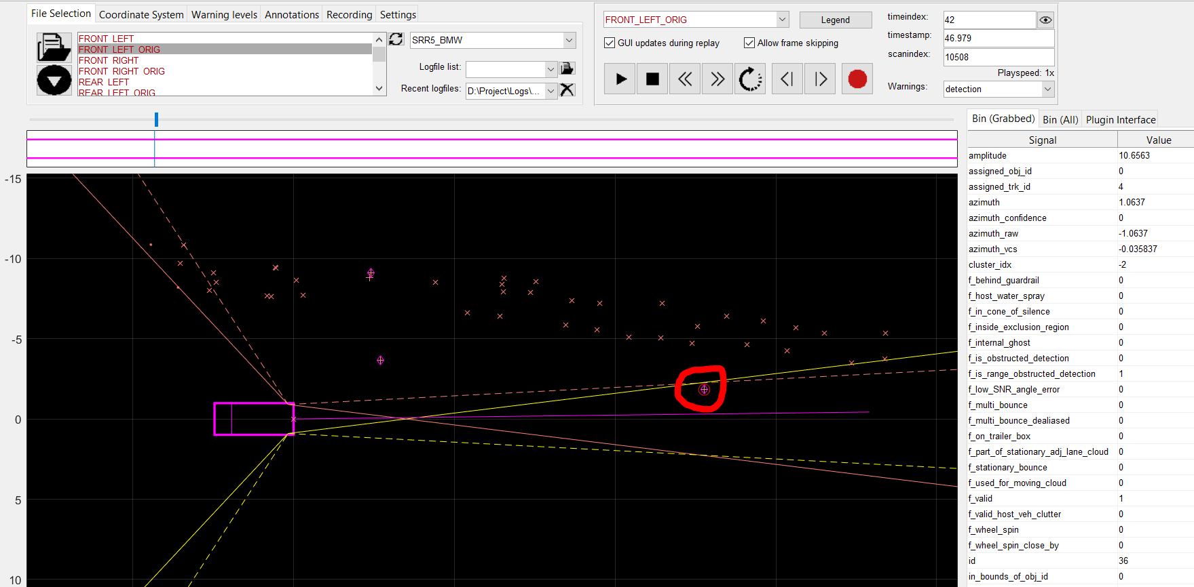
Example(using MATE – Matlab based Automated Testing Environment)
Log: C:\Project\Logs\SRR5\BMW\20191023_LOW_A310_SENSORS\SRR_Specific_Data_RAW_DEBUG_LOW\LOW_3.8.201_check_20min_WBACR61010LH94641_20191023_095829_WR3_0036_ORCAS.mf4
Position: FRONT_LEFT_ORIG
Start timeindex: 42, detection id: 36, tracklet id: 4
Timeindex: 44, Object id 31 is formed
Timeindex: 47, tracklet id 2 gets associated to object id 31

Slide 11
Wrappers around the tracker
Heading
Guardrail detector
Cloud processing - Clustering
Countermeasures
Terminate long coasted entity
Terminate Stationary entity
Terminate entities behind guardrail
Terminate ghosts – low probability, eclipsed
Add derived signals
Reference points
Object Amplitude
Object class – Size, speed, wheelspin
Cloud
2nd order Guardrail
Two Wheeler
Pedestrian
Truck
Car
Reference points
Class

Slide 12
What can go wrong?
VehicleData | Detection
Timestamp N | Timestamp N-2
Timestamp N+1 | Timestamp N-1
Timestamp N+2 | Timestamp N
Timestamp N+3 | Timestamp N+1
Mounting position
Alignment
Calibration
Async vehicle data
Calibration
Reality
DetRangeRate = 10m/s
Azimuth = 30deg
DetRangeRate = 8m/s
Azimuth = 32deg
Timestamp N
Timestamp N+1
VehSpeed = 20m/s
YawRate = 1deg/s
VehSpeed = 18m/s
YawRate = 2deg/s
Mounting/Alignment errors
Async vehicle data

Slide 13
THANK YOU!

