Slide 1
DEVELOP A MOBILE APPILICATION TO MANAGE FEES COLLECTION AT A CLINIC (PS-02)
Description:
The clinic currently employs spreadsheets to mark fees to be paid and track fee payments.Fees are collected through UPI QR scanners and bank transfers. This creates multiple sources of information and difficulty in reconciliation process. Bill generation is delayed. The clinic is in need of a database driven mobile application that can efficiently collect payments and Issue receipts in addition to facilitating data analytics. Your team's mission is to design and develop a mobile application that provides these capabilities to the clinic.
TEAM MEMBERS NAME
(team id TEAMAPTN166)
MEENASHALINI P
KRISHNAKUMAR D
INDHUMATHI S

Slide 2
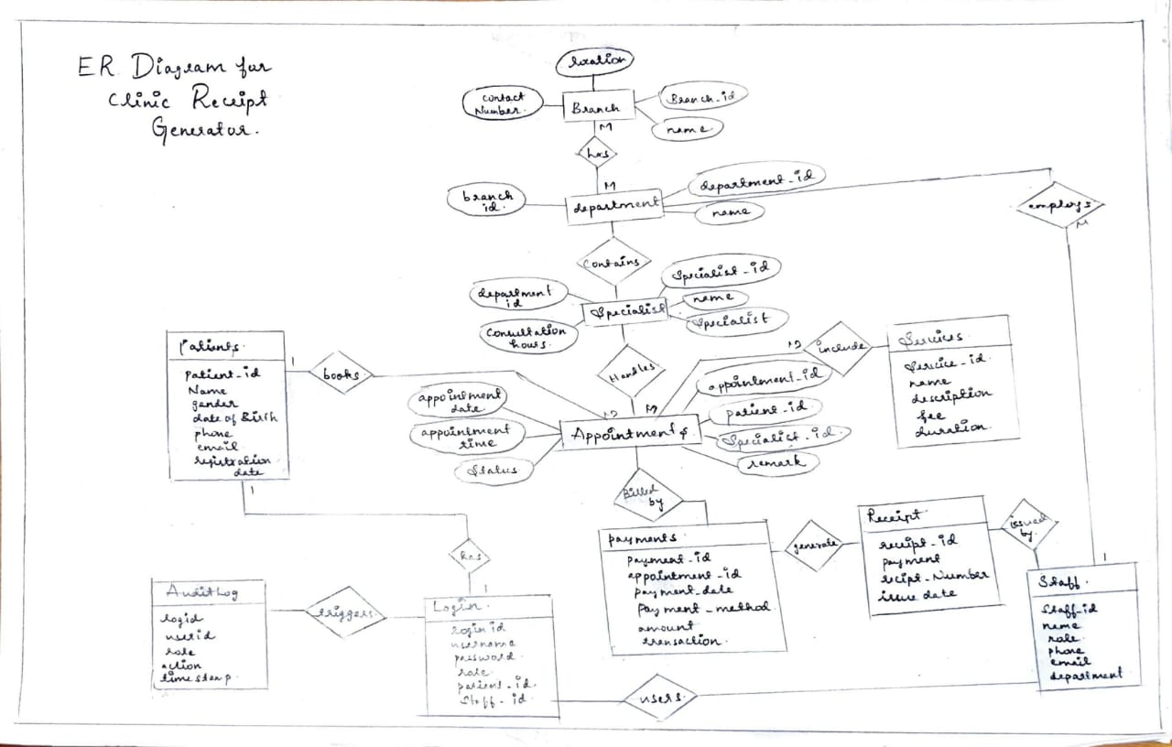
ER diagram

Slide 3
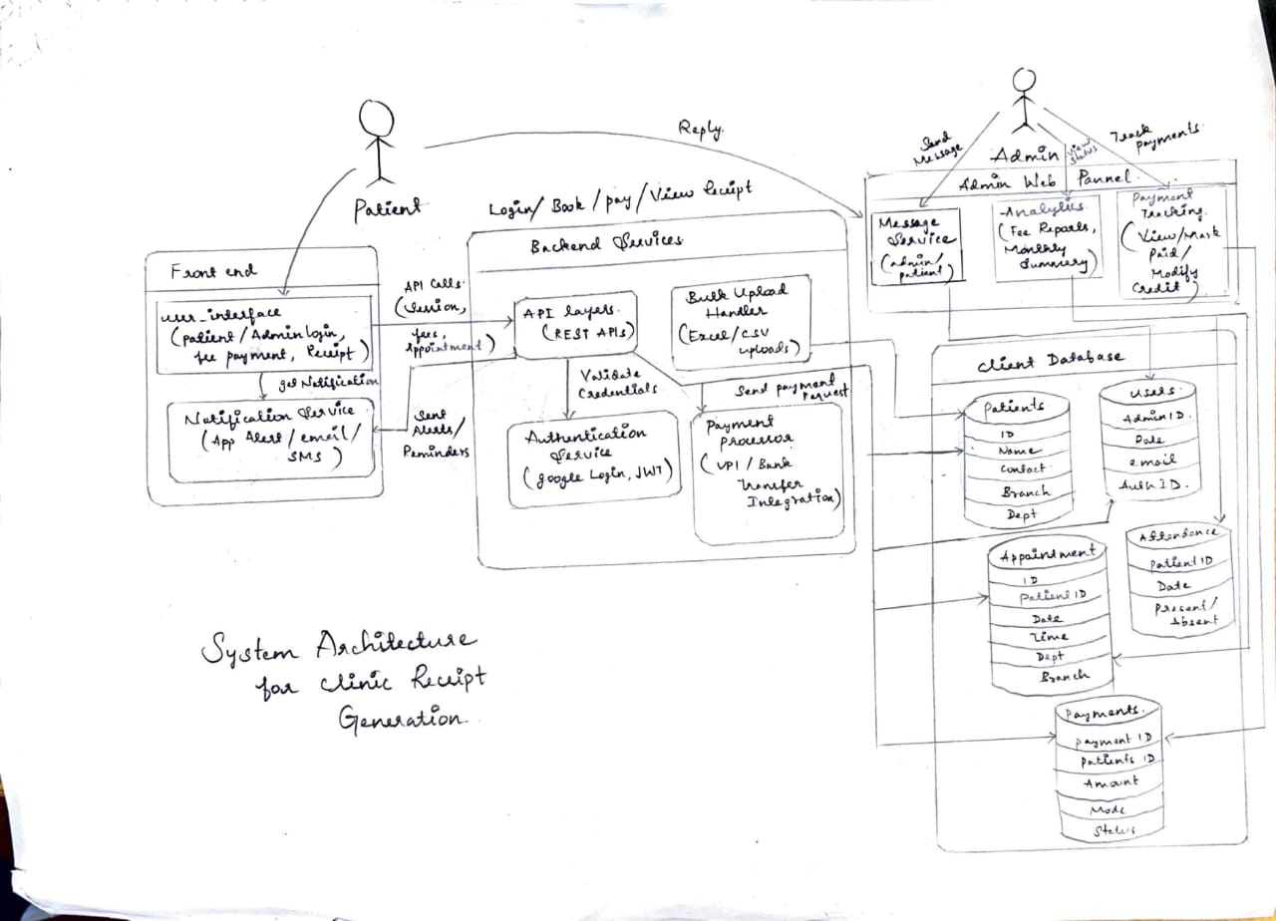
System architecture diagram

Slide 4
1. User Management Module
Patient registration/login
Admin login with role-based access
Forgot password / password reset
Profile management (update name, contact, etc.)

Slide 5
2. Appointment Management Module
💰 3. Payment Management Module
Schedule new appointment (choose department/date/time)
View upcoming & past appointments
Cancel/reschedule appointments
Appointment status updates (confirmed/pending/completed)
Fee calculation based on selected services
View payable amount (e.g., consultation + scan fees)
UPI/Bank Transfer (integration with Razorpay or QR scanning)
Confirm payment status
Store transaction details

Slide 6
🧾 4. Receipt & Billing Module
📊 5. Analytics & Reporting Module (Admin Only)
Total collections per day/week/month
Department-wise revenue
Pending payments list
Export analytics to Excel/CSV
Fee calculation based on selected services
View payable amount (e.g., consultation + scan fees)
UPI/Bank Transfer (integration with Razorpay or QR scanning)
Confirm payment status
Store transaction details

Slide 7
📬 6. Notification & Alerts Module
📑 7. Department & Service Management
Push notifications (appointment reminders, payment due alerts)
SMS/email notifications via Twilio or Firebase Cloud Messaging
Real-time update on payment confirmation or appointment approval
View list of departments (e.g., Emergency, Outpatient, Lab)
Select services (consultation, scan, rehab, etc.)
Admin can update pricing or add/remove services

Slide 8
💬 8. Messaging / Communication Module
9.Mobile Dashboard Module (Patient)
Admin can send custom alerts to specific patients
Chat interface for queries (optional for future upgrades)
View upcoming appointments
View payment history
View/download receipts
Profile settings

Slide 9
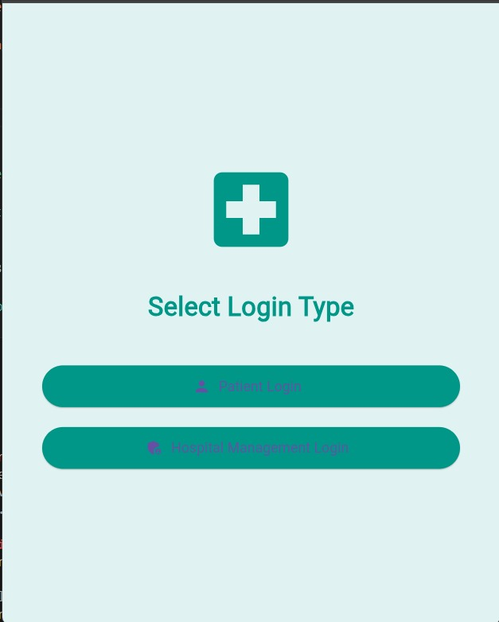
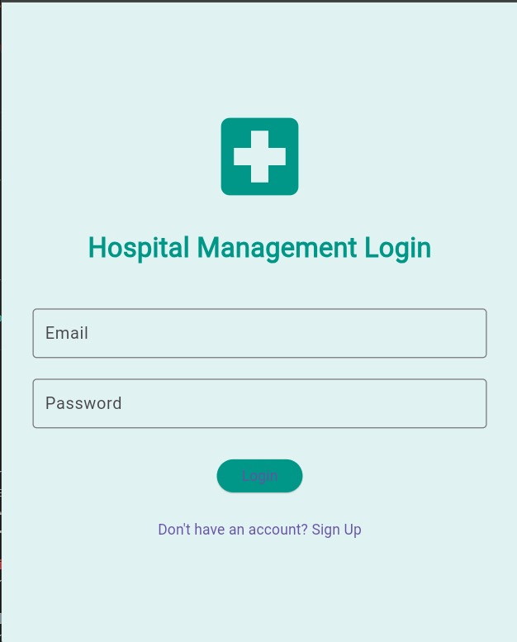
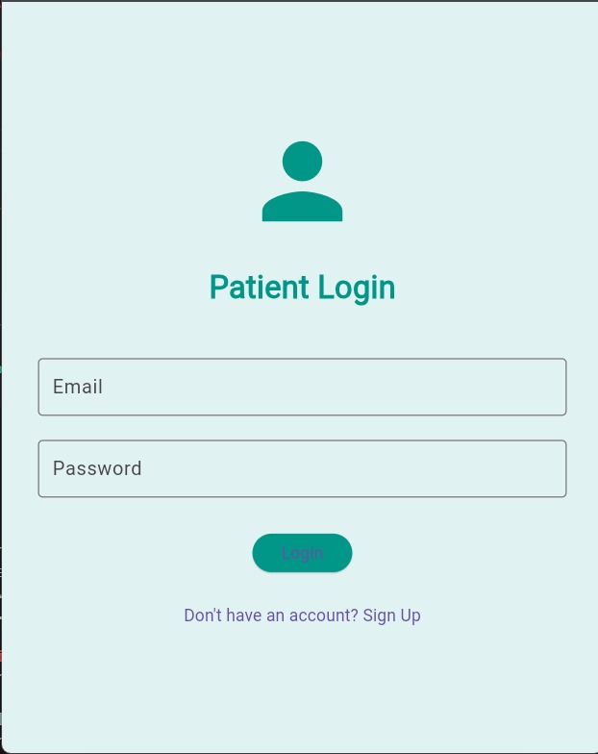

Slide 10
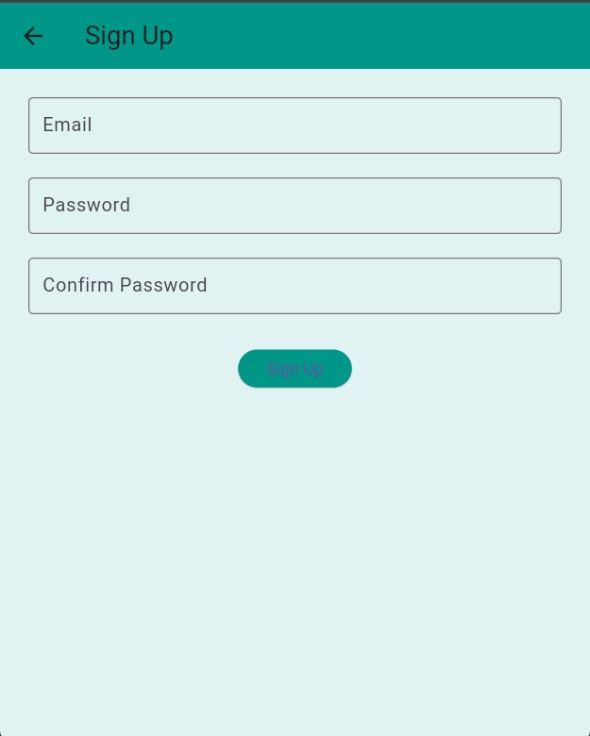
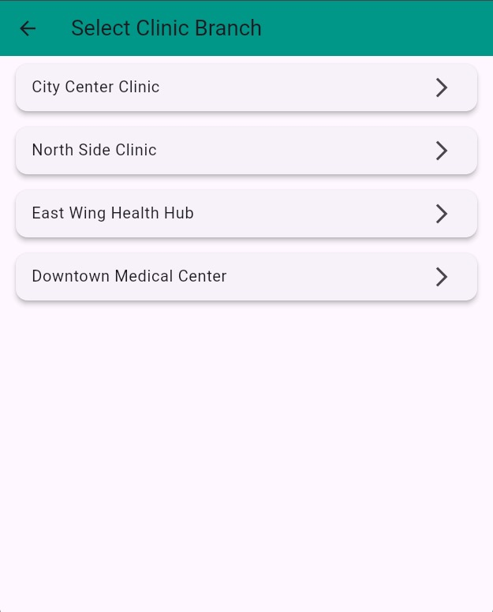
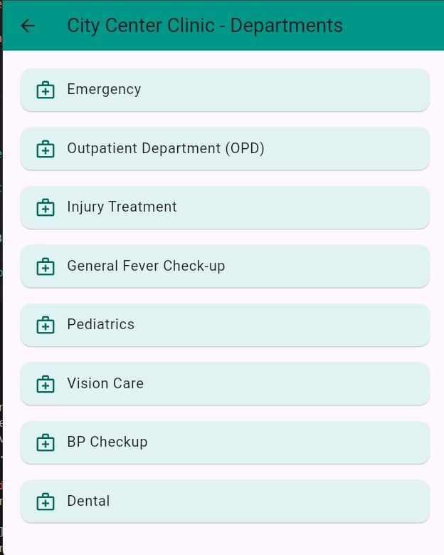

Slide 11
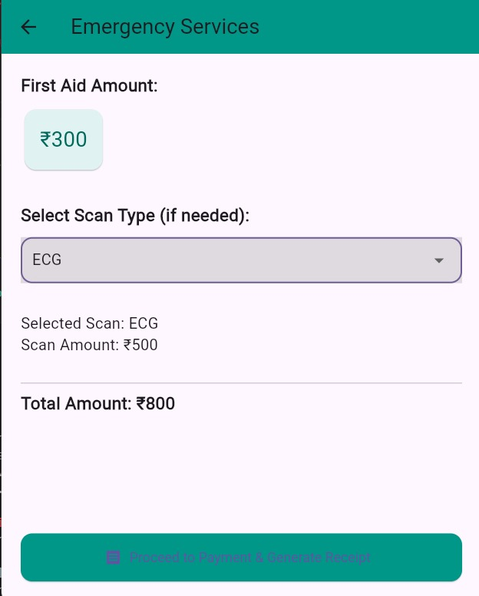
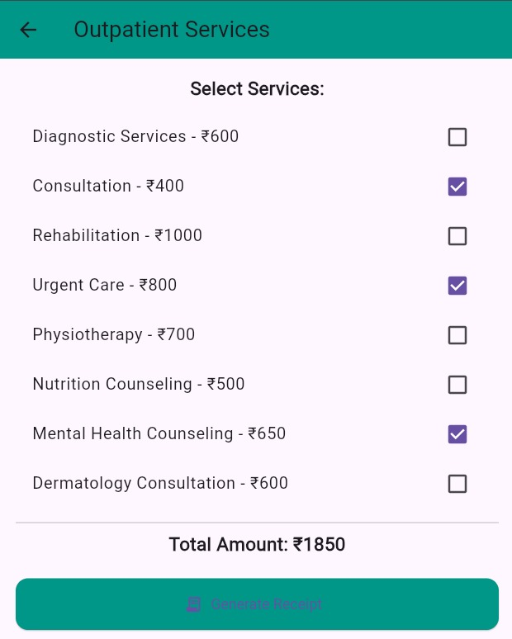
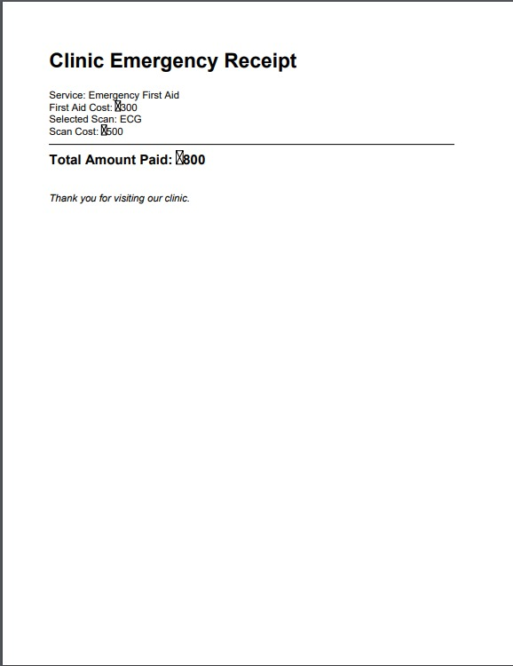
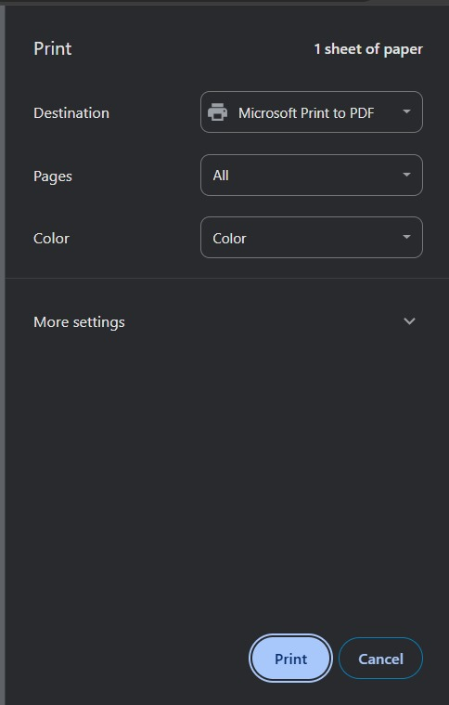

Slide 12
References, packages and services used
Packages
Flutter: firebase_auth, cloud_firestore, provider, razorpay_flutter, http, intl, printing, charts_flutter
References
Flutter Docs
Firebase Docs
Razorpay API Docs
Tools & Services
Firebase (Auth, Hosting, FCM)
Razorpay / Paytm (Payments)
MongoDB / MySQL (Database)

Slide 13
Github link
https://github.com/krishnakumarkris/clinic_app.git

