Slide 1

RCB Performance Analysis
Krishna Kushwah
16/05/2025

Slide 2
Introduction & Problem Statement
Objective: Analyze IPL data to uncover insights about RCB’s performance.
Despite a strong squad, RCB has never won the IPL trophy.
Aim: Identify patterns, player performance, and strategic gaps.

Slide 3
Data Description
Matches
Ball by Ball
Match_Id: Unique identifier for each match.
Match_Date: The date when the match took place.
Match_Winner: The team that won the match.
Outcome_Type: Type of result (win, tie, etc.).
Toss_Winner: The team that won the toss.
Win_Type: The method by which the match was won (e.g., runs or wickets).
Win_Margin: The margin by which the match was won.
Venue_Id: Reference to the venue where the match was played.
Season_Id: The season in which the match occurred.
Match_id: Unique identifier for a cricket match
Over_id: Unique identifier for an over in a cricket match
Ball_id: Unique identifier for a ball in an over
Innings_No: The innings number in a cricket match
Team_Batting: The team batting in a particular innings
Team_Bowling: The team bowling in a particular innings
Striker_Batting_Position: The batting position of the striker batsman
Striker: The batsman currently on strike
Non_Striker: The batsman currently at the non-striker's end
Bowler: The bowler bowling the current delivery

Slide 4
Data Description
Venue
Wickets taken
Venue_Id: Unique identifier for each venue.
Venue_Name: Name of the venue.
City_Id: Reference to the city where the venue is located.
Team
Team_Id: Unique identifier for a team.
Team_Name: The name of a team
Ball_Id: Reference to the specific ball during which the wicket was taken.
Fielder: Reference to the player who fielded the ball.
Bowler: Reference to the bowler who took the wicket.
Player_Out: Reference to the player who was dismissed.
Player
Player_Id: Unique identifier for a player.
Player_Name: The name of a player.

Slide 5
Data & Tools Used
Key Tables: matches, players, ball_by_ball, venue, team, wicket_taken
Tools: SQL for data extraction, Excel for pivot tables & charts
Cleaned data inconsistencies (e.g., team name corrections)

Slide 6
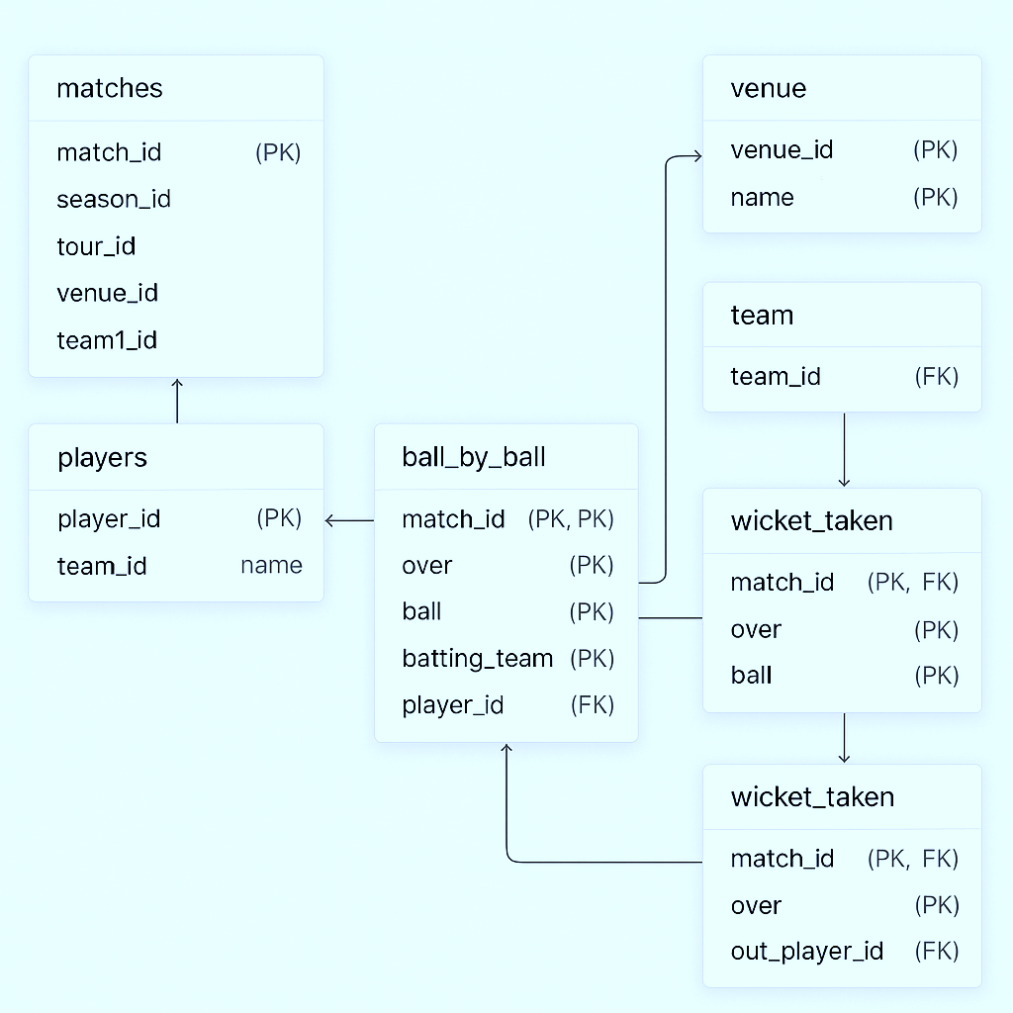
Database Schema

Slide 7
Methodology
Used SQL queries for aggregation, joins, filtering, and grouping
Created pivot tables and visual charts for key metrics
Focus: wins/losses, batting & bowling stats, venue influence

Slide 8
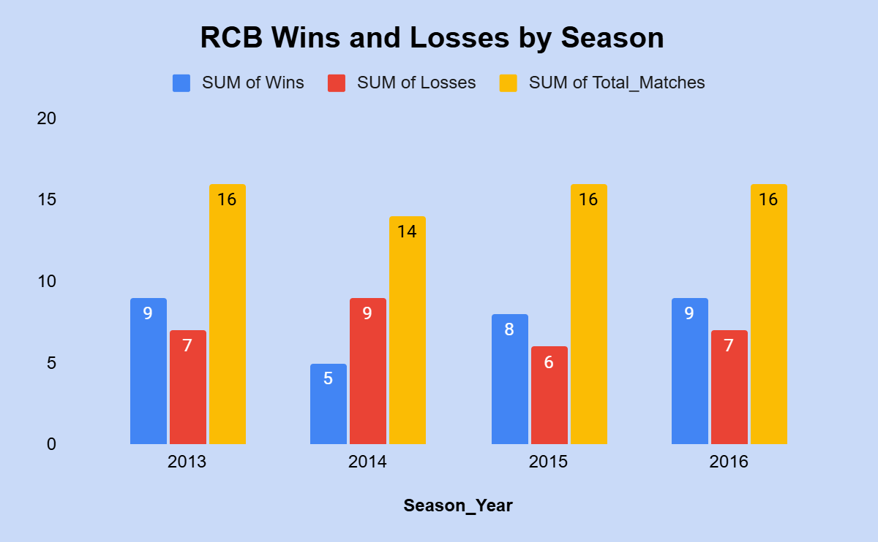
RCB Season Performance Overview
Query: Season-wise wins, losses, total matches
Insight: Fluctuating performance; e.g., 2014 had 5W–9L, 2016 had 9W–7L

Slide 9
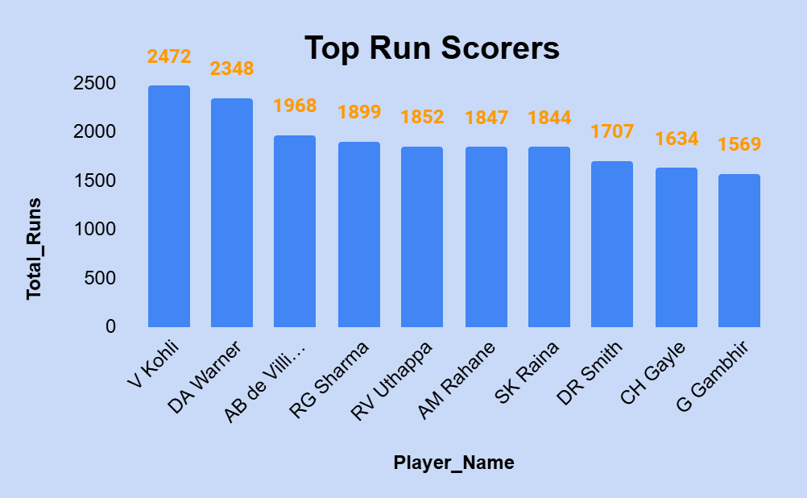
Most Runs Scored by Batsmen
Query: Sum(Runs_Scored) GROUP BY Striker
Insight: Identified consistently high scorers

Slide 10
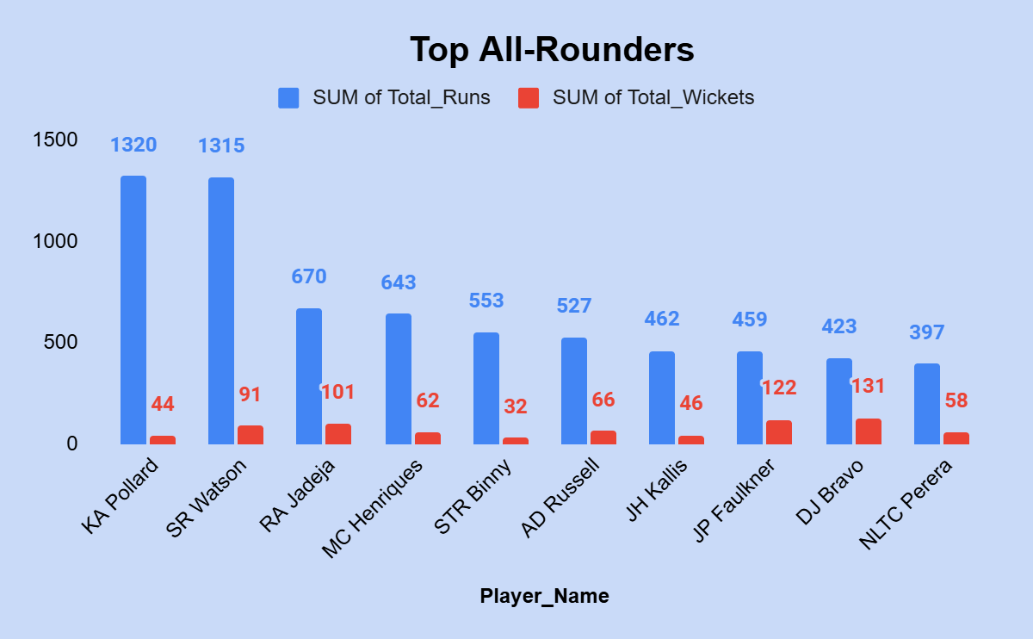
All-Rounder Analysis
Combined total runs & wickets using CTE
Filtered: Wickets > 30

Slide 11
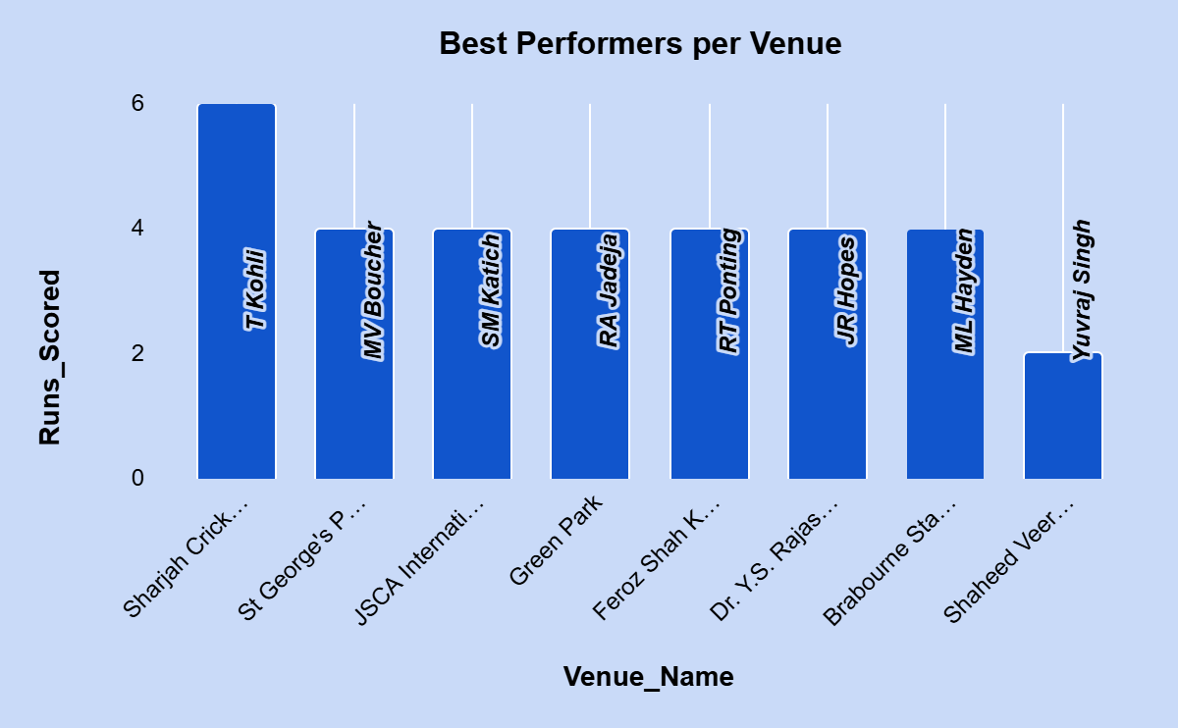
Venue-Wise RCB Performance
Grouped wins/losses by Venue_Name
Highlight: 55% win rate at Chinnaswamy

Slide 12
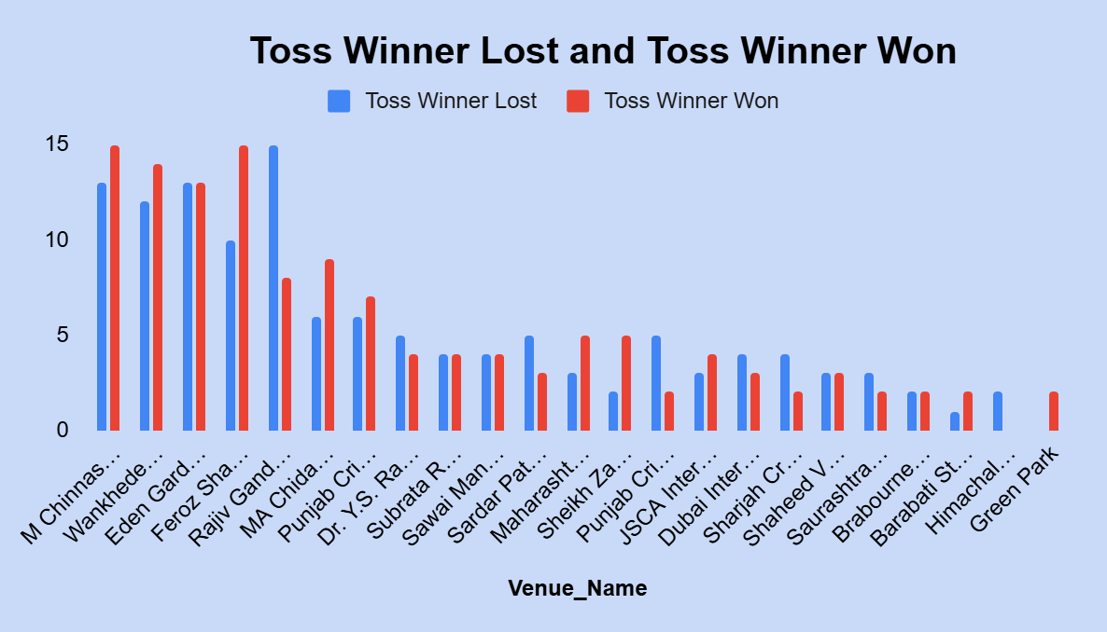
Toss Decision vs Match Outcome
Compared toss winners and match winners
Found impact at specific venues

Slide 13
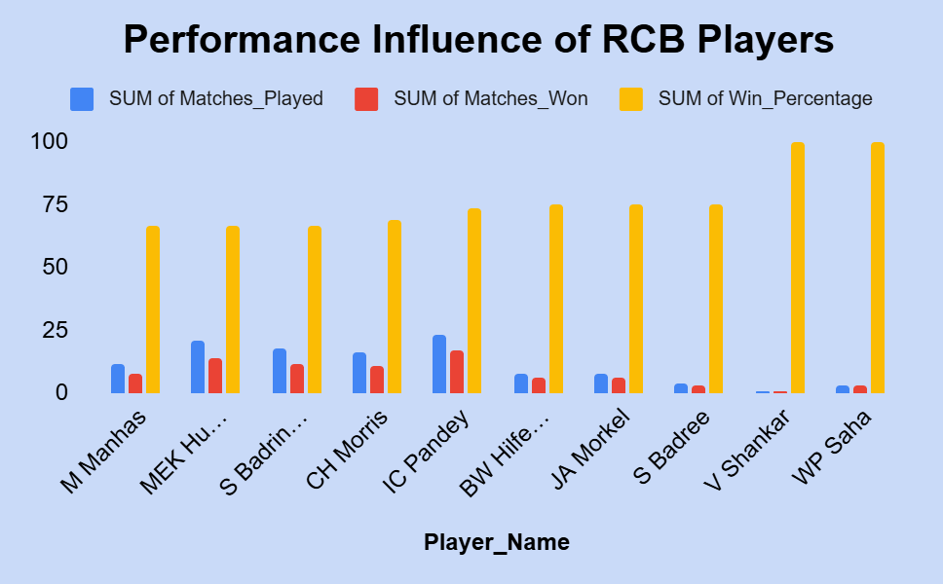
Key Player Impact (Win %)
Used player_match + match data
Measured win percentage with player in XI

Slide 14
Auction Strategy Recommendations
Retain consistent all-rounders
Recruit bowlers effective at flat pitches
Use venue-based performance for squad selection

Slide 15
Factors Behind High Scoring Matches
Data shows high scores linked to flat pitches, short boundaries
Impact: Viewership boost, strategy shift toward deeper batting

Slide 16
Home Ground Advantage
55% win rate at Chinnaswamy Stadium
Suggest recruiting pace variations and power hitters

Slide 17
RCB’s Key Weaknesses
Overreliance on top batters
Bowling lacked depth in playoffs
Inconsistent performance under pressure

Slide 18
Fixing Team Name Issues in Queries
Used CASE WHEN with JOIN on team table
Replaced 'Delhi_Capitals' with 'Delhi_Daredevils' dynamically

Slide 19
Conclusion
Strong individual performances but gaps in consistency & strategy
Data insights suggest tactical changes for better outcomes
RCB can improve title chances through data-driven planning

Slide 20
References
Newton School for providing the Ipl Raw Dataset.
MySQL Workbench – used for writing and executing SQL queries
Google Sheet – used for data visualization (pivot tables, charts)

Slide 21
THANKYOU

