Slide 1


MAZE SOLVER
Differential Drive Robot simulated in ROS

Slide 2
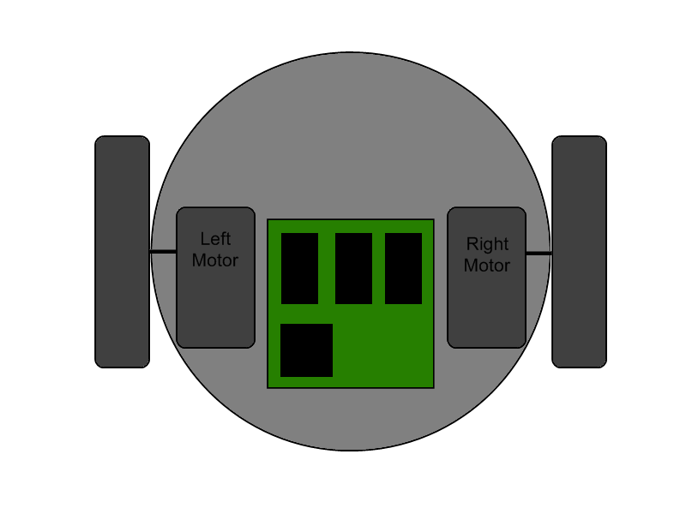
DIFFERENTIAL DRIVE ROBOT
Mobile Robot whose movement is based on two separately driven wheels (separate motors) on either side of robot.
The motion vector of the robot is sum of the independent wheel motions.
The non-driven wheel is a caster wheel.
By varying the velocities of the two wheels, we can vary the trajectories that the robot takes.

Slide 3
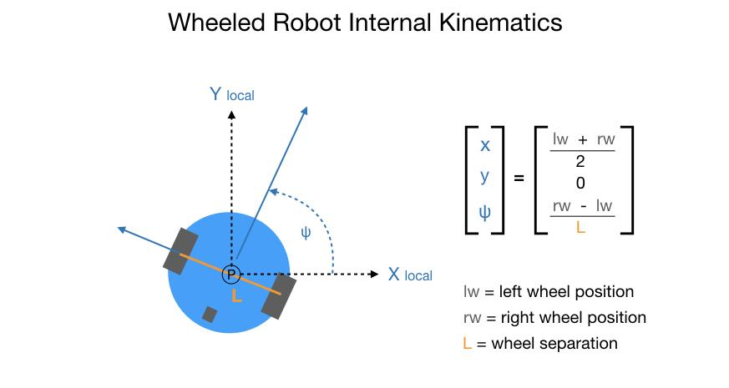
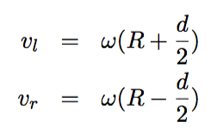
KINEMATICS OF DD ROBOT
By varying the velocities of the two wheels, we can vary the trajectories that the robot takes.
The point that the robot rotates about is known as the ICC - Instantaneous Center of Curvature
The rate of rotation ω about the ICC must be the same for both wheels, we can write the following equations:

Slide 4
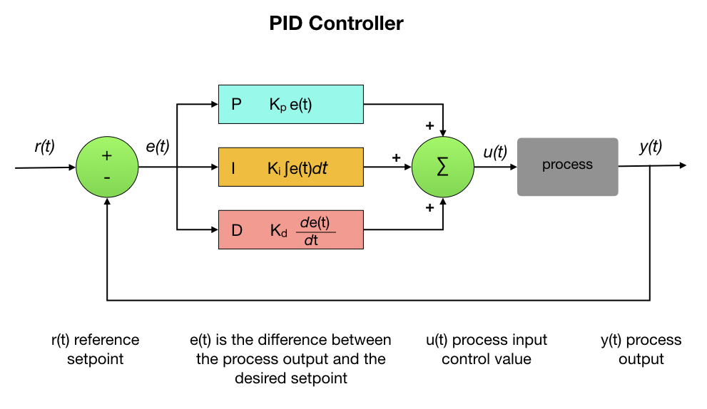
CONTROLLER - P
A PID controller is a control loop feedback mechanism that calculates the difference between a desired setpoint and the actual output from a process, and uses the result to apply a correction to the process.

Slide 5
APPROACH
Mapping pixel coordinates to gazebo coordinates (map function)
Point to point navigation algorithm of DD robot.
Determining required rotation speed and linear velocity of robot by Implementing P controller.
Mapping final bot trajectory parameter to each wheel rotational speed.
publishing respective omega to each wheel to achieve desired trajectory.

Slide 6
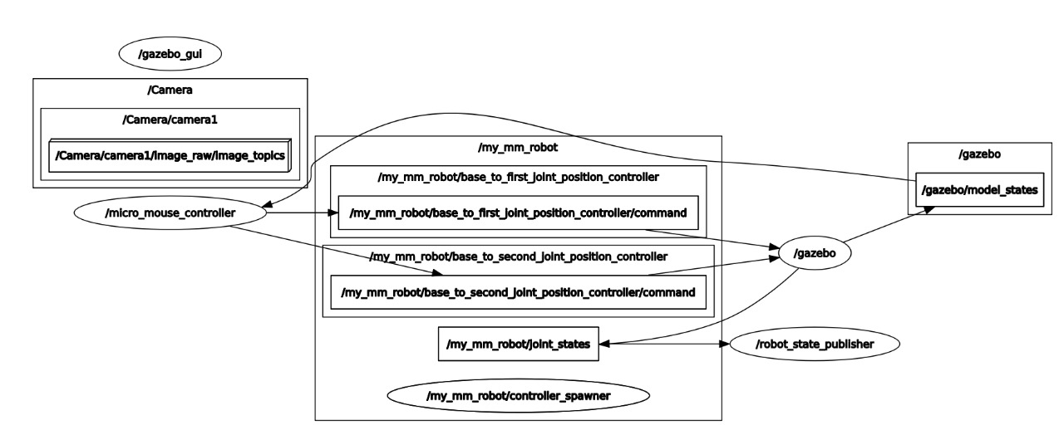
RQT graph (approach simulated in ROS)

Slide 7
Thank you

