Slide 1
Linux & Open Source Tools Assignment
Krishna Mahajan
B.Tech CSE – KR Mangalam University
November 2025

Slide 2
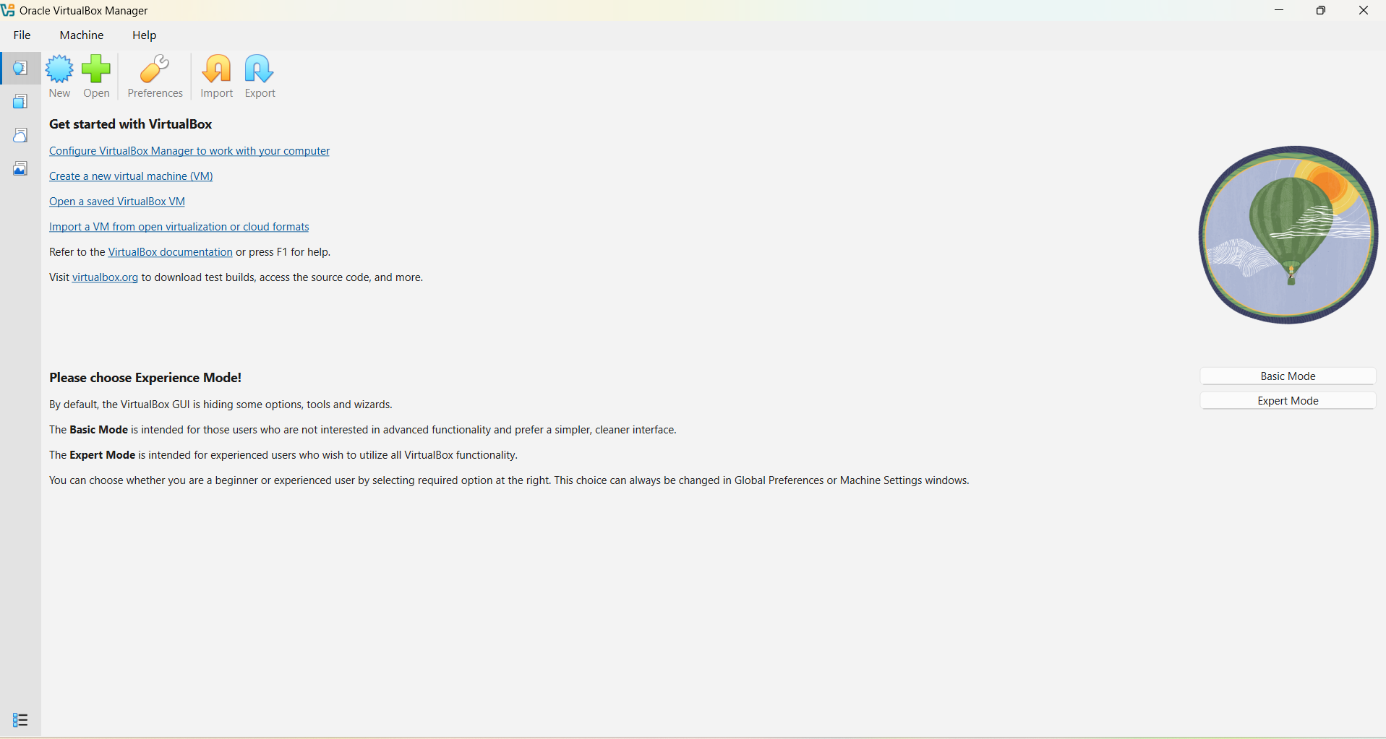
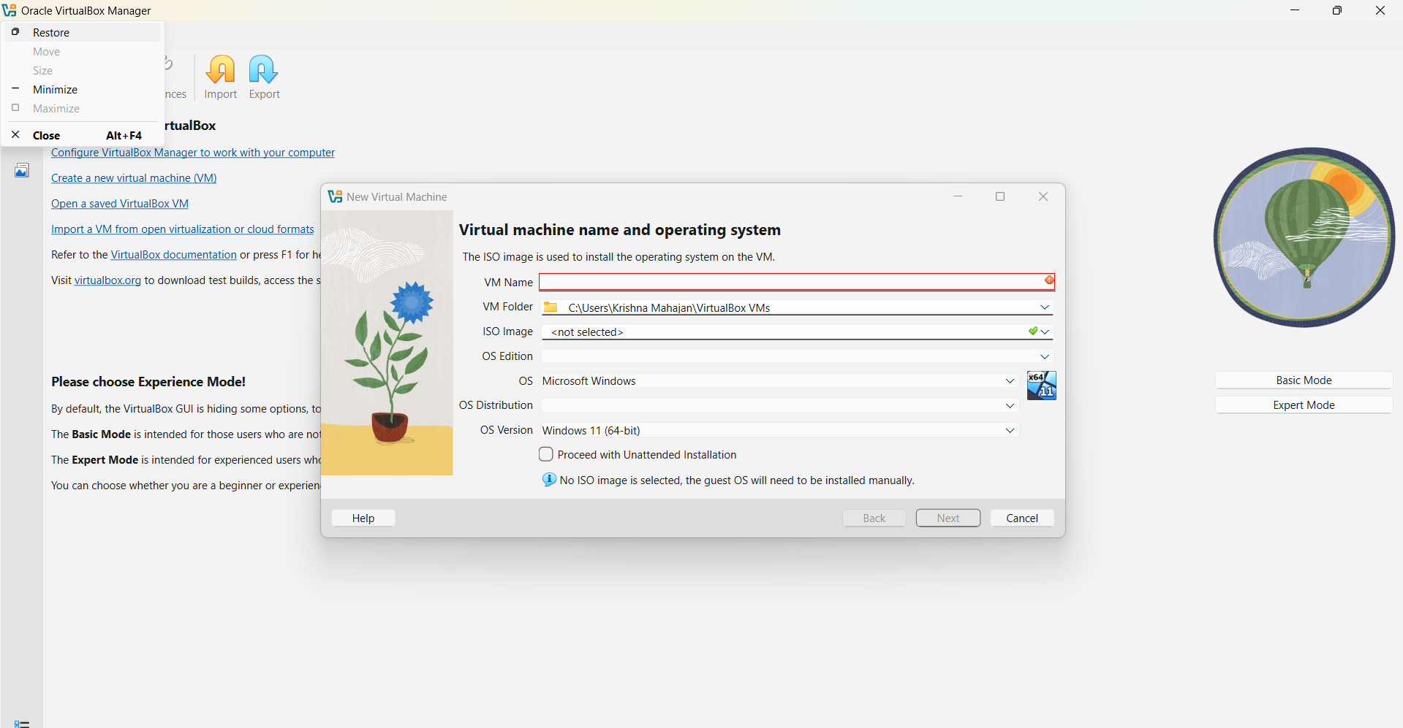
Linux Installation
CONTAINS SCREENSHOTS
- VirtualBox setup
- ISO mounting
- Ubuntu installation steps
- First boot screen

Slide 3
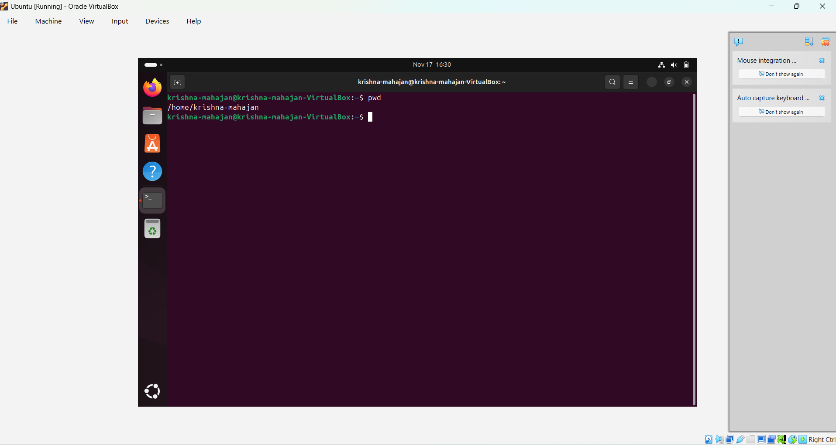
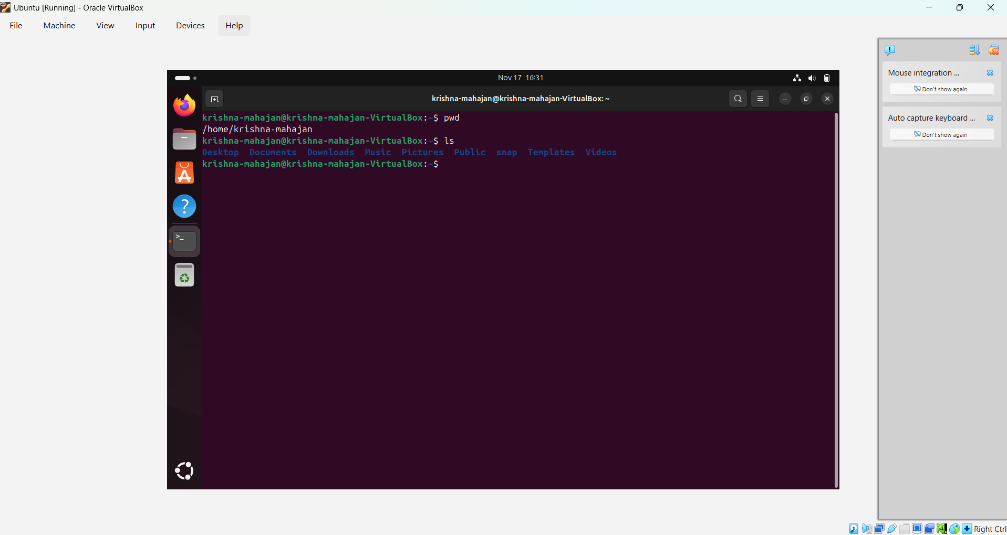
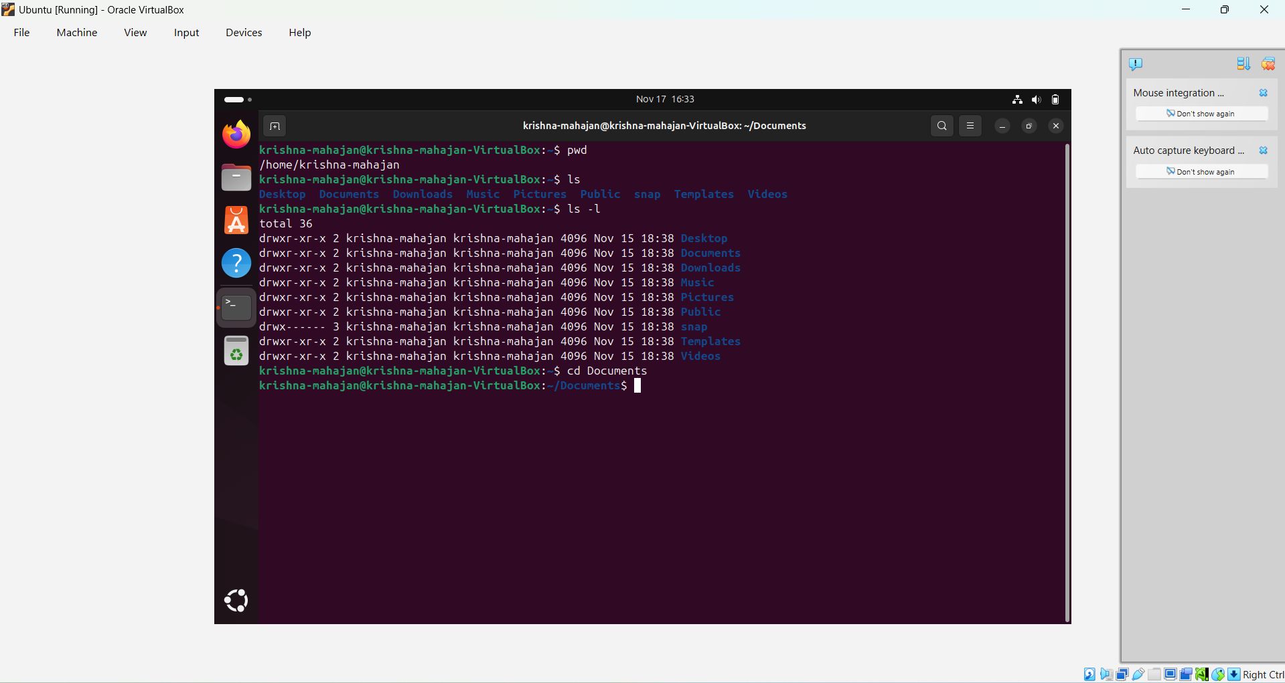
Navigation Commands
Screenshots for:
- pwd
- ls / ls -l
- cd
- tree

Slide 4
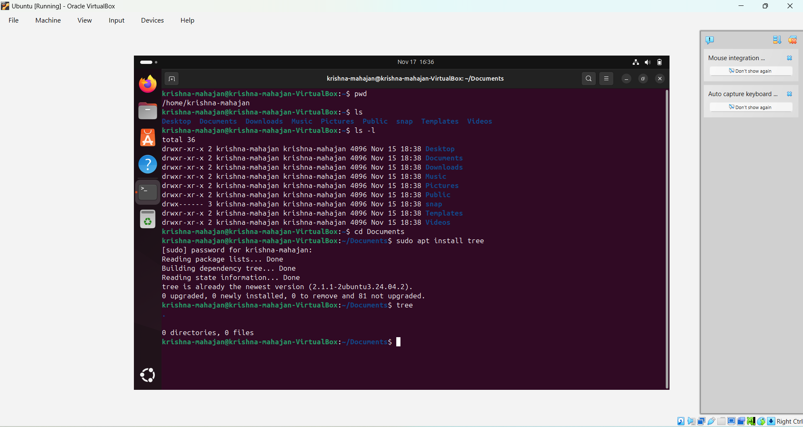
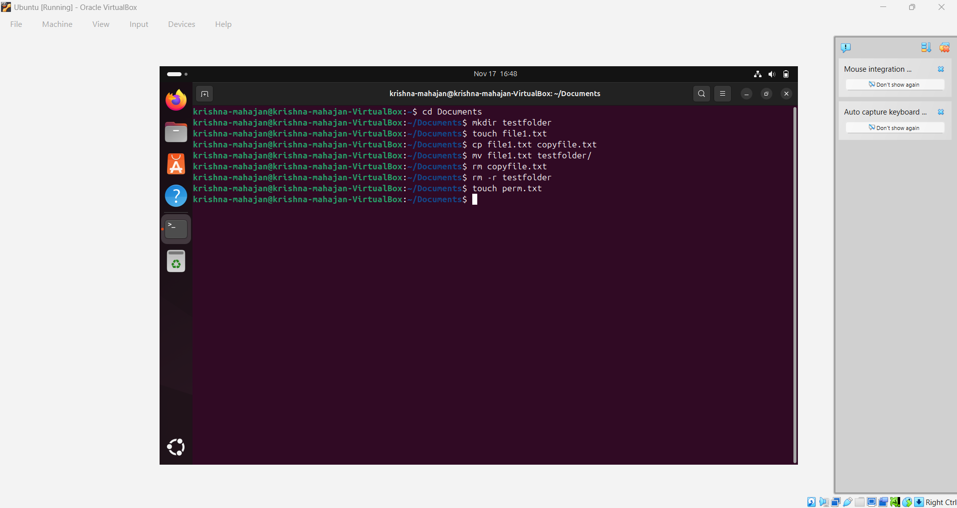
File & Folder Commands
📸 Add screenshots for:
- mkdir
- touch
- cp
- mv
- rm / rm -r

Slide 5
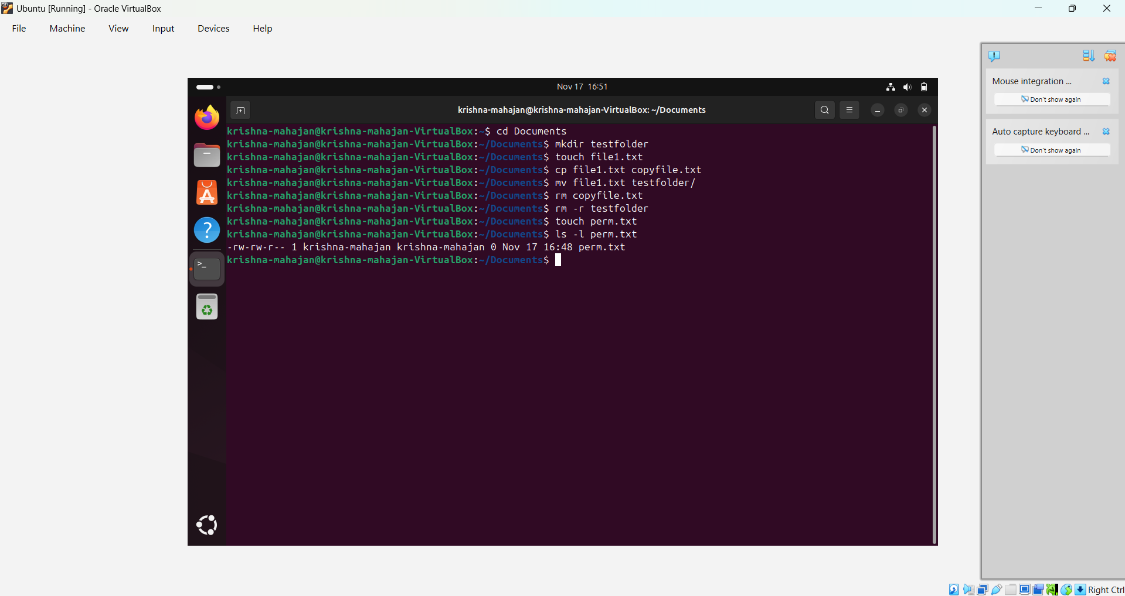
Permissions
Screenshots for:
- chmod
- chown

Slide 6
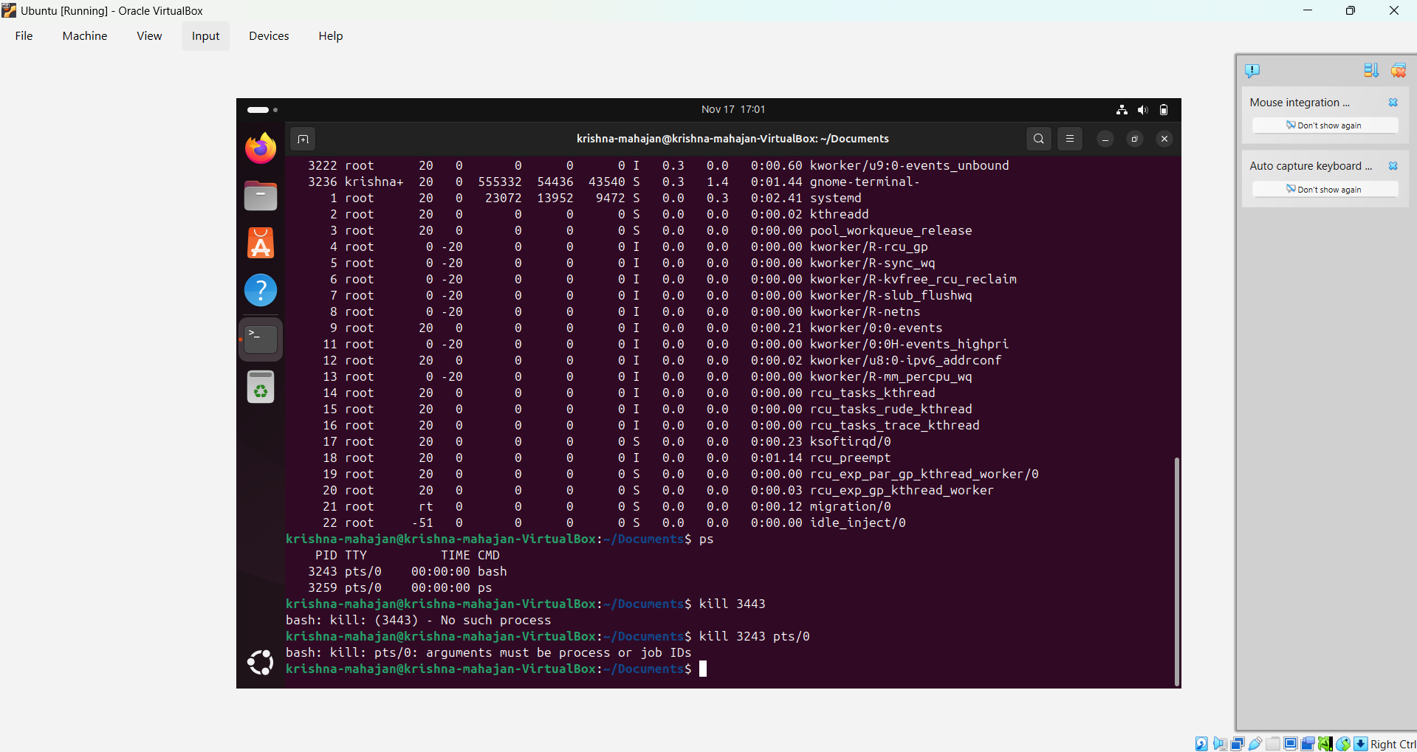
Process Monitoring
📸 Add screenshots for:
- ps
- top
- kill

Slide 7
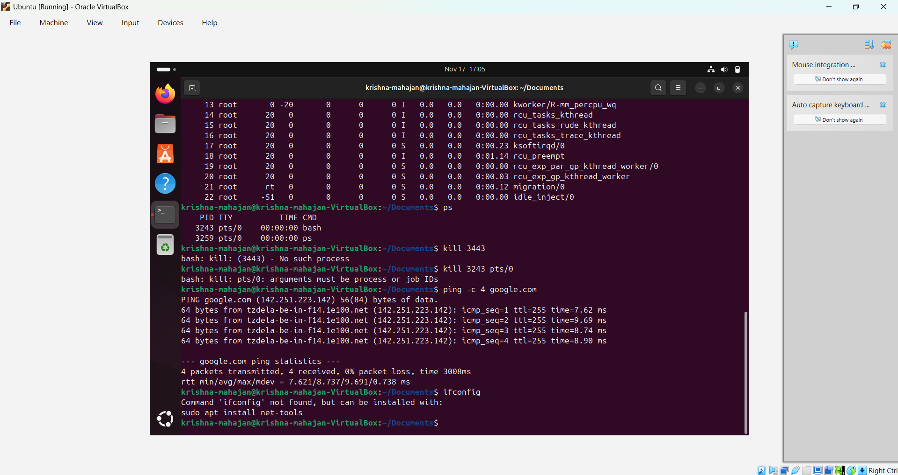
Disk Usage
📸 Add screenshot for:
- df -h

Slide 8
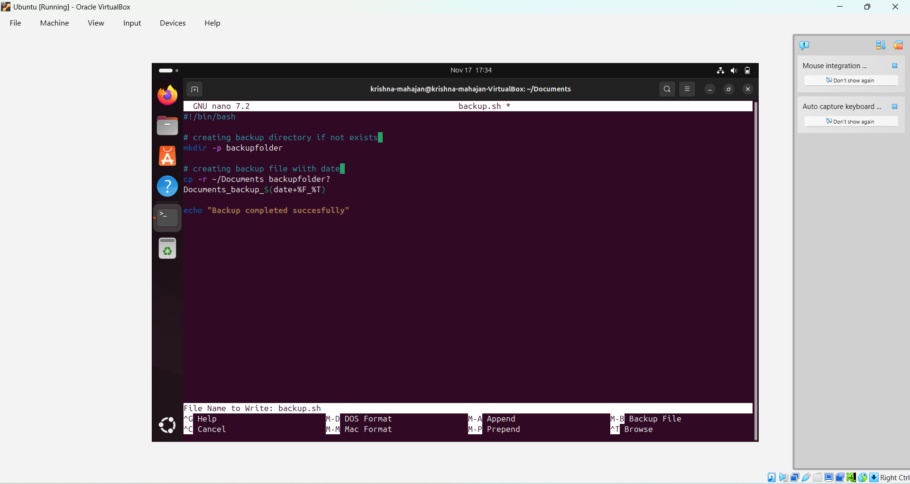
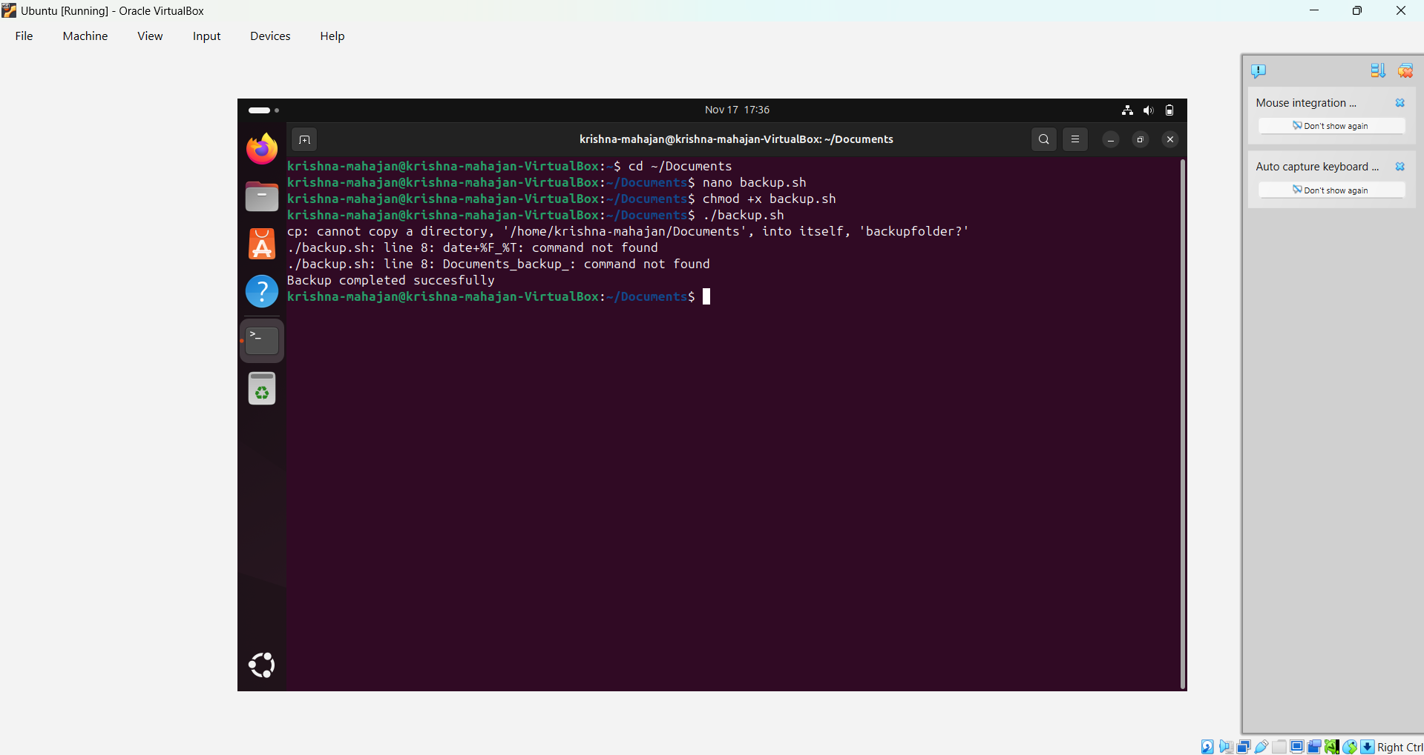
Shell Script: backup.sh
📸 Add:
- Script code in nano
- Script output

Slide 9
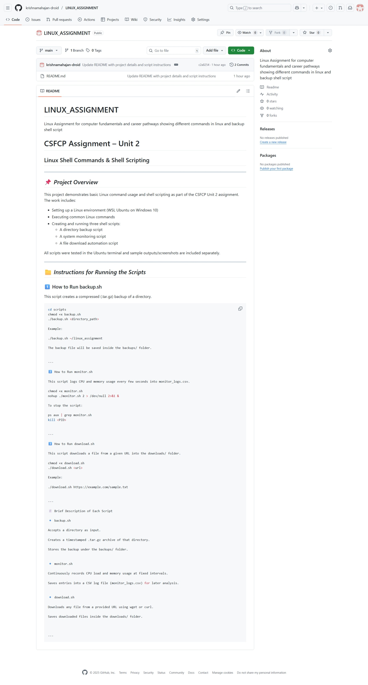
GitHub Submission
Screenshots of:
- Repo page
- Uploaded files
- README.md
- Commit history
Git Hub Link
krishnamahajan-droid/LINUX_ASSIGNMENT: Linux Assignment for computer fundamentals and career pathways showing different commands in linux and backup shell script

Slide 10
Conclusion & Reflection
Summarize:
- What you learned
- Challenges faced
- Real-world usage of Linux & shell scripting

