Slide 1

Amity University, Noida
Finland's Education System
A Comparative Analysis for Curriculum Studies
Knowledge and Curriculum (B.Ed.) — Department of Education
A COMPARATIVE STUDY
Presented by
Krishna Mahato
Sahil Kumar
Academic Year 2025-2027
B.Ed Department of Education

Slide 2




Finland's
Education System
A Comprehensive Analysis for Curriculum Studies
Excellence Through Equity
Mirror, Not Model
KEY FOCUS
ANALYSIS
MODEL
Curriculum Design
Finland-India
Global Reform

Slide 3







The Finnish Paradox - Excellence Through Equity
Four Pillars of the Finnish Model
What Finland Doesn't Have
Equity
Teacher Quality
Standardized testing
Fair access for all
Highly qualified professionals
School inspections
Formative Assessment
Holistic Curriculum
Feedback for learning
Designed for life, not tests
School rankings
Private competition
Significance for Curriculum Studies
Performance pay
Excessive homework
Curriculum matters
• Design shapes classroom reality
Teachers matter most • No curriculum exceeds teacher capacity
Context matters • Adaptation not adoption
Time matters • Systemic change requires decades

Slide 4

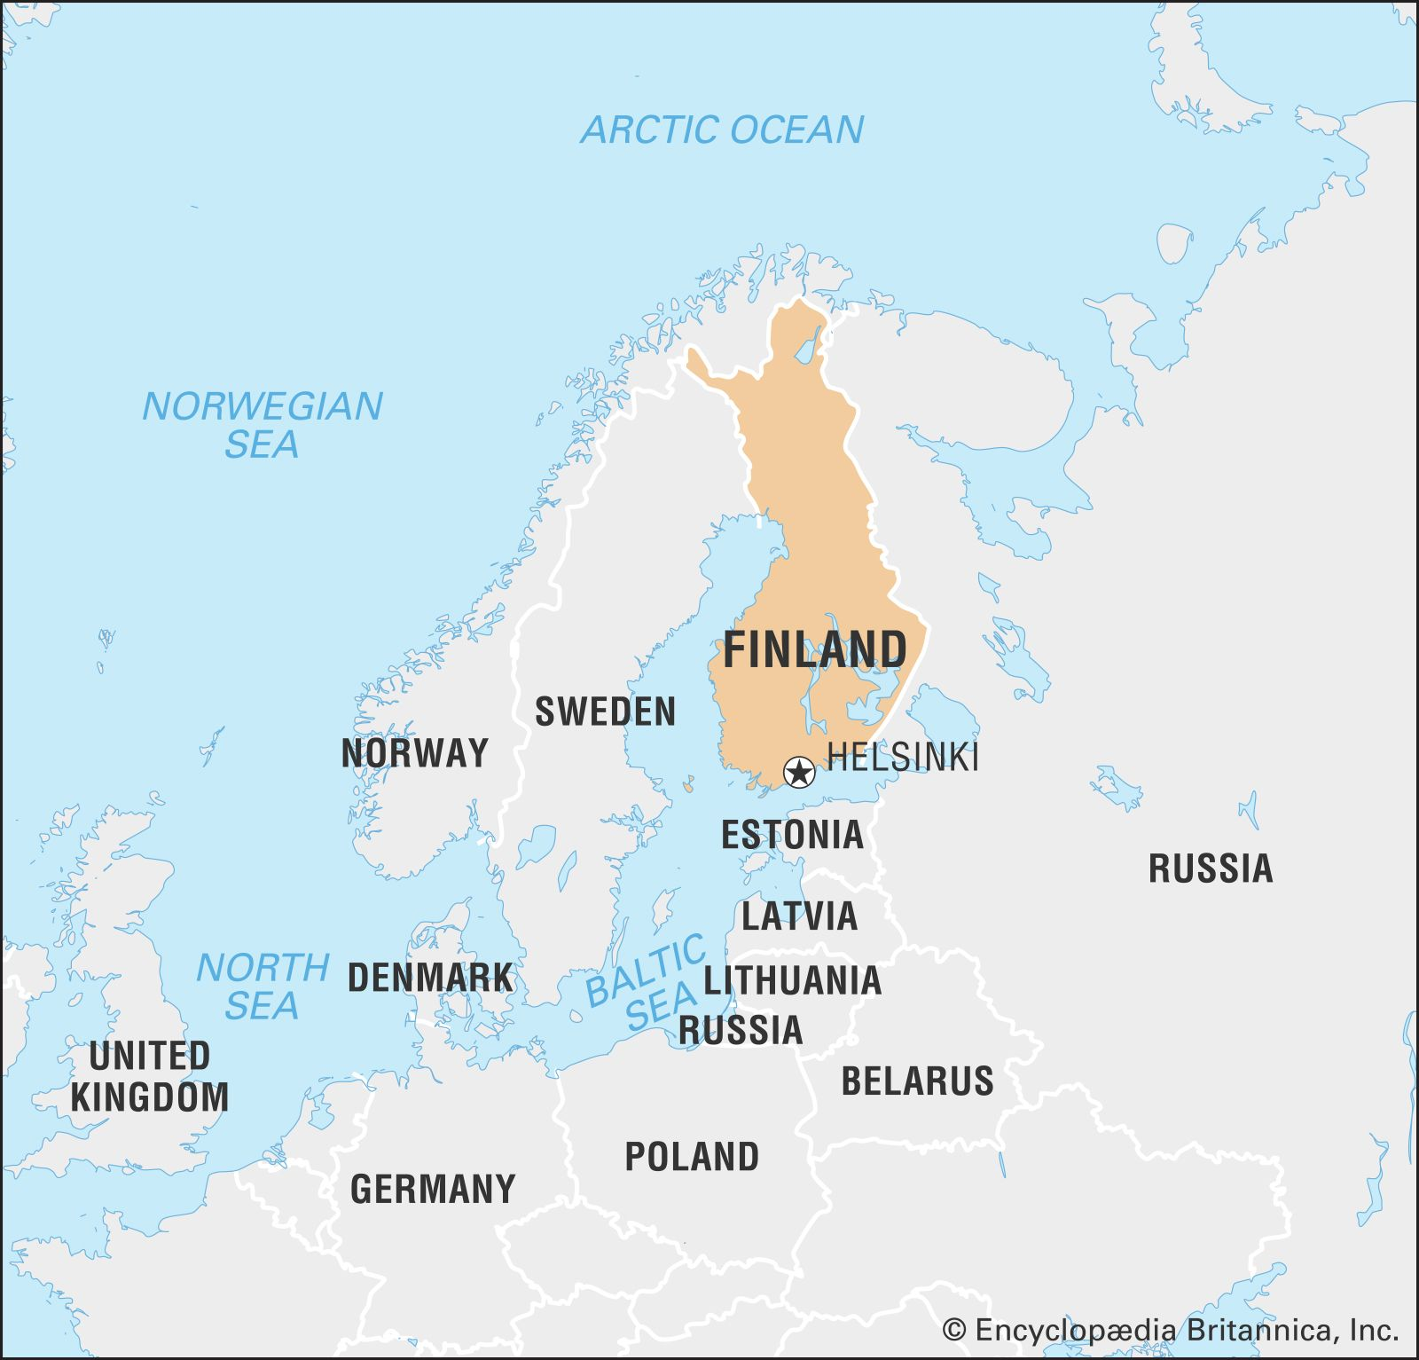








Context: Geographical, Socio-Cultural & Historical
Geographical Challenges
18
180K+
86%
people/km²
lakes
forest cover
Harsh climate & long winters
Dispersed settlements across vast distances
Nordic Welfare State
Historical Evolution
Consensus & trust culture
Pre-70s
Dual-track system
Social cohesion & equity focus
1968-77
Comprehensive school reform
Universal healthcare & education
1980s
Decentralization & trust
Strong labor protections
1990s
Teacher education enhancement
2000s+
Student welfare & PhBL
Nordic Welfare State Foundation

Slide 5





Educational Pathway: From ECEC to Higher Education
ECEC
Pre-Primary
Comprehensive
Ages 0-6
Age 6 • 1 Year
7-16 Years • 9 Years
• Play-based learning
• School readiness
• No tracking/streaming
• Qualified teachers
• Assessment before schooling
• No national exams
• Early intervention
• Compulsory since 2015
• Free meals & transport
Upper Secondary
Higher Education
16-19 Years • 3 Years
19+ Years
General (Lukio)
Vocational
Universities
UAS
Academic • Matriculation exam
Practical skills • Workplace learning
Research-focused • Academic
Practice-oriented • Applied
Parity of esteem • Students can switch tracks

Slide 6
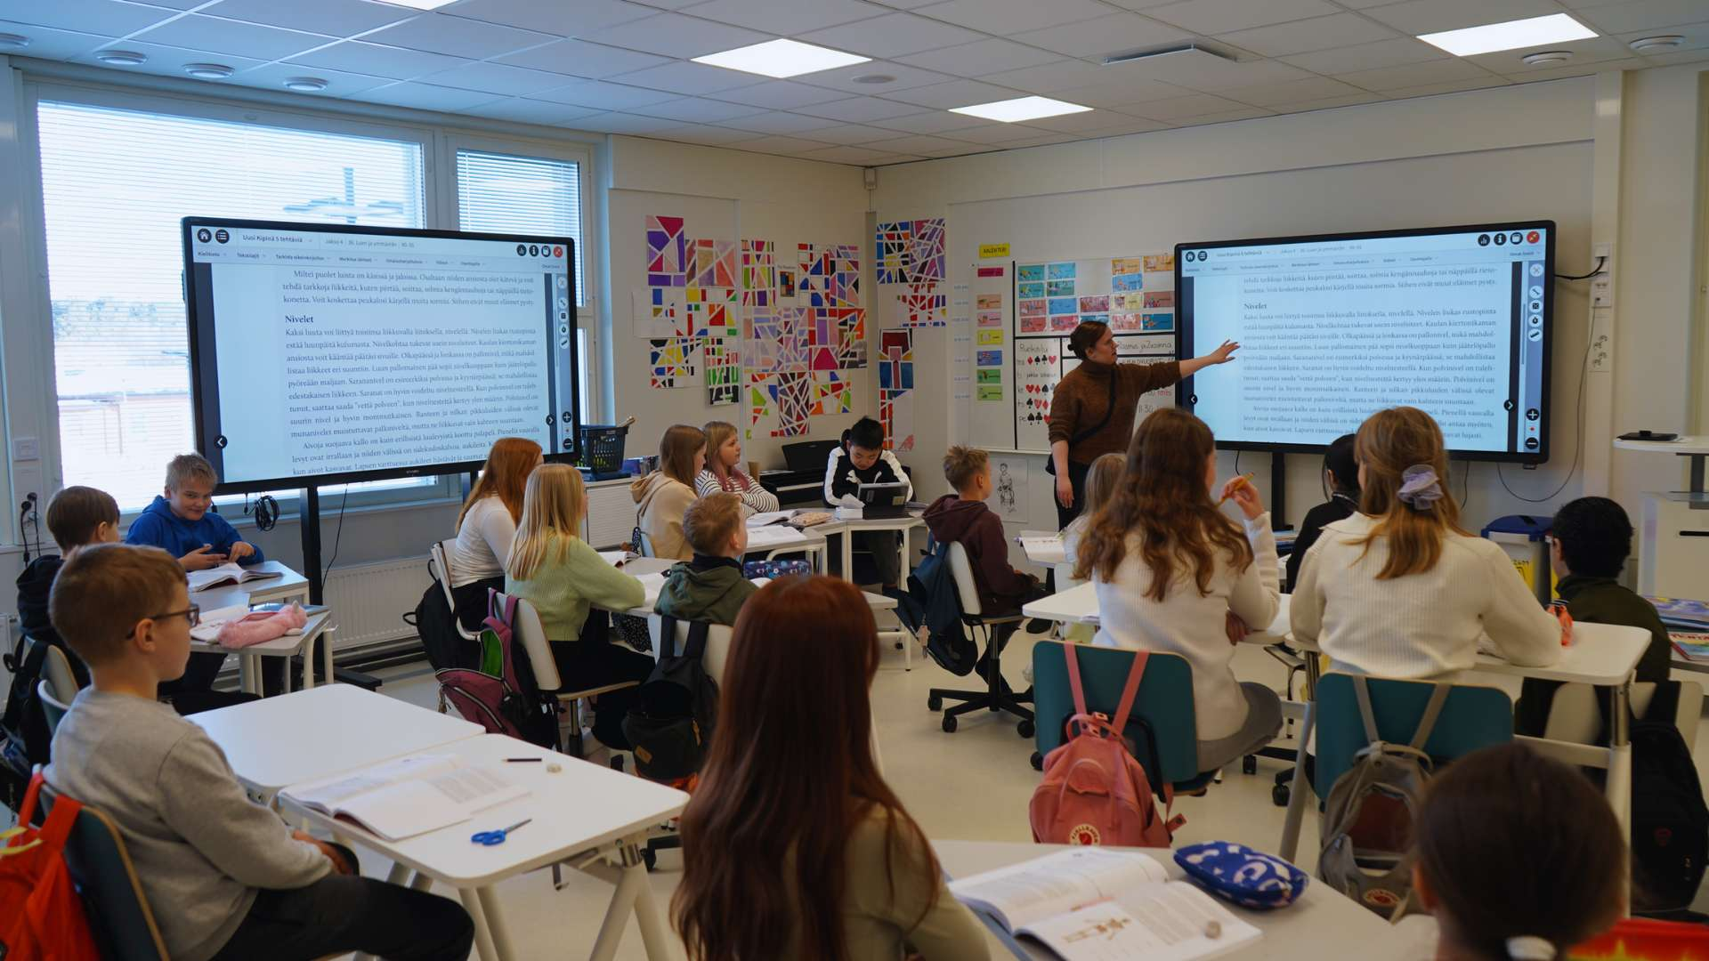











Comprehensive School (Peruskoulu)
No Tracking or Streaming
Mixed-ability teaching for all students
Multi-Tiered Support System
1
General
2
Intensified
3
Special
Short-term interventions
Regular long-term support
Individualized support
Free Services
Support Teams
Free meals
Student welfare teams
Learning materials
Guidance counseling
Healthcare
Dental care
Transportation
No national exams
9 Years • All Students Together

Slide 7










Upper Secondary & Higher Education
Upper Secondary
16-19 Years • 3 Years
General (Lukio)
Vocational
Subject-based with increasing choice
Competence-based learning
Matriculation Examination
Workplace learning emphasis
Academic preparation for university
Eligibility for higher education
Parity of esteem • Students can switch tracks • No dead ends
Higher Education
19+ Years • Dual Model
Universities
Universities of Applied Sciences
Research-focused orientation
Practice-oriented education
Academic degrees (Bachelor, Master, Doctoral)
Professional degrees (Bachelor, Master)
Selective admission process
Applied research & development

Slide 8









National Curriculum: Evolution, Structure & Values
Curriculum Evolution
70s
Centralized, content-based
80s
Decentralization begins
Core Values Underpinning the Curriculum
90s
Competence orientation
00s
Holistic development
14+
Phenomenon-based learning
Three-Tiered Structure
Human Dignity
Equity
Inclusive practices
Fair access for all
Democracy
Sustainability
Participation & voice
Ecological responsibility
National Core Curriculum
Cultural Diversity
Respect for multiple identities • Multilingual awareness • Inclusivity
Municipal Curriculum
School-Level Curriculum
Teacher's Annual Plan

Slide 9




Curriculum Content: Subjects, Competencies & PhBL
Subject Structure (199 Lessons)
56
29
23
30
Mother Tongue
Mathematics
Languages
Arts & PE
13
12
9
7
Environmental
Sciences
Religion/Ethics
Other
Seven Transversal Competencies
T1
Thinking
T2
Cultural
T3
Self-care
T4
Multiliteracy
Metacognition
Communication
Well-being
Texts & media
T5
ICT Skills
T6
Working Life
T7
Participation
Digital use
Entrepreneurship
Sustainable future
Phenomenon-Based Learning
Investigating real-world phenomena from multiple disciplinary perspectives • At least one multidisciplinary module annually

Slide 10






Teacher Education & Professional Autonomy
Rigorous Selection
10% acceptance rate • Multi-stage assessment
Research-Based Master's
Mandatory for all teachers • University programs
Professional Autonomy
Collaborative Culture
No routine inspections
Team planning
Freedom in methods
Peer observation
Choice of materials
Multi-professional teams
Teachers as Curriculum Developers
Interpret framework • Adapt locally • Design learning experiences • Evaluate practice

Slide 11


Assessment System Overview
Low-stakes, High-trust Model • Assessment for Learning
Formative Assessment
Matriculation Exam
Continuous Feedback
Sole High-Stakes Test
Ongoing, detailed guidance
At age 18, end of upper secondary school
Descriptive Comments
Purpose
Narrative reports over grades
Evaluate intellectual development • Certify readiness for higher education
Teacher Autonomy
Design own assessments
Results
No School Rankings
For student, not school ranking
Collaboration over competition
University Admission
One factor among many • Universities conduct own entrance tests
Reduces anxiety • Encourages risk-taking

Slide 12









Performance & Strengths of the Finnish Model
PISA 2024 Scores
Seven Strengths of the Model
Mathematics
484
Philosophical Coherence
Teacher Professionalism
490
Values-embedded curriculum
Curriculum developers
Reading
Flexibility
Holistic Orientation
Science
511
Framework approach adaptable locally
Balance across all domains
Future-Orientation
Equity Focus
Competency-based preparation
Universal design for all
KEY INDICATOR: Equity
Innovation
Between-School Variance:
Phenomenon-based learning
5%
25%
40%+
Finland demonstrates that equity + quality can coexist without traditional competitive measures
Finland
OECD Avg
India
Socio-Economic Impact
Minimal influence on outcomes

Slide 13













Finland vs India: Curriculum Philosophy & Structure
Finland
India
Purpose
Purpose
Holistic development • Democratic citizenship • Life preparation
Holistic development • 21st century skills • Indian knowledge systems
Orientation
Orientation
Competence-based • Phenomenon-focused • Transversal competencies
Competency-based • Learning outcomes-focused • Essential competencies
Values
Values
Nordic welfare state • Equity • Democracy • Sustainability
Constitutional values • Indian traditions • Cultural heritage
Teacher Role
Teacher Role
Autonomous curriculum developer • High professionalism
Empowered pedagogical facilitator • Developing professionalism
Framework
Framework
NCC • Municipal & school adaptation
NCF • State & local flexibility
Integrated Learning
Integrated Learning
PhBL mandatory • Multidisciplinary modules
Interdisciplinary projects encouraged • Cross-curricular competencies

Slide 14




Policy Lessons for India: From Principle to Practice
Teacher Education
Assessment Reform
Local Curriculum
4-year ITEP with curriculum studies
Reduce syllabus content for depth
Build state/district capacity
University-affiliated demo schools
Redesign board exams for competencies
Develop exemplar curricula
Continuous professional development
Develop school-leaving profiles
Allocate teacher collaboration time
Research orientation in preparation
Multiple measures vs single exam
Empower teachers as developers
Address Equity
PhBL Adaptation
Strengthen foundational layer (nutrition, health)
Start gradually (1/year)
Develop resource materials
Target resources to disadvantaged schools
Build teacher capacity
Connect to local issues
Create equity in materials
Recognize schools must compensate deficits

Slide 15




What India Can and Cannot Learn from Finland
Adaptable Principles
Contextual Limitations
Trust as Foundation
Cultural Specificity
Build through capacity development
Trust requires homogeneity, difficult to replicate
Teacher Quality
Resource Intensity
Invest in education, selection, support
Small classes, extensive support require investment
Less is More
Declining PISA Performance
Reduce syllabus, prioritize depth over coverage
Questions whether innovations deliver outcomes
Formative Assessment
Multicultural Adaptation
Learning improves with feedback, not rankings
Designed for homogeneous society, needs negotiation
Flexible Pathways
No dead ends, parity between tracks
Phenomenon-Based Learning
Engages students, develops competencies
Finland is a mirror for reflection, not a model for replication

Slide 16





Finland as Mirror, Not Model
Offers principles, not blueprints
Success rests on decades of capacity-building
Implementation matters more than policy vision
Context must shape adaptation
Trust earned through competence, not granted
Time is essential for systemic change
Curriculum must serve all students, not just elites

