Slide 1
Global YouTube Statistics 👨‍🔬 Analysis
By Manchala Krishna Kumar

Slide 2
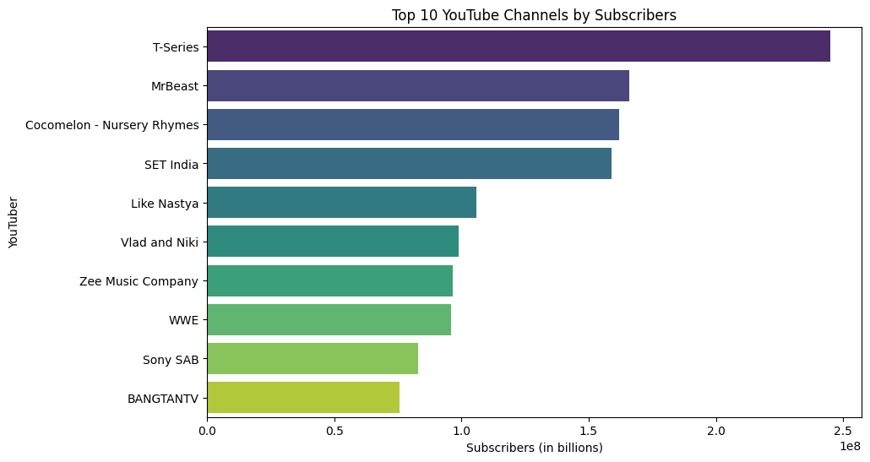
1. What are the top 10 YouTube channels based on the number of subscribers?

Slide 3
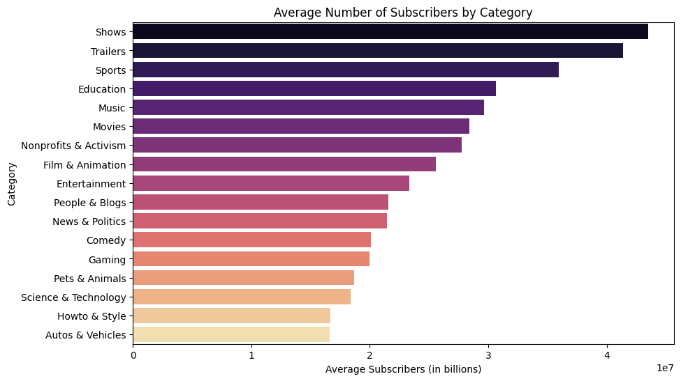
2. Which category has the highest average number of subscribers?

Slide 4
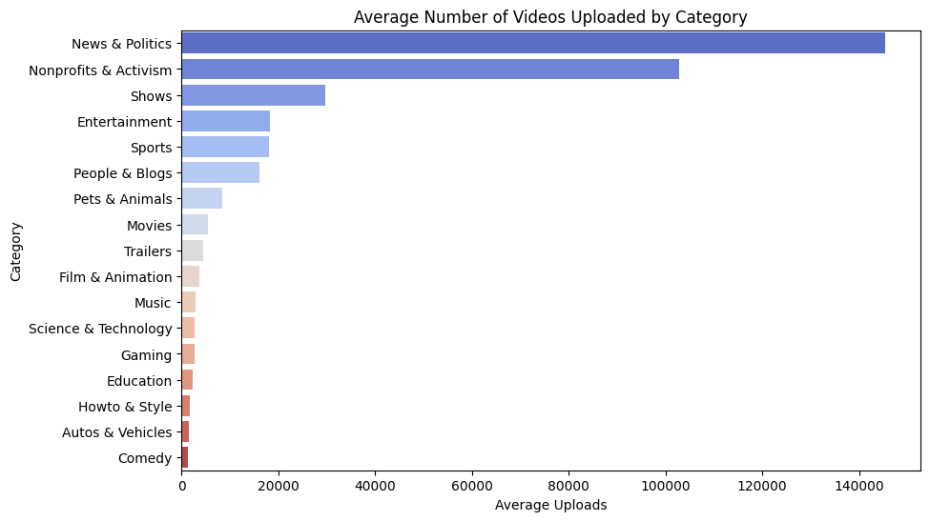
3. How many videos, on average, are uploaded by YouTube channels in each category?

Slide 5
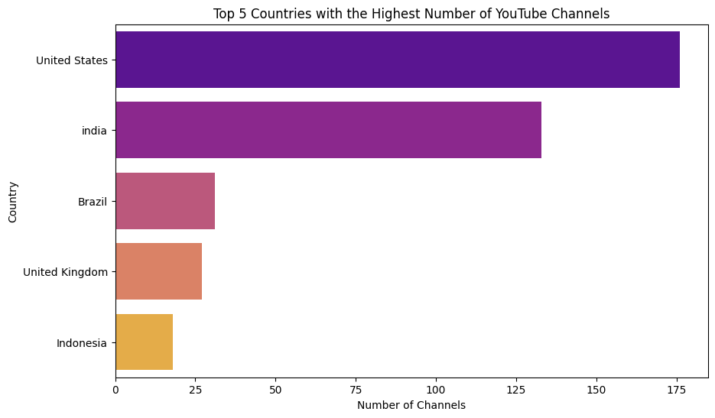
4. What are the top 5 countries with the highest number of YouTube channels?

Slide 6
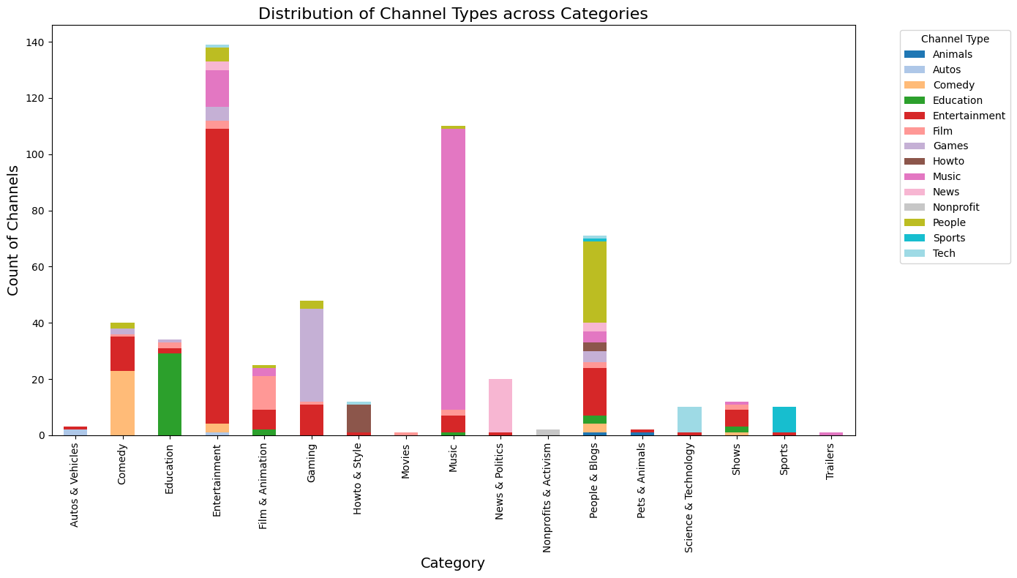
5. What is the distribution of channel types across different categories?

Slide 7
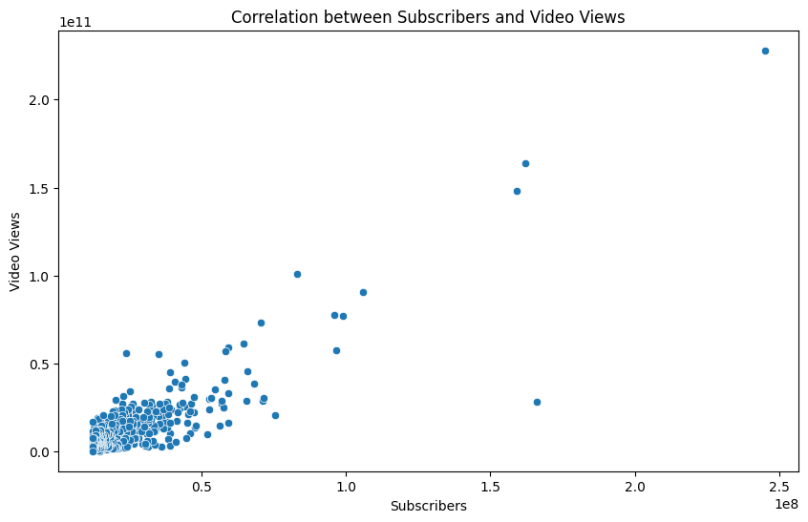
6. Is there a correlation between the number of subscribers and total video views for YouTube channels?
Pearson correlation coefficient: 0.8582454817358005
Interpretation:- There is a positive correlation between the number of subscribers and total video views for YouTube channels. Channels with more subscribers generally tend to have higher total video views. However, there are outliers that have significantly higher subscribers and video views, which could skew the overall correlation.
Conclusion:- There is a strong positive correlation between the number of subscribers and total video views for YouTube channels. This implies that channels with a larger subscriber base tend to accumulate more video views, which is expected as more subscribers likely contribute to higher view counts.

Slide 8
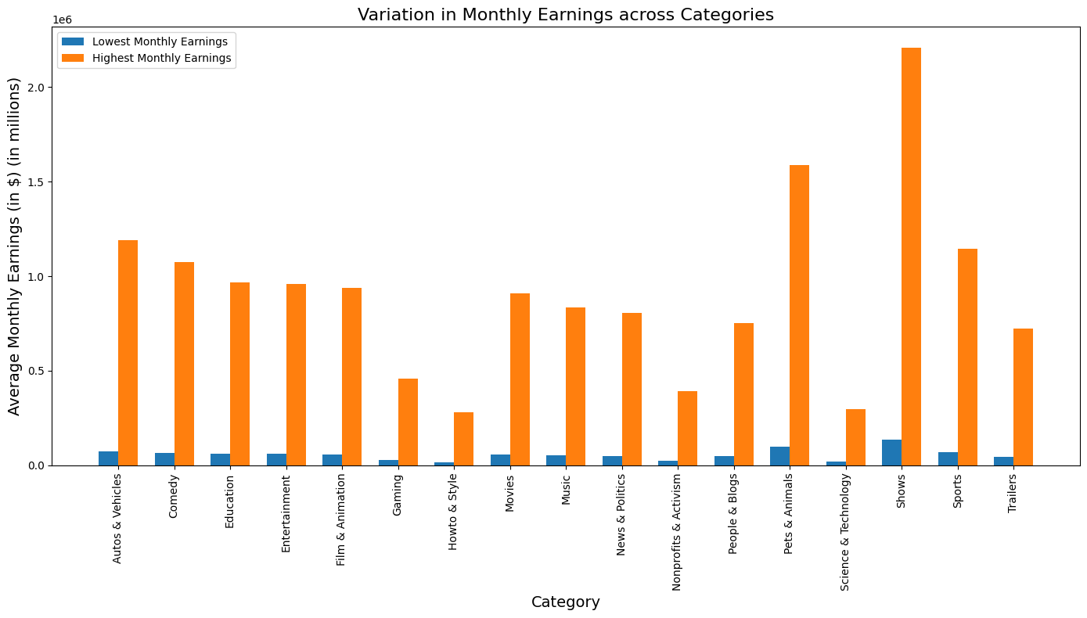
7. How do the monthly earnings vary throughout different categories?

Slide 9
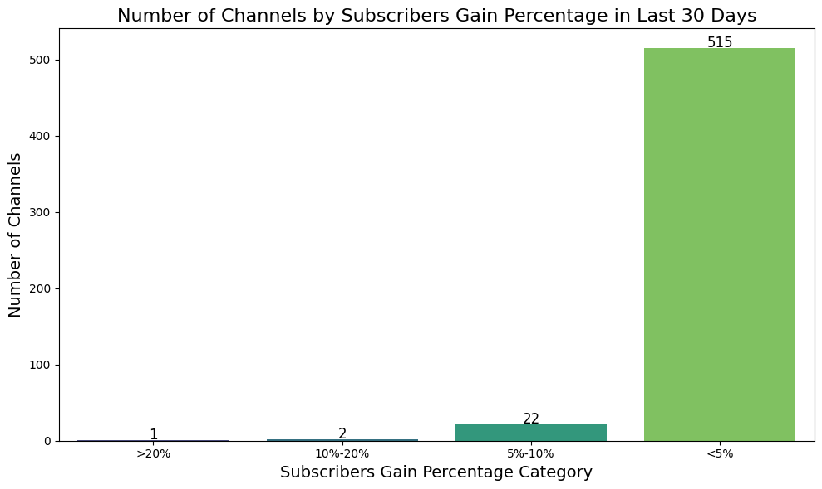
8. What is the overall trend in subscribers gained in the last 30 days across all channels?
Channels with >20% gain:
['DaFuq!?Boom!']
Channels with 10%-20% gain:
['Jess No Limit', 'Go Ami Go!']
Channels with 5%-10% gain:
['LeoNata Family', 'Topper Guild', 'Prime Video India', 'ViralHog', '_vector_', 'Heroindori', 'Ishaan Ali 11', 'Priyal Kukreja', 'jaanvi patel', 'Pokï¿½ï¿½ï¿½ï¿½ï¿½ï¿½ï¿½ï¿½ï¿½', 'Ricis Official', 'TheDonato', 'PANDA BOI', 'tuzelity SHUFFLE', 'Ami Rodriguez', 'dednahype', 'Willie Salim', 'Younes Zarou', 'ILYA BORZOV', 'ISSEI / ï¿½ï¿½ï¿½ï¿½', "GH'S", 'Natan por Aï¿']
Maximum percentage gain achieved: 34.183673469387756% by DaFuq!?Boom!

Slide 10
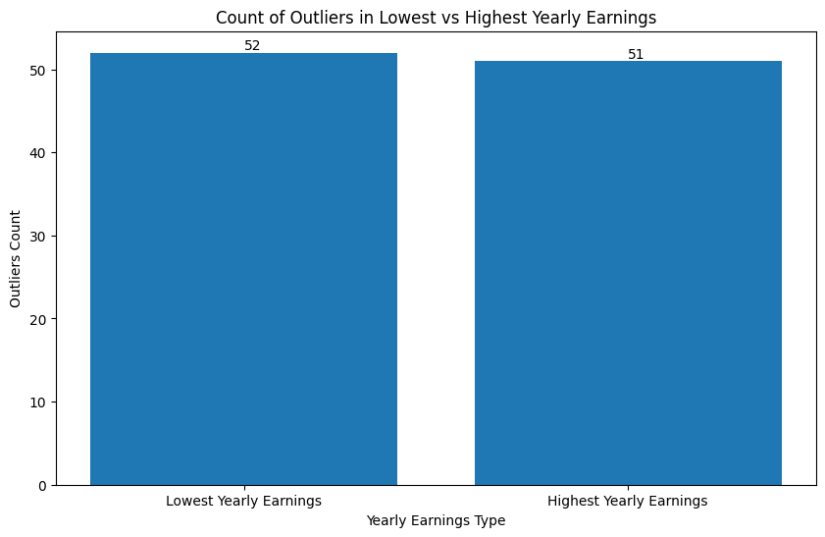
9. Are there any outliers in terms of yearly earnings from YouTube channels?
Channels with outliers only in lowest yearly earnings:
['Taylor Swift']
Channels with outliers only in highest yearly earnings:
[]
Yes, there are outliers in terms of yearly earnings from YouTube channels. After analyzing the dataset, we found that there are channels with yearly earnings that are significantly higher or lower than the majority of channels, indicating outliers in both the lowest and highest yearly earnings categories. These outliers can have a notable impact on the overall distribution and statistical analysis of yearly earnings among YouTube channels.

Slide 11
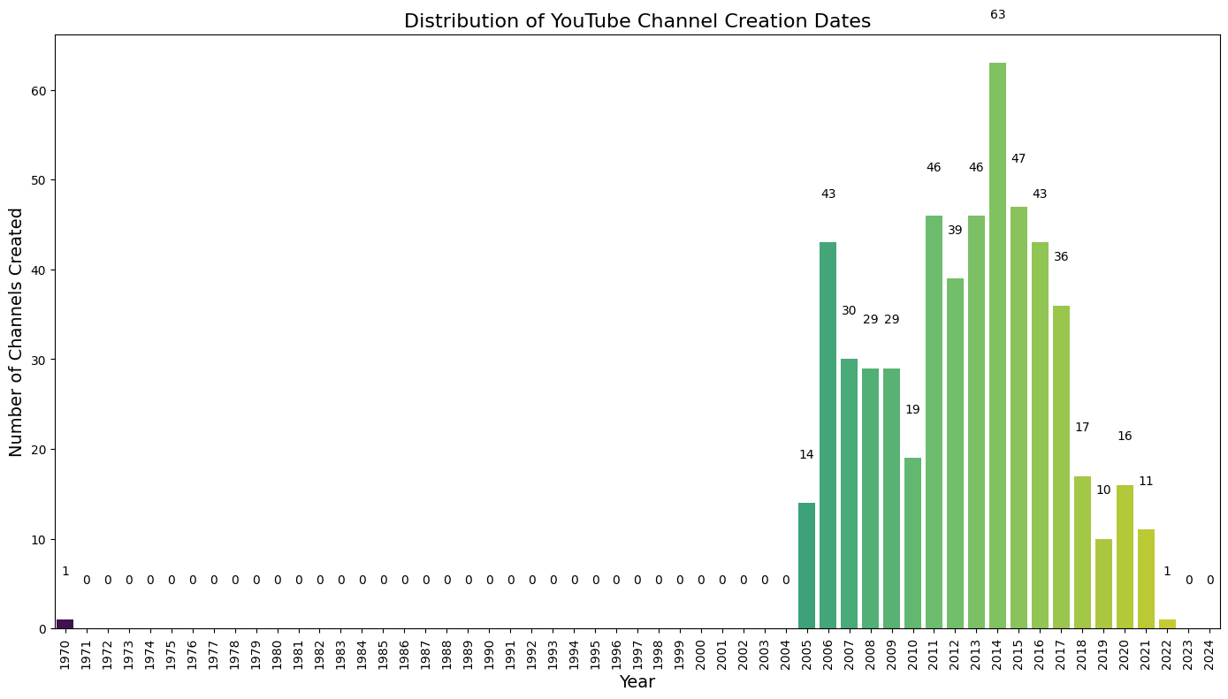
10. What is the distribution of channel creation dates? Is there any trend over time?

Slide 12
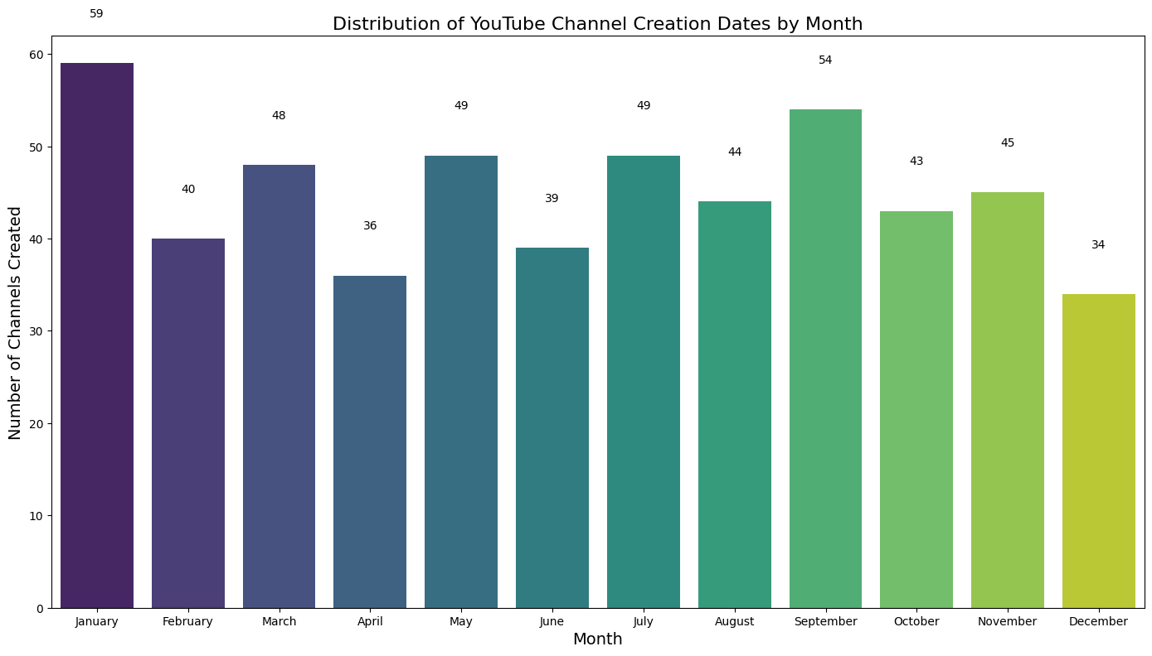
The month with the highest number of channel creations is January with 59 channels created.

Slide 13
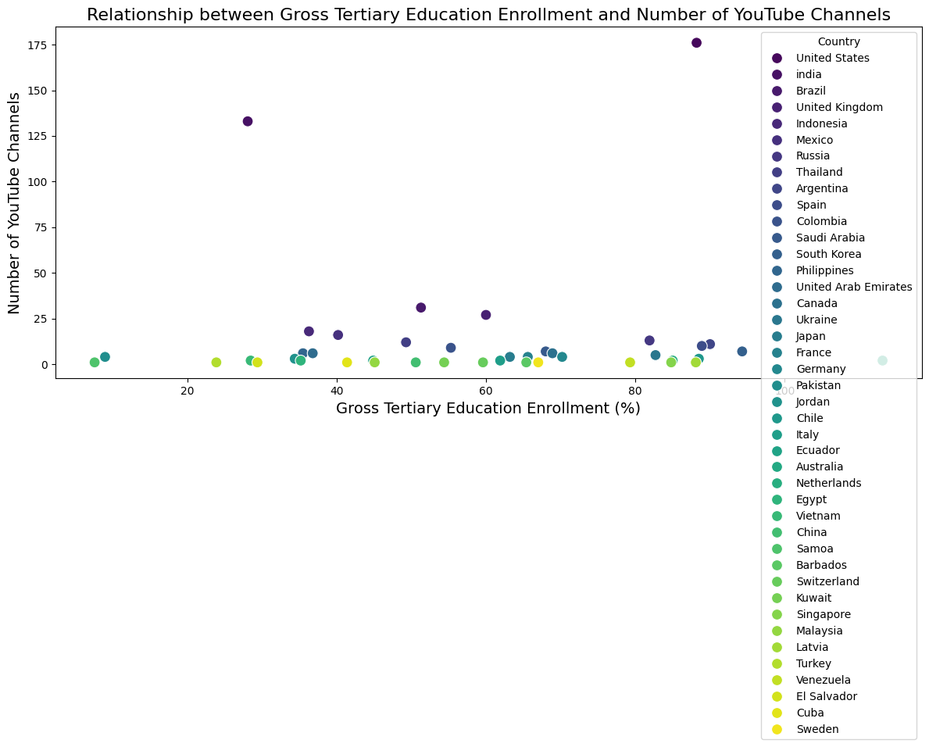
11. Is there a relationship between gross tertiary education enrollment and the number OF YouTube channels in a country?
Pearson correlation coefficient: 0.0389678619785874
P-value: 0.8064469295630986
Conclusion:- Based on the Pearson correlation coefficient of 0.039 and the high p-value of 0.806, we conclude that there is no significant relationship between gross tertiary education enrollment and the number of YouTube channels in a country. This implies that variations in tertiary education enrollment rates do not appear to be associated with the number of YouTube channels across different countries.

Slide 14
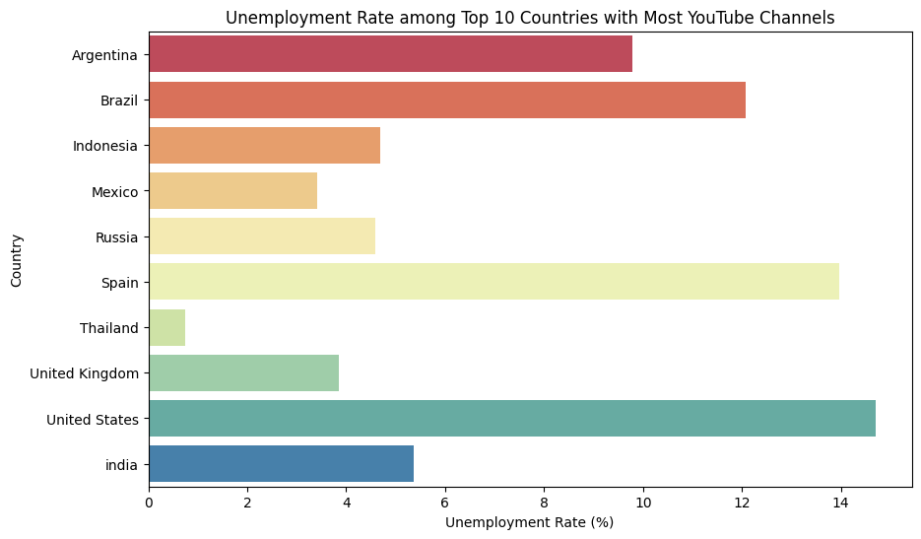
12. How does the unemployment rate vary among the top 10 countries with the highest number of YouTube channels?

Slide 15
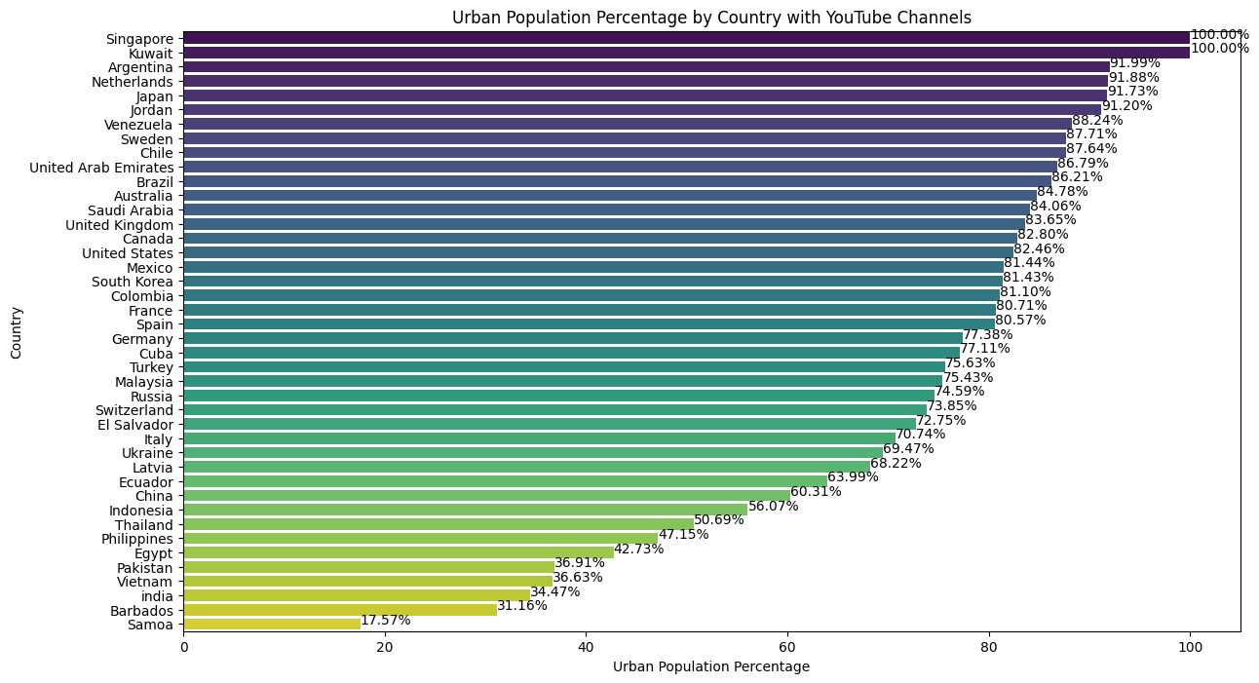
13. What is the average urban population percentage in countries with YouTube channels?
The overall average urban population percentage in countries with YouTube channels is 72.36%

Slide 16
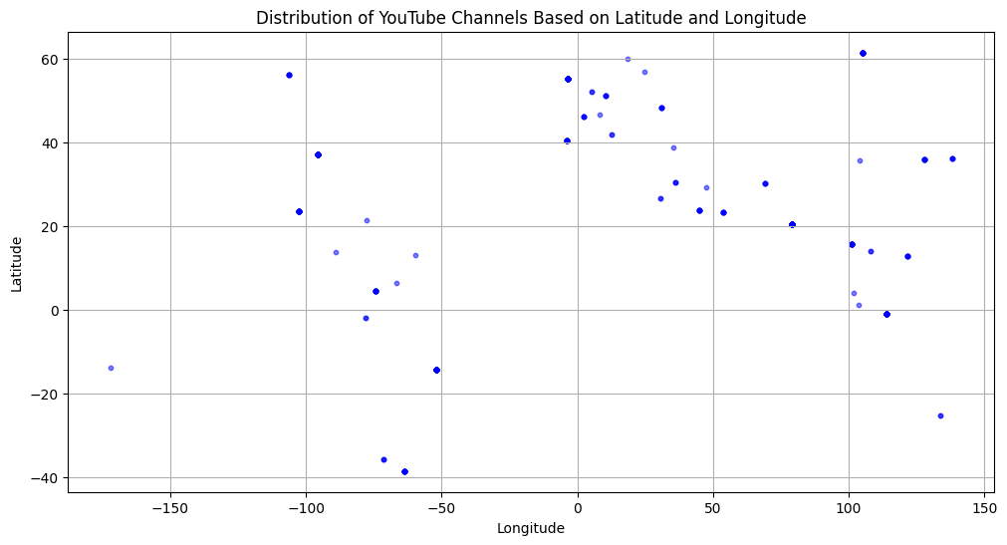
14. Are there any patterns in the distribution of YouTube channels based on latitude and longitude coordinates?

Slide 17
Distribution of YOUTUBE CHANNELS BASED ON LATITUDE AND LONGITUDE
Based on the scatter plot of YouTube channels distributed by their latitude and longitude coordinates, the following patterns are observed:
1. Northern Hemisphere Dominance:
A majority of YouTube channels are concentrated in the northern hemisphere, particularly between 20°N and 60°N latitude. This suggests a higher density of YouTube channels in regions like North America, Europe, and parts of Asia.
2. Clustering around Specific Longitudes:
Noticeable clusters are found around the longitude ranges of -150° to -50° (covering the Americas) and 0° to 100° (covering Europe and Asia). This indicates a higher prevalence of YouTube channels in these longitudes, likely due to higher population densities and better internet infrastructure in these regions.
3. Sparse Distribution in the Southern Hemisphere:
There are fewer YouTube channels in the southern hemisphere, particularly in the latitude ranges between -40° to 0°. This suggests less representation from regions such as South America, Africa, and Oceania.
4. Geographical Concentration:
The concentration of YouTube channels aligns with highly populated and developed regions, which may reflect better internet infrastructure and a higher level of digital engagement in these areas.
Conclusion :- These patterns indicate that the distribution of YouTube channels is influenced by geographical, demographic, and infrastructural factors, with more channels present in regions with higher population densities and better internet connectivity.

Slide 18
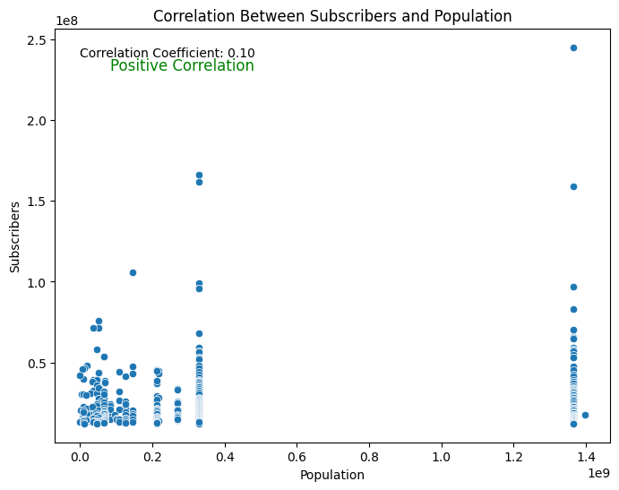
15. What is the correlation between the number of subscribers and the population of a country?
Pearson Correlation Coefficient: 0.10429950791314799
There is a positive correlation between the number of subscribers and the population of a country.

Slide 19
16. How do the top 10 countries with the highest number of YouTube channels compare in terms of their total population?

Slide 20
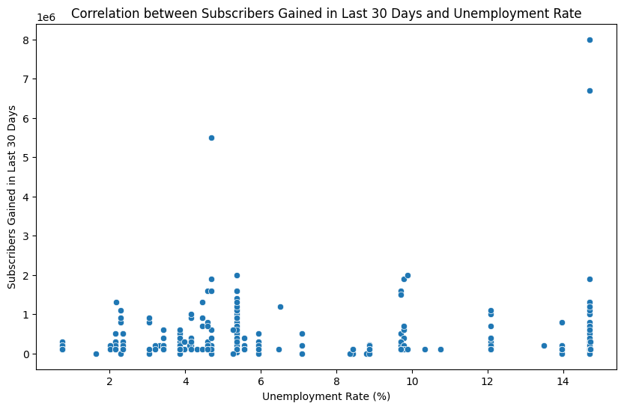
17. Is there a correlation between the number of subscribers gained in the last 30 days and the unemployment rate in a country?
Pearson Correlation Coefficient: -0.008366005999595872
There is a negative correlation between the number of subscribers gained in the last 30 days and the unemployment rate.
The Pearson Correlation Coefficient of approximately -0.008 suggests a very weak negative correlation between the number of subscribers gained in the last 30 days and the unemployment rate. This means that there is a slight tendency for the number of subscribers gained to decrease slightly as the unemployment rate in a country increases, and vice versa. However, the correlation is so close to zero that it is not practically significant, indicating that there is no meaningful relationship between these two variables in the dataset analyzed.

Slide 21
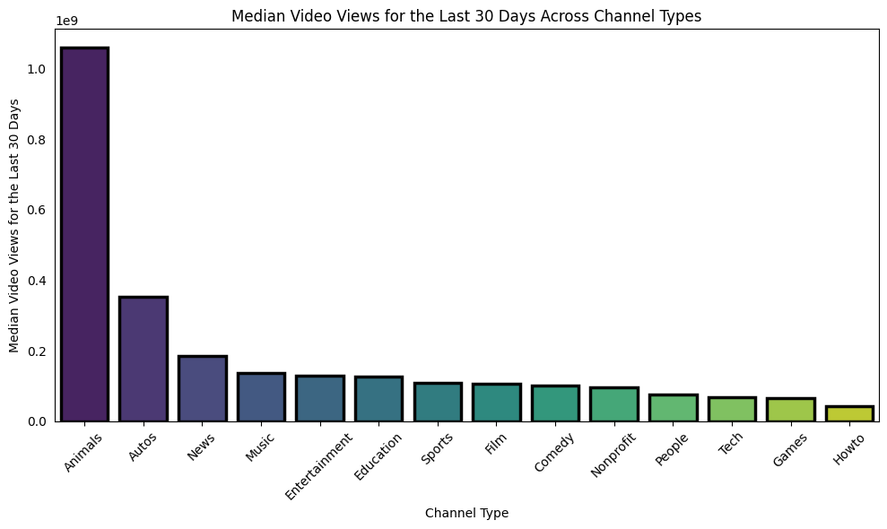
18. How does the distribution of video views for the last 30 days vary across different channel types?
Channel Types in Order of Decreasing Views for the Last 30 Days: Index(['Animals', 'Autos', 'News', 'Music', 'Entertainment', 'Education', 'Sports', 'Film', 'Comedy', 'Nonprofit', 'People', 'Tech', 'Games', 'Howto'], dtype='object', name='channel_type')

Slide 22
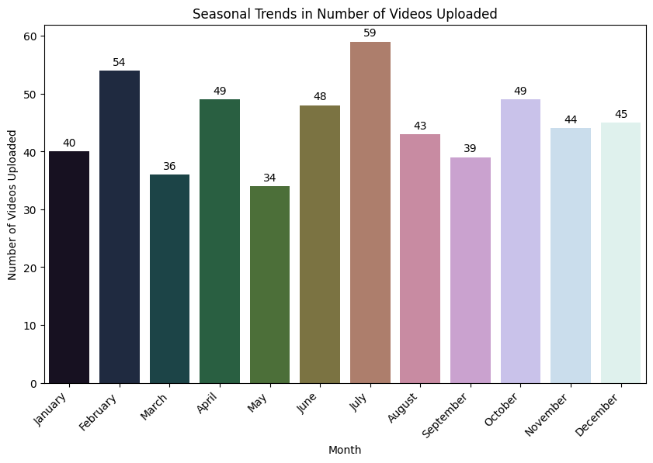
19. Are there any seasonal trends in the number of videos uploaded by YouTube channels?
Conclusion:- The count plot shows the seasonal trends in the number of videos uploaded by YouTube channels. By analyzing the plot along with the annotated values on the bars, we can observe any significant variations in video uploads across different months.

Slide 23
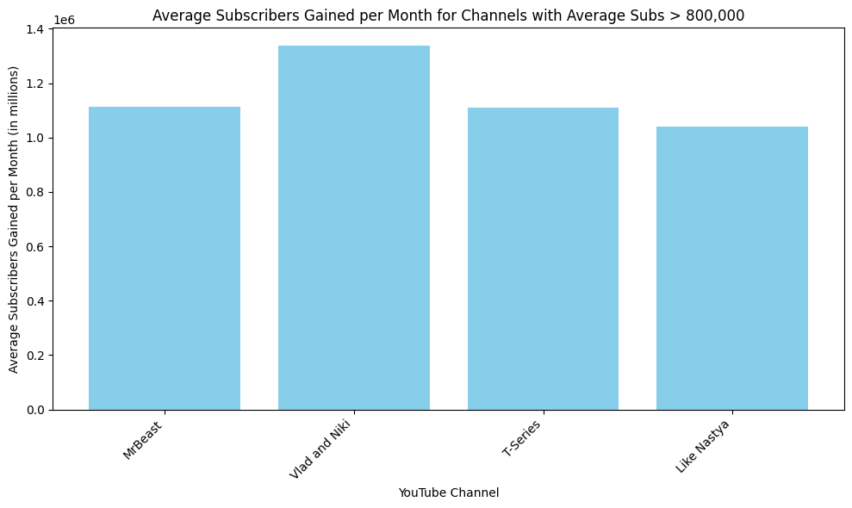
20. What is the average number of subscribers gained per month since the creation of YouTube channels till now?
Top 5 Channels with Average Subscribers Gained per Month > 800,000:
Youtuber avg_subs_per_month
2 Vlad and Niki 1.336486e+06
0 MrBeast 1.114094e+06
176 T-Series 1.108597e+06
428 Like Nastya 1.039216e+06
Mean Average Subscribers Gained per Month: 200783.50667527522

Slide 24


