Slide 1
Module 1: C1
Presented By
Krishna Mandhane
Associate Software Engineer Trainee
XenonStack
Notes:
Good morning/afternoon everyone and welcome to my presentation.
First of all, let me thank you all for coming here today
As you can see on the screen, our topic today is Module1 :C1

Slide 2
Agenda
CI CD Pipeline
Git
Linux
DevOps
Cloud
Notes:
## Agenda
CI CD Pipeline
Git
Linux
DevOps
Cloud and related topics

Slide 3
What is CI and CD mean?
CI(Continuous Integration)
• Developers push the code to a code repository often (GitHub / CodeCommit / Bitbucket / etc…)
• A testing / build server checks the code as soon as it’s pushed (CodeBuild / Jenkins CI / etc…)
• The developer gets feedback about the tests and checks that have passed / failed
• Find bugs early, fix bugs
• Deliver faster as the code is tested
• Deploy often
• Happier developers, as they’re unblocked
Developer
Tell developer results of build
Push code often
Build Server
Code Repository
Get code build & test
Notes:
### CI CD
First start with, what is CI CD
CI CD stands for continuous integration and then continuous delivery ,So let's start with continuous integration.
So the way it works that developers push the code to a code repository, often it could be GitHub or could commit or Bitbucket whatever we want.
And so as we can see, we push the code as often as possible, and then as soon as the code is pushed,
there will be a testing or a build server that checks the code as soon as it pushed.
And so the reason we do this is that we want to make sure that the code can be built and is tested correctly.
And , Why do we do this?
Because then the developer will get feedback about the test and checks that have passed and failed.
And so therefore we can improve our code and we can find bugs early and fix them bugs very early as well.
So this way we can deliver code faster as it is tested continuously and then deploy often.
developer just need to push the code to a code repository and then the build server will do the heavy job for them testing the code, building it,
and maybe even notifying the developer of how it went. ,So continuous integration is the first step in CI CD

Slide 4
What is CI and CD mean?
CD(Continuous Delivery)
Developer
Push code often
• Ensure that the software can be released reliably whenever needed.
• Ensures deployments happen often and are quick
• Shift away from “one release every 3 months” to ”5 releases a day”
• That usually means automated deployment
• CodeDeploy
• Jenkins CD
• Spinnaker
• Etc…
Code Repository
Get code build & test
Build Server
Deploy every passing build
Deployment Server
Application Server v1
Application Server v1
Application Server v1
Application Server v2
Application Server v2
Application Server v2
Notes:
### Now we have continuous delivery, so we want to make sure that whenever our software is built, it can be released reliably whenever we need.
And we want to make sure that the deployments happen very often and are quick because we want to move away from doing one release every three months to doing
five releases a day, and that you can only do five releases a day if you have something called continuous delivery.
So that means that the deployment will be fully automated., So we could use technology such as codedeploy, Jenkins, Spinnaker, etc., etc..
So what does a continuous delivery pipeline look like?
Well, we have our happy developer and it pushes code often and then the build server will get the code, build it and test it.
And then the deployment server after the build server is done, will get the build outputs and say, okay, I want to deploy this new version to my application
server so that they go from Version 1 to V2 at a high level.
So this is the idea behind continuous delivery.
### so now let's go back to

Slide 5
What is the CICD stack using AWS?
Code
Build
Test
Deploy
Provision
AWS
CodeCommit
AWS CodeBuild
AWS Elastic Beanstalk
AWS CodeDeploy | User Managed EC2 Instances Fleet (CloudFormation)
GitHub Or 3rd party
code repository
Jenkins CI
Or 3rd party CI servers
Orchestrate: AWS CodePipeline
Notes:
What is the CICD stack looking for in aws?
These are the steps we can do in our CICD.
we have code build, test, deploy and provision.
So for code, we would use a device aws code commit or GitHub or a third party repository.
Then for building and testing, we would use a code build or Jenkins CI or any third party CI servers.
and for deploying and provisioning beanstalk or provisioning infrastructure with cloud formation, And for deployment especially, we would use code deploy.
finally to orchestrate everything we would use a AWS code pipeline.

Slide 6
GIT
• Version control is the ability to understand the various changes that happened to the code over time (and possibly roll back).
• All these are enabled by using a version control system such as Git
• A Git repository can live on one’s machine, but it usually lives on a central online repository
• Benefits are:
• Collaborate with other developers
• Make sure the code is backed-up somewhere
• Make sure it’s fully viewable and auditable
Notes:
## GIT
Git is a one of popular vesion control system
version control is the ability to understand the various changes that happen to the code over time, and possibly for rollback.
2. And so all of these can be enabled using a version control system and a very popular one is called git
A git repository can live on one's machine, but it can also live in a central online repository.
3. And so this repository can be GitHub or a AWS code commits the benefits of using a central online repository for our git.
4. It means that we can collaborate with other developers and you can make sure that the code is backed up somewhere and to make sure it's fully viewable,
auditable and we can roll back at any point of time.

Slide 7
Linux
Linux is highly configurable and depends on a modular design that enables users to customize their own versions of Linux. Depending on the application,
Linux can be optimized for different purposes such as:
networking performance;
computation performance;
deployment on specific hardware platforms; and
deployment on systems with limited memory, storage or computing resources.
Linux distributors:
Linux distributions may be community-developed, like Slackware and Gentoo.
Other distributions are commercial and intended for enterprise use, including Red Hat Enterprise Linux and SUSE Linux Enterprise Server.
Many distributions use a combination of community- and corporate-supported development, such as Red Hat's Fedora, openSUSE from SUSE and Ubuntu.
Notes:
## Linux
Linux is highly configurable and depends on a modular design that enables users to customize their own versions of Linux. Depending on the application,
all the super computer which is working on 100% linux and also linux is used in servers
Linux can be optimized for different purposes such as:
networking performance;
computation performance;
deployment on specific hardware platforms; and
deployment on systems with limited memory, storage or computing resources.
Linux distributors:
Linux distributions may be community-developed, like Slackware and Gentoo.
Other distributions are commercial and intended for enterprise use, including Red Hat Enterprise Linux and SUSE Linux Enterprise Server, it uses 5.14 version of linux kernel and it support multiple hardware platforms.
Many distributions use a combination of community- and corporate-supported development, such as Red Hat's Fedora, openSUSE from SUSE and Ubuntu.

Slide 8
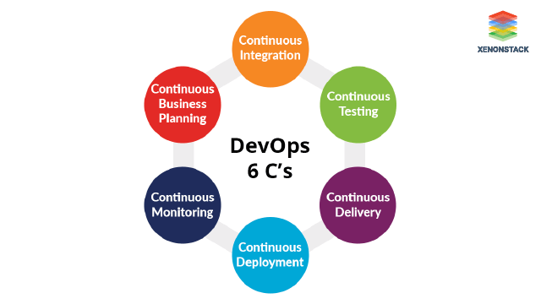
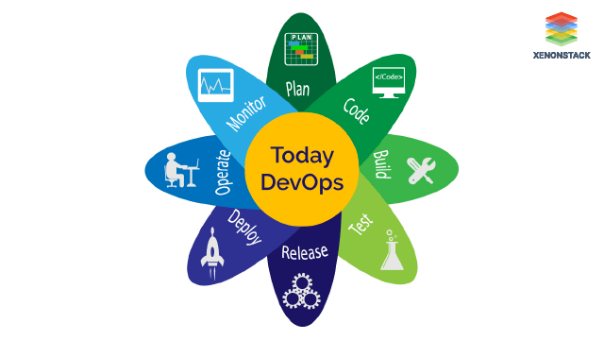
DevOps
1
What is DevOps?
DevOps is a process in which, Modern Software engineering Culture and Practices develop software where the development and operation teams work hand in hand as one unit, unlike the traditional ways, it is called the Agile Methodology.
2
What are the 6 C's of DevOps Processes?
Notes:
1. What is DevOps?
DevOps is a process in which, Modern Software engineering Culture and Practices develop software where the development and operation teams work hand in hand as one unit, unlike the traditional ways, it is called the Agile Methodology.
•Continuous Integration aims to give rapid feedback so any defect can be identified and corrected immediately, we will use BuildBot, Travis, Jenkins etc.
•Continuous Testing The test function helps the developer to balance quality and speed. Automated tools are used for testing as it is easier to test continuously than
testing a full software. The tool used for testing the software is Selenium.
•Continuous Delivery It is the ability to do changes like including new features, configuration management, fixes bugs and experiments into production.
•Continuous Deployment The code is automatically deployed to the production environment as it passes through all the test cases
•Continuous Monitoring It is a reporting tool because of which developers and testers understand the performance and availability of their application
•Continuous Business Planning The goal of continuous business planning is to define the results and capabilities of the application

Slide 9
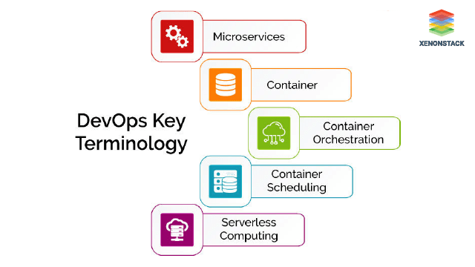
DevOps Key Technologies and Terminologies in its Processes
1
What are Microservices?
Microservices is an architectural style of developing a complex application by dividing it into smaller modules/microservices.
2
What are Containers?
Containers create a virtualization environment that allows us to run multiple applications or operating systems without interrupting each other.
3
Container Orchestration
It is Automated, Arrangement, Coordination, and Management of containers and the resources they consume while deploying a multi-container packed application.
Notes:
2. What are Microservices?
Microservices is an architectural style of developing a complex application by dividing it into smaller modules/microservices.
3. What are Containers?
Containers create a virtualization environment that allows us to run multiple applications or operating systems without interrupting each other.
4. Container Orchestration
It is Automated, Arrangement, Coordination, and Management of containers and the resources they consume while deploying a multi-container packed application.

Slide 10
DevOps Key Technologies and Terminologies in its Processes
4
What is Container Scheduling?
Container Scheduling is one of the key features of container Orchestration .
Container Scheduling also helps in two important aspects -
Auto-Recovery .
Container Deployments
5
Serverless Computing Architecture
Serverless Computing is simply a building code and runs of applications without thinking about servers. “Serverless” doesn’t mean servers are no longer involved. It means the existence of servers is hidden from developers.
Notes:
5. What is Container Scheduling?
Container Scheduling is one of the key features of container Orchestration .
Container Scheduling also helps in two important aspects -
-Auto-Recovery .
-Container Deployments
6. Serverless Computing Architecture
Serverless Computing is simply a building code and runs of applications without thinking about servers. “Serverless” doesn’t mean
servers are no longer involved. It means the existence of servers is hidden from developers.

Slide 11
Infrastructure as Code
• Currently, we have been doing a lot of manual work
• All this manual work will be very tough to reproduce:
• In another region
• in another AWS account
• Within the same region if everything was deleted
• Wouldn’t it be great, if all our infrastructure was… code?
• That code would be deployed and create / update / delete our infrastructure
• Benefits of Infrastructure as code
• No resources are manually created, which is excellent for control
• The code can be version controlled for example using git
• Changes to the infrastructure are reviewed through code
Notes:
## infrastructure is code.
What is it?
1. Well, currently we've been doing a lot of manual work.
We've automated it a little bit with Elastic Beanstalk.
We set up our pipelines to be able to automate our system using could build, etc. and pipeline.
2. But all this manual work that we've been is kind of tough to reproduce, right, if we want to reproduce
it in another region.
And so that's a new concept.
And this is quite a new phenomenon, a new train in the IT world called infrastructure as code.
3. And so that means that this code that we're going to write, we'll be able to deploy it and it will
in turn create, update and delete our infrastructure.
4. Benefits of Infrastructure as code
• No resources are manually created, which is excellent for control
• The code can be version controlled for example using git
• Changes to the infrastructure are reviewed through code

Slide 12
AWS Monitoring, Troubleshooting & Audit
Why Monitoring is Important
• We know how to deploy applications
• Safely
• Automatically
• Using Infrastructure as Code
• Leveraging the best AWS components!
• Our applications are deployed, and our users don’t care how we did it…
• Our users only care that the application is working!
• Application latency: will it increase over time?
• Application outages: customer experience should not be degraded
• Users contacting the IT department or complaining is not a good outcome
• Troubleshooting and remediation
• Internal monitoring:
• Can we prevent issues before they happen?
• Performance and Cost
• Trends (scaling patterns)
• Learning and Improvement
Notes:
### AWS Monitoring
Why Monitoring is Important
• We know how to deploy applications
• Safely
• Automatically
• Using Infrastructure as Code
• Leveraging the best AWS components!
• Our applications are deployed, and our users don’t care how we did it…
• Our users only care that the application is working!
• Application latency: will it increase over time?
• Application outages: customer experience should not be degraded
• Users contacting the IT department or complaining is not a good outcome
• Troubleshooting and remediation
• Internal monitoring:
• Can we prevent issues before they happen?
• Performance and Cost
• Trends (scaling patterns)
• Learning and Improvement

Slide 13
Monitoring in AWS
AWS CloudWatch:
• Metrics: Collect and track key metrics
• Logs: Collect, monitor, analyze and store log files
• Events: Send notifications when certain events happen in your AWS
• Alarms: React in real-time to metrics / events
AWS X-Ray:
• Troubleshooting application performance and errors
• Distributed tracing of microservices
AWS CloudTrail:
• Internal monitoring of API calls being made
• Audit changes to AWS Resources by your users
Notes:
### AWS Monitoring
1. Now, in AWS there, CloudWatch.
And CloudWatch allows us to collect metrics.
It allows us to collect logs to monitor and analyze the log files.
Events to send notifications when certain things happen in our AWS environment.
And alarms to react in real time to metrics events and even logs.
2. Then we have X-Ray and X-Ray is kind of a new service
it allows us to troubleshoot our application performance and errors,
so we'll see the latency and we'll see the errors just live.
And it allows us to do something really cool called distributed tracing of microservices.
So if you have a lot of services
doing a lot of things and calling one another, or if you're in track with many AWS components, such as, we know, S3, DynamoDB, etc,
then we able to see how our application makes calls and how long they take and we can trace our call all the way through, which is really, really nice.
3. CloudTrail is allowing us to do internal monitoring of our API calls being made, and also audit the changes made to AWS resources by our users.
So overall, these three technologies all together gives us a really solid combination to monitor AWS.

Slide 14
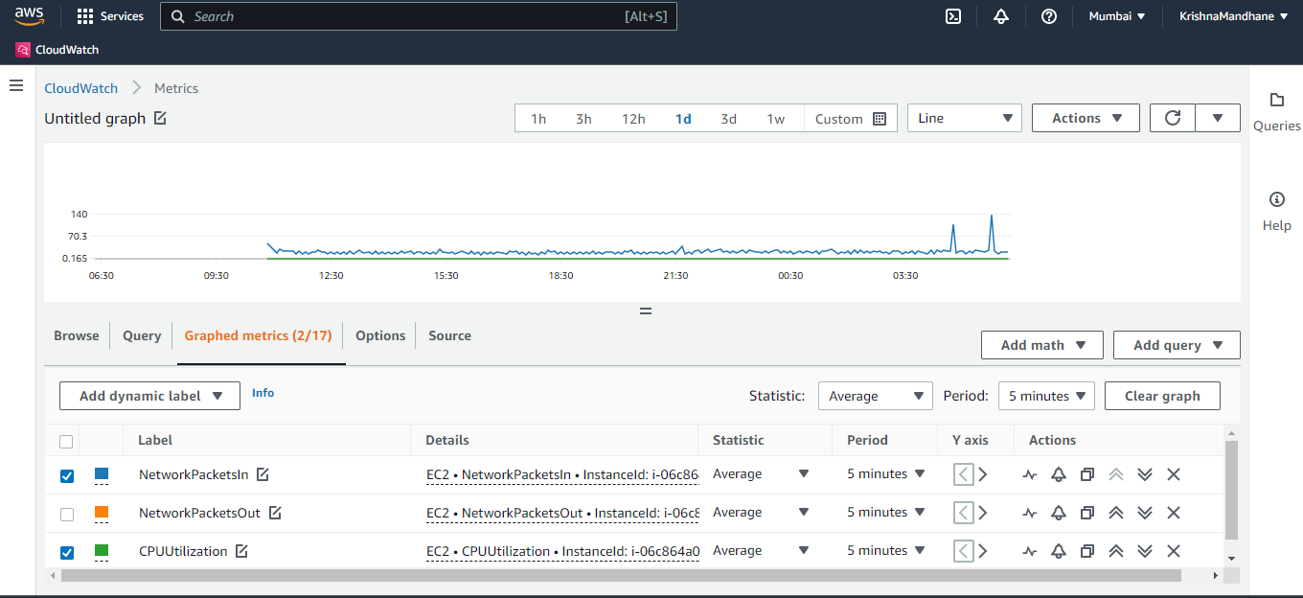
Monitoring in AWS
AWS CloudWatch: Metrics

Slide 15
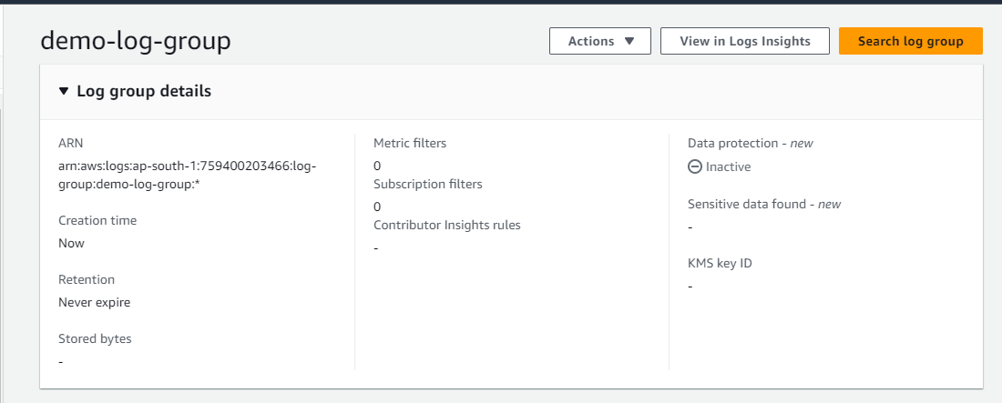
Monitoring in AWS
AWS CloudWatch: Log

Slide 16
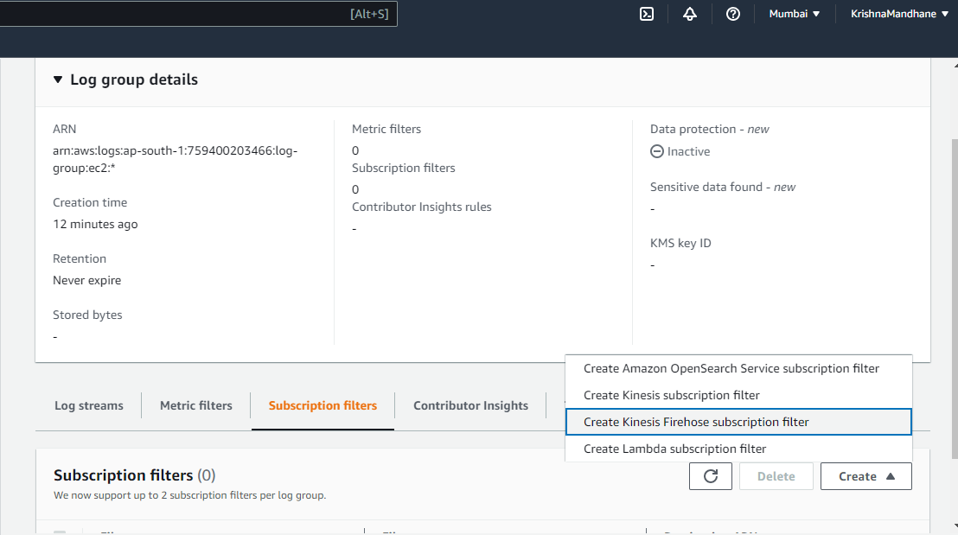
Monitoring in AWS
AWS CloudWatch: Subscription Filter

Slide 17
Deployment Strategies
There are a variety of techniques to deploy new applications to production, so choosing the right strategy is an important decision, weighing the options in terms of the impact of change on the system, and on the end-users.
So what architecture is the best for deployments?
Well, it really matters on how your application is, whether the requirements are in terms of speed, in terms of reliability, in terms of cost and so on.
Following are the strategies used for deployment :
In Place
Rolling
Replace
Blue / Green
Notes:
### deployments strategies
There are a variety of techniques to deploy new applications to production, so choosing the right strategy is an important decision, weighing the options in terms of the impact of change on the system, and on the end-users.
So what architecture is the best for deployments?
Well, it really matters on how your application is, whether the requirements are in terms of speed, in terms of reliability, in terms of cost and so on.
Following are the strategies used for deployment :
In Place
Rolling
Replace
Blue / Green

Slide 18






Deployment Strategies : Auto Scaling and ALB
• In place (one LB, one TG, one ASG)
ALB
ALB
Auto Scaling group
Instance, running v1
Auto Scaling group
Same instance, running v2
CodeDeploy
Notes:
• So this one is called in place.
• That means we have one load balancer that has a target group, and that target group is pointing to the easy two instances in our ASG.
And so in this case, our instance is running our application V1 and by doing an in-place deployment,for example,
using code deploy, then we'll have the same instance that will be running the version two of our application.
•So in here the instance state has mutated so it's not immutable, has mutated, has changed So the application was stopped.
Then the new application files were deployed onto the instance to v2 and the application was started. So this is in place and it has its own implications.
• Then we have rolling.

Slide 19




Deployment Strategies : Auto Scaling and ALB
• Rolling (one LB, one TG, one ASG, new instances)
ALB
Auto Scaling group
Instance, running v1
New Instance, running v2
Notes:
So rolling means that we have one load balancer, one target group, one ASG.
But instead of directly updating each instance, we're going to create a new instance that will have the V 2 on it.
And then once the instance is running and operational, then the first instance running V1 is going to disappear.
So this is a kind of a rolling update .
So with this strategy, as we can see here, we are serving version one and version two at the same time.
•Then we have replace.

Slide 20



Deployment Strategies : Auto Scaling and ALB
• Replace (one LB, one TG, two ASG, new instances)
ALB
Auto Scaling group
Instance, running v1
New Auto Scaling group
New instance, v2
Notes:
So replace means we have one load balancer that is pointing to one target group and that has an auto scaling and has an instance running V one.
And what we do is that we create a new auto scaling group altogether with a new launch configuration or launch templates, and that will have a new instance
in there running the V2 application.
So at some point the ALB, we will be pointing to both auto scaling groups and then when we're done, we will terminate the first auto scaling group and
replace it altogether.
• And finally, we have blue green.

Slide 21







Deployment Strategies : Auto Scaling and ALB
• Blue / Green (two LB, two TG, two ASG, new instances, R53)
Amazon Route 53 record Simple, Weighted
ALB
ALB
Auto Scaling group
Instance, running v1
Auto Scaling group
New instance, v2
Notes:
So in this case, we have two little dinosaurs.
So we have our first application stacking here and we create another entirely new application stack in which we have a new application of the
application and we'll be running version two in our scanning group.
What will happen is that here we are more free to use something like Route S3 to have a simple record or a weighted record and maybe direct a little bit of
traffic to our version two to see how it performs before we switch the entire traffic all over to the version two application.
And something to be very conscious of when you do have this kind of architecture is that because we are creating a new application , it cannot receive all the
load at once.

Slide 22
What is Configuration Management?
Configuration Management is the process of maintaining systems, such as computer hardware and software, in a desired state. Configuration Management (CM) is also a method of ensuring that systems perform in a manner consistent with expectations over time.
What are Benefits of Configuration Management?
Utilizing a Configuration Management system helps avoid problems that occur when hardware and software systems are improperly configured. Simply tracking changes can help avoid expensive remediation projects down the road. CM is insurance you pay for today so you can prevent issues tomorrow. For example, Configuration Management helps ensure the development, test, and production environments are the same, so that deployed applications will behave in the manner that is expected of them.

Slide 23
How to make data driven decisions ?
Data-driven decision making is the process of collecting data based on your company’s key performance indicators (KPIs) and transforming that data into actionable insights.
Essentially, being data-driven means that you try to make decisions without bias or emotion. As a result, you can ensure that your company’s goals and roadmap are based on evidence and the patterns you’ve extracted from it, rather than what you like or dislike.
Some decisions we can make with support from data include:
How to drive profits and sales
How to establish good management behavior
How to optimize operations
How to improve team performance
Notes:
Data-driven decision making is the process of collecting data based on your company’s key performance indicators (KPIs) and transforming that data into actionable insights.
Essentially, being data-driven means that you try to make decisions without bias or emotion. As a result, you can ensure that your company’s goals and roadmap are based on evidence and the patterns you’ve extracted from it, rather than what you like or dislike.
Some decisions we can make with support from data include:
How to drive profits and sales
establish good management behavior
optimize operations
How to improve team performance
4. Know your Vision
• Find Data Sources
• Organize your data
• Perform Data Analysis
• Draw Conclusions

Slide 24
How to make data driven decisions ?
1
Know your Vision
2
Find Data Sources
3
Organize your data
4
Perform Data Analysis
5
Draw Conclusions

Slide 25
Thank You

