Slide 1
Module 3: C3
Presented By
Krishna Mandhane
Associate Software Engineer Trainee
XenonStack

Slide 2
Agenda
How to Automate Business Processes ?
Task
What Technical Debt Is And How It's Measured ?

Slide 3
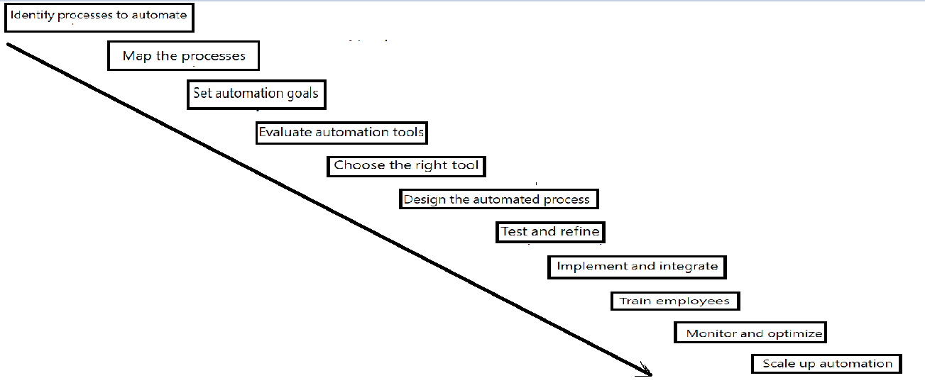
How to Automate Business Processes ?

Slide 4
Manual (man) page setup of internsctl
usr/share/man/
file
Directory
man1
man2
man3
man4
Internsctl.1
man5
man6
man7
man8

Slide 5
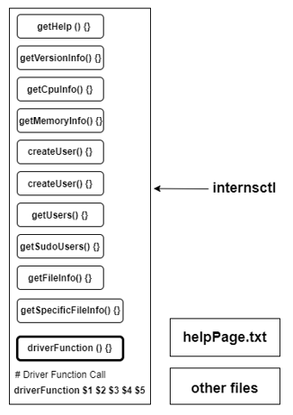
Script Setup of internsctl
Function
file
Directory
/bin

Slide 6
GitHub Link
Git Repository
https://github.com/krishnamandhane/module3_XenonStack.git
ReadMe
https://github.com/krishnamandhane/module3_XenonStack#readme
helpPage
https://github.com/krishnamandhane/module3_XenonStack/blob/main/helpPage.txt
internsctl
https://github.com/krishnamandhane/module3_XenonStack/blob/main/internsctl

Slide 7
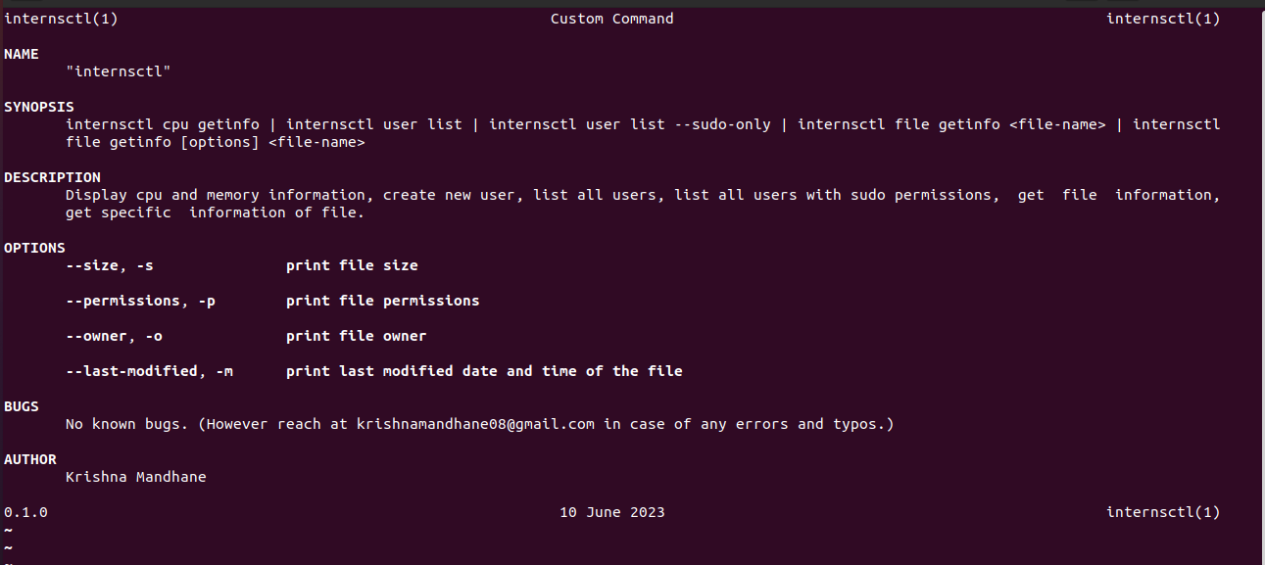
Section A
Below Snapshot of `man internsctl`

Slide 8
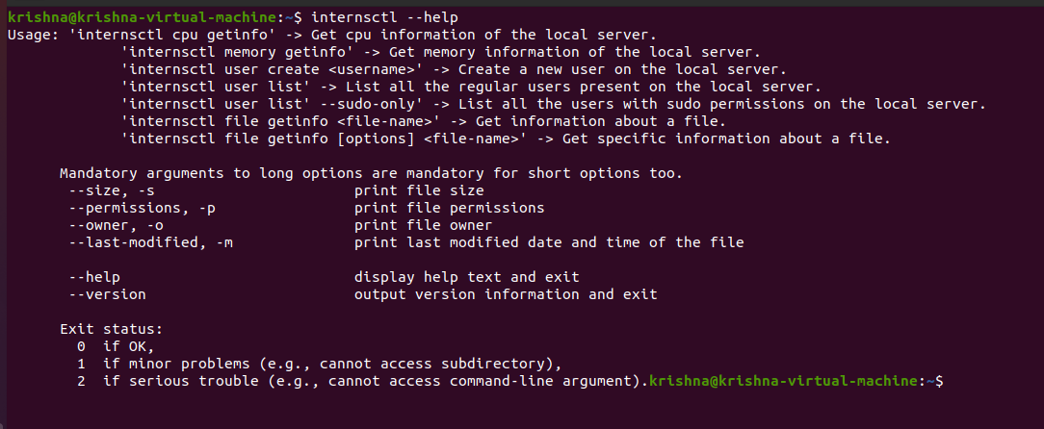
Section A
Below Snapshot of `internsctl --help`

Slide 9
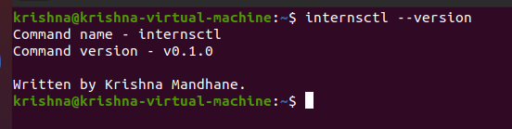
Section A
Below Snapshot of `internsctl --version`

Slide 10
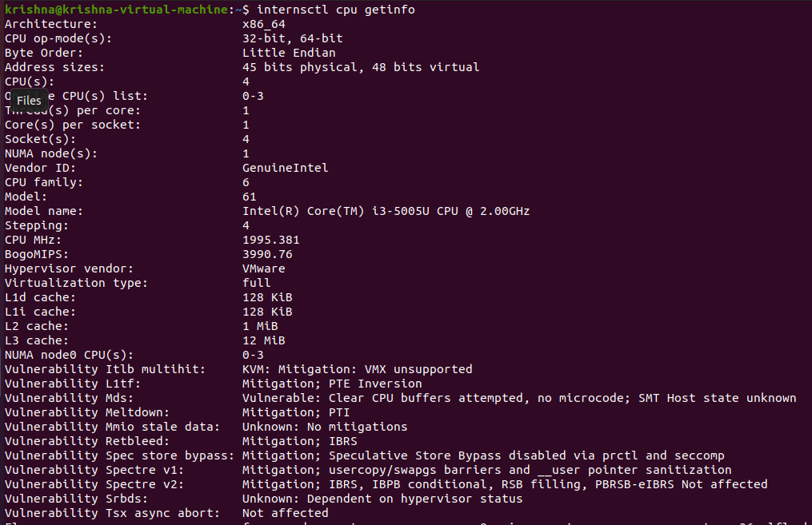
Section B Part1
Below Snapshot of `internsctl cpu getinfo`

Slide 11
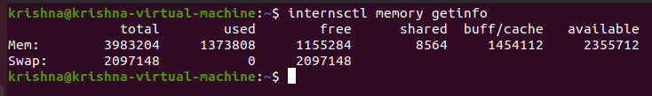
Section B Part1
Below Snapshot of `internsctl memory getinfo`

Slide 12
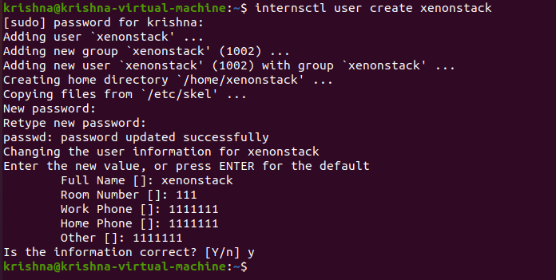
Section B Part2
Below Snapshot of `internsctl user create <UserName>`

Slide 13
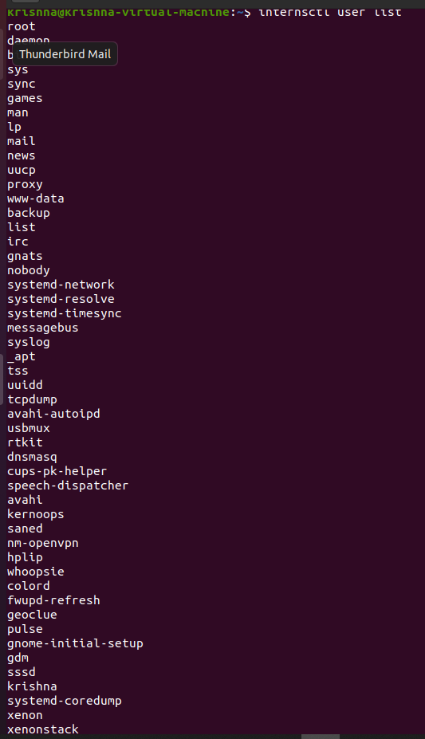
Section B Part2
Below Snapshot of `internsctl user list`

Slide 14
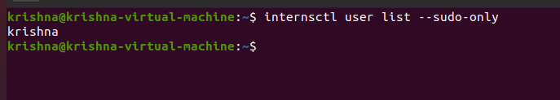
Section B Part2
Below Snapshot of `internsctl user list –-sudo-only`

Slide 15
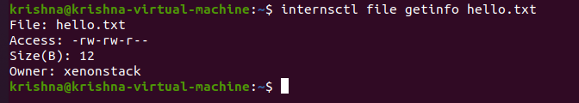
Section B Part3
Below Snapshot of `internsctl file getinfo hello.txt

Slide 16
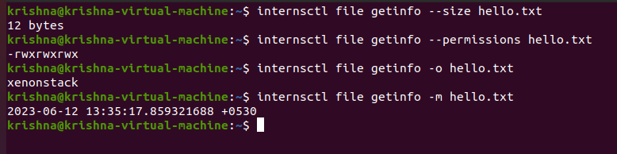
Section B Part3
Below Snapshot of `internsctl file getinfo --size hello.txt`
`internsctl file getinfo –-permissions hello.txt`
`internsctl file getinfo –o hello.txt`
`internsctl file getinfo –m hello.txt`

Slide 17
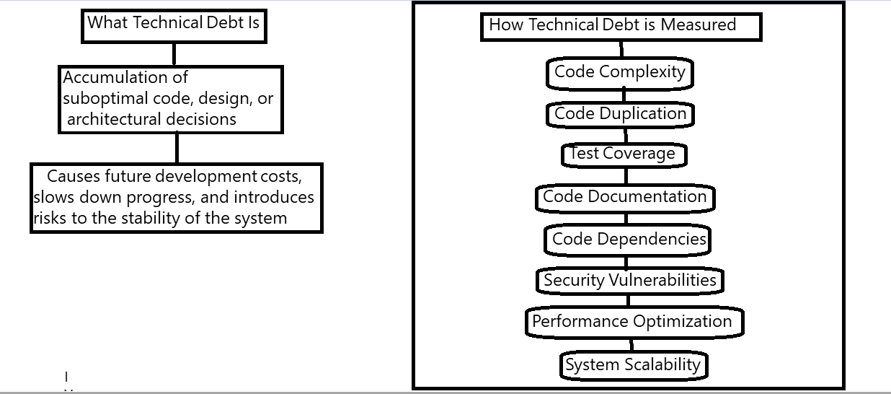
What Technical Debt Is And How It's Measured ?

Slide 18
Thank You

