Slide 1


Tires On
Highways
Group Id:G81
Group Members:
Varun
Deepak
Gargey
Charan
Shiva
Manoj

Slide 2
Problem Statement :
It has come to the attention of TSTP ( Telangana State Turn Pike) administration that a large percent of the accidents on the turn pike are due to bad or worn out tires. They would like to alert the drivers of the vehicles about the state of the tires. When the drivers stop their vehicles at the toll, the cameras present near the ground at the toll plaza will take pictures of the tires and the person at the toll will upload them to the TiresOnHighways web app. The app will then analyze the images and give a feedback on how bad the tires are.
SMS will be sent to the owner of the vehicle. All data that has been submitted needs to be stored in the database so that every fortnight a check will be made to see how many vehicles on highway have defective tires.

Slide 3

Process Flow
Connection with toll plaza through the website (Toll Login)
Allowing the toll plaza field officer
to upload images of tires, vehicle and mobile numbers of the owner
Classifying the tire images (through the ML model)
Checking the database every fortnight
Alerting the vehicle owner through SMS
Storing the images and their conditions along with the vehicle info in the database

Slide 4
Tech Stack
Frontend
Middleware
Backend
Database
React JS, CSS ,
Bootstrap
Express JS
(nodeJS)
Flask
MongoDB

Slide 5
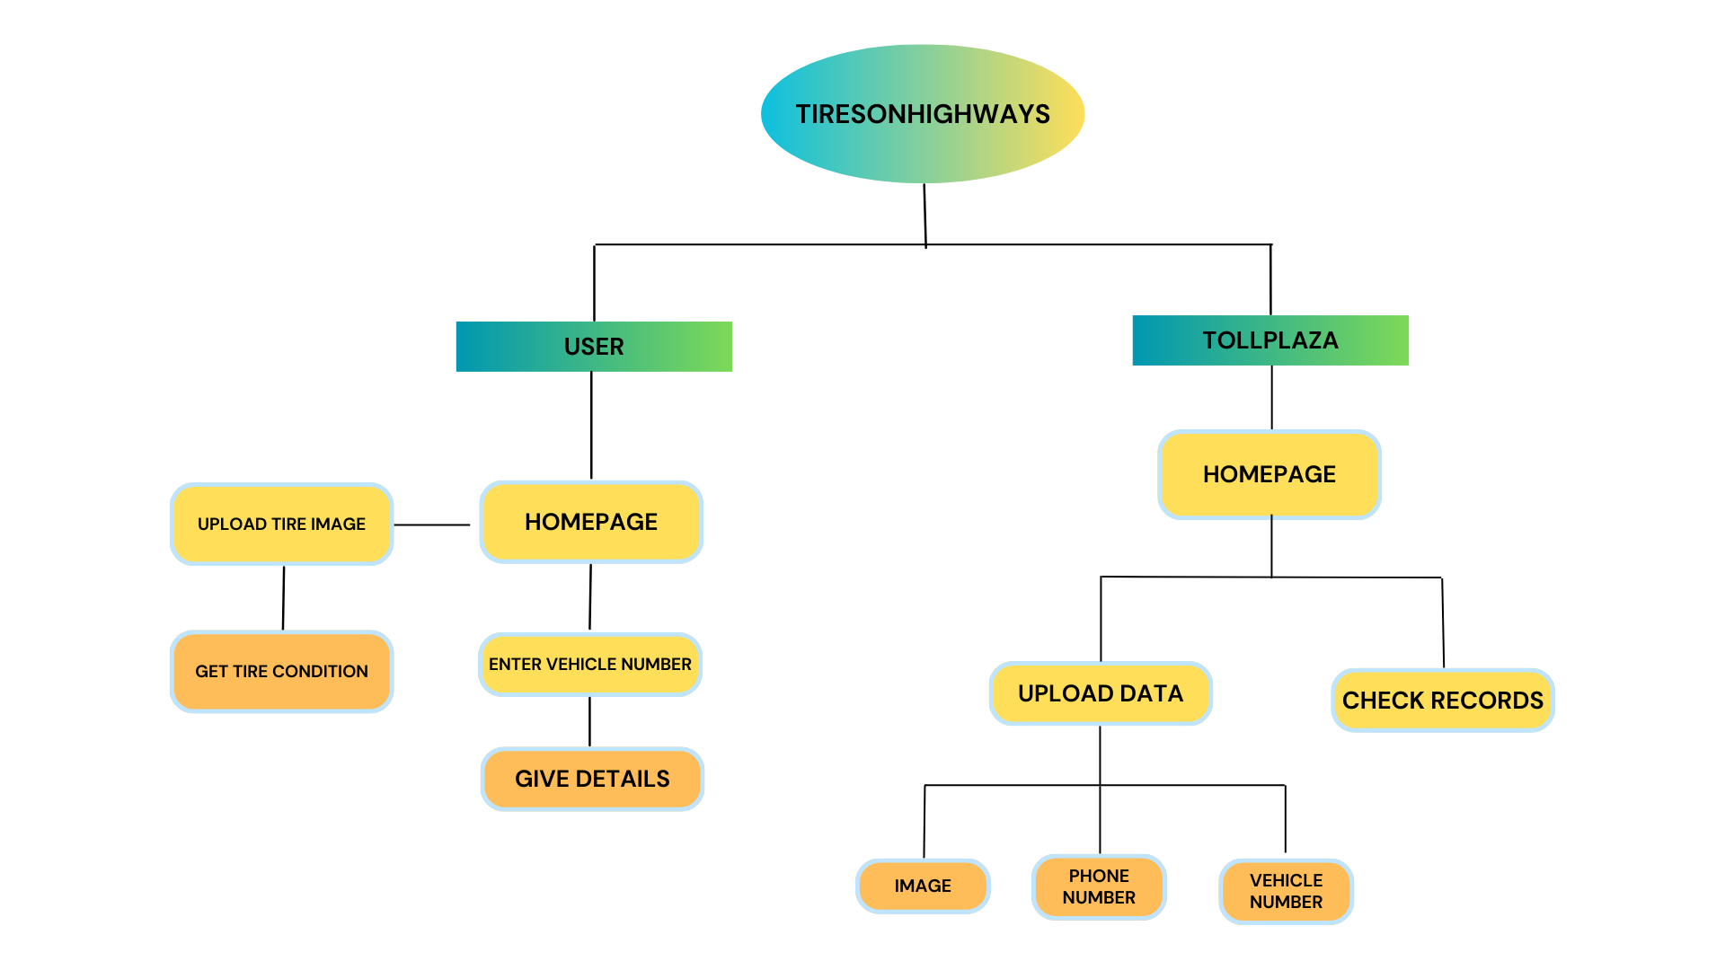

Slide 6
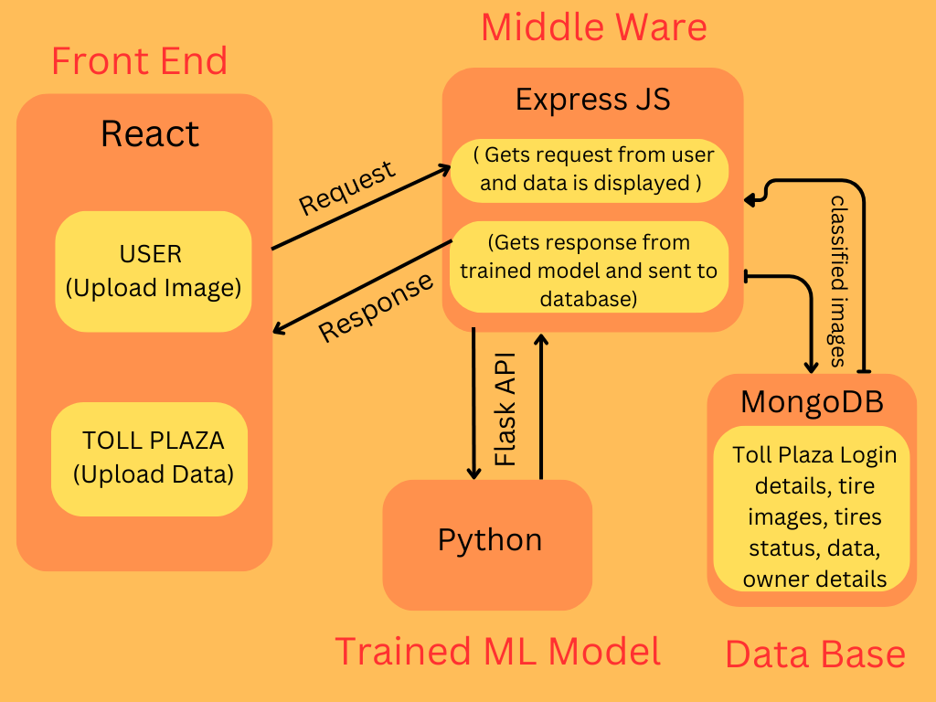
(Backend)

Slide 7
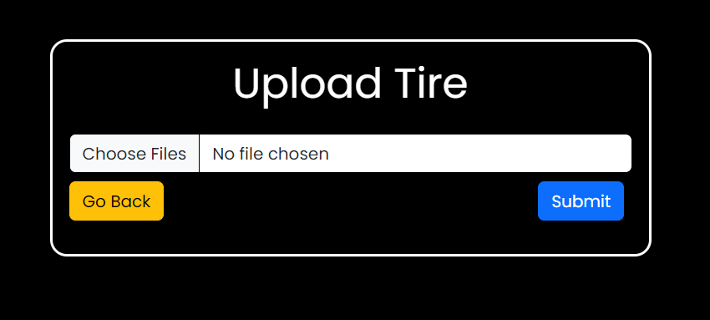
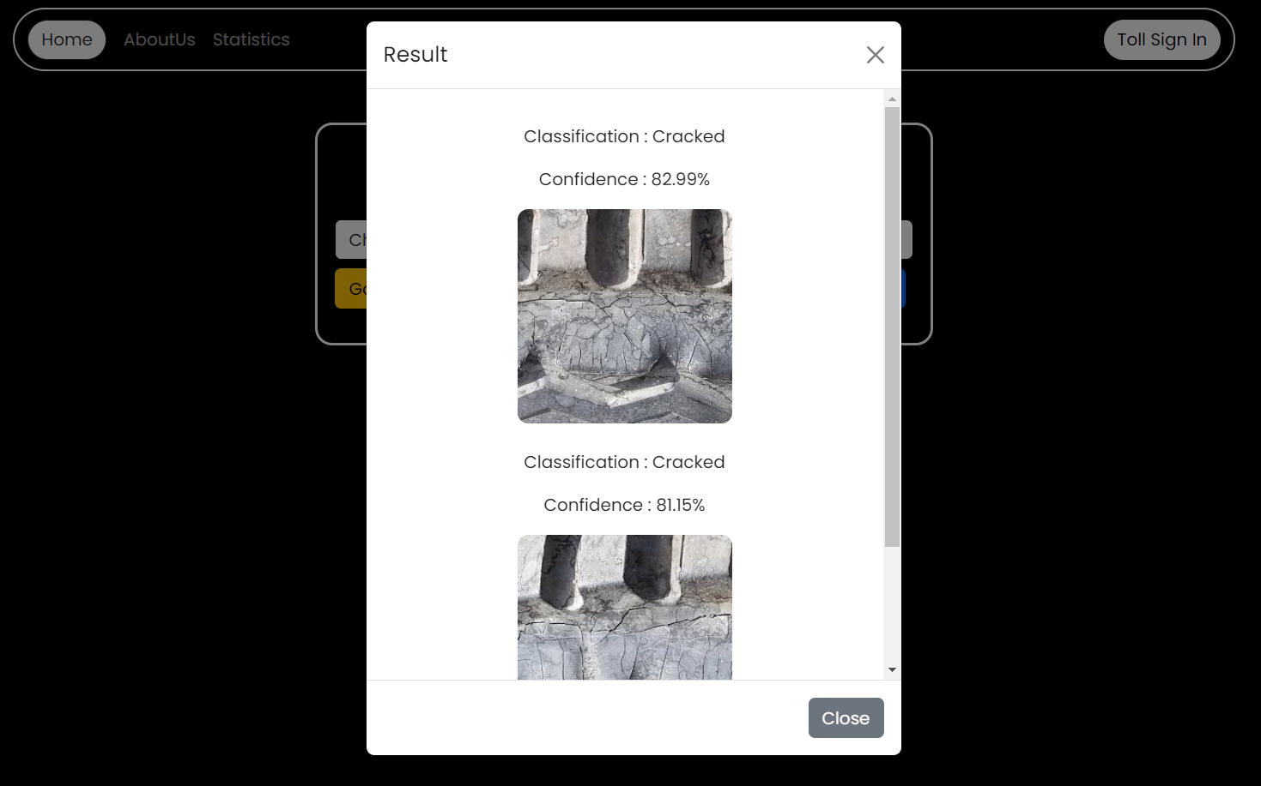
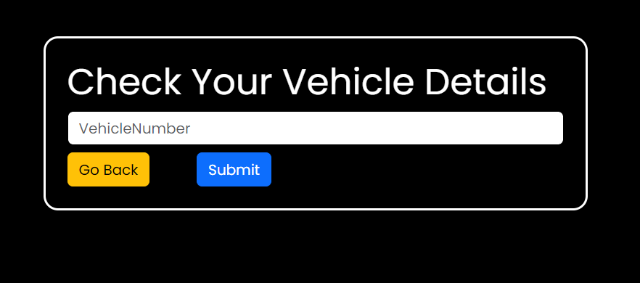
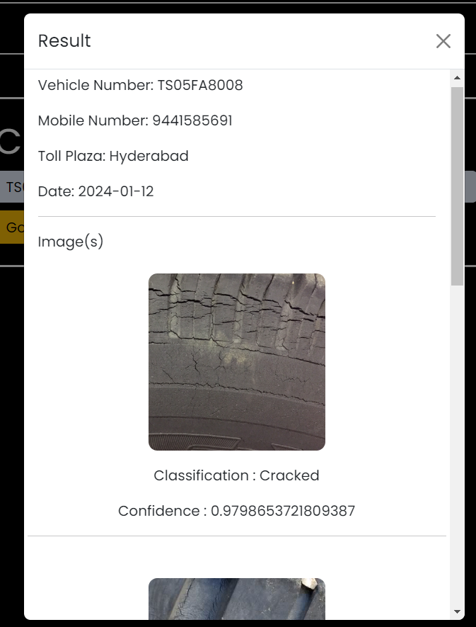
User Upload Interface
User Upload Results
User CheckDetails Interface
User CheckDetails Result

Slide 8
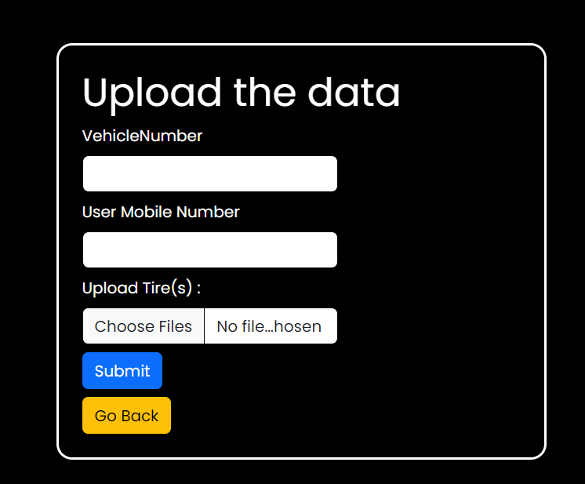
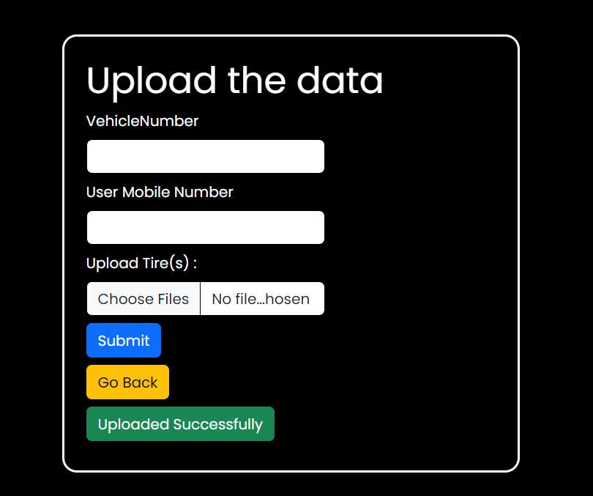


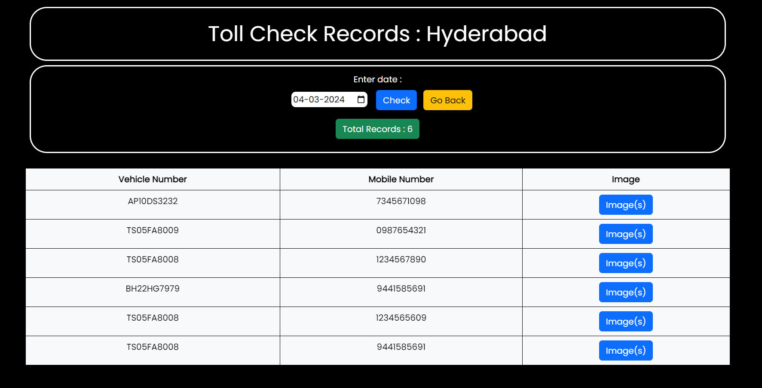
Toll Officer Upload Interface
Toll Officer Upload Result
Toll CheckRecords Interface
Toll CheckRecords Result

Slide 9
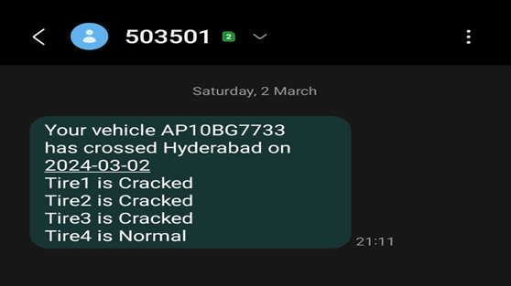
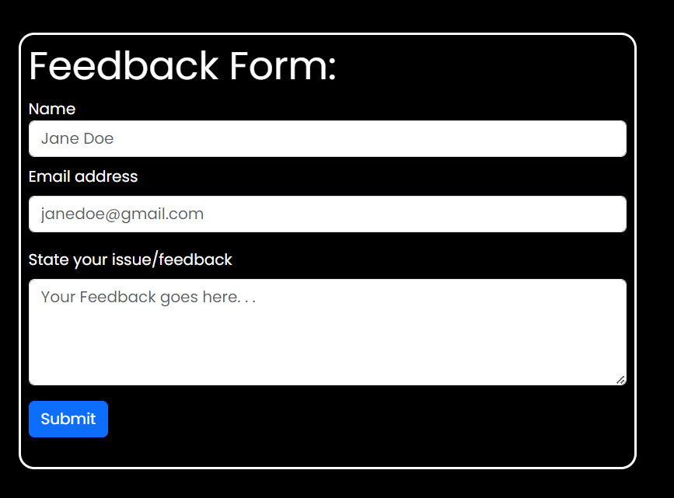
SMS Alert to the vehicle owner after image upload at Toll Plaza
Feedback Form

Slide 10
Thank You

