Slide 1


Tires
On
Highways
Group Id : G81
Group Members :
Varun
Deepak
Gargey
Charan
Shiva
Manoj

Slide 2
Problem Statement :
TSTP administration notes high accident rates due to bad/worn tires on turnpike.
Plan to alert drivers about tire condition:
Cameras at toll plaza capture tire images when vehicles stop.
Toll personnel upload images to TiresOnHighways web app.
WebApp analyzes images, provides feedback on tire condition.
SMS alerts sent to vehicle owners regarding tire status.
Data stored in database for fortnightly check on vehicles with defective tires on highway.

Slide 3

Process Flow
Connection with toll plaza through the website (Toll Login)
Allowing the toll plaza field officer
to upload images of tires, vehicle and mobile numbers of the owner
Classifying the tire images (through the ML model)
Checking the database every fortnight
Alerting the vehicle owner through SMS
Storing the images and their conditions along with the vehicle info in the database

Slide 4
Tech Stack
Frontend
Middleware
Backend
Database
React JS, CSS ,
Bootstrap
Express JS
(nodeJS)
Flask
MongoDB

Slide 5
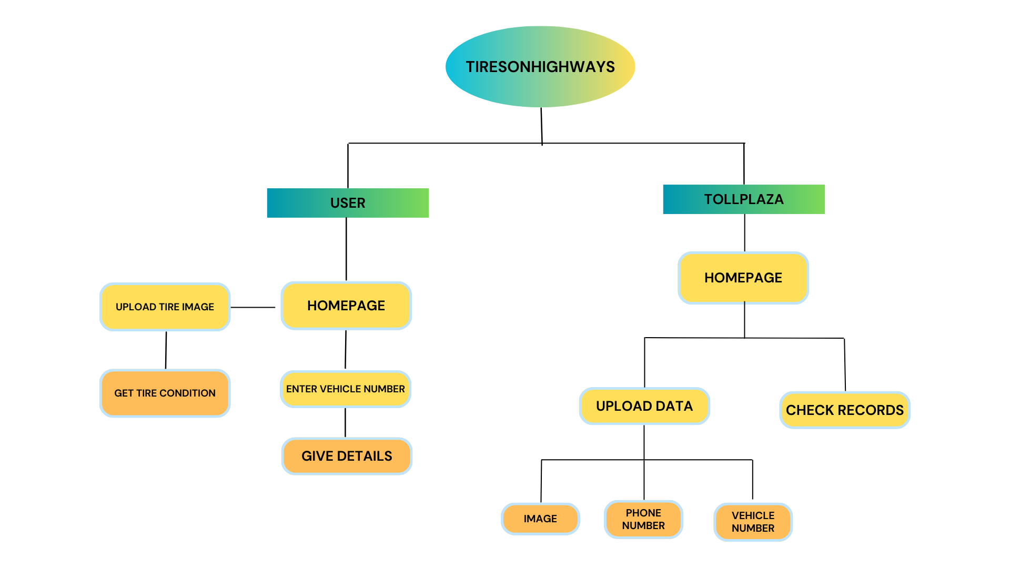

Slide 6
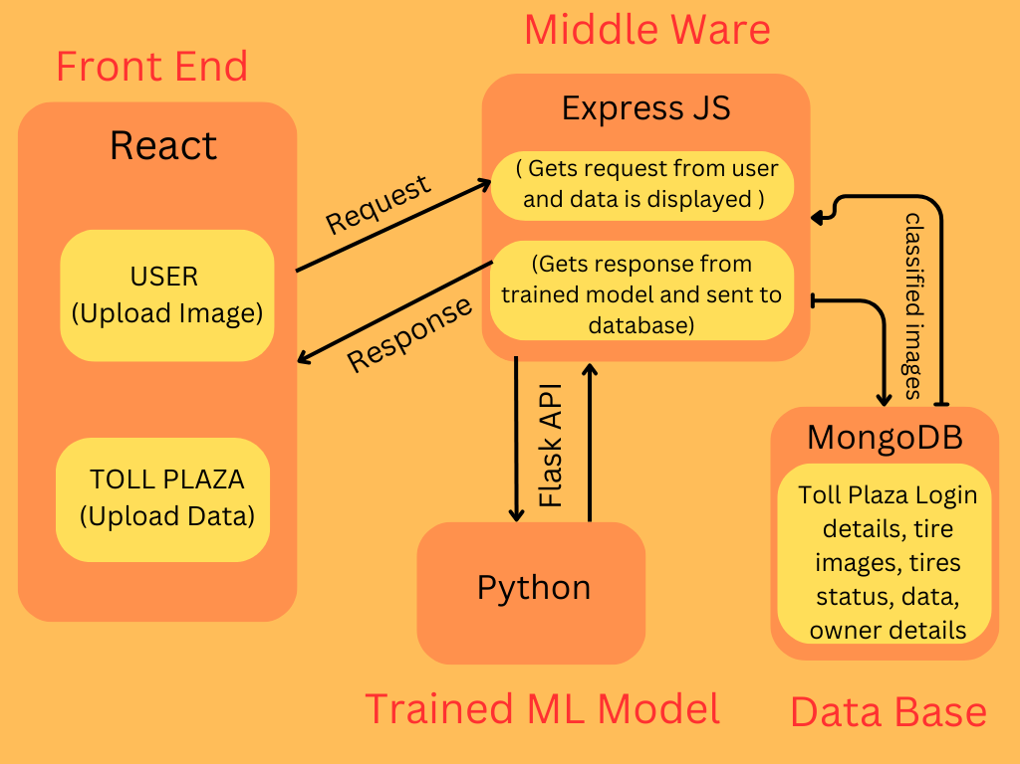
(Backend)

Slide 7
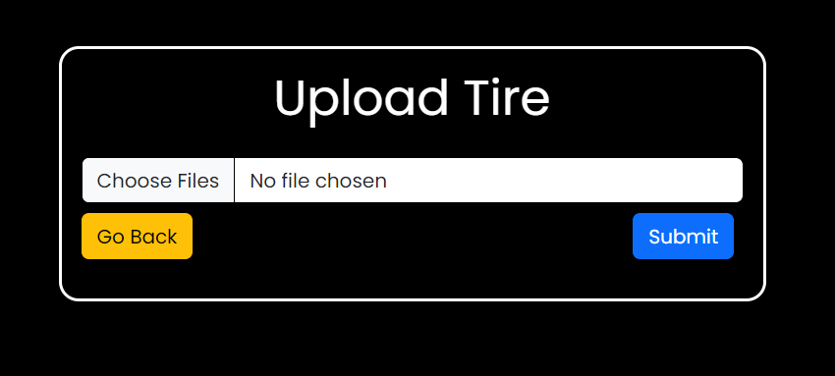
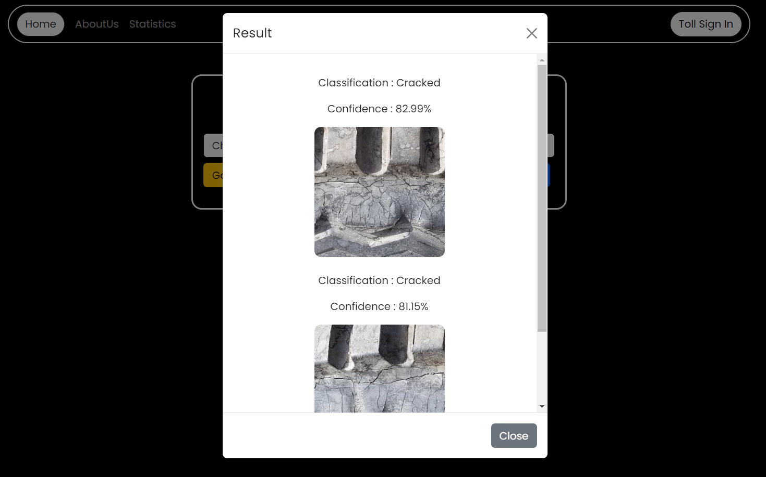
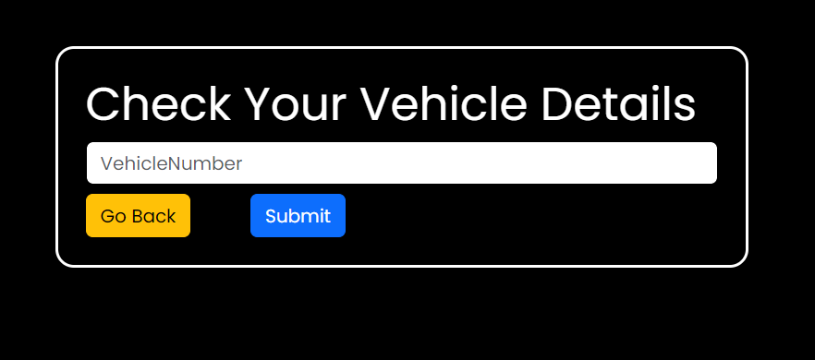
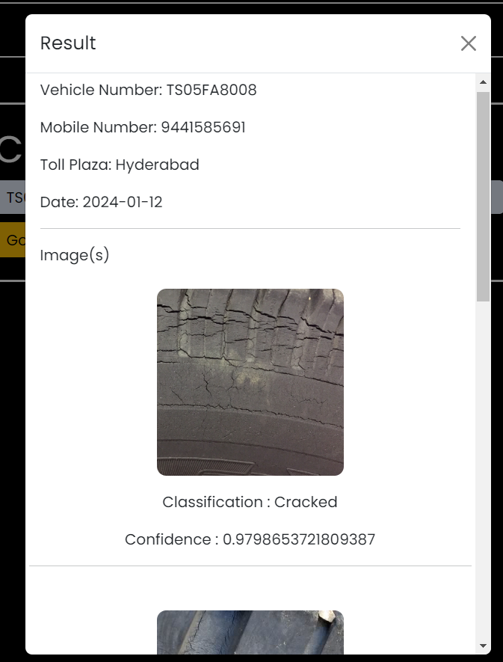
User Upload Interface
User Upload Results
User CheckDetails Interface
User CheckDetails Result

Slide 8
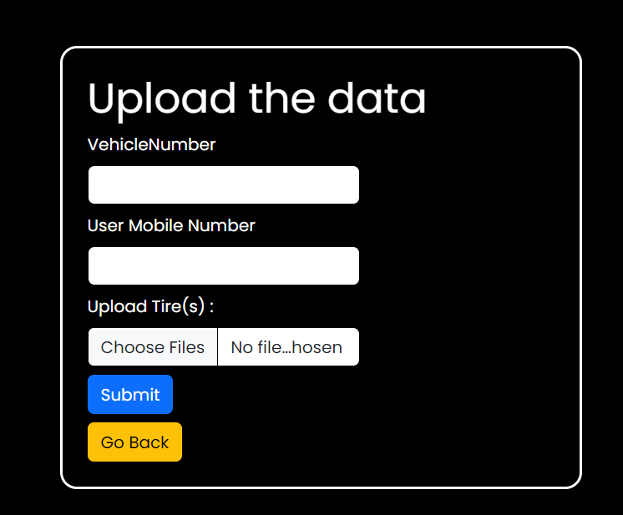
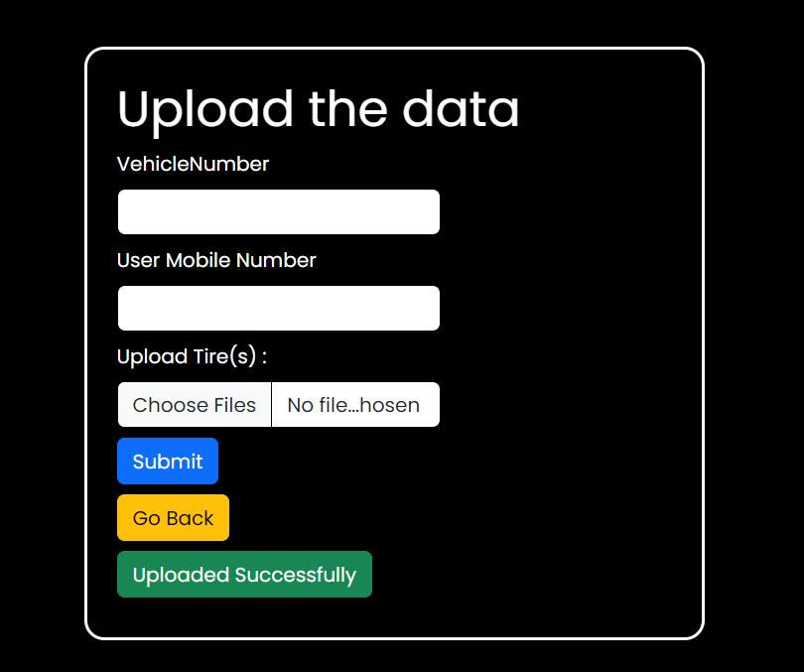


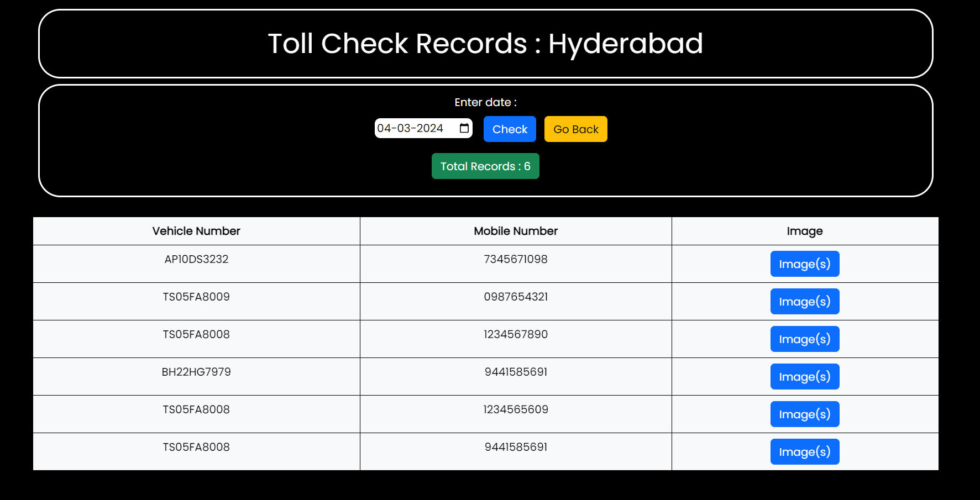
Toll Officer Upload Interface
Toll Officer Upload Result
Toll CheckRecords Interface
Toll CheckRecords Result

Slide 9
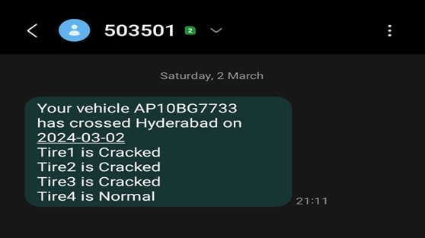
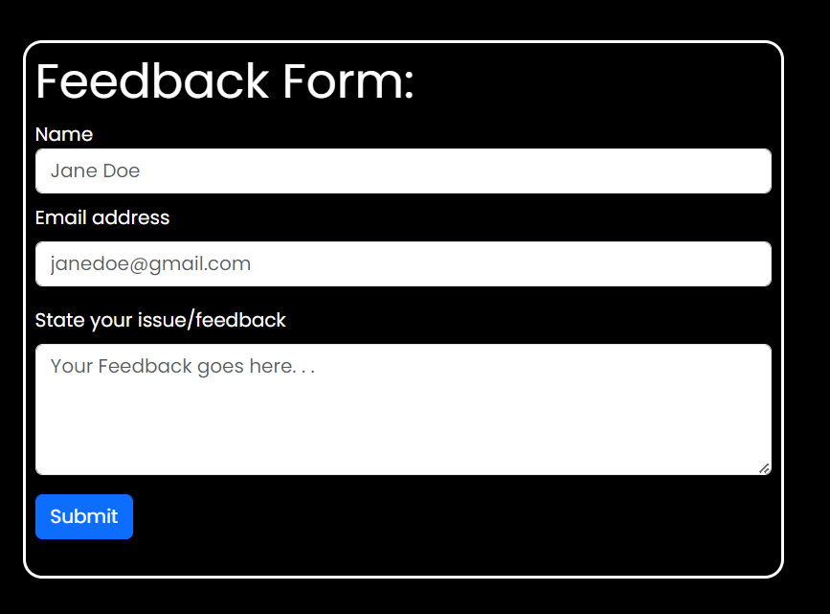
SMS Alert to the vehicle owner after image upload at Toll Plaza
Feedback Form

Slide 10
Thank You

