Slide 1


Tires on
highways
T Varun Reddy
P Deepak
N Sai Gargey
Maruthi Charan
Shiva Sai Charan
PVR Krishna Manoj
Group Id : G81

Slide 2
Problem Statement :
It has come to the attention of TSTP ( Telangana State Turn Pike) administration that a large percent of the accidents on the turn pike are due to bad or worn out tires. They would like to alert the drivers of the vehicles about the state of the tires. When the drivers stop their vehicles at the toll, the cameras present near the ground at the toll plaza will take pictures of the tires and the person at the toll will upload them to the TiresOnHighways web app. The app will then analyze the images and give a feedback
on how bad the tires are.
SMS will be sent to the owner of the vehicle. An SMS will be sent to the official
TireManufacturing company of TSTP who will then get intouch with the owner.
All data that has been submitted needs to be stored in the database so that every fortnight a check will be made to see how many vehicles on highway have defective tires.

Slide 3

Process Flow
Connection with toll plaza and (tires company) through the website
Field Officer uploading vehicle number and phone number of the owner
Allowing the plaza
to upload images
Training the model with given dataset
Checking the database every fortnight
Alerting the vehicle owner through SMS
Storing them in a database if they are “Bad/Worn out”

Slide 4
Tech Stack
Frontend
Backend
Database
React JS, HTML,
CSS ,JS
Node Js, Express Js
MongoDB

Slide 5
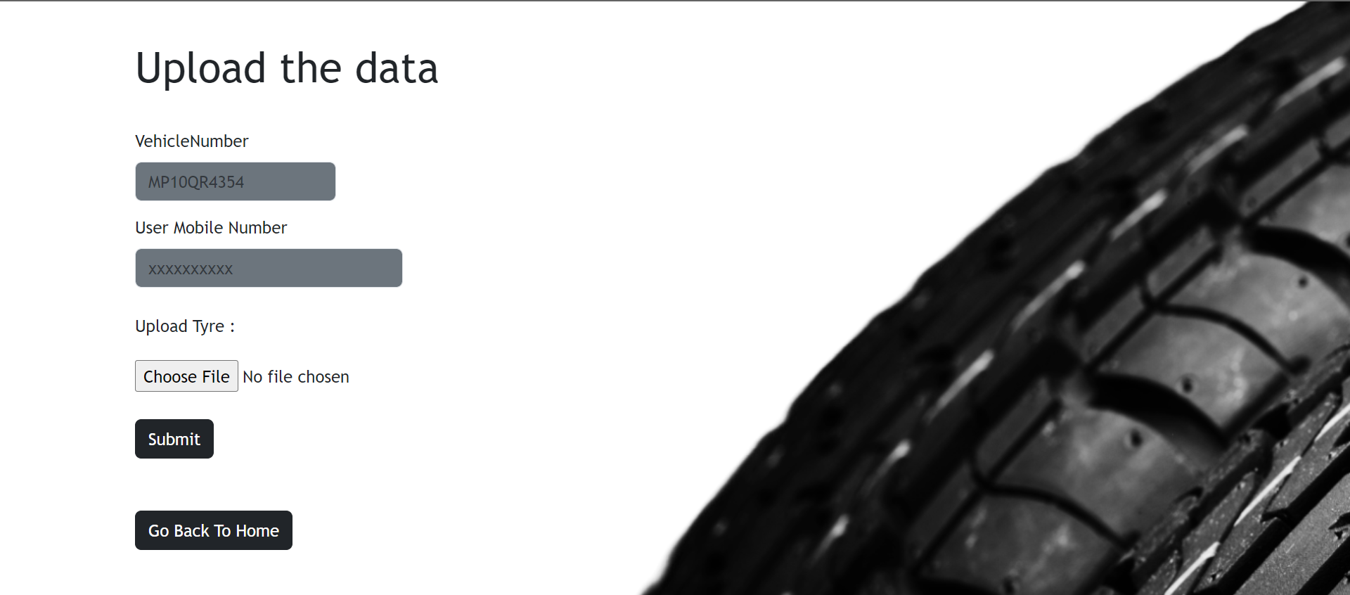
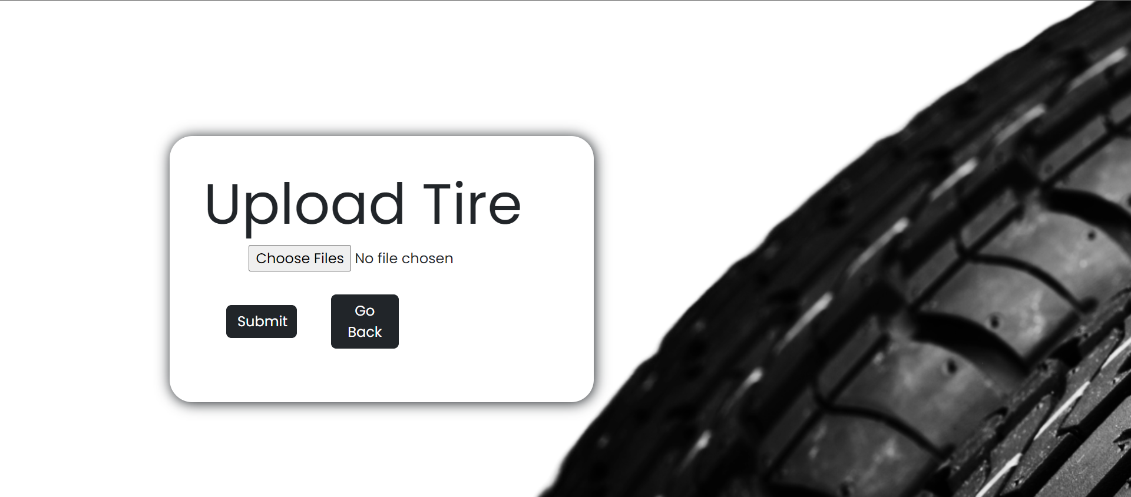
Toll Officer Upload Interface
User Upload Interface

Slide 6
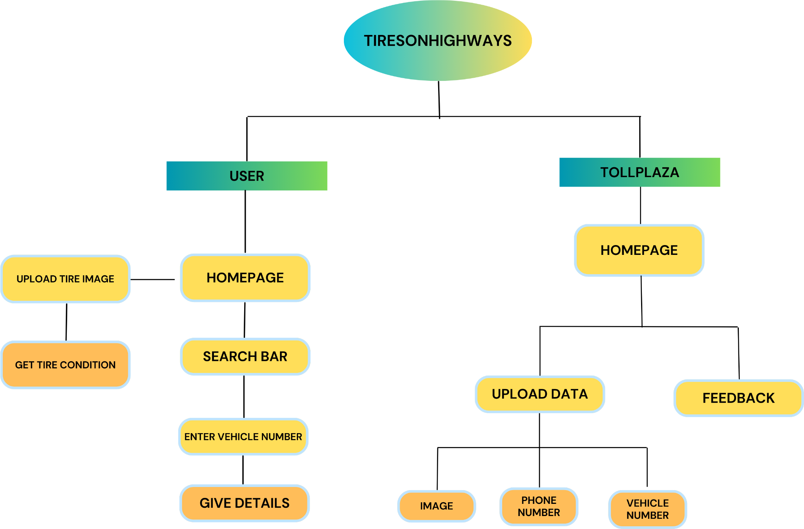

Slide 7
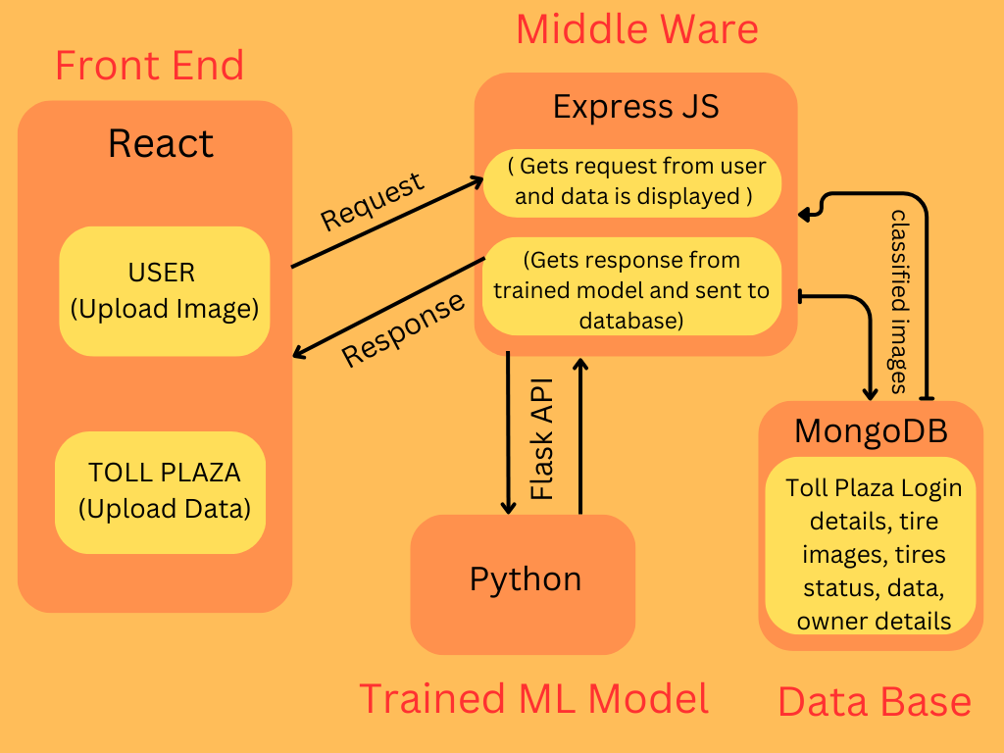

Slide 8
Thank You

