Slide 1
A PROJECT ON FOOD SPOILAGE DETECTION USING ARDUINO
Guidance By
Dr. K. Suresh
M.Tech, PhD
Associate Professor
Department of CSE
From
N. Harisha 17121A05D7
P. Krishna Murali 17121A05G9
R. Sanketh kumar 17121A05H5
P. Yaswanth Reddy 17121A05G3

Slide 2
ABSTRACT
Food safety and hygiene is a major concern in order to prevent the food wastage. The smart phones and raising demands of easy and quick way of solving their day-to-day life tasks, it has become vital to have a technological control over the industrial and the domestic applications using IOT. There are various emerging technologies alongside the internet of things using Arduino which by the way employs the script programming and also the sensors like MQ2 Sensor, moisture sensor, DHT sensor, Arduino UNO etc. Food quality detecting technique can be made by using the sensors along with the Arduino. Refrigeration is one of the essential techniques for food storage that operates by lowering the reproduction rate of the bacteria present in the food.

Slide 3
But at some situations, one may fail to notice the food items that are not used for a long-term storage inside it. Monitoring devices keep a watch on the environmental factor that cause or pace up decay of the food. Keep watch of environmental factors like temperature, humidity, alcohol content and exposure to light.
Food spoilage represents an environmental problem as well as an ethical issue. Sensor assistance can be used to identify the spoilage by continuous sensing is going to solve food spoilage problems. Based on the freshness and quality of food, the food spoilage will be displayed to the user through an alert message that is sent to their registered mobile numbers.

Slide 4
INTRODUCTION
The food can be contaminated due to chemical changes within the food or from storage.
Norovirus, a very contagious virus caused by contaminated food or water. About 351,000 people die of food poisoning globally every year.
An estimated 600 million – almost 1 in 10 people in the world – fall ill after eating contaminated food and 420,000 die every year, resulting in the loss of 33 million healthy life years.
It is necessary to develop a system that can help people to identify the spoiled food items and also freshness of food or quality of food items.
Our system is based on electrical and biosensors. The system monitors the food through the temperature, humidity and light sensors.

Slide 5
The light around the food should not be too bright beacuse it might decay the food. So, LDR sensor is used to prevent this.
The system also monitors the gas levels coming out of the food, when the food is about to get spoiled. The amount of the gas level released from the food is monitored through the gas sensors and converted into analog values to be displayed on the IoT platform to be monitored wherever required.
When the food is spoiled, the owner receives a mail saying that the corresponding food is spoiled.

Slide 6
STATEMENT OF THE PROBLEM
The problem statement is to detect spoiled food using arduino and also to monitor the freshness of the food by various sensors

Slide 7
OBJECTIVES
The primary objective is to detect the spoiled food using arduino uno.
This system also helps us to store fruits and vegetables for longer period of time as the period of freshness can be monitored and determined.
Email alerts.
Sensor data is stored in the cloud, that is in thinkspeak.com
Data visualization using freeboard.io

Slide 8
SOFTWARE AND HARDWARE REQUIREMENTS
SOFTWARE REQUIREMENTS:
Arduino IDE which is open-source.
HARDWARE COMPONENTS:
Arduino Uno
MQ sensors
DTH11 sensor
Nodemcu module
Light Dependent Resistor
Note: More detailed explanation is in SRS document report.

Slide 9
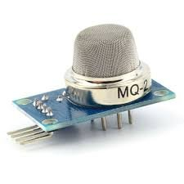
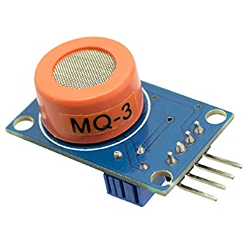
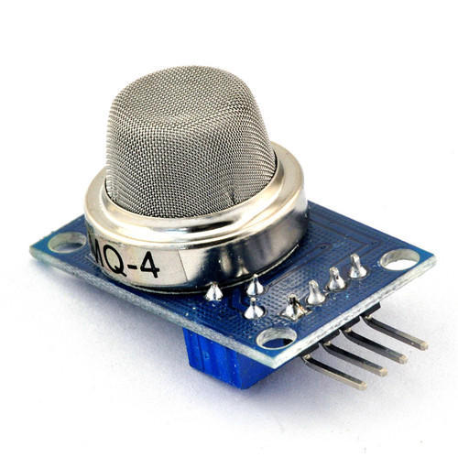
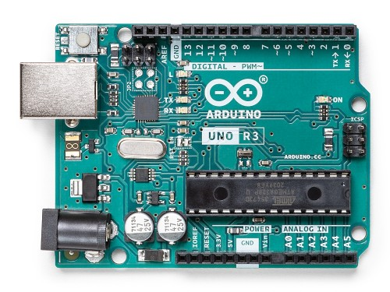
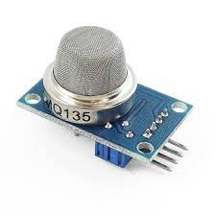
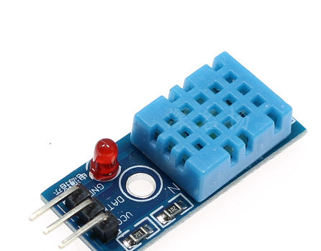
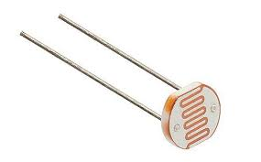
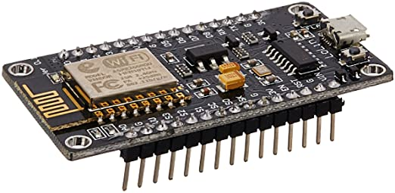

Slide 10
EXISTING SYSTEM
The block diagram of the design is as shown in Project design section. It consists of power supply unit, Arduino microcontroller, Wi-Fi modem, Gas sensor, LDR, DTH11 sensor, LCD.
The sensor collects the alcohol content present in the air. If the alcohol content around the food is more compared to normal,then it is detected as anomaly and the LCD screen indicates that the food is spoiled.
The system is very limited and it is very easy to implement.

Slide 11
SOFTWARE REQUIREMENT SPECIFICATION (SRS) DOCUMENT REPORT
1. PURPOSE:
The purpose of this project is to provide the solution an efficient way to detect the spoiled food
2. Software requirements:
2.1 Arduino IDE:
The software used is arduino IDE which is open-source.
The software also verifies the code and uploads the code in arduino uno.
The software has many inbuilt libraries which makes the developer easy to use and we have also used modules like “DHT-11”, “MQunifiedsensor”, etc...
The main objective of software is to read, process the data and send the output.

Slide 12
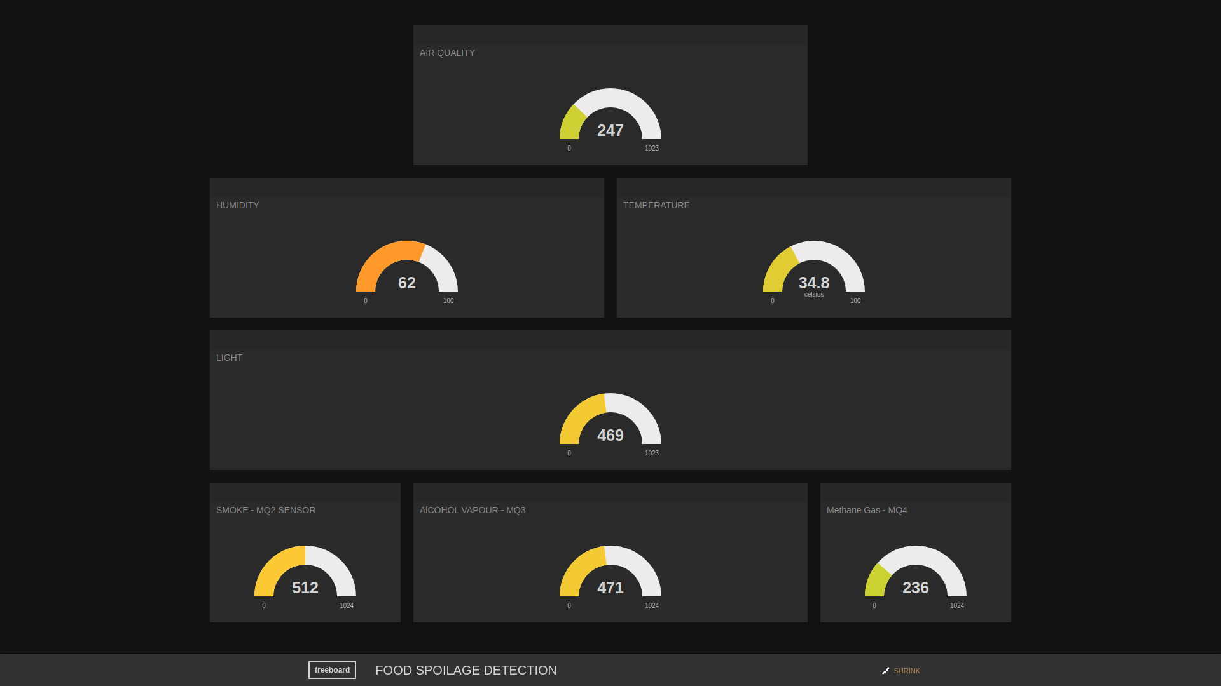
2.2 Web browser for using FREEBOARD:
This is the website which is used to view the collected reading from the arduino. The WiFi module sends the data to the thinkspeak and the freeboard reads the value and aligns all the readings in a beautiful way.
The main objective of freeboard is to align the values in an neat way from which the customer can easily view the reading.
2.3 Operating system:
Mac os, linux or windows.

Slide 13
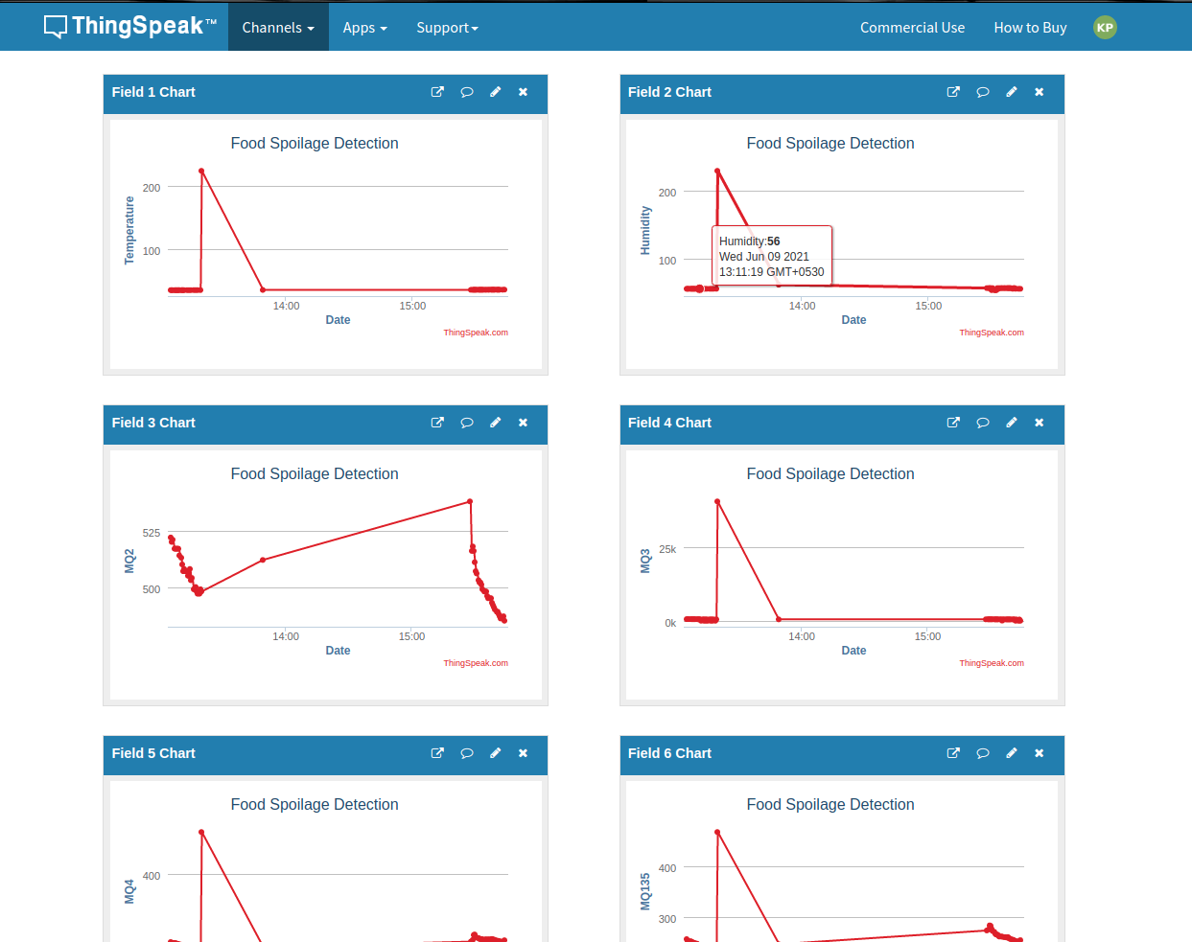

2.4 Web browser for using THINGSPEAK:
ThingSpeak is an IoT analytics platform service that allows you to aggregate, visualize and analyze live data streams in the cloud.
ThingSpeak provides instant visualizations of data posted by your devices to ThingSpeak.
2.5 Web browser for using IFTTT:
IFTTT helps you connect all of your
different apps and devices.

Slide 14
3. Hardware Requirements:
System with i3 processor or higher
2gb of RAM or higher
1gb space in hard disk
Arduino Uno
Gas sensors – MQ-2, MQ-3, MQ-4, MQ-135
DTH11 sensor
nodemcu module
Light Dependent Resistor

Slide 15
PROPOSED SYSTEM
We have used the same existing system with little modifications. In order to detect all kinds of food spoilage, we are using a series of MQ sensors. In the existing system, they have used only MQ2 sensor which detects Methane, Butane, LPG, smoke. But, in the proposed system we are using MQ-3, MQ-4, MQ-135.
System also detects the air quality surrounded by the food using MQ-135 sensor. By this sensor, we can predict whether the food is spoiled or not and we can send an alert message saying that the food about to be spoiled.
System also sends email notification, and also updates the reading of the sensor on server so that the customer can see review anytime.

Slide 16
LCD screen is also attached to view directly from the system.
Optional:
Adding GPS tracker module to know the current location of a particular system if we are using two or more systems.
When the food is spoiled, the system sends a photo of the spoiled food
SENSORS | DESCRIPTION
MQ-2 | Methane, Butane, LPG, smoke
MQ-3 | Alcohol, Ethanol, smoke
MQ-4 | Methane, CNG Gas
MQ-135 | CO, Ammonia, Benzene, Alcohol, smoke

Slide 17
For example,
When meat and fish are rotted, ammonia, amides, and other nitrogen substances and gases (e.g., NOx) are released because of the protein in meat. Similarly is the case about garlic. These gases can be detected using MQ-135.
When eggs rots, sulfur-containing substances, such as SH2 and SO2 are produced and released. That is due to the presence of sulfur compounds in eggs. These gases can be detected using MQ-136.

Slide 18
APPROACH USED
Sensors reads the values from the food and environment. A certain threshold is maintained for each sensor and if the sensor reads the value above the threshold value, then an alert message is send to the customer.
Firstly, the system always check the air quality, temperature, humidity and light, if there is any unbalance, then the system sends and alert message saying that the air quality around the food is not good and the food is about to spoil.
If the customer neglects the alert message, then after a certain time gases will be released from the spoiled food and the corresponding MQ sensor detects it and informs the customer that the food is spoiled.
The system also reads the temperature and humidity constantly.
Constant updates on the server is done.

Slide 19
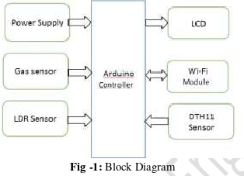
PROJECT DESIGN
Block Diagram of existing system:

Slide 20
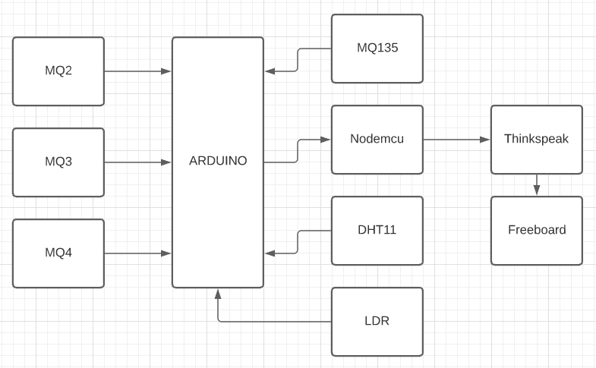
Block Diagram of proposed system:

Slide 21
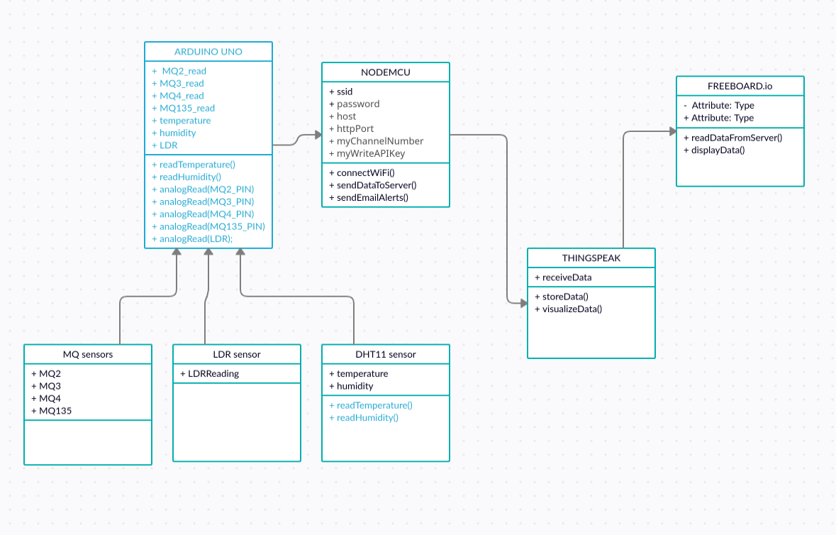
UML Diagram:

Slide 22
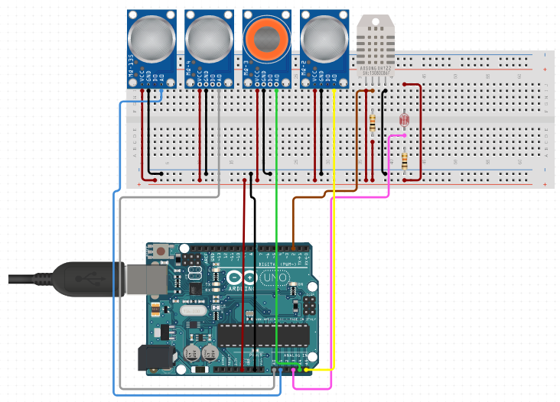
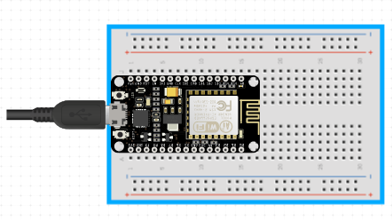
circuit diagram:

Slide 23
PROGRAM CODE AND EXPLANATION
Complete project code is available on:
https://github.com/krishnamurali1999/Food-Spoilage-Detection

Slide 24
CONCLUSION
We are trying to rectify the disadvantages in the existing system. We are detecting various gases like Ammonia, Benzene, Alcohol, smoke, methane, etc.. which causes food spoilage. Using sensors to detect the presence of these gases among foods can help detect food spoilage early and prevent consumption of spoiled food.
The data which is stored in the cloud can be downloaded as a csv file and which can be used to train the machine learning and deep learning models.

Slide 25
REFERENCES
[1]Yousefi H., Ali M M., Su H M., Filipe C D., and Didar T F.( 2018). Sentinel wraps: Real-time monitoring of food contamination by printing dnazyme probes on food
packaging. ACS Nano, (pp. 3287–3294)
[2] Min C., Jiafu W., and Fang L. (2012). Machine-to-machine communications: Architectures, standards and applications. KSII Trans. Internet Inf. Syst, (pp. 480–497)
[3]Wisitsoraat A., Tuantranont Comini E., Sberveglieri G., and Wlodarski W. (2009). Characterization of n-type and p-type semiconductor gas sensors based on NiOx doped TiO2 thin films, Thin Solid Films, (pp. 2775–2780)
[4]Abdullah M Z., Aziz S A., and Dos Mohamed A M. (2000). Quality inspection of bakery products using a color-based machine vision system, Journal of Food
Quality, (pp. 39–50)
[5]Syeda Erfana Zohora A M., Khan A K., Srivastava A. (2013). Electronic Noses Application to Food Analysis Using Metal Oxide Sensors: A Review, Journal of Soft Computing and Engineering, (pp. 79–84)

Slide 26


