Slide 1
Neural Networks - Foundation

Slide 2
Agenda
Why Neural Networks?
Introduction to a simple Neural Network
Components of a Neural Network
How a Neural Network is trained
Hands-on: Image classification problem using TensorFlow

Slide 3
Background – Why Neural Networks?
Unable to solve complex problems using generic algorithms
Recognizing a human face
Computer Vision
Commonly used in pattern identification related use cases
Identification of features is difficult or complex

Slide 4
What is a Neural Network?
A Neural Network is a computational network inspired by the study of biological neural processing
Ref.: Neural Networks & Fuzzy Logic, Dr. Valluru B Rao and Hyagirva V Rao

Slide 5
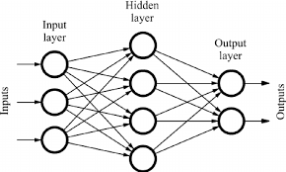
A Simple Neural Network

Slide 6
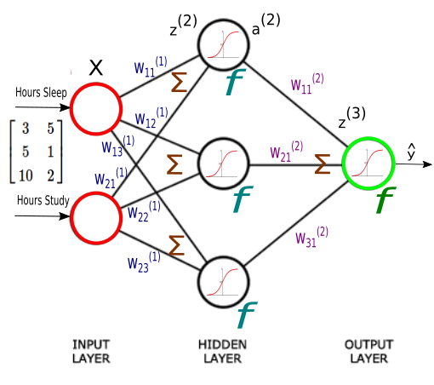
What is a simple Neural Network made up of ?
Layers
Layers consist of a group of individual processing units i.e nodes or neurons
Classified as ..
Input
Hidden
Output
Weights
Nodes/Neurons
Processing Unit
Loss Function
Optimization Function
http://www.bogotobogo.com/python/scikit-learn/Artificial-Neural-Network-ANN-2-Forward-Propagation.php

Slide 7
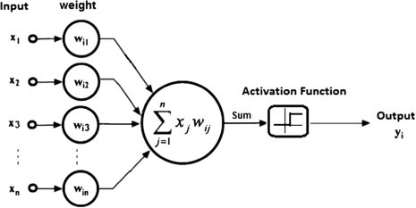
What does each node do?

Slide 8
Components of a node
Consists of 2 parts
Summation function
Used for calculating the weighted sum of inputs
Eg. Linear Regression algorithm
z = w * x + b

Slide 9
Components of a node
Activation function
Also known as Threshold function / Transfer function
What is the use of Activation Function?
Used to make NN learn complex problems
Adds non-linear properties to the NN
Transforms output of summation function to a value in specific range

Slide 10
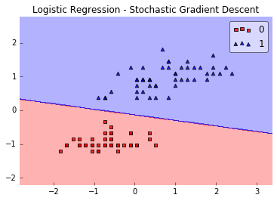
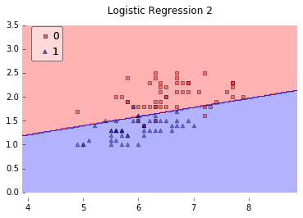
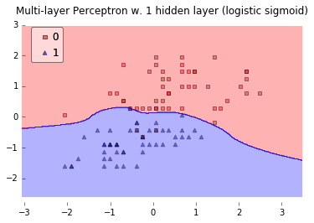
Activation Function

Slide 11
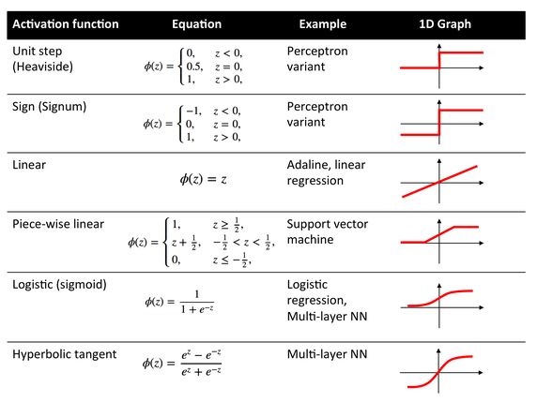
https://www.kdnuggets.com/2016/08/role-activation-function-neural-network.html

Slide 12
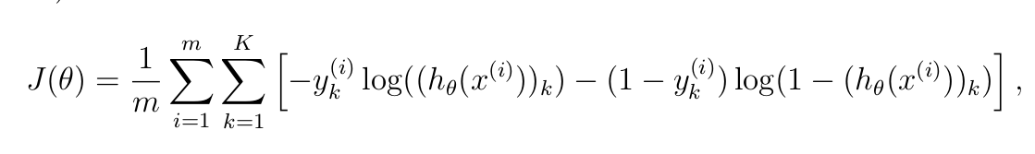
Loss Function
Also called as Cost Function
This is used to quantify the error between the predicted value vs the actual value
Impacts the network’s performance
Ex.
Mean Squared Error
Cross entropy Loss

Slide 13
Optimization Function
Used to correct the weights based on the outcome of loss function
The impacts the performance of the network
Ex.
Stochastic Gradient Descent
Mini Batch Gradient Descent
Adam
AdaDelta
AdaGrad

Slide 14
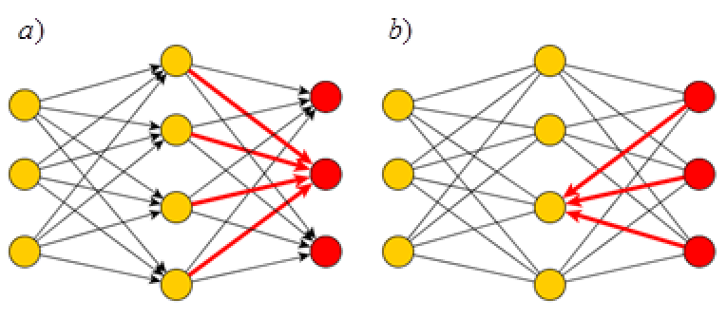
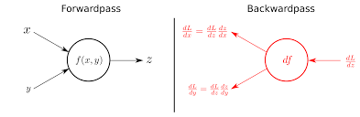
How to train a Neural Network?
Consists of 2 Phases
Forward propagation
Backward propagation

Slide 15
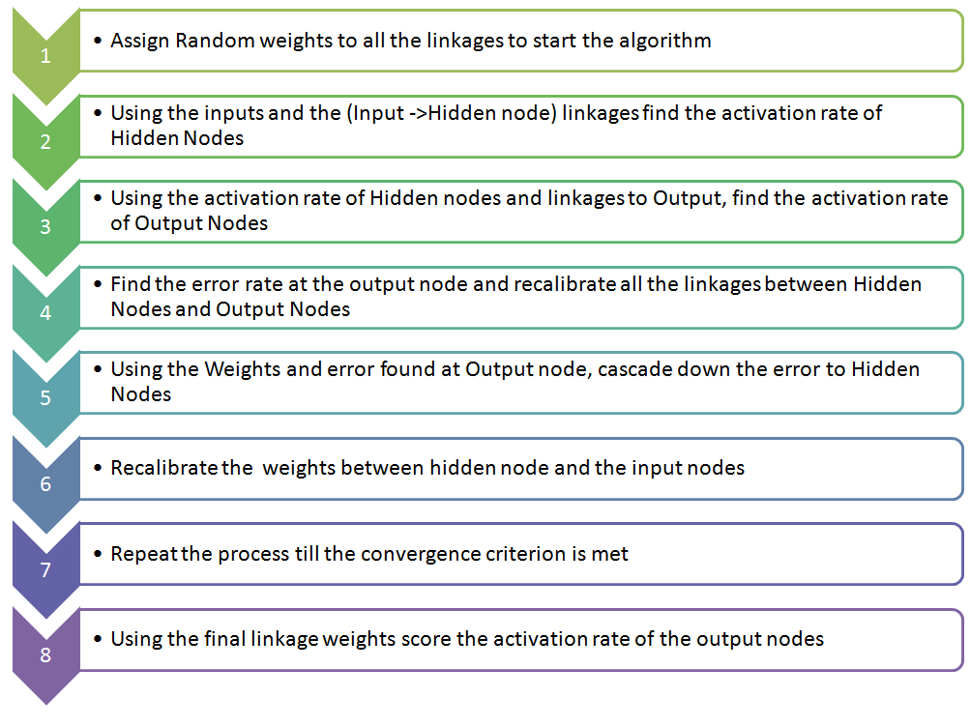
How to train a Neural Network? – Putting it together
Ref. : https://www.analyticsvidhya.com/blog/2014/10/ann-work-simplified/

Slide 16
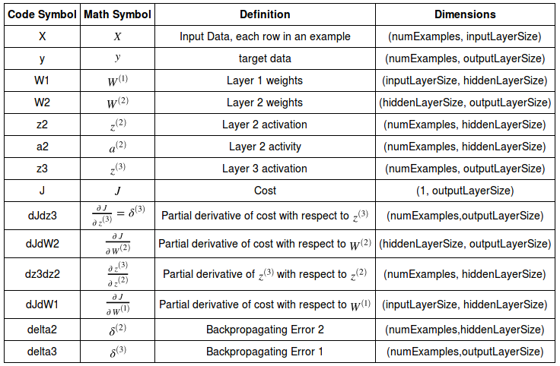
Example Definitions for a NN with 3 layers, 2 input nodes and 1 output node

Slide 17
Characteristics of Neural Network
No. of Layers
No. of Nodes
Activation Function
Learning Algorithm
Learning rate

Slide 18
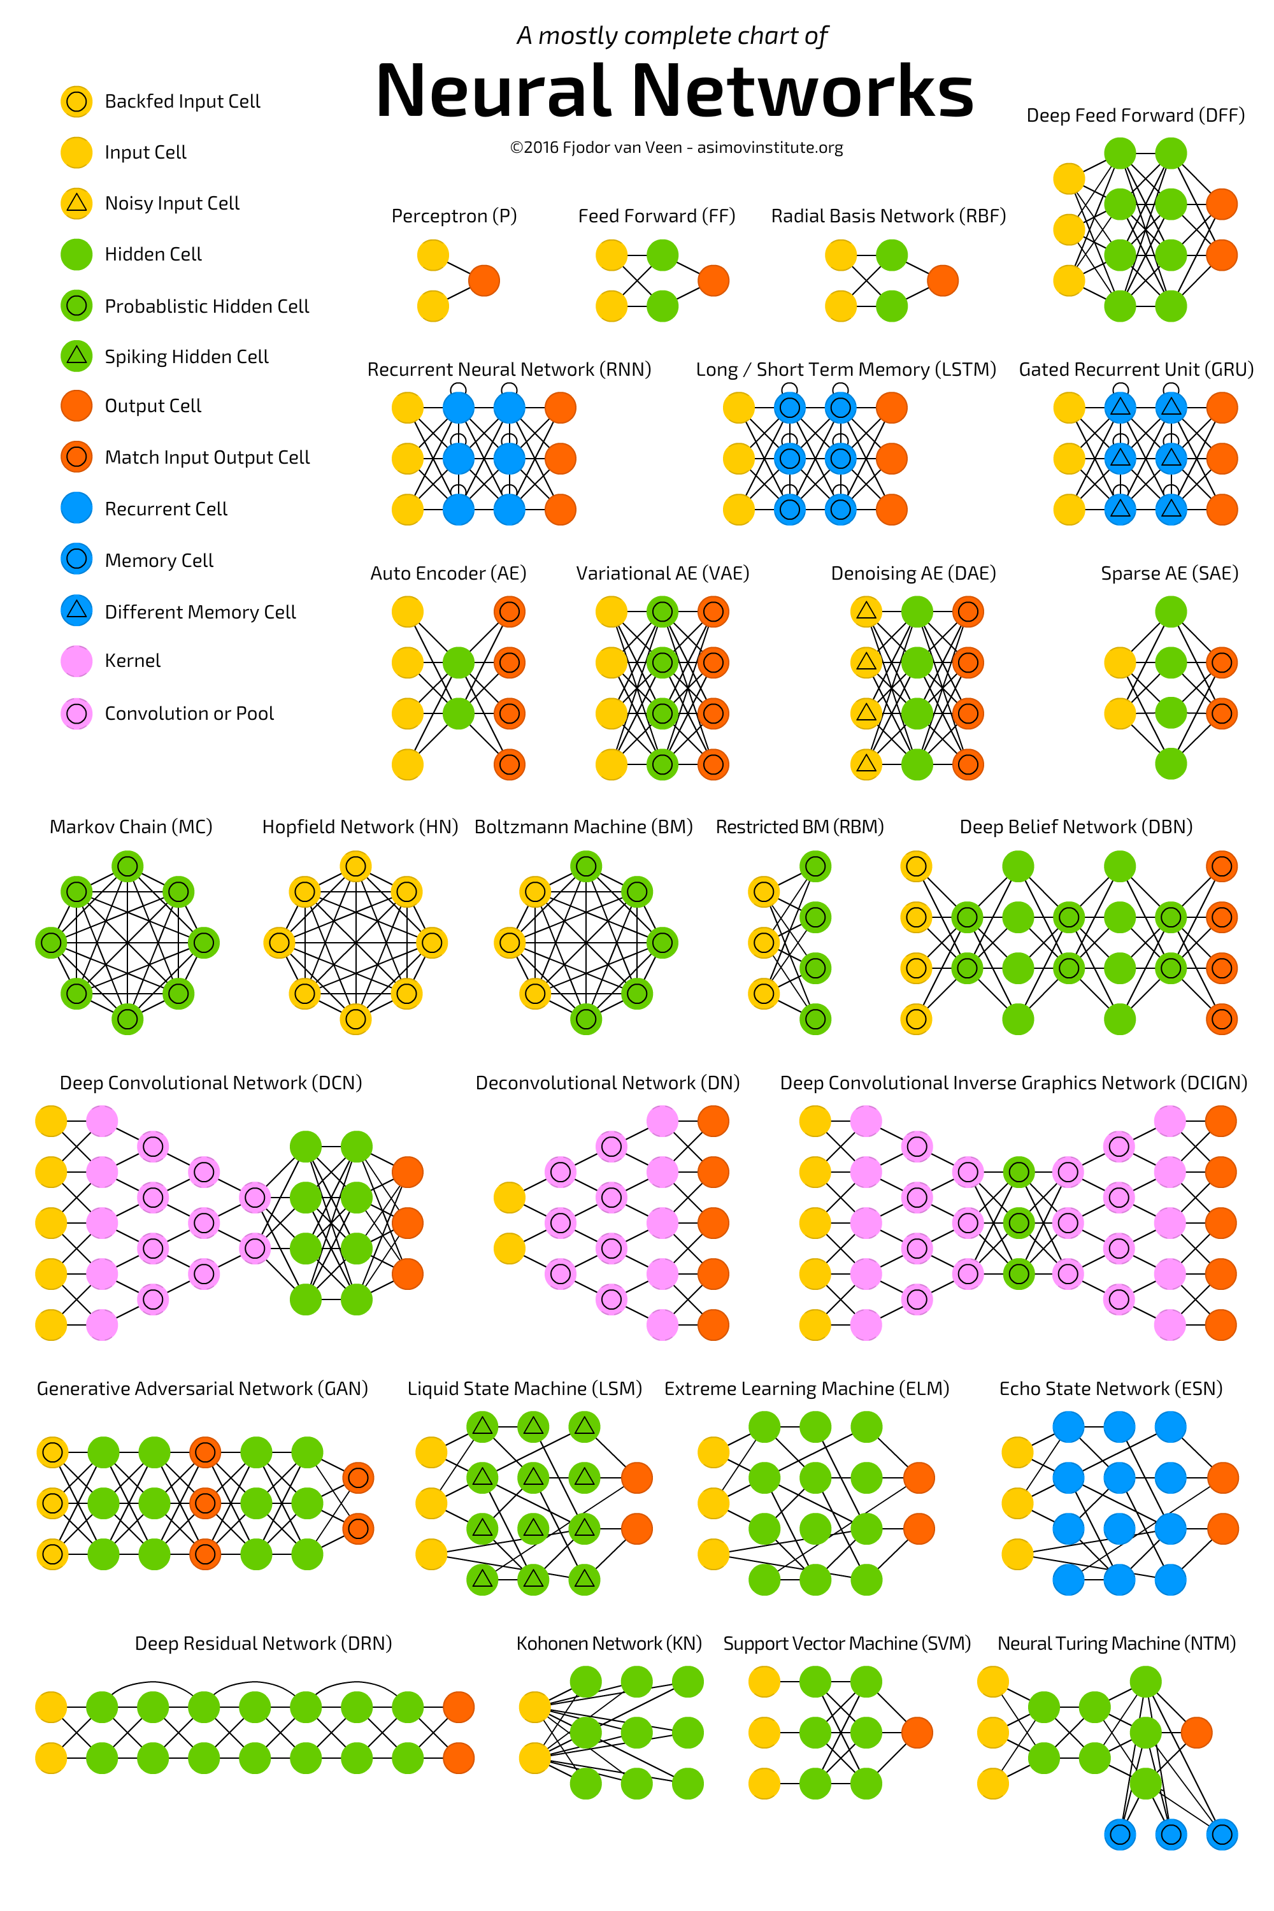

Slide 19
Image Classification Example using TensorFlow

