Slide 1
How to evaluate a classification model and tune it? PART - 1

Slide 2
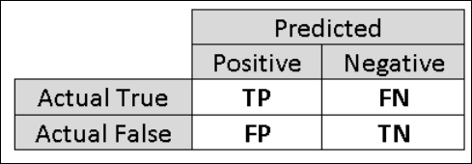
Understanding the outcome of a classification problem - Confusion Matrix

Slide 3
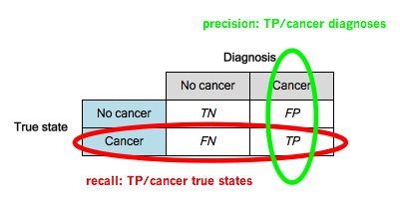

Slide 4
Metrics used to measure classification model performance
Accuracy
Average of correct predictions made by the model
Precision or Positive Predictive Value
How many positive cases are actually correct
P = TP/(TP+FP)
Ref.: https://www.quora.com/What-is-the-best-way-to-understand-the-terms-precision-and-recall

Slide 5
Metrics used to measure classification model performance
Recall or Sensitivity
How many positive cases did we miss to predict correctly
R = TP/(TP + FN)
Specificity
How many actual negative cases did we predict correctly
S = TN/(TN + FP)
Ref.: https://www.quora.com/What-is-the-best-way-to-understand-the-terms-precision-and-recall

Slide 6
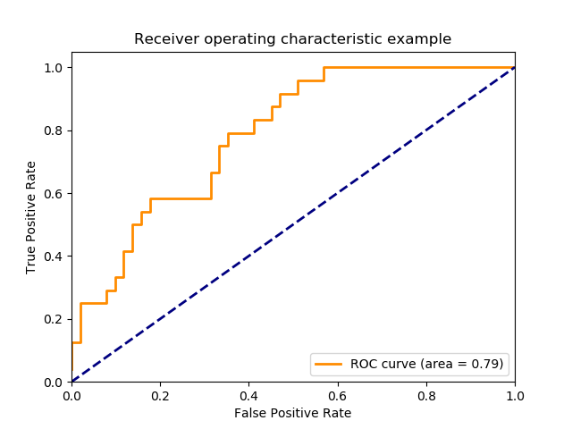
Metrics used to measure classification model performance
ROC curve and AUC
Receiver Operating Characteristic curve
Area Under (ROC) Curve
ROC = True Positive Rate Vs False Positive Rate
Closer the curve is to the upper left corner = Good
Ref.: http://scikit-learn.org/stable/auto_examples/model_selection/plot_roc.html

Slide 7
Metrics used to measure classification model performance
F1 - Score
Calculated based on Precision and Recall
Weighted average of Precision and Recall
Best score = 1
Worst score = 0
F1 = 2 * (precision * recall) / (precision + recall)
Ref.: http://scikit-learn.org/stable/modules/generated/sklearn.metrics.f1_score.html

Slide 8
What are the symptoms of bad classification model?
Wrong predictions with training data and testing data
Under fitting , High Bias
Correct predictions with training data but wrong predictions with testing data
Overfitting, High Variance
Unacceptable Precision, Sensitivity and Specificity proportions – Depends on the problem domain
Low AUC, F1-Score value
Etc.

Slide 9
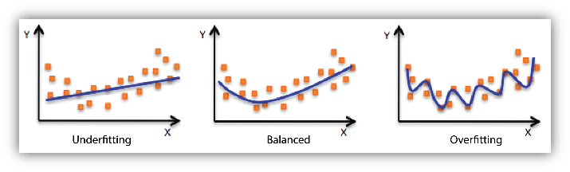
Over fitting and under fitting
Ref. : https://docs.aws.amazon.com/machine-learning/latest/dg/model-fit-underfitting-vs-overfitting.html

Slide 10
Reasons for under fitting & how to avoid it
Signifies a training performance issue
May be there is less training data. Train with more data
May be the features that we chose are insufficient or not related enough to the target. Should revisit feature engineering
May be the algorithm that we chose does not suite the data. Try different algorithms

Slide 11
Reasons for over fitting & how to avoid it
May be a training data set quality issue – not a good mix of data. Ensure training data contains required mix of data
May be there is less training data. Get more training data else use cross validation technique to train model.
May be there are too many features. Revisit feature selection.
Model could not generalize from patterns observed in the training data.
Tune the model’s hyper parameters
Try different regularization methods
Try using Ensembling method – combining predictions from multiple separate models
Use techniques like early stopping, drop outs etc.

