Slide 1

Developing a C++ based driver for ENS160 Sensor for mbed LPC1768
Team Members: Poorvi Bhaskar - A Shreyaa Senthilnathan - A Surya Senthilkumar Shanthi - A Venkata Siva Krishna Madala - A

Slide 2
Introduction
In our lab experiments we used a lot of Libraries from the mbed community. We wanted contribute back to them and hone our C++ skills.
We narrowed down on the SparkFun Qwiic ENS160 Air Quality Sensor as it was very recently launched and would be significantly challenging to write a C++ based I2C driver for mbed board.
We also planned on extending our driver to Raspberry Pi 4 Model B and Raspberry Pi Pico. We worked on the Pi Pico driver but faced multiple issues trying to debug it.

Slide 3
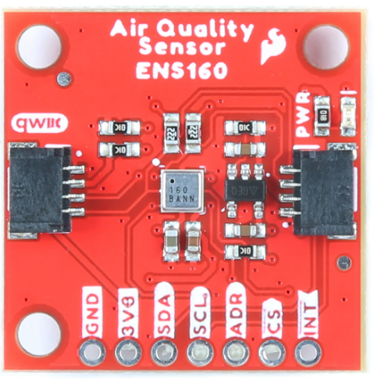
List of Parts and Tools Used
ENS160 Sensor
Mbed LPC 1768
LCD Display(uLCD – 144G2)
Push button
Jumper Wires(M/M)
Breadboard
Connections
Mbed | Sensor | LCD Display | Pushbutton
5V = VU | +5V | +5V
GND | GND | GND | GND
p9 | SDA
p10 | SCL
p8 |  |  | Pin
p27 |  | RX
p28 |  | TX
p30 |  | RES
Tools
MBED Online Compiler
Pi Pico C++ SDK 1.4.0
GNU ARM Toolchain 11.2.0
CMake 3.25
Visual Studio Code 1.74
Git for Windows

Slide 4
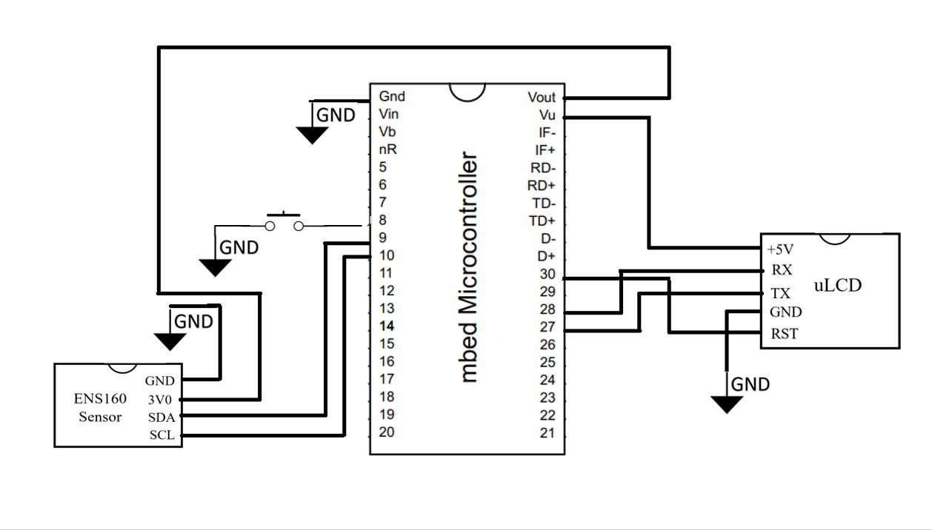
Schematic

Slide 5
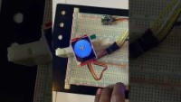
Demo

Slide 6
Future Work
Extending the driver to Raspberry Pi 4 B.
Debug and complete the driver for Pi Pico after issues surrounding the TinyUSB based printf’s are resolved.
We hope to inspire future students to follow our footsteps and contribute to both the mbed and open-source community with high quality libraries for commercially available sensors.

