Slide 1
Predicting Customer Behaviour
By Krishnan Srinivas

Slide 2
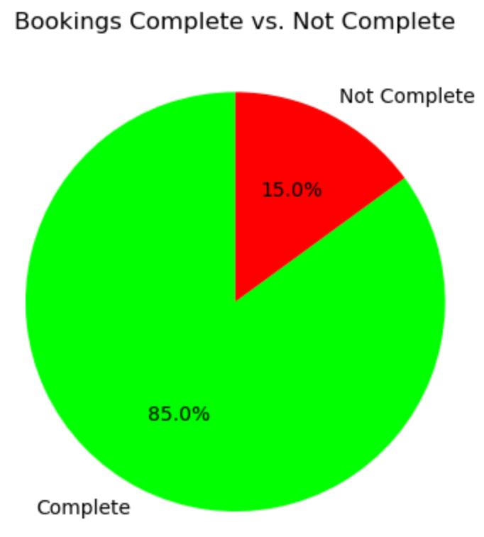
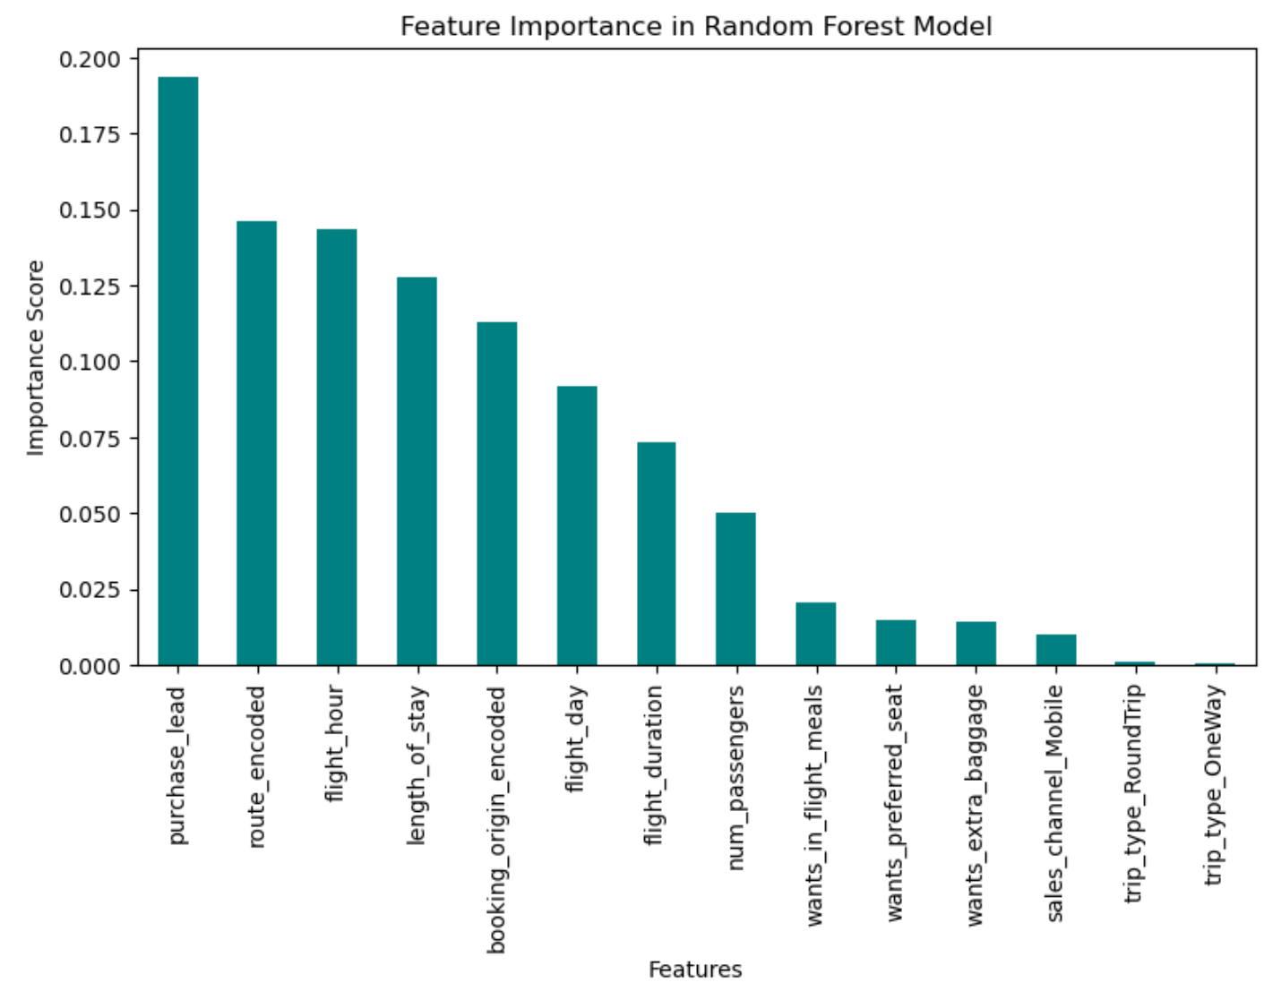
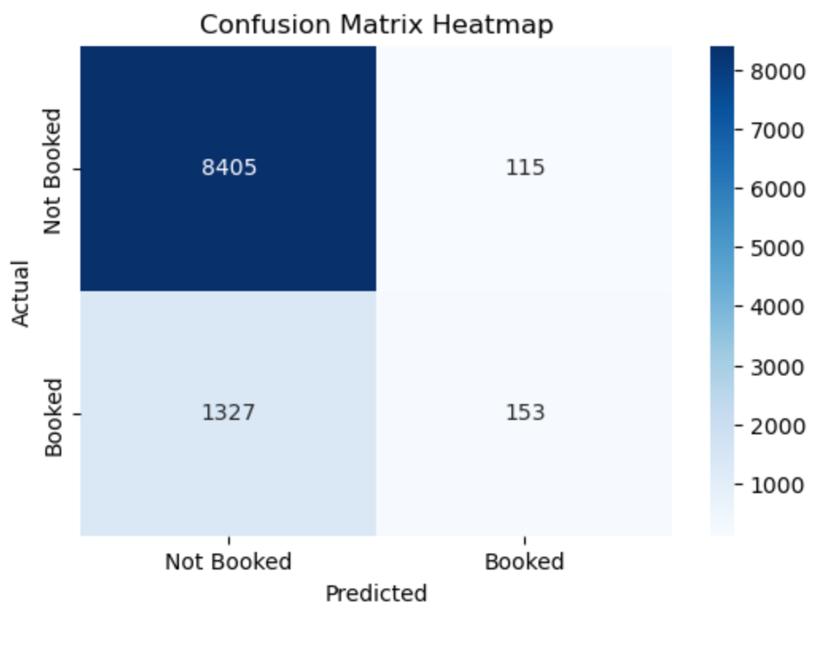
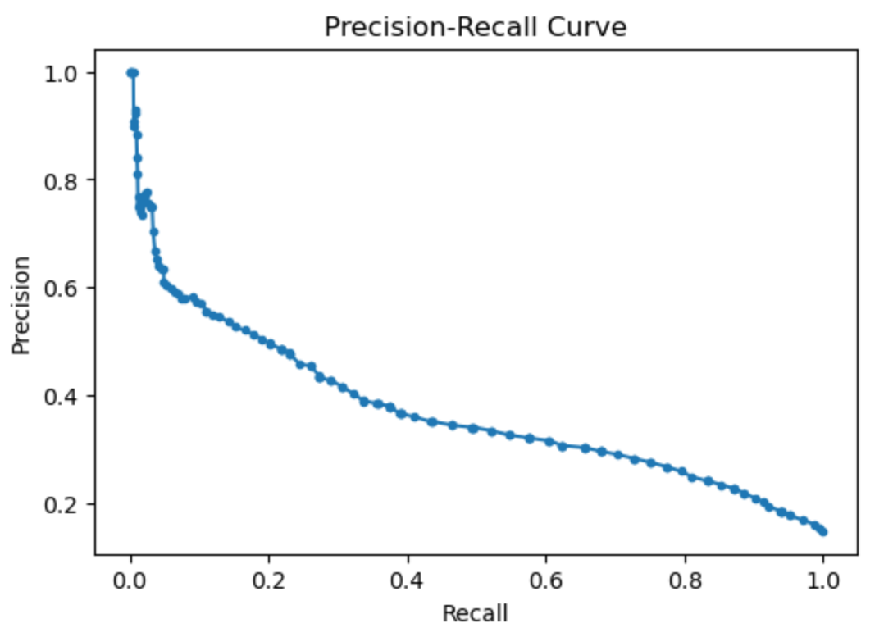
Feature Importance shows purchase lead, route, flight hour are the top predictors.
Hence a focus on marketing offers based on timing and route can be effective
85% booked, 15% didn’t
Showing severe class
Imbalance
Confusion Matrix shows high accuracy (85.58%) but poor recall for actual bookings (low true positives
High precision, low recall, indicating that the model is too cautious missing actual bookers
Key Takeaways
Model needs to be adjusted to improve recall, and class imbalance needs to be fixed to improve model fairness
Target High-Booking routes and time Windows
Use the date before booking (Purchase Lead) to predict and engage customers early

