Slide 1
EMPLOYEE DATA ANALYSIS USING EXCEL SPECIFICALLY FOR SALARY DISTRIBUTION &TRENDS ACROSS THE DEPARTMENT.
Name – Krishnan. M
REGISTER NO - CCF201842AC76EEA580417AFB29C5639
DEPARTMENT - B.com General
COLLEGE - DRBCCC Hindu College

Slide 2

AGENDA
PROBLEM STATEMENT
PROJECT OVERVIEW
END USERS
OUR SOLIUTIONS & PREPOSITION
DATASET DESCRIPTION
MODELLING APPROACH
RESULTS & DISCUSSION
CONCLUSION

Slide 3

PROBLEM STATEMENT
The organization faces the challenge of ensuring equitable and competitive compensation across its departments and job titles. With a diverse workforce, it is crucial to understand how salaries are distributed to identify any potential disparities or areas needing adjustment. Without a clear analysis, the organization risks inconsistencies in pay structures, which could affect employee satisfaction and retention.
To address this, we conducted an analysis of the employee compensation data, focusing on total salary distribution by department and average salary by job title.

Slide 4

PR0JECT OVERVIEW
This project focuses on analyzing the compensation data of 45 employees to gain insights into salary distribution across various departments and job titles. By leveraging Excel Pivot Tables and Charts, we aimed to identify trends and disparities in how salaries are allocated within the organization. The primary goal was to provide a clear understanding of total salary expenses by department and average compensation across different roles.
This analysis supports data-driven decision-making for HR and Finance, helping to ensure fair and competitive pay structures while aligning with the organization's strategic goals. Through this project, we offer valuable insights that can guide future salary reviews and contribute to maintaining equity in employee compensation.

Slide 5

WHO ARE THE END USERS ?
Primary Users:
HR Department: For reviewing and refining compensation policies.
Finance Department: For budgeting and financial planning.
Management: For strategic decision-making regarding employee compensation.
Secondary Users:
Employees: For understanding salary structures within the organization.
External Auditors: For verifying financial compliance and fairness in compensation.

Slide 6

OUR SOLUTION AND VALUE PRESENTATION
SOLUTION:
Utilizing Excel Pivot Tables and Charts to aggregate and visualize employee salary data.
Analyzing salary distribution across departments and job titles to identify any disparities or areas of concern.
:
VALUE REPRESENTATION:
Provides clear, actionable insights into salary allocation.
Helps to ensure fair and competitive compensation across departments and job roles.
Supports organizational goals of transparency and equity in compensation.

Slide 7

DATA SET AND DESCRIPTION
Dataset: Comprises 45 employees with the following attributes:
Employee ID: Unique identifier for each employee.
Department: The department the employee belongs to.
Job Title: The specific role or position of the employee.
Salary: The annual compensation of the employee.
Other Attributes: Age, Gender, Hire Date, Performance Rating, Years in Company, Education Level, Location.
Source: Internal HR records of the organization.

Slide 8
MODELLING APPROACH
Methodology:
Data Cleaning: Ensured that the dataset was accurate and free from inconsistencies.
Pivot Tables:
Total Salary by Department: Summed salaries for each department to understand the distribution of payroll expenses.
Average Salary by Job Title: Calculated the mean salary for each job title to compare compensation across different roles.
Tools: Microsoft Excel was used for data analysis and visualization.
Visualization: Created pivot charts to visually represent the salary distribution and averages, facilitating easier interpretation of data.

Slide 9
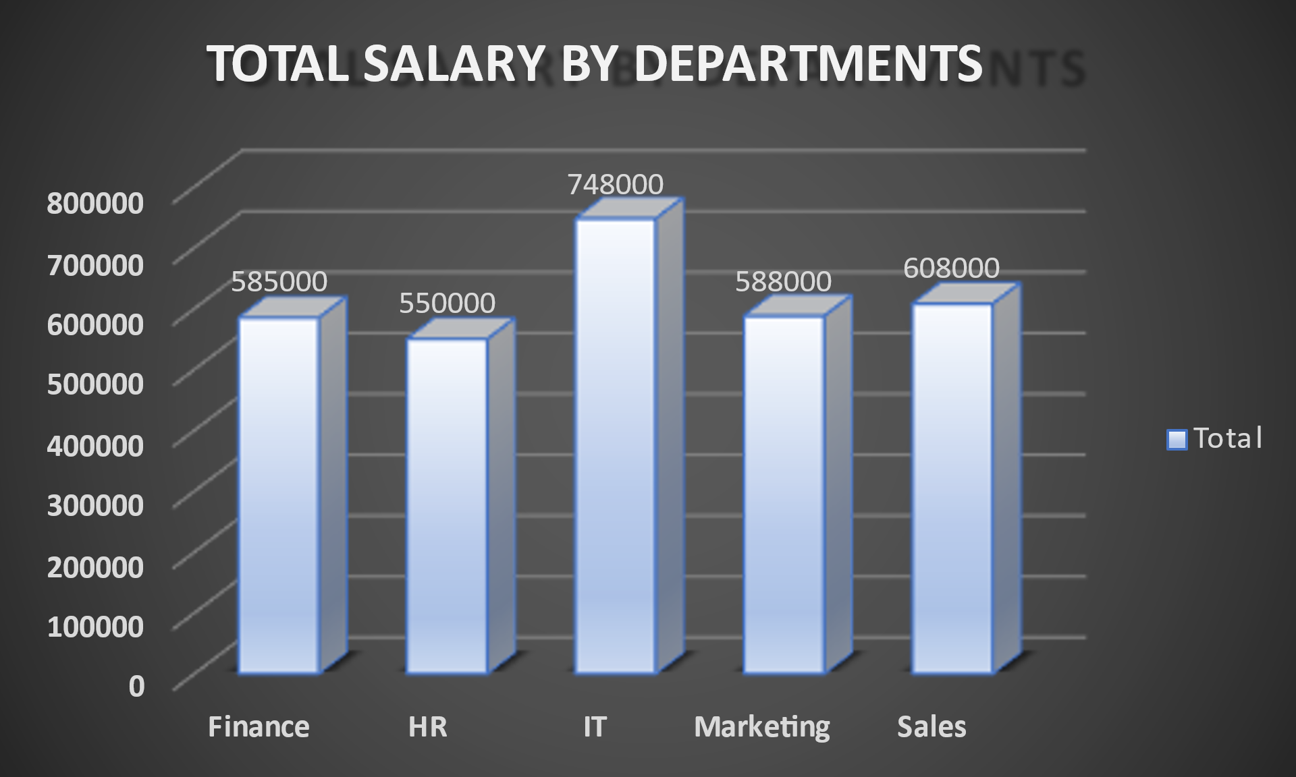

Slide 10
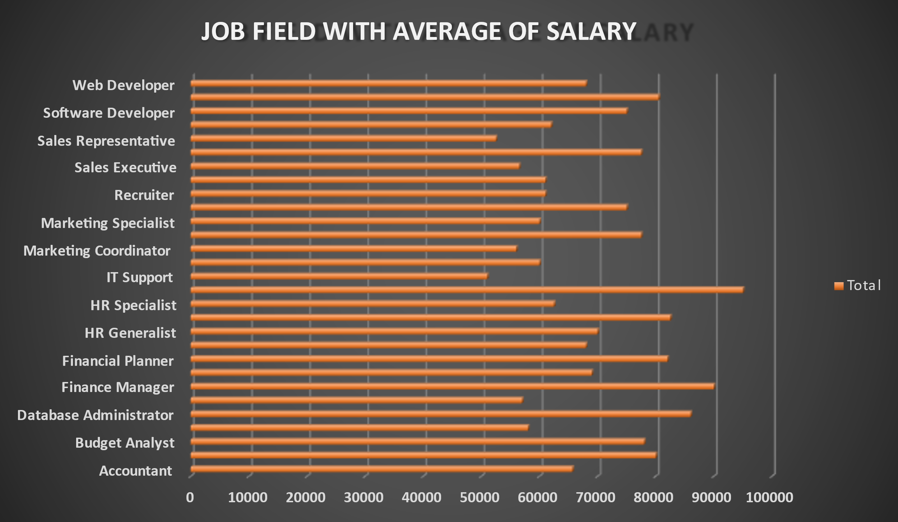

Slide 11

RESULTS AND DISCUSSION
Total Salary by Department:
Highlighted how salary expenses are allocated across different departments.
Identified which departments have the highest and lowest total salaries.
Discussion: Departments like IT and Finance may have higher salary totals due to technical and financial expertise requirements.
Average Salary by Job Title:
Showed average compensation for various roles.
Identified job titles with significantly higher or lower average salaries.
Discussion: Higher averages in certain job titles could indicate roles that require more specialized skills or experience.

Slide 12
CONCLUSION
In conclusion, the analysis of the 45-employee dataset revealed key insights into the organization's salary distribution across departments and job titles.
The total salary by department highlighted where the organization's payroll resources are concentrated, while the average salary by job title provided a clear view of compensation levels across various roles. These findings suggest that departments such as IT and Finance, which demand specialized skills, have higher total salaries, while certain job titles command higher average compensation, likely due to the expertise required.
This analysis not only underscores the importance of equitable pay structures but also offers a valuable tool for ongoing salary reviews and strategic financial planning.

