Slide 1


CREDIT CARD FRAUD DETECTION
Presented By:
SUDHANSHU KUMAR
JUGAL RAMCHIARY
PROGRAM- B.Tech 3rd Year/6th Sem
Date
Under the Guidance: Prof. Pavan Kumar Naik

Slide 2
CONTENTS
ABSTRACT
INTRODUCTION
LITERATURE SURVEY
PROBLEM FORMULATION
METHODOLOGY
RESULTS
CONCULSION AND FUTURE SCOPE

Slide 3

With the exponential growth of online transactions, credit card fraud has become a significant concern for financial institutions and consumers alike.
Traditional rule-based systems for fraud detection are often inadequate in identifying sophisticated fraudulent activities. Therefore, there is a pressing need for advanced techniques that can effectively detect fraudulent transactions in real-time.
This study proposes a novel approach to credit card fraud detection leveraging machine learning algorithms.
Detecting fraudulent transactions promptly is crucial to mitigate financial losses and uphold trust in the banking system.

Slide 4

Credit card fraud detection is a set of methods and techniques designed to block fraudulent purchases, both online and in-store.
This is done by ensuring that you are dealing with the right cardholder and that the purchase is legitimate.
Card-not-present fraud is when the criminal uses the details associated with the card, such as the card number, accountholder name, and CVV code, without having the card in their possession.
Card present fraud is when the criminal uses a physical card, which is either stolen or duplicated, to make fraudulent purchases. Card present fraud can be the result of the theft of a card through robbery, pickpocketing, or mail theft.

Slide 5
LITERATURE SURVEY
The model used by Alenzi and Aljehane to detect fraud in credit cards was Logistic Regression, their model scored 97.2% in accuracy, 97% sensitivity and 2.8% Error Rate.
A comparison was performed between their model and two other classifier which are 4 Voting Classifier and KNN. VC scored 90% in accuracy, 88% sensitivity and 10% error rate, as for KNN where k = 1:10, the accuracy of the model was 93%, the sensitivity 94% and 7% for the error rate (Alenzi & Aljehane, 2020).
Dr. SP Maniraj’s team built a model that can recognize if any new transaction is fraud or nonfraud, their goal was to get 100% in the detection of fraudulent transactions in addition to trying to minimize the incorrectly classified fraud instances. Their model has performed well as they were able to get 99.7% of the fraudulent transactions (Maniraj et al., 2019).

Slide 6
PROBLEM FORMULATION
Formulating the problem of credit card fraud detection involves defining the task, identifying the objectives, and outlining the constraints and resources available. Here's a structured formulation:
Task Definition : The task is to detect instances of fraudulent credit card transactions within a dataset.
Objective: The primary objective is to minimize financial losses due to fraudulent activities while maximizing the detection rate of fraudulent transactions. Secondary objectives may include minimizing false positives (legitimate transactions flagged as fraudulent) to prevent inconvenience to customers.
Input Data: The input data consists of records of credit card transactions, including various features such as transaction amount, time, location, type of transaction, etc.
Output: The output is a binary classification indicating whether a transaction is fraudulent or legitimate.

Slide 7
Performance Metrics:
Accuracy: Overall correctness of the classification.
Precision: The ratio of true positive predictions to the total positive predictions, indicating the accuracy of fraud predictions among all transactions flagged as fraudulent.
Recall (Sensitivity): The ratio of true positive predictions to the total actual positives, indicating the ability to detect fraudulent transactions among all truly fraudulent transactions.
F1 Score: The harmonic mean of precision and recall, providing a balanced measure between them.
ROC-AUC: Receiver Operating Characteristic - Area Under Curve, which evaluates the model's ability to discriminate between positive and negative classes across various thresholds.
Computational Resources: Availability of computational power for training and inference.
Data Privacy Regulations: Compliance with regulations such as GDPR, PCI DSS, etc., ensuring the privacy and security of customers' financial data.
Scalability: Ability of the solution to scale with increasing transaction volume.
Latency: Real-time or near-real-time detection to prevent fraudulent transactions promptly.
Interpretability: Depending on the context, the model may need to provide explanations for its predictions to comply with regulatory requirements or for business understanding.
Approach:
Utilize supervised learning algorithms such as logistic regression, decision trees, random forests, support vector machines, or neural networks.
Feature engineering to identify relevant features and potentially create new ones.
Address class imbalance using techniques like oversampling, undersampling, or using algorithms designed to handle imbalanced datasets.
Employ anomaly detection techniques for detecting unusual patterns or outliers in transaction data.
Continuous monitoring and updating of the model to adapt to changing patterns of fraudulent behavior.

Slide 8
METHODOLOGY
Systematic literature reviews, for example, are a type of methodology, which conducts a literature review on a specific topic, could be used to detect fraud.
A systematic review's primary goal in this context is to identify, evaluate, and Interpret the available studies in the literature that address the authors' research questions.
A secondary goal is to identify research gaps and opportunities in the area of interest. In this paper, we attempted to walk through the activities proposed by Kitchenham: analysis preparation, execution, and reporting in iterations

Slide 9
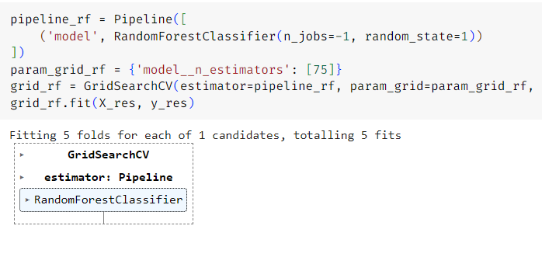
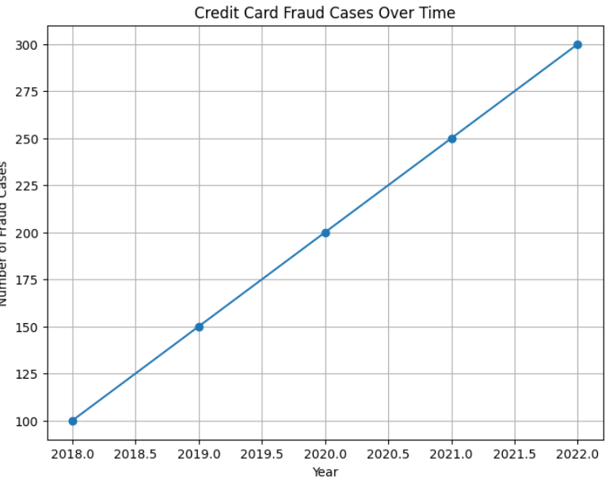
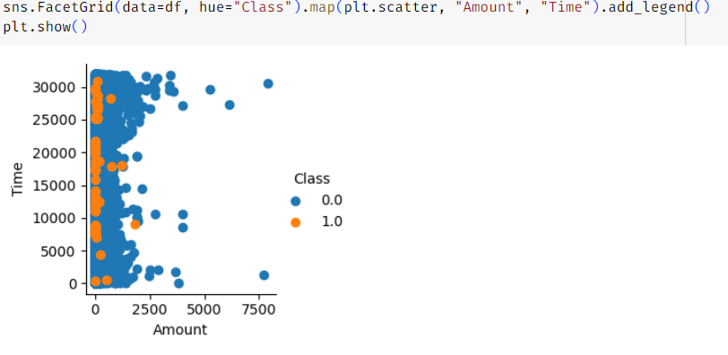
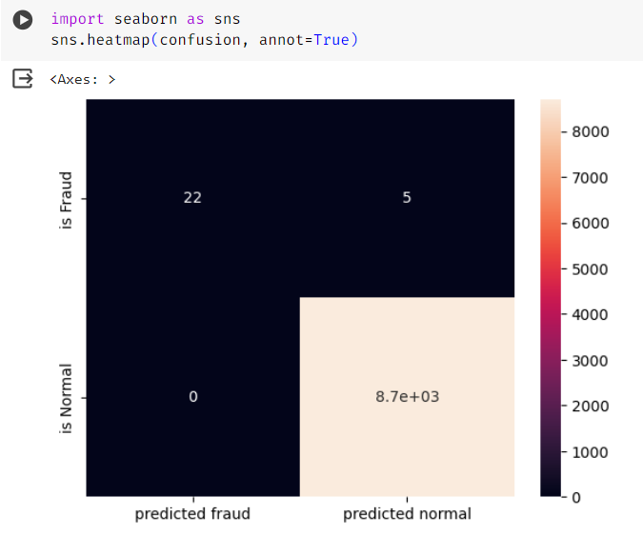
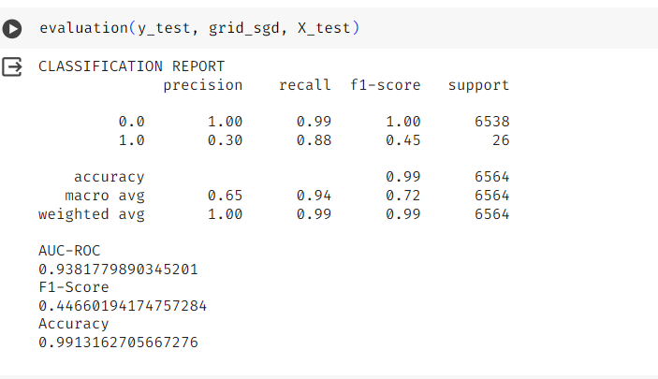
RESULTS

Slide 10
CONCULSION AND FUTURE SCOPE
To sum up, credit card fraud detection is an essential job in the financial industry that aims to spot and stop fraudulent transactions, protecting the financial interests of both companies and consumers. The issue at hand is a binary classification problem with the dual goals of minimizing financial losses and maximizing the detection rate of fraudulent activity. The problem formulation highlights the intricacy of the work.
This problem is addressed using a variety of strategies and tactics, such as efficient feature engineering, anomaly detection techniques, and supervised learning algorithms. Performance indicators including F1 score, ROC-AUC, accuracy, precision, recall, and F1 score are used to assess how effective fraud detection algorithms are.

Slide 11
The future scope of credit card fraud detection is composed for exciting advancements driven by technological innovations, evolving fraud tactics, and increasing data accessibility. Here are several potential areas of growth :
AI and Machine Learning Advancements: Continued advancements in artificial intelligence (AI) and machine learning (ML) algorithms will enable more sophisticated fraud detection models.
Big Data Analytics: The proliferation of big data analytics tools and techniques will enable financial institutions to process and analyze vast amounts of transaction data in real-time.
Predictive Analytics and Prescriptive Analytics: Future fraud detection systems may incorporate predictive analytics to anticipate potential fraudulent activities before they occur.
Advanced Fraud Detection Techniques: Emerging fraud detection techniques, such as network analysis, social network analysis, and graph analytics, can uncover fraudulent activities by examining the relationships and connections between entities involved in transactions.

Slide 12


