Slide 1
Programming with Scalding
Krishnan Raman
Data Scientist, Twitter
http://github.com/krishnanraman/bigdata

Slide 2
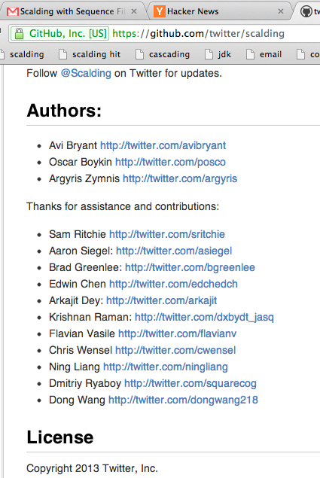
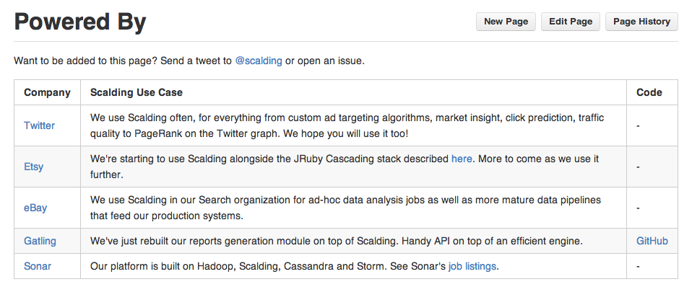
What is Scalding ?
Primary Usecase: Hadoop Map-Reduce Jobs in Scala
Abstract away low-level Hadoop + Cascading details ( but can still get to them … )
Identical functions as Scala – map, flatMap, filter, project,takeWhile, groupBy….
Work well with CT primitives – Twitter’s Bijection libraries ( Monoids, Groups, Rings, …)
Notes:
Scalding – DSL atop cascading, can always use the Java Cascading API if need be
No need to know about TupleEntry, Taps, - show Cascading API at this point
Show bijection libraries

Slide 3
ssql : Gentle Intro to Scalding
open employees file1.txt
columns 3
column 1 name text
column 2 age number
column 3 income decimal
rows select age > 20
rows select age < 27
column add newincome income*1.1 + (age-20)*100
column remove age
column remove income
save file2.txt
fred 25 10000
sam 25 150000
oscar 39 200000
baker 27 234567
pascal 24 123456
ford 22 55000
haskell 56 45466
➔
fred 11500.0
sam 165500.0
pascal 136201.6
ford 60700.0
Notes:
Scalding – DSL atop cascading, can always use the Java Cascading API if need be
No need to know about TupleEntry, Taps, - show Cascading API at this point
Show bijection libraries

Slide 4
ssql : Gentle Intro to Scalding
open employees file1.txt
columns 3
column 1 name text
column 2 age number
column 3 income decimal
rows select age > 20
rows select age < 27
column add newincome income*1.1 + (age-20)*100
column remove age
column remove income
save file2.txt
import com.twitter.scalding._
class somescript(args : Args) extends Job(args){
val employees =
TextLine("file1.txt")
.read
.mapTo('line -> ('name,'age,'income) ){
line:String =>
val res = line.split(" ").map( _.trim).filter(_.length > 0)
val name:String = res(0).toString
val age:Int = res(1).toInt
val income:Double = res(2).toDouble
(name,age,income)
}.filter('age) {
age:Int =>
(age > 20)
}.filter('age) {
age:Int =>
(age < 27)
}.map(('income,'age) -> ('newincome)) {
columns:(Double,Int)=>
val (income,age) = columns
income*1.1 + (age-20)*100
}.discard('age)
.discard('income)
.write(Tsv("file2.txt"))
}
ssql
somescript
somescript.scala
Notes:
Scalding – DSL atop cascading, can always use the Java Cascading API if need be
No need to know about TupleEntry, Taps, - show Cascading API at this point
Show bijection libraries

Slide 5
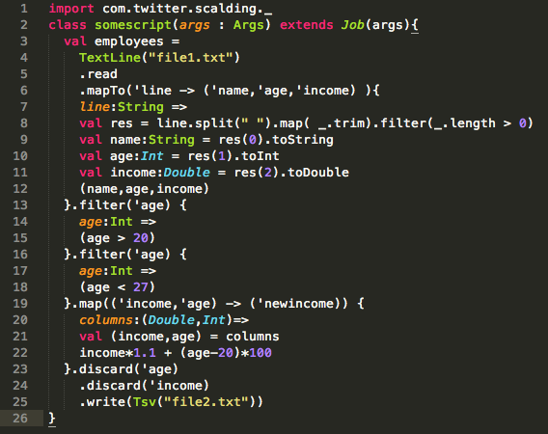

Slide 6
Portfolio Management with Scalding
Divide $1000 among 4 stocks –
Kroger, $27
Abbott Labs, $64
Dollar Tree, $41
Monster Beverage, $52
in the “best” possible way.
These are 4 stocks with a low beta ( risk) and high average volume.
Solve: 27x + 64y + 41z + 52w = 1000

Slide 7
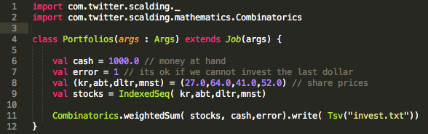

Slide 8
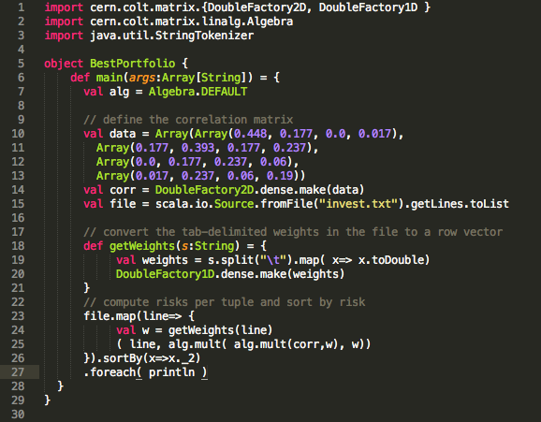

Slide 9
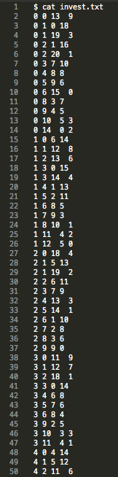
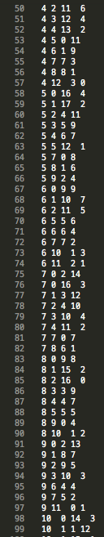
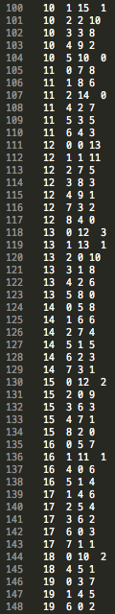
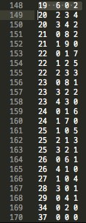
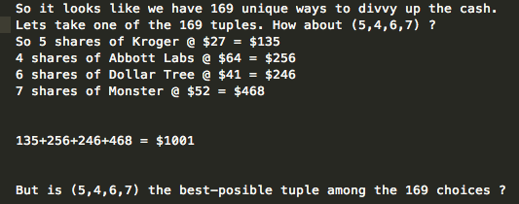
weighted sums…

Slide 10
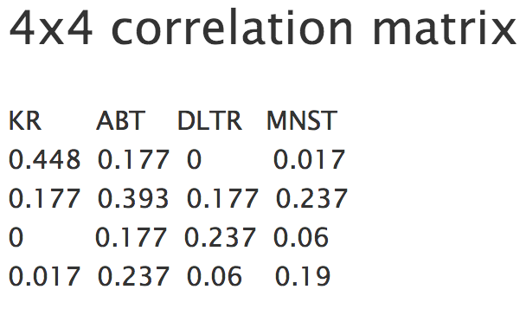
Correlations among equities…
Given a vector of weights W, the net risk imposed by this matrix = W'CW
Goal: Want the 4-tuple with the least risk.

Slide 11
The 4-tuple with the least risk…
// compute risks per tuple and sort by risk
file.map(line=> {
val w = getWeights(line)
( line, alg.mult( alg.mult(corr,w), w))
}).sortBy(x=>x._2)
res11: List[(String, Double)] = List(
(1 0 6 14,56.776),
(4 0 4 14,56.824),
(2 1 5 13,57.544),
(4 1 5 12,58.552),
(2 2 6 11,59.646),
.....
(37 0 0 0,613.312)
“Best” tuple
“Worst” tuple

Slide 12
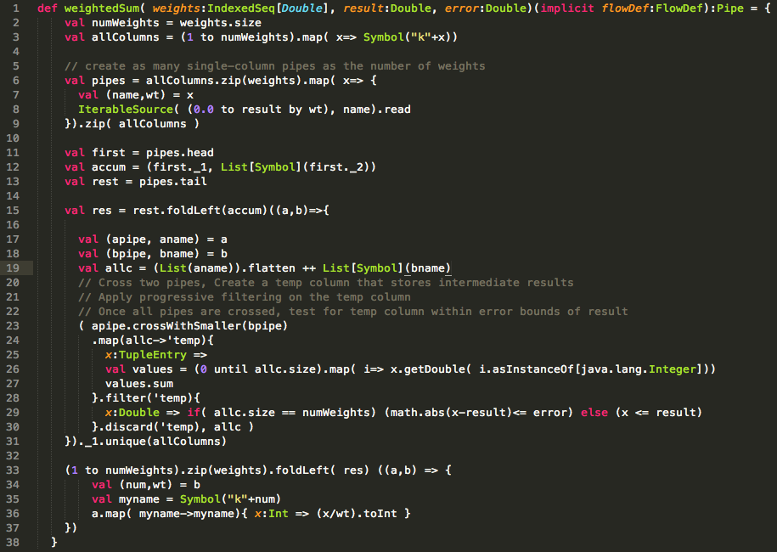
Under the hood…weightedSum(..)

Slide 13
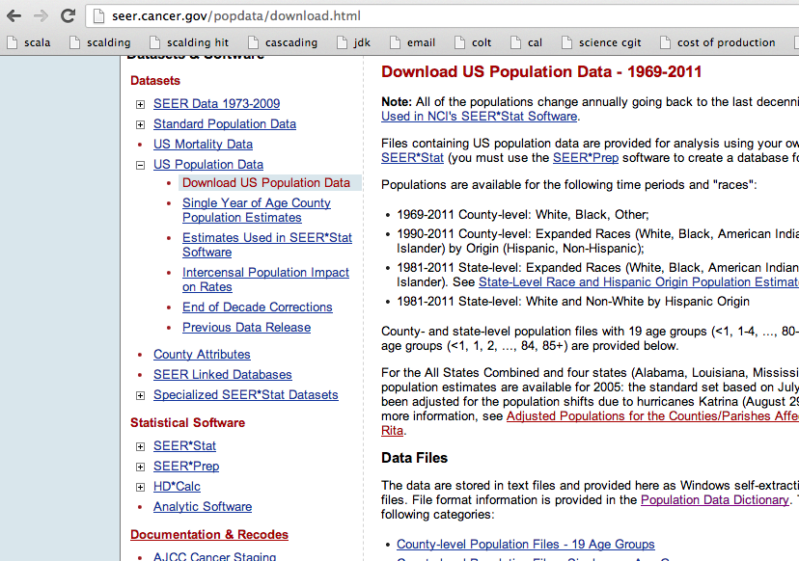
US Population Data Analysis

Slide 14
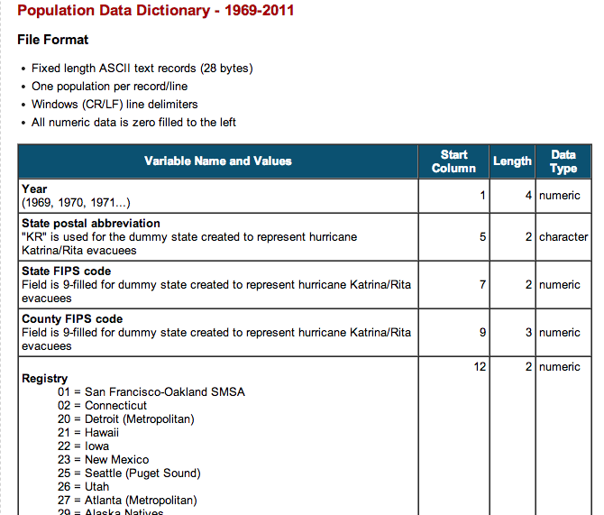
Population Data Dictionary

Slide 15
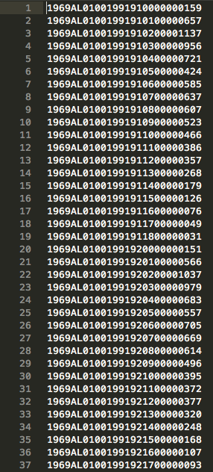
Population data – 12 million records

Slide 16
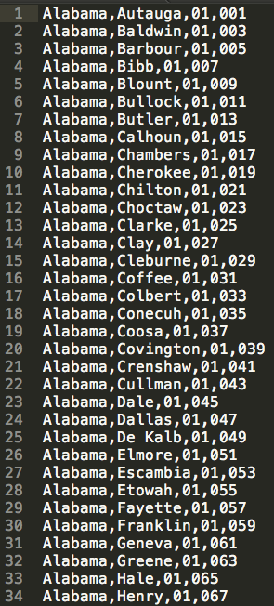
US FIPS Codes.csv ( 3000+ records )

Slide 17
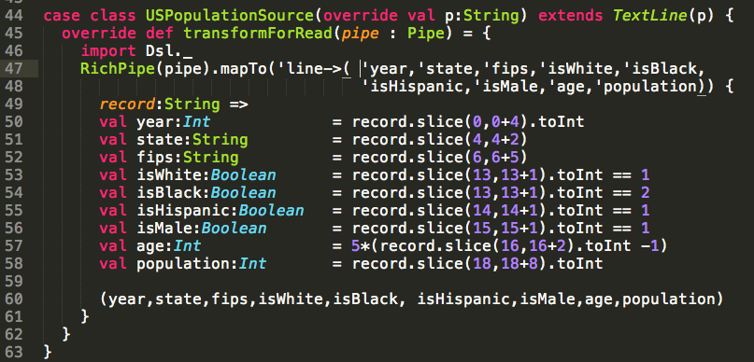
Convert pop.txt to a legit Scalding Source

Slide 18
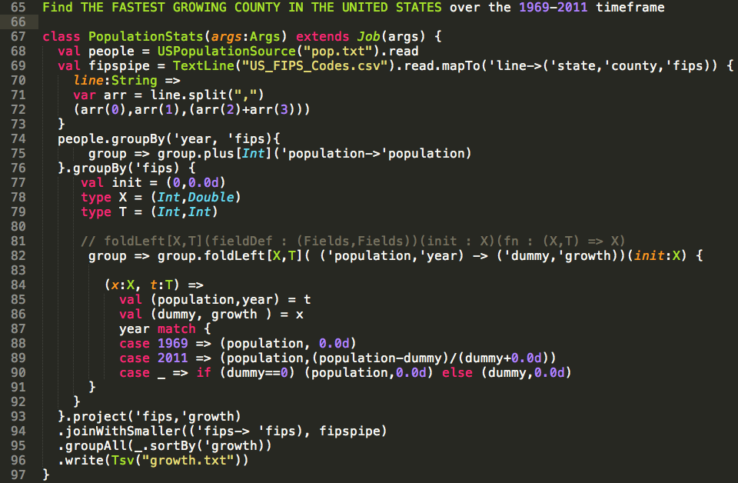

Slide 19
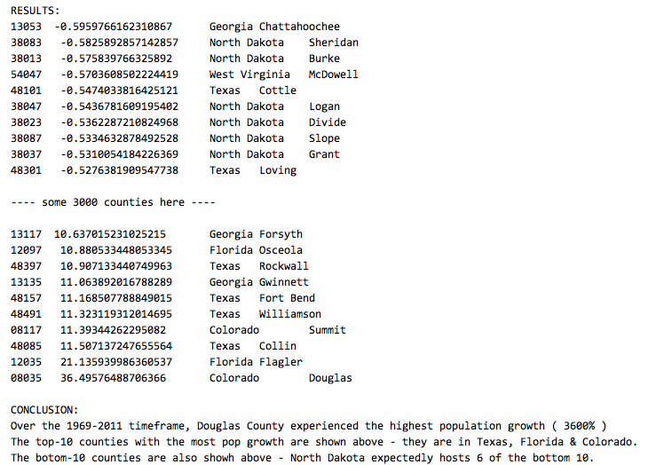

Slide 20
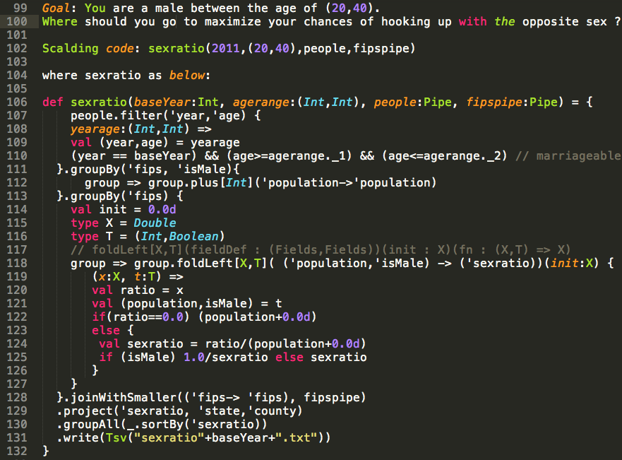

Slide 21
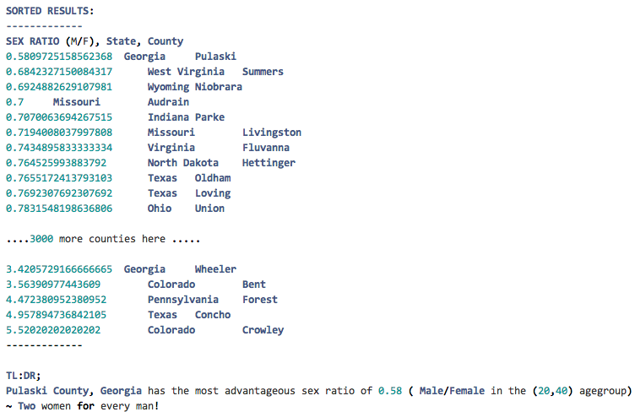

Slide 22
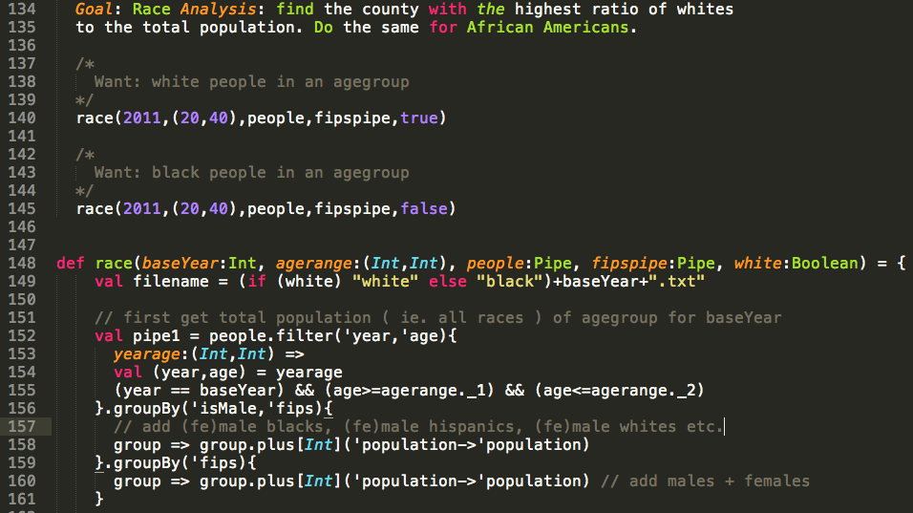

Slide 23
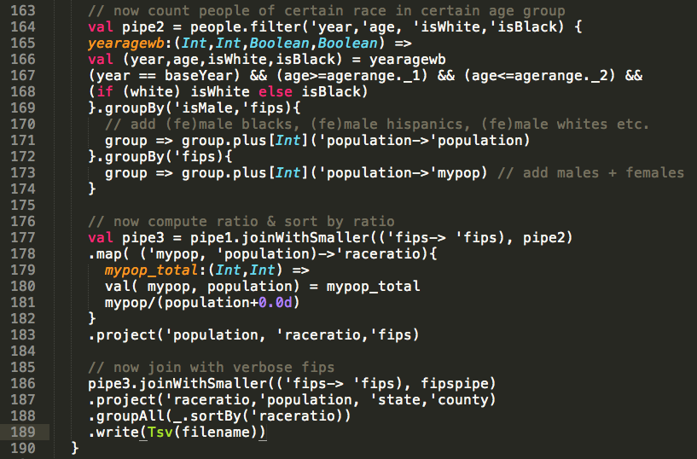

Slide 24
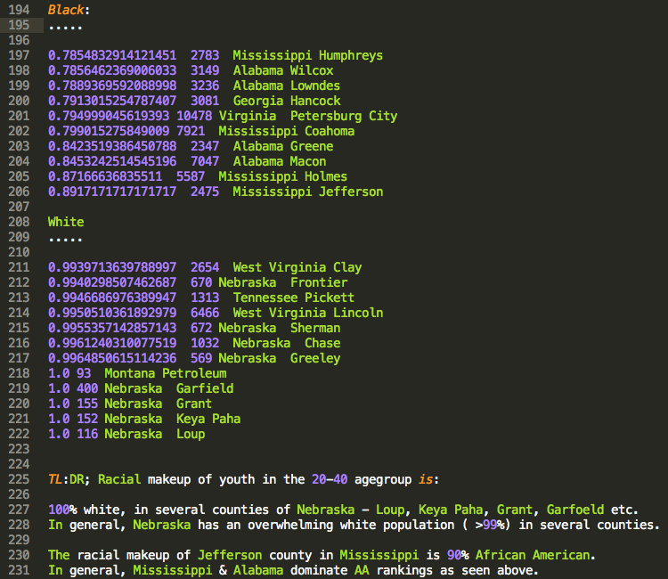

Slide 25
Algebird…Twitter’s Abstract Algebra library
Model a wide class of "reductions" as a sum on some iterator
Average, moving average, max/min, set union, approximate set size (in much less memory with HyperLogLog), approximate item counting (using CountMinSketch).
Implementations of Monoids for interesting approximation algorithms, such as Bloom filter, HyperLogLog and CountMinSketch.
Use CMS, HLL within Storm ( realtime aggregation ) and Scalding (batchmode aggregation

Slide 26
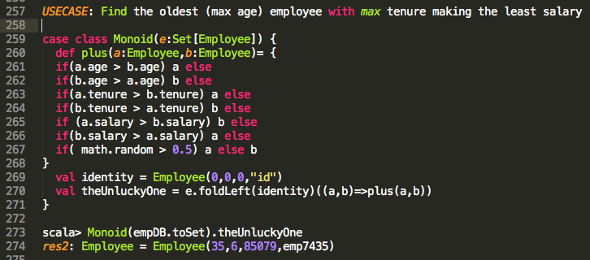
Trivial Monoid: Employee Monoid

Slide 27
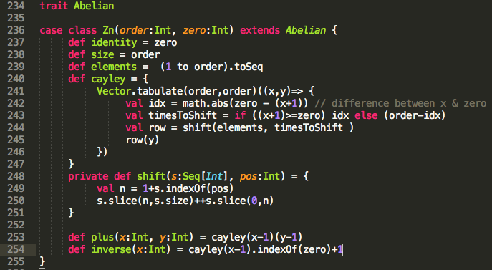
Nontrivial example: Abelian Group

Slide 28
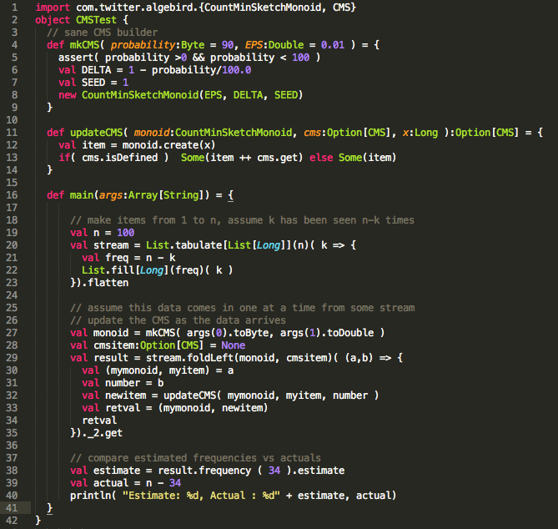
CMS Monoid for counting tweets

Slide 29
More goodies…
https://github.com/twitter/scalding
https://github.com/twitter/algebird
https://github.com/twitter/bijections
Thank you! ( Krishnan Raman, kraman@twitter.com )

