Slide 1

WeatherWise
Shareable web app walkthrough
The deck captures the complete app journey: the main story/game flow, the build simulation, every tutorial step, and the final play mode.
18 captured app screens

Slide 2
Story opening
MAIN APP
02 / 19

Slide 3
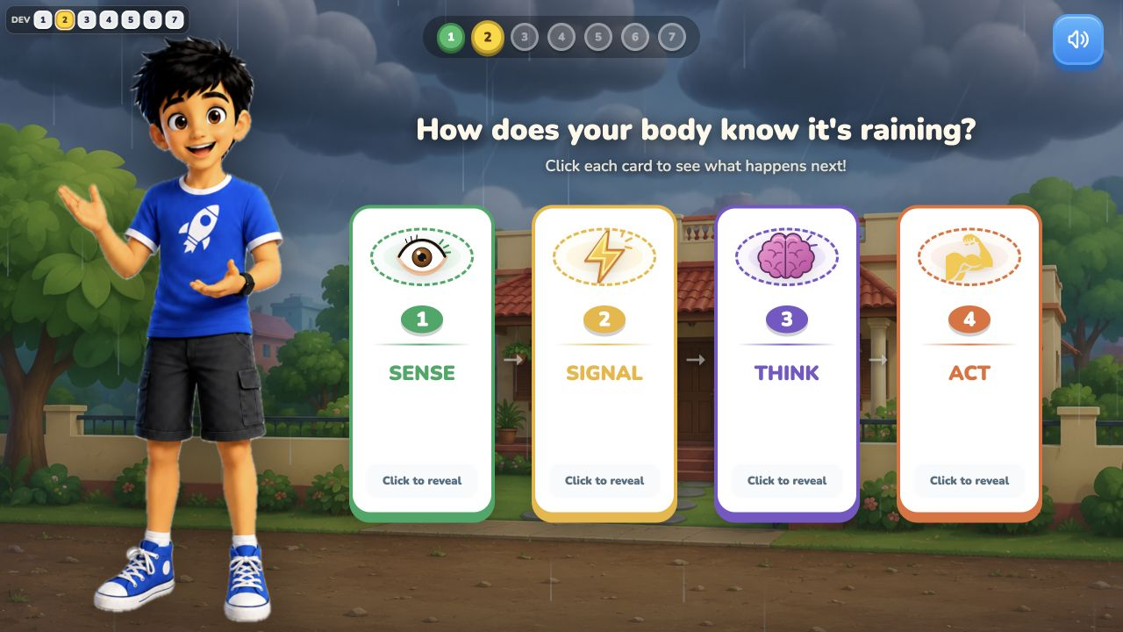
Feel the rain
MAIN APP
03 / 19

Slide 4
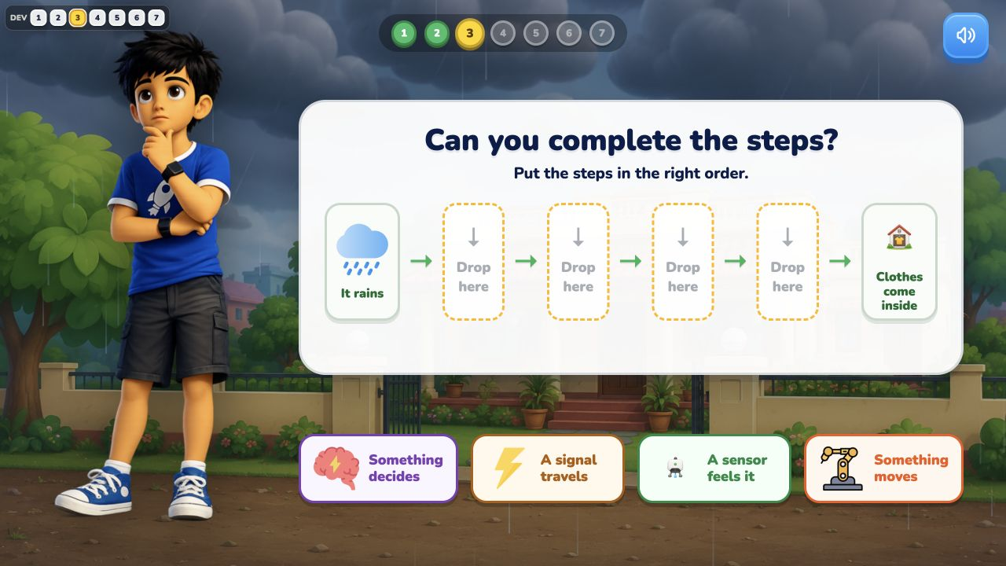
Complete the steps
MAIN APP
04 / 19

Slide 5
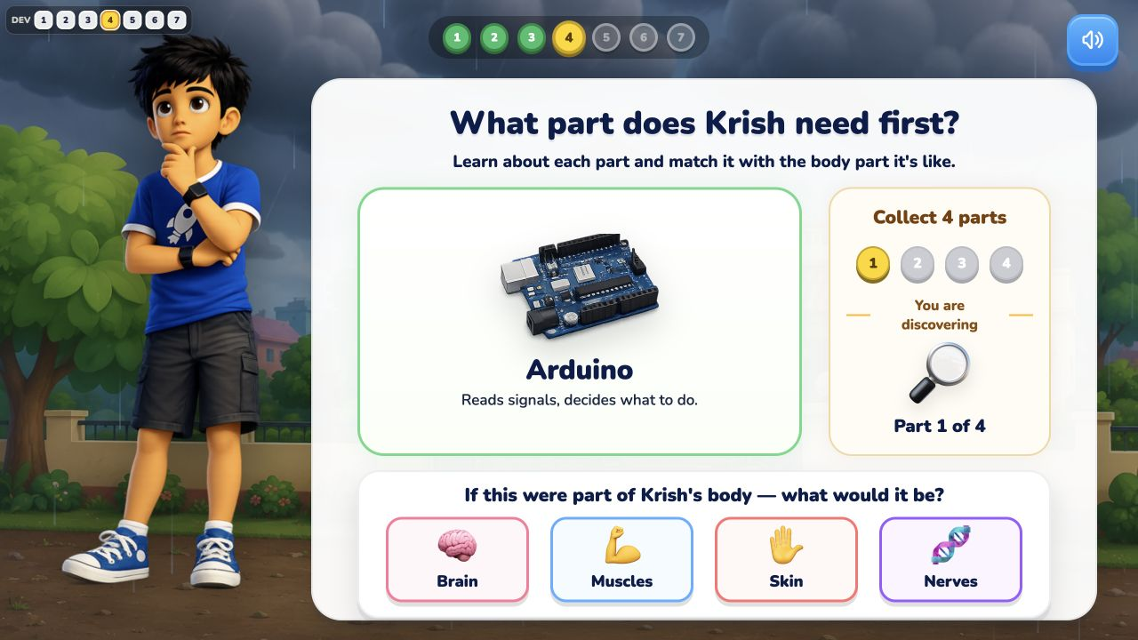
Match machine parts
MAIN APP
05 / 19

Slide 6
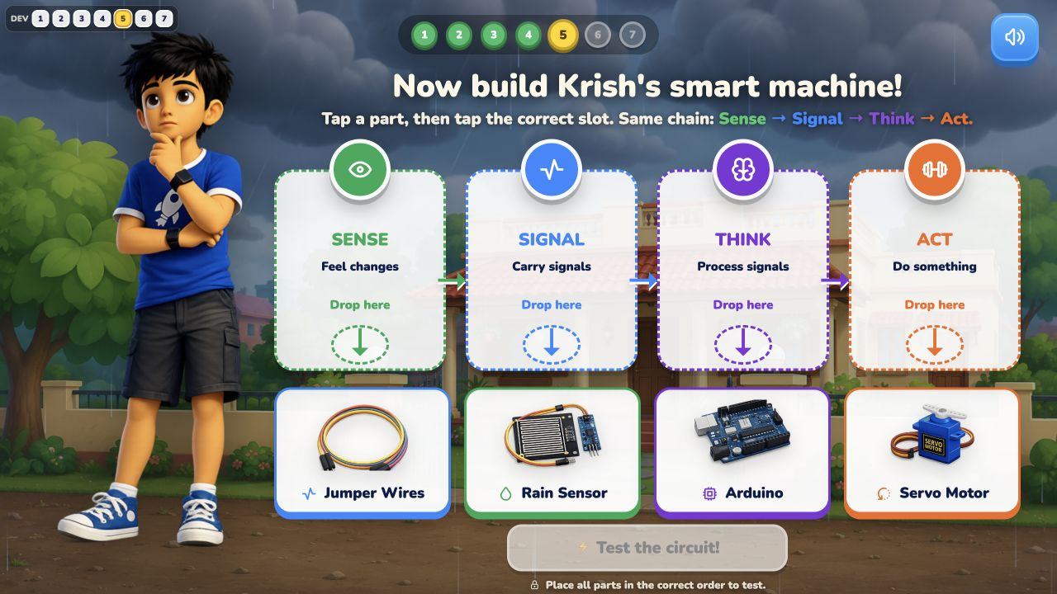
Build the circuit
MAIN APP
06 / 19

Slide 7
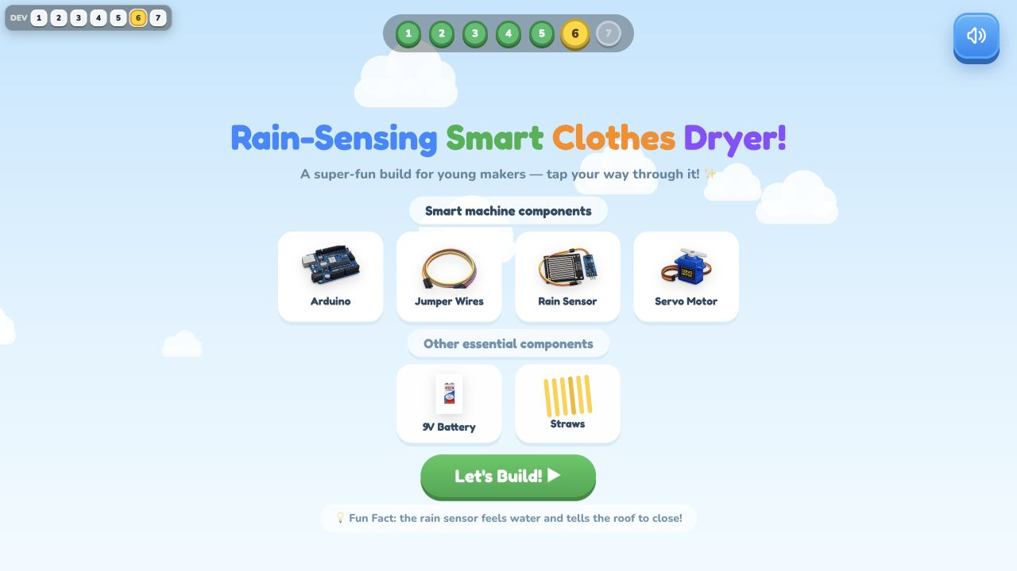
Simulation handoff
MAIN APP
07 / 19

Slide 8
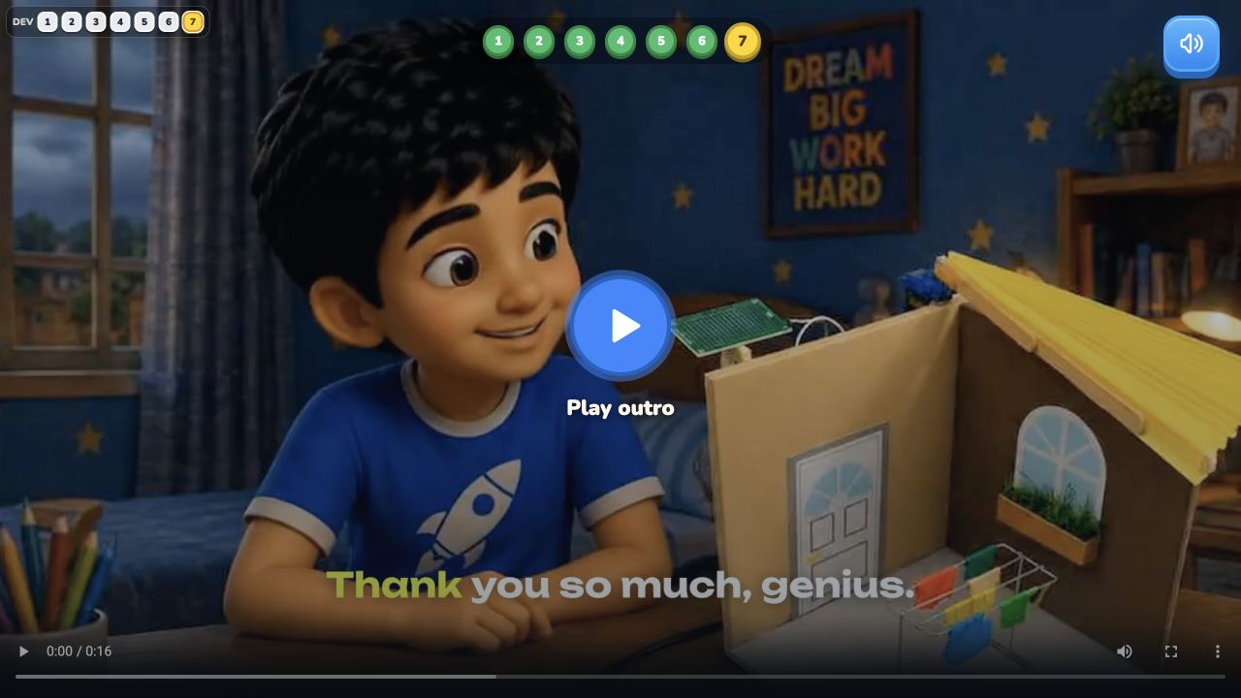
Outro
MAIN APP
08 / 19

Slide 9
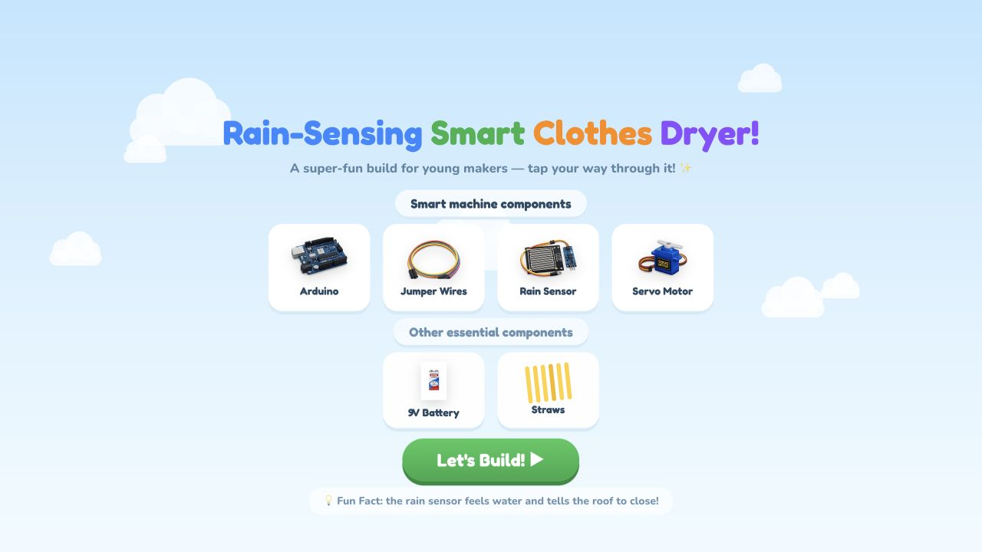
Simulation intro
SIMULATION
09 / 19

Slide 10
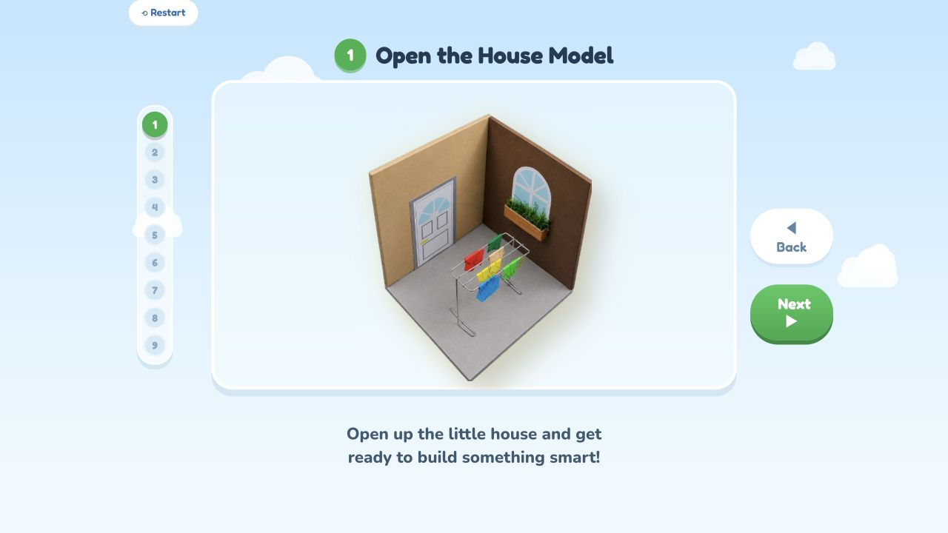
Build step 1: Open the house model
SIMULATION
10 / 19

Slide 11
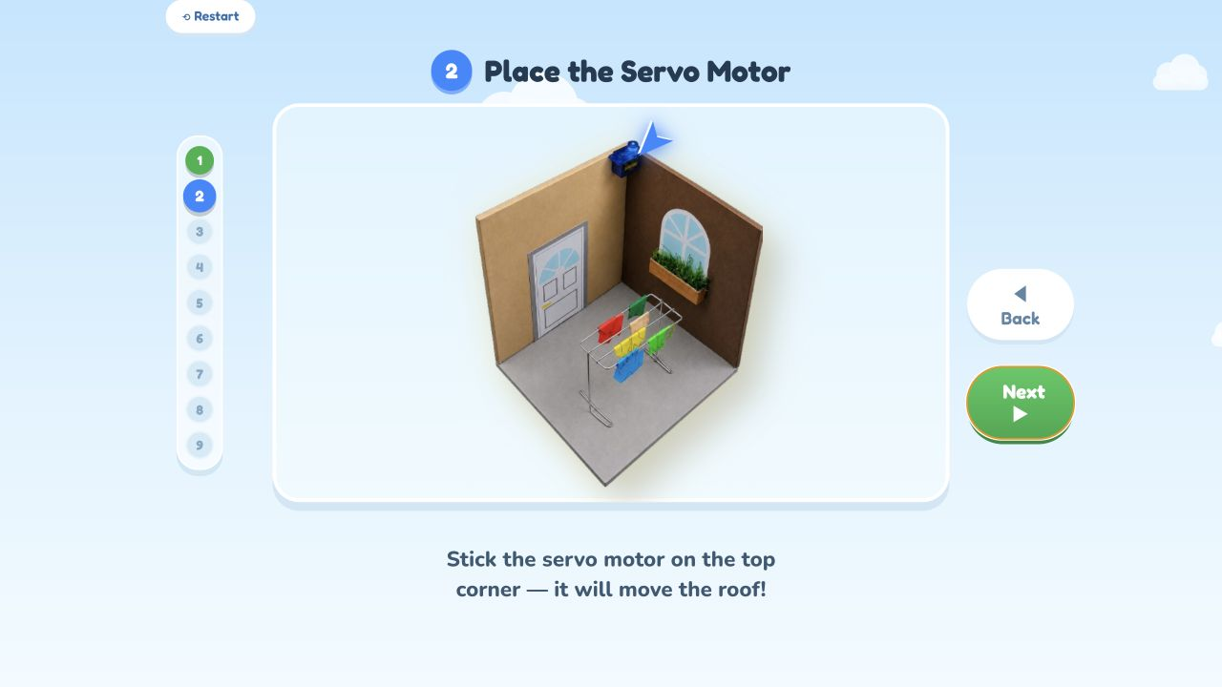
Build step 2: Place the servo motor
SIMULATION
11 / 19

Slide 12
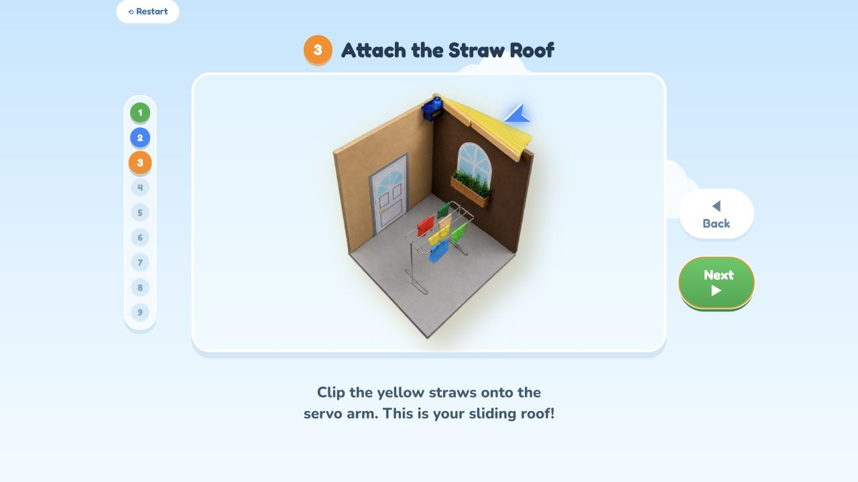
Build step 3: Attach the straw roof
SIMULATION
12 / 19

Slide 13
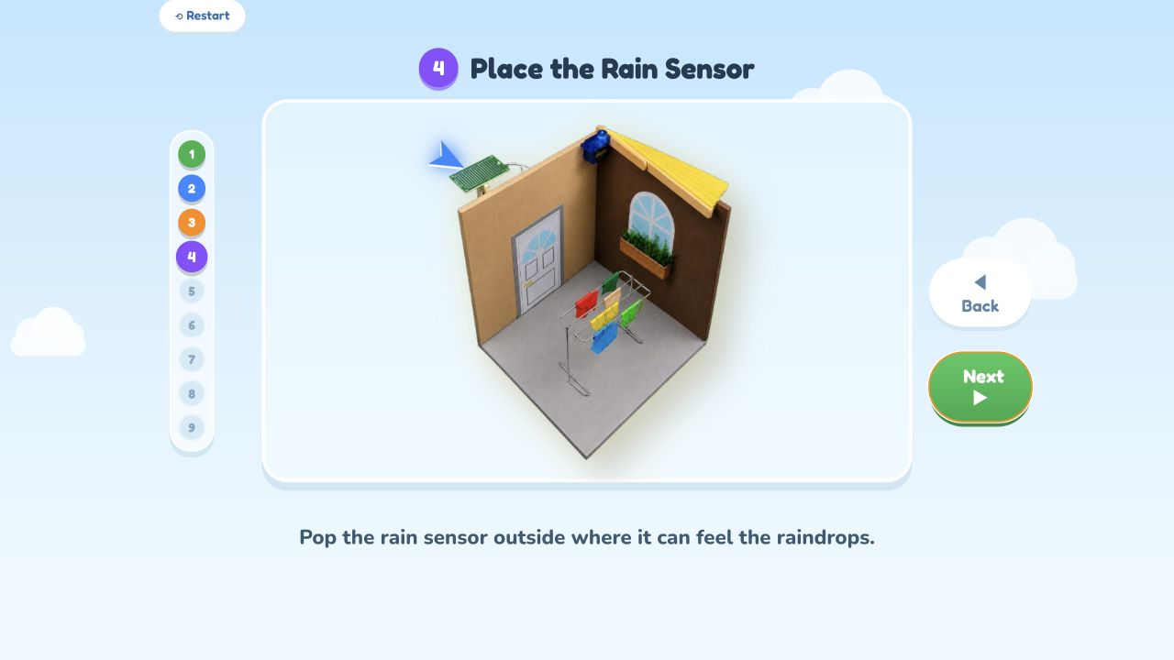
Build step 4: Place rain sensor outside
SIMULATION
13 / 19

Slide 14
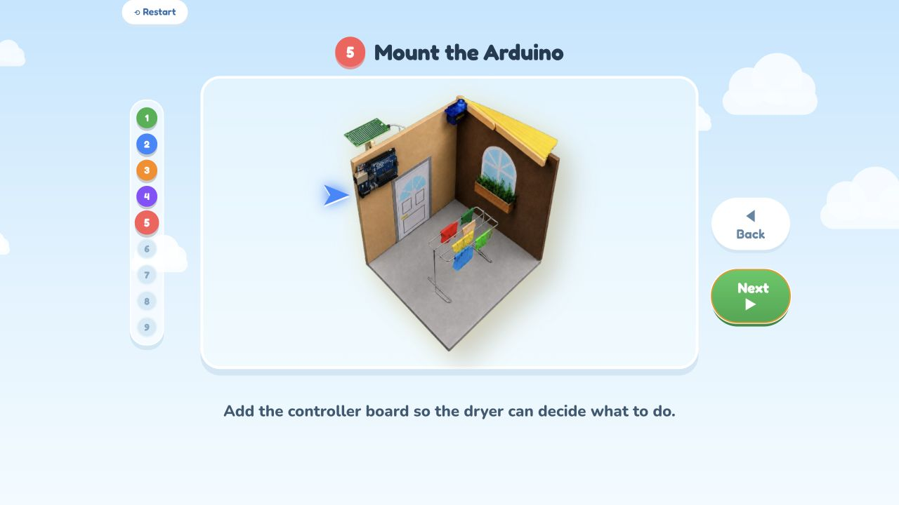
Build step 5: Mount the Arduino
SIMULATION
14 / 19

Slide 15
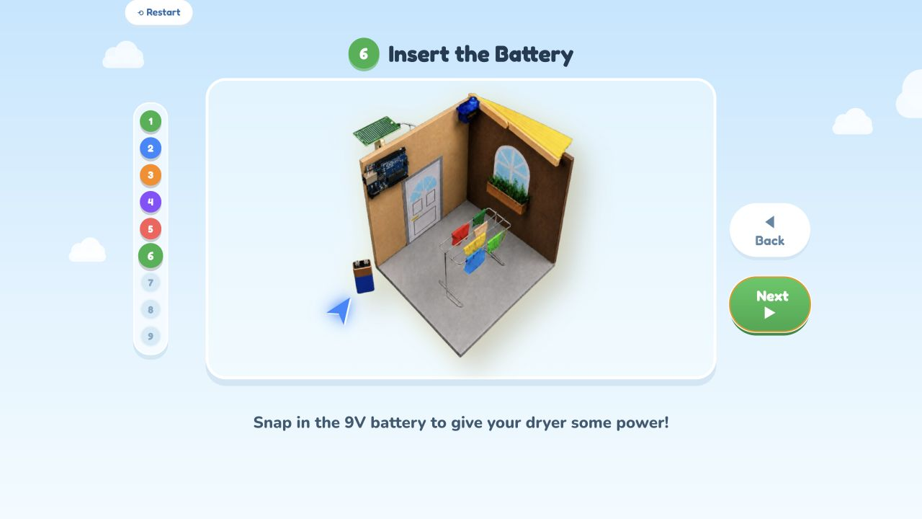
Build step 6: Insert the battery
SIMULATION
15 / 19

Slide 16
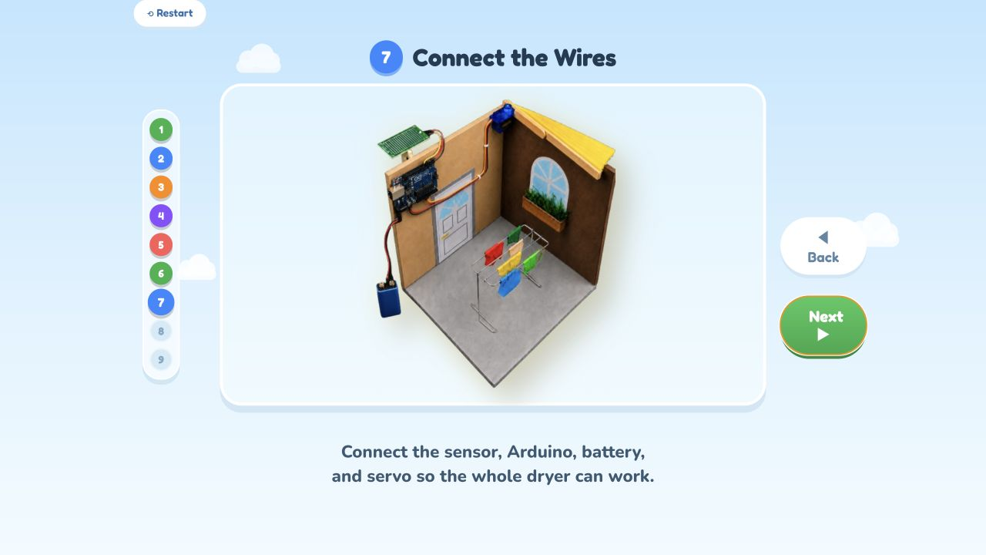
Build step 7: Connect the wires
SIMULATION
16 / 19

Slide 17
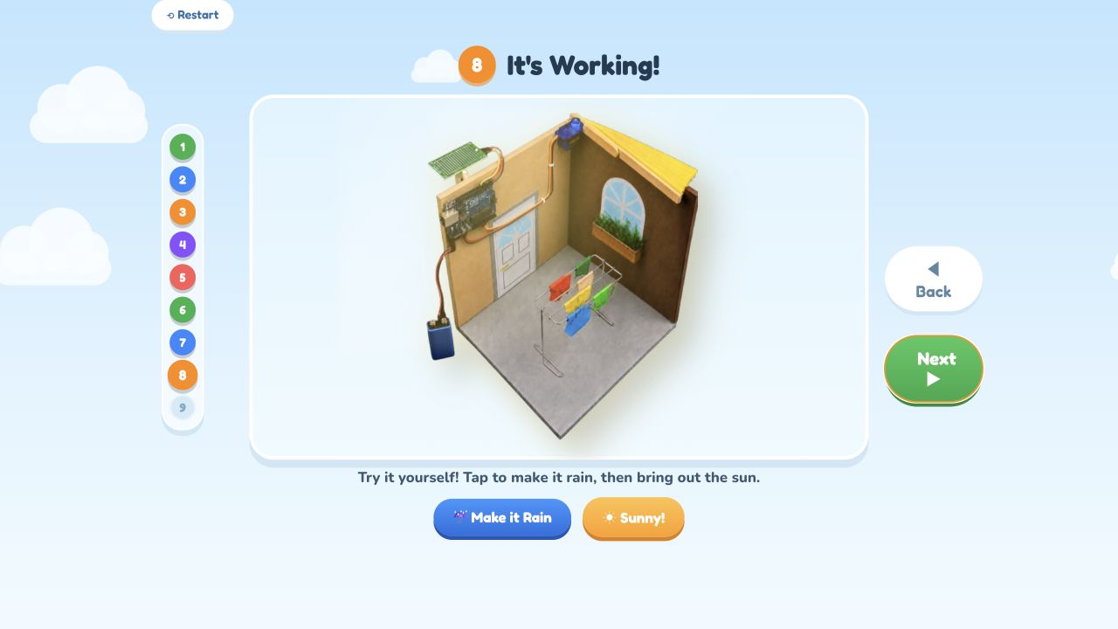
Build step 8: It is working
SIMULATION
17 / 19

Slide 18
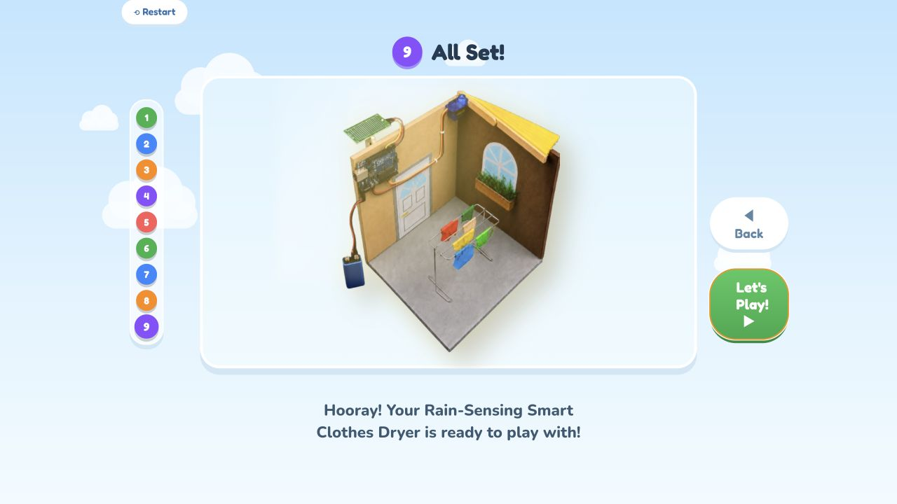
Build step 9: All set
SIMULATION
18 / 19

Slide 19
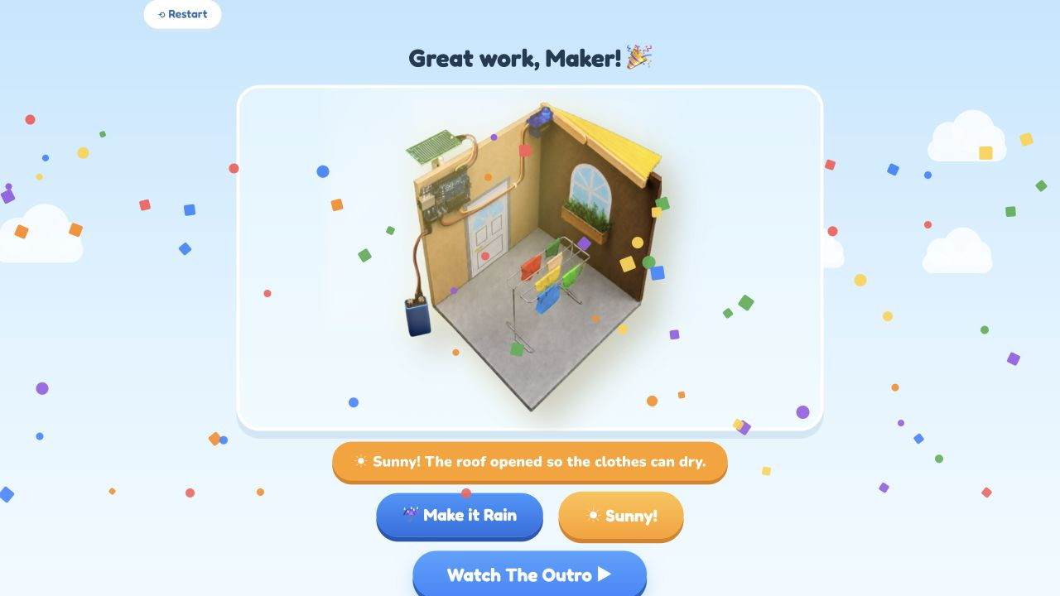
Final play mode
SIMULATION
19 / 19

