Slide 1
JAVA 17 • SPRING BOOT • LOCAL AGENT
Advanced AI
Workbench
AGENT RUN
Analyse workspace
✓ Plan review
Complete Functional & Technical Overview
✓ Step 1
Chat + evidence-based Agent planning + sequential verified execution + resilient model failover + adaptive token management
✓ Verify
○ Step 2
○ Complete
Prepared from the current portable-JAR source baseline
09 September 2026

Slide 2
1. Product at a Glance
A local, prompt-driven development assistant designed for controlled autonomous work on real projects.
💬
Chat mode
⚡
Agent mode
⌂
Local-first runtime
Streaming conversation with persistent history, file attachments and editable messages.
Analyse the mapped workspace, build an evidence-based plan, execute one approved step at a time and verify changes.
Works directly against user-supplied filesystem paths. JAR-owned state remains local beside the application.
↻
Model resilience
∑
Token efficiency
◫
Extensible tooling
Primary + ordered fallback models. Current workspace and plan state survive failover.
Adaptive pruning, rolling compaction, durable checkpoints and relevant-file retrieval reduce repeated context.
Workspace tools, shell, HTTP, LSP, MCP, skills, subagents, attachments and project resources.
Design principle: give the agent freedom inside the active step, while keeping plan boundaries, permissions and verification deterministic.

Slide 3
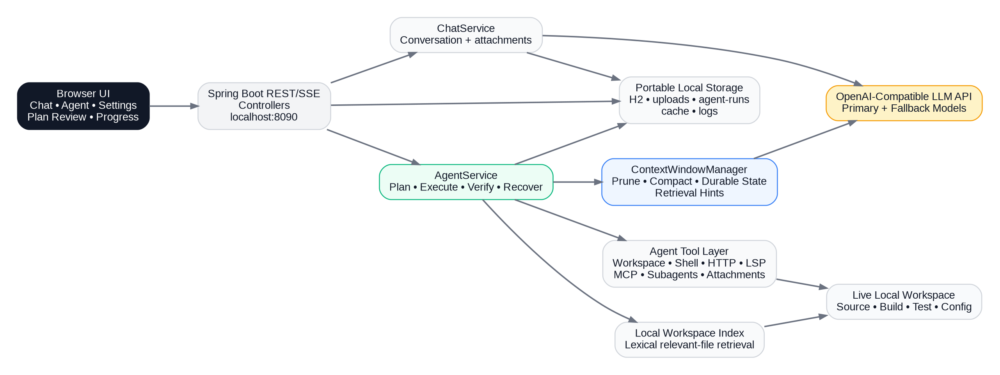
2. High-Level Architecture
Single-user local web application with Spring Boot orchestration and OpenAI-compatible model access.
The browser never accesses the workspace directly; Spring Boot mediates persistence, tools, approvals, model calls and execution state.

Slide 4
3. User Experience & Interaction Modes
CHAT
AGENT
Fast conversational work
Controlled autonomous execution
Persistent conversations and message history
File upload, extraction, download and view
Streaming answer delivery over SSE
Edit / rewind user messages
Project/file context can be included
Filesystem paths are resolved from the prompt
Read-only analysis occurs before planning
Plan can be edited, added to, reordered or unselected
Single approval locks the plan
Each step must do real work and verify mutations before progression
Live progress, model and token telemetry
Only Chat and Agent are exposed as primary modes; workspace selection is prompt-driven rather than a permanent sidebar state.

Slide 5
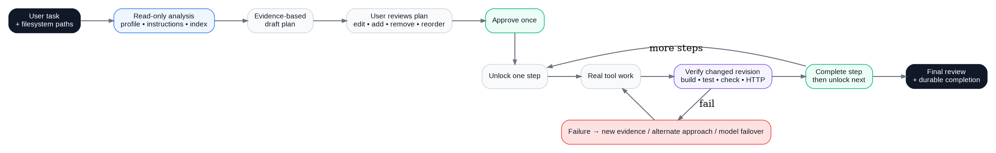
4. Agent End-to-End Lifecycle
The Agent does not generate a plan directly from the prompt; it first gathers workspace evidence.
Before approval
After approval
Completion
Read project profile, instructions, descriptors, relevant file index, resource catalog and focused search results. No normal workspace mutation.
Only the active plan step is unlocked. The model may autonomously inspect, edit and run tools within that step.
A mutated revision must be verified. Next step unlocks only after completion; final response waits until the whole plan is done.
This state machine prevents a model response from accidentally crossing multiple plan-step boundaries in one turn.

Slide 6
5. Evidence-Based Planning & Editable Review
1
2
3
4
5
6
Resolve paths
Inspect workspace
Collect evidence
Generate 4–12 steps
User edits plan
Approve once
Evidence used before planning
Plan review controls
Workspace profile and mapped resources
AGENTS.md / CLAUDE.md / OpenCode instructions
Build descriptors and high-signal project files
Focused lexical search from the user objective
Skills, subagents, MCP/LSP status
Edit text of any step
Add new steps
Remove unwanted steps
Include / unselect individual steps
Move steps up or down
Save changes before approval
Approval means “lock this edited plan and run Step 1” — not approval after every individual step.

Slide 7
6. Sequential Execution & Verification Gate
Active step
Real tool work
Mutation?
Verify revision
Unlock next
No mutation → step can complete
Mutation → verifier must pass first
Guard 1
Guard 2
Guard 3
todo_update alone cannot fake completion.
Later tool calls in the same response are deferred after a plan boundary.
Final answer is blocked while approved plan steps remain incomplete.
Verification is revision-aware: only a real changed workspace revision requires a new verifier.

Slide 8
7. Workspace & Multi-Resource Resolution
Primary workspace
Instruction hierarchy
Prompt
Authoritative live root. Agent mutations, build and verification happen here.
AGENTS.md, CLAUDE.md, .opencode/instructions.md, Copilot instructions and nested project guidance.
Primary project: D:\work\new-playwright
Reference project: D:\work\selenium-old
Recorded flow: D:\recordings\payment.json
Reference resources
Additional paths can be exposed with safe roles for read/write/build/test/check operations.
Extension discovery
Resolver supports Windows, UNC, quoted/backticked, smart-quoted and POSIX-style paths.
Skills, MCP configuration and LSP configuration can come from project or supported user-level locations.
Attachments
Uploaded artifacts remain conversation-scoped and can be listed, read or searched.

Slide 9
8. Agent Tool Ecosystem
60 built-in tools plus dynamically discovered MCP tools.
Inspect & retrieve
Mutate workspace
Execute & verify
inspect_workspace, profile, list, glob, grep, index, read, chunk, read_many
edit, write, apply_patch, copy, move, delete, resource_*
build, test, check, bash, process_start/status/output/stop
Integrations
Context resources
Plan state
http_request, MCP status/tools, LSP, skills, subagents
attachments, instruction catalog, resource catalog
todowrite, todoread, todo_update, workspace_status/diff
Independent read-only calls can be executed in parallel; mutation and plan progression remain ordered.

Slide 10
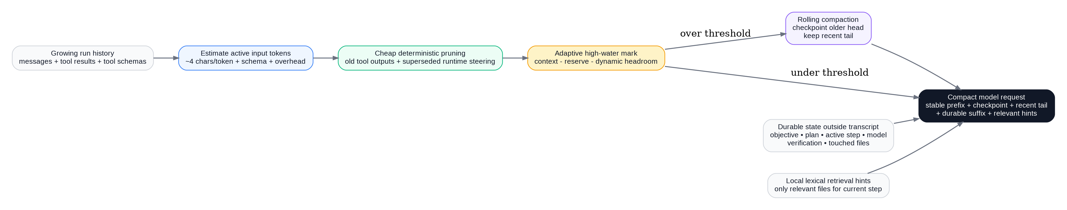
9. Token & Context Management
Adaptive rolling context keeps durable state while reducing repeated tool/history tokens.
Estimate
Prune early
Compact adaptively
Rehydrate state
Message tokens + tool-schema tokens + request overhead are estimated before each call.
Old tool output and superseded runtime steering are reduced before hard compaction.
Threshold = usable input limit − dynamic headroom. Recent tail remains verbatim.
Objective, active plan, model, revisions, verification and relevant-file hints are re-injected compactly.
Defaults: ~8k recent-context target, 20k safety/output reserve, ~1,200 characters for older tool observations.

Slide 11
10. Model Pool, Recovery & Failover
Primary model
Fallback 1
Fallback 2
Fallback 3
Preserved across switch
Immediate failover
Current retry behavior
Workspace root, edited/approved plan, active step, mutation revision, verification state and durable run record.
Unknown / unsupported / unavailable model errors skip the normal retry budget and move to the next configured model.
Transient 429/5xx/timeout failures currently share the per-model recovery budget. A future refinement should separate transport retries from reasoning recovery.
Recommended operational improvement: cap 504/timeout retries, compact once, then fail over instead of resending the same large request repeatedly.

Slide 12
11. Persistence, Data Model & Portable JAR
Portable application layout
Persistent data
<jar-folder>/
advanced-ai-workbench.jar
data/
chatdb.mv.db
uploads/
agent-cache/
agent-runs/
cache/
logs/
Conversation
Message
title + timestamps
role + content + attachments
File
ProjectWorkspace
stored path + MIME + extracted text
conversation + local path
ProjectFile
Agent run
relative path + indexed text
JSON record in data/agent-runs
ZERO-CONFIG PATH RESOLUTION
Startup resolves the packaged JAR directory at runtime, avoiding the old “./data follows the current CMD directory” portability problem.

Slide 13
12. REST & SSE API Surface
Browser UI communicates with localhost Spring Boot endpoints.
Chat
Agent
Conversations
POST /api/chat/stream
PUT /api/agent/runs/{id}/plan
POST /approvals/{id}
POST /runs/{id}/cancel
GET /runs/{id}
GET/POST /api/conversations
GET /{id}/messages
PATCH /{id}
POST /{id}/rewind/{messageId}
DELETE /{id}
GET /{id}/export
SSE model stream
Plan, approval and durable run state
History and editable conversation state
Files
Projects
Artifacts
POST /api/files
GET /api/files
GET /{id}/text|view|download
POST /api/projects[/local]
GET /api/projects
POST /{id}/files/batch
POST /{id}/apply
DELETE endpoints
POST /api/artifacts/excel
POST /api/artifacts/project-patch
Upload and extraction
Indexed project context
Generated downloadable artifacts
The service binds to 127.0.0.1:8090 by default; API key is supplied to model calls through the application, not stored as a shared global credential.

Slide 14
13. File, Project & Artifact Capabilities
File ingestion
Project indexing
Secret handling
Conversation-scoped upload storage. Plain text is read directly; DOCX/XLSX/PPTX use structured extractors with Tika fallback; PDF/other formats use Tika.
Local project scan skips common build/dependency/cache directories, binaries, oversize files and sensitive filenames. Common build descriptors are prioritized.
Indexed text is redacted for common API key/token/password/secret assignments and Bearer tokens before persistence.
Patch safety
Artifacts
Live workspace
Target normalization and symlink-segment checks prevent a project patch from escaping the selected root.
Supports Excel export and project-patch artifact creation through dedicated endpoints.
Agent operates on the real mapped local path; project index is context support, not a sandbox substitute.
Images/audio/video are stored as attachments but do not receive generic text extraction in the current file service.

Slide 15
14. Permissions, Security & Privacy
Agent permission matrix
Current deployment boundary
Edit
allow / ask / deny
Localhost-only binding by default
Single-user local application architecture
API keys are personal and should not be shared
Request/header DEBUG logging should remain disabled because Authorization may contain the key
Indexed project content applies secret redaction and sensitive-file skipping
Enterprise exposure would require TLS, authentication, RBAC, central secrets and audit controls
Shell
allow / ask / deny
Review
allow / ask / deny
MCP
allow / ask / deny
Subagent task
allow / ask / deny
LSP
allow / ask / deny
“Allow” gives autonomy; “Ask” creates explicit approval points; “Deny” blocks the action category.

Slide 16
15. Build, Test, Packaging & Startup
1
2
3
4
5
6
Java 17
Maven / wrapper
Spring Boot package
Copy JAR anywhere
java -jar ...
Open localhost:8090
Technology baseline
Release test behavior
Portable startup
Spring Boot 3.5.16
Java 17
H2 runtime database
Apache Tika 2.9.2
Apache POI 5.2.5
Default POM currently skips Maven tests during normal install/package. Full tests are enabled explicitly through the full-tests profile.
The JAR creates data, uploads, agent-cache, agent-runs, cache and logs beside itself. No hard-coded drive or user-home data path is required.
java -jar advanced-ai-workbench.jar
Roadmap: re-enable deterministic unit tests in normal release CI and quarantine only genuinely environment-bound integration tests.

Slide 17
16. Troubleshooting & Operational Guidance
Symptom
Likely cause
Recommended action
H2 “unsupported database file version / invalid header”
Old/incompatible/corrupt H2 file or wrong historical data location
Stop app; preserve/rename DB if needed. New portable build writes beside JAR.
HTTP 504 Gateway Time-out
Provider model did not respond before upstream gateway timeout
Check model load and input size; prune/compact; retry conservatively; fail over.
Agent repeats same action
No-progress reasoning loop or stale assumption
Inspect last events; recovery rotates strategy; fallback model if loop persists.
Agent waits for approval
Draft plan or tool permission is in Ask state
Review/edit/approve plan or resolve the visible tool approval.
High token consumption
Large tool observations, repeated retries or uncompacted context
Watch token telemetry; prune/compact; avoid repeated identical 504 retries.
A 504 is a provider/gateway timeout, not proof of context overflow. A true hard context error is normally returned as a client/request validation failure.

Slide 18
17. Current Constraints & Recommended Next Improvements
Transport retry policy
Provider diagnostics
Separate HTTP retry budgets from Agent reasoning recovery; especially cap 504/timeout retries and compact before retrying large payloads.
Show per-request input estimate, payload size, output allowance, latency, HTTP status and retry reason.
Optional semantic index
Database migration
Add embedding-backed retrieval for very large repositories while keeping the zero-cost lexical index as the default.
Add explicit H2 migration/backup/reinitialize workflow for incompatible legacy database files.
Enterprise hardening
Release CI
Authentication, TLS, RBAC, centralized secrets and audit trails when deployment moves beyond localhost.
Run deterministic unit tests by default; isolate only environment-sensitive tests.
Ready for controlled local testing: analyse → plan → review → execute → verify → recover → finish

