Slide 1
ELIYA09
Complete Product, Agent Architecture, Workflow & Usage
Chat + Agent • MCP • Live Workspace • Large Task Manager • 68 Built-in Tools
BNP green corporate theme
As-built from ELIYA09 source
25 September 2026
1

Slide 2
ELIYA09 in one slide
A local Java 17 AI workbench with a conversational path and a controlled execution path
CHAT
AGENT
LARGE TASKS
Streaming Q&A, documents, images, project context, read-only MCP, PDF/Markdown/JSON and Excel exports.
Plan → approval → one active step → tools → live workspace → final verification. Durable status and optional fallback models.
Durable work-item ledger, bounded batches, checkpoints, failure clustering, failed-only recovery and completion gates.
Core idea: evidence and runtime state are authoritative; model text alone cannot satisfy completion gates.
ELIYA09 | As-built source documentation
2

Slide 3
Chat vs Agent
Use the mode whose safety and execution boundary matches the task
Chat is for
Agent is for
Conversation • local document understanding • images • read-only MCP • project explanation • exports
Planned code work • migrations • tests • shell/build/test • external writes • live project changes • long tasks
Agent workspace can be optional
Jira + Confluence + attached requirement analysis can run without a project. Add a workspace when the request needs project inspection or mutation.
ELIYA09 | As-built source documentation
3

Slide 4
Feature map
Everything visible to the user plus the execution machinery behind it
✓
Independent Chat/Agent models
✓
Prompt Library
✓
Attachments + local extraction
✓
Vision in Chat
✓
Local project mapping
✓
Plan approval
✓
Live Agent status
✓
68 built-in tools
✓
Dynamic MCP tools
✓
Jira/Confluence read & write boundaries
✓
LSP integration
✓
AGENTS.md / skills
✓
Subagent profiles
✓
Large-task ledger
✓
Checkpoints / rollback
✓
Revision-aware verification
✓
Optional Agent fallbacks
✓
Conversation history / rewind
✓
Clear history
✓
PDF / MD / JSON / XLSX / patch ZIP
ELIYA09 | As-built source documentation
4

Slide 5
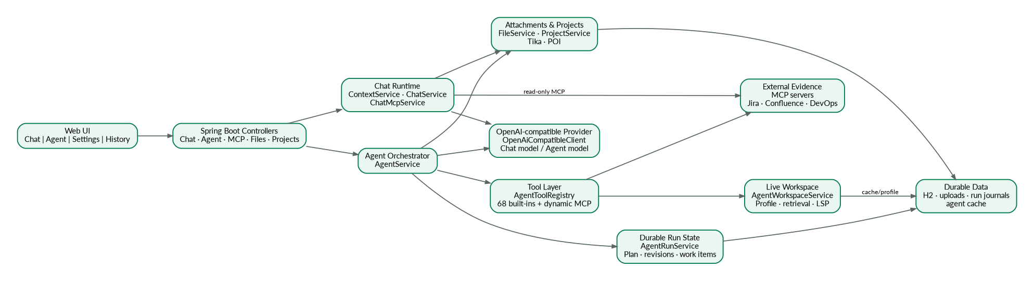
Solution architecture
Separation of UI, Chat, Agent, tools, workspace, external evidence and durable state
ELIYA09 | As-built source documentation
5

Slide 6
Request routing
The runtime deliberately chooses different paths instead of treating every prompt as an autonomous code task
Ordinary Chat
MCP Chat
Workspace Agent
ChatService → ContextService → provider streaming → persist response
ChatMcpService detects external evidence intent → read-only MCP loop → grounded response
Project + resources + instructions + retrieval + MCP/LSP → plan → tools → verification
No-workspace Agent
Remembered workspace routing
MCP + uploaded documents → plan/approval → analysis/report. Local mutation tools are not invented.
External-only Jira/Confluence/document prompts can detach a remembered workspace; project/code intent keeps it active.
ELIYA09 | As-built source documentation
6

Slide 7
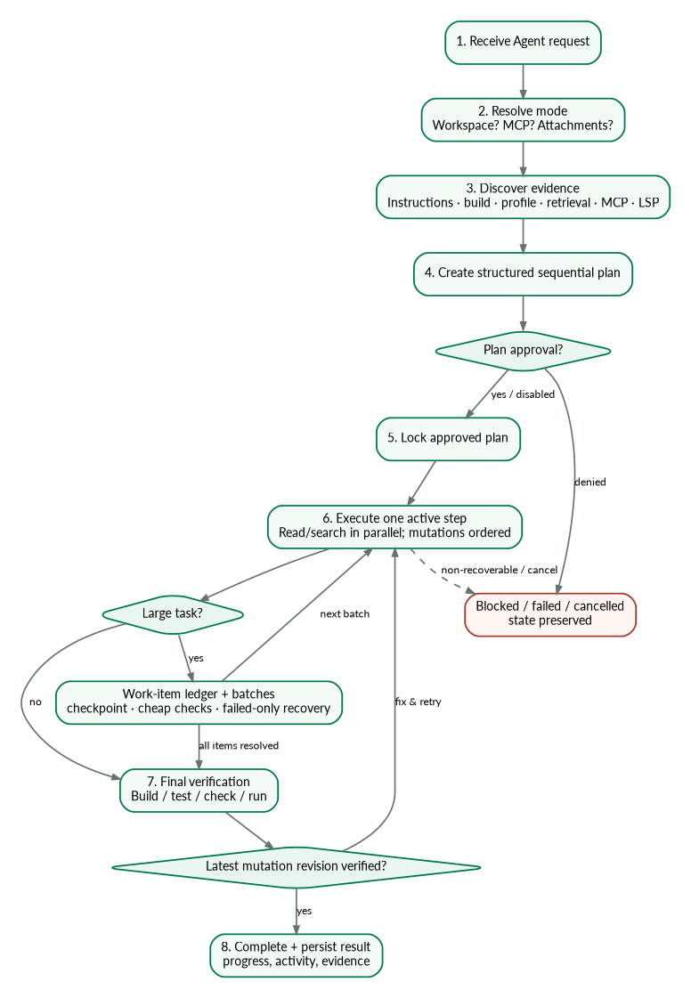
Agent lifecycle
Plan-first sequential execution with deterministic verification gates
ELIYA09 | As-built source documentation
7

Slide 8
Planning & approval
Human control is a runtime boundary, not just a prompt instruction
Plan creation
Plan approval
Plan lock
Model receives bounded evidence and creates a structured sequential plan with validation and a final verification phase.
Enabled by default. User can review/edit before lock. Denial cancels without local execution.
After approval only one step becomes active; later steps remain gated. Model prose cannot skip locked steps.
The plan is execution state stored by AgentRunService—not merely text in the chat transcript.
ELIYA09 | As-built source documentation
8

Slide 9
Live workspace architecture
Agent works on the user-selected project directly
AgentWorkspaceService
PromptResourceResolver
Read/search/edit/write/copy/move/delete • build/test/check/bash • process • HTTP • checkpoints • final delta
Explicit paths become role-aware aliases: primary/secondary workspace, reference, input, diagnostic.
Why this design helps
No staging mirror • fewer path ambiguities • reference projects stay read-only • mutations feed revision tracking • final state is hash/binary safe.
ELIYA09 | As-built source documentation
9

Slide 10
Core Agent components I
Orchestration, durable state, tools and workspace
AgentService
AgentRunService
AgentWorkspaceService
Coordinates planning, approval, tool loop, recovery, verification and completion.
Durable plan/progress/model/work-item/revision/activity state.
Real local filesystem/process/build/test/HTTP/checkpoint execution.
AgentToolRegistry
AgentApprovalService
PromptResourceResolver
68 allowlisted tool schemas + aliases + parallel-read classification + MCP merge.
Plan/permission approval lifecycle.
Safe multi-path role and alias resolution.
ELIYA09 | As-built source documentation
10

Slide 11
Core Agent components II
Evidence, context and external capability
WorkspaceProfileService
WorkspaceRetrievalIndexService
ContextWindowManager
Caches reusable repository basics.
Local lexical index + incremental changed-path refresh.
Token estimation, pruning, compaction and durable-state reinjection.
McpManager
LspManager
AgentProfileService
Generic stdio/HTTP MCP discovery, calls, config, secrets and status.
Language-server diagnostics/reference evidence against live files.
Reusable subagent profile discovery and focused task delegation.
ELIYA09 | As-built source documentation
11

Slide 12
Shared components used by the Agent
Provider, files, projects, models and exports
OpenAiCompatibleClient
ContextService
FileService
OpenAI-compatible provider + tool protocol compatibility
Conversation/document/image context assembly
Tika/POI local extraction + attachment tools
ProjectService
ModelCapabilityRegistry
ModelProbeService
Workspace/project metadata and Chat project operations
Model type/context/vision metadata
User-defined model validation
BoundedCommandOutput
Hashing
ConversationService
Command transcript limits
Binary-safe baseline/delta identity
History/rewind/delete
FileContextSelector
ProjectContextService
Pdf/Excel/ProjectPatch services
Relevant prior attachment selection
Bounded Chat project context
User-facing exports
ELIYA09 | As-built source documentation
12

Slide 13
Complete Java component inventory 1/4
Every main-source class is represented; detailed Agent responsibilities are on the preceding component slides
LlmApplication
Spring Boot application entry point.
ChatController
Chat SSE, cancellation and model-probe API.
AppConfig
Spring configuration and application beans.
ConversationController
Conversation/history/export API.
AppPathResolver
Resolves per-user application data/cache/log paths.
FileController
Attachment upload/read/view/download/re-extract API.
AgentController
Agent run/plan/approval/cancel/status REST API.
McpController
Remote MCP config/test/clear API.
ApiExceptionHandler
Global API exception mapping.
ProjectController
Project/workspace mapping, rescan, files and patch apply API.
ArtifactController
Excel/PDF/project-patch export API.
ELIYA09 | As-built source documentation
13

Slide 14
Complete Java component inventory 2/4
Every main-source class is represented; detailed Agent responsibilities are on the preceding component slides
ChatMode
Chat-vs-Agent mode enum.
ConversationEntity
H2/JPA conversation record.
ChatRequest
Request payload carrying conversation, prompt, mode, settings, attachments and project context.
FileEntity
H2/JPA attachment record.
ChatSettings
Normalized provider/model/context/agent permission/fallback settings.
MessageEntity
H2/JPA message record.
ConversationDto
Conversation API view.
ProjectFileEntity
H2/JPA project-file metadata record.
ExcelExportRequest
Excel export request.
ProjectWorkspaceEntity
H2/JPA project/workspace record.
FileDto
Attachment metadata/extraction status view.
ConversationRepository
Spring Data repository for conversations.
MessageDto
Message API view.
FileRepository
Spring Data repository for attachments.
ProjectDto
Project/workspace API view.
MessageRepository
Spring Data repository for messages.
ProjectFileUpload
Project file upload item.
ProjectFileRepository
Spring Data repository for project-file records.
ProjectPatchRequest
Project patch/export request.
ProjectWorkspaceRepository
Spring Data repository for workspaces.
ProjectUploadBatch
Batch project upload request.
ELIYA09 | As-built source documentation
14

Slide 15
Complete Java component inventory 3/4
Every main-source class is represented; detailed Agent responsibilities are on the preceding component slides
AgentApprovalService
Approval gateway
ChatMcpService
Read-only Chat MCP loop
AgentCancelledException
Explicit cancellation signal
ChatService
Supporting runtime component
AgentProfileService
Reusable agent-profile discovery
ContextService
Conversation context assembler
AgentRunService
Durable state machine
ContextWindowManager
Context budget manager
AgentService
Agent orchestration
ConversationService
Conversation persistence
AgentToolRegistry
Tool contract & routing
ExcelExportService
Markdown-table to XLSX export
AgentWorkspaceService
Live workspace engine
FileContextSelector
Relevant prior-file selector
BoundedCommandOutput
Output limiter
FileService
Local document extraction
ELIYA09 | As-built source documentation
15

Slide 16
Complete Java component inventory 4/4
Every main-source class is represented; detailed Agent responsibilities are on the preceding component slides
Hashing
Content identity helper
PdfExportService
Local PDF export
ImageUnderstandingService
Supporting runtime component
ProjectContextService
Chat project evidence selector
LspManager
Language-server bridge
ProjectPatchService
Patch ZIP builder
McpManager
Generic MCP runtime
ProjectService
Conversation project/workspace records
ModelCapabilityRegistry
Model capability metadata
PromptResourceResolver
Multi-path resource resolver
ModelProbeService
Custom model probe
WorkspaceProfileService
Durable project profile
OpenAiCompatibleClient
Provider transport
WorkspaceRetrievalIndexService
Local retrieval index
PatchConflictException
Patch conflict signal
ELIYA09 | As-built source documentation
16

Slide 17
Tool architecture
Compact stable built-ins + dynamically discovered MCP
Stable allowlist
Deferred capability
Parallel reads
68 built-in tools with JSON schemas and canonical names.
tool_search can expose relevant deferred/dynamic schemas only when needed.
Independent read/search/status calls can run together; mutations stay ordered.
Workspace discovery & local evidence (13)
Prompt-resolved resources (16)
Conversation attachments (3)
Reusable guidance / delegation / deferred capability (8)
Direct workspace mutations (6)
Execution, process & network (9)
Review, checkpoint & plan state (7)
Large-task work-item management (6)
ELIYA09 | As-built source documentation
17

Slide 18
All built-in tools 1/4
Every fixed AgentToolRegistry component is listed; dynamic MCP tools are discovered at runtime
Workspace discovery & local evidence (13)
inspect_workspace • workspace_profile • workspace_profile_refresh • list • glob • grep • file_info • file_index • read • read_chunk • read_many • instruction_catalog • instructions_for
Prompt-resolved resources (16)
resource_catalog • resource_list • resource_info • resource_index • resource_read • resource_chunk • resource_grep • resource_edit • resource_write • resource_delete • resource_copy • resource_move • resource_build • resource_test • resource_check • resource_bash
ELIYA09 | As-built source documentation
18

Slide 19
All built-in tools 2/4
Every fixed AgentToolRegistry component is listed; dynamic MCP tools are discovered at runtime
Conversation attachments (3)
attachment_list • attachment_read • attachment_search
Reusable guidance / delegation / deferred capability (8)
skill_catalog • skill • agent_catalog • task • tool_search • mcp_status • lsp_status • lsp
ELIYA09 | As-built source documentation
19

Slide 20
All built-in tools 3/4
Every fixed AgentToolRegistry component is listed; dynamic MCP tools are discovered at runtime
Direct workspace mutations (6)
edit • write • copy • move • delete • apply_patch
Execution, process & network (9)
build • test • check • bash • process_start • process_status • process_output • process_stop • http_request
ELIYA09 | As-built source documentation
20

Slide 21
All built-in tools 4/4
Every fixed AgentToolRegistry component is listed; dynamic MCP tools are discovered at runtime
Review, checkpoint & plan state (7)
workspace_status • workspace_diff • workspace_checkpoint • workspace_rollback • todowrite • todoread • todo_update
Large-task work-item management (6)
work_items_discover • work_items_init • work_items_add • work_items_read • work_items_update • verification_failures
ELIYA09 | As-built source documentation
21

Slide 22
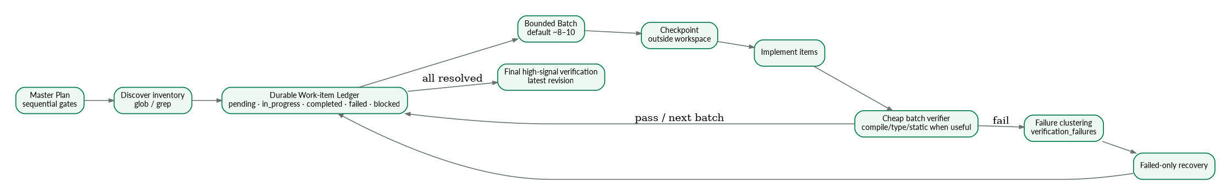
Large-task manager
Normal tasks stay fast; broad migrations gain durable batching only when needed
Completion is blocked while work items or verifier failures remain unresolved.
ELIYA09 | As-built source documentation
22

Slide 23
Revision-aware verification
The latest changed workspace must be the revision that passed real verification
Mutation revision
Verifier evidence
Completion gate
Meaningful writes advance the revision requiring verification.
build / test / check / run / HTTP verification is recorded against a revision.
Stale verifier success cannot prove later edits. Latest required revision must pass.
Large-task extra gate
Unresolved pending/failed/blocked work items or captured verifier failures also prevent success.
ELIYA09 | As-built source documentation
23

Slide 24
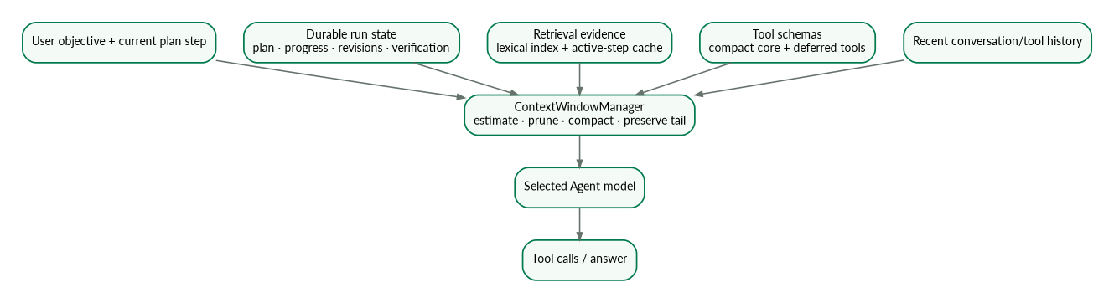
Context & token management
Durable runtime facts stay outside the transcript; only bounded evidence enters each model call
Incremental retrieval refresh + active-step cache + pruned tool outputs reduce repeated work.
ELIYA09 | As-built source documentation
24

Slide 25
Models, retries & optional fallback
Current ELIYA09 source behavior
Independent selectors
Fallbacks are optional
Run state is preserved
One Chat model and one primary Agent model.
UI supports up to two fallback Agent models; disabled by default.
Model switching does not reset approved plan/workspace/work-item state.
Provider recovery
Documentation note
Source defines three retries per model activation and bounded cyclic model switching when enabled.
README still contains older “no fallback chain” text. Executable source/UI is the as-built truth for this package.
ELIYA09 | As-built source documentation
25

Slide 26
Remote MCP architecture
Generic integration—no Jira/Confluence logic in AgentService
Configuration
Chat
Agent
Settings → Remote MCP: URL, connection name, timeout, user-id and product tokens. Test performs initialize + tools/list.
MCP activates for relevant external prompts and exposes read/search only.
Uses full discovered tools subject to permission policy; can combine MCP + workspace + attachments.
Secrets
Precedence
Managed file lives outside project; values are not returned by config API or inserted into model prompts.
User-level config + workspace .agents/.opencode MCP config; workspace server name overrides user-level.
ELIYA09 | As-built source documentation
26

Slide 27
Agent without a workspace
Designed for Jira / Confluence / MCP / document analysis
Example
Read Jira ABC-1234 and the linked Confluence pages, then compare them with the attached requirement document. Produce risks, dependencies, missing requirements and test coverage. No workspace required.
• Still uses plan approval and durable progress
• Can read/search uploaded documents progressively
• Can call configured MCP tools
• Does not invent local workspace operations
• Failed/cancelled runs do not mark remaining steps complete
ELIYA09 | As-built source documentation
27

Slide 28
LSP, AGENTS.md, skills & subagents
Reusable project intelligence without bloating every model turn
Instructions
Skills
Subagents
instruction_catalog / instructions_for load root + nested AGENTS.md and CLAUDE.md.
skill_catalog / skill load focused .agents/skills/.../SKILL.md guidance.
agent_catalog / task run focused fresh-context delegated analysis while main plan remains authoritative.
LSP
Deferred tools
Generic language-server status/diagnostics/reference evidence synchronized to current live files.
tool_search loads relevant tool schemas only when needed, reducing baseline context.
ELIYA09 | As-built source documentation
28

Slide 29
Documents, images & attachments
Local extraction avoids provider-native file upload dependency
Office + PDF
HTML
Images
DOC/XLS/PPT families via Tika/POI; PDF embedded text; old uploads can be re-extracted.
Parsed as document content, so scripts/styles/raw tags are not treated as user-visible text.
Chat only; vision-capable model required; Agent intentionally rejects image understanding.
Agent attachment tools
Known limitation
attachment_list • attachment_read • attachment_search
Image-only/scanned PDF requires OCR outside the current extraction path.
ELIYA09 | As-built source documentation
29

Slide 30
How to use Chat
Fast path for conversation, documents, images, external read evidence and exports
• 1 Configure endpoint/key + Chat model
• 2 Select Chat
• 3 Attach document/image/project if needed
• 4 Ask question; MCP detector activates only for relevant external prompts
• 5 Stream response; Stop is explicit cancellation
• 6 Export PDF / Markdown / JSON / XLSX as needed
• 7 Switch to Agent for mutations/execution/external writes
ELIYA09 | As-built source documentation
30

Slide 31
How to use Agent
A practical operating sequence
• 1 Select Agent + primary model (+ optional fallbacks)
• 2 Select/mention project for code work; omit for external-only analysis
• 3 Attach requirements/logs; configure MCP if required
• 4 State objective, constraints, expected verification and non-goals
• 5 Review/edit/approve generated plan
• 6 Watch current step, backend status and live activity
• 7 Let large tasks use ledger + batches instead of one monolith
• 8 Require final verification of the latest revision
• 9 Review workspace diff/status and final evidence
ELIYA09 | As-built source documentation
31

Slide 32
Settings reference
Main controls that change runtime behavior
Connection
MCP
API key • Base URL • Chat model • Agent model • temperature • max tokens
enabled • name • URL • timeout • user-id • Jira/Confluence/GitLab/Sonar tokens • test • clear
Agent safety
Performance
system prompt • earlier file context • shell • plan approval • granular permissions
parallel reads • context/compaction controls
Recovery
Models
optional fallbacks up to 2 • recovery attempts • auto-approve Ask when configured
editable model library: id • type • context tokens
UI
theme • remembered key • history controls
ELIYA09 | As-built source documentation
32

Slide 33
Persistence & safety boundaries
Durable local state with explicit external/write controls
H2 + uploads
Agent journals
Local binding
Conversations, messages, attachments and project metadata.
Durable run snapshots/activity/work items allow polling and restart continuity.
Default server bind 127.0.0.1:8090.
Secrets
Resource permissions
MCP secrets are not returned to UI API/model prompts; config lives outside project.
Read-only reference/input/diagnostic roles + granular Agent allow/ask/deny controls.
ELIYA09 | As-built source documentation
33

Slide 34
REST/SSE surface
Controllers expose the product without merging UI concerns into runtime services
Chat
Agent
/api/chat/stream • /cancel • /model-probe
approvals • plan edit • cancel • run status • conversation runs
MCP
Files
config GET/POST/DELETE • test
upload • list • re-extract • text • view • download
Projects
Conversations
create/local • rescan • apply • files • delete
list/create/messages/rename/rewind/delete/export
Artifacts
excel • pdf • project-patch
ELIYA09 | As-built source documentation
34

Slide 35
Sample Chat prompts
Coverage across documents, images, project context and read-only MCP
• “Summarize the attached requirement into acceptance criteria, risks, dependencies and questions. Do not invent missing details.”
• “Analyze this screenshot and identify visible UI state/errors and an evidence-based troubleshooting checklist.”
• “Read Jira ABC-1234 and linked Confluence pages through MCP; produce an alignment/gap table. Read-only.”
• “Compare the two attached documents and show common, conflicting, A-only and B-only requirements.”
• “Produce one clean Markdown table so I can export the findings to Excel.”
ELIYA09 | As-built source documentation
35

Slide 36
Sample Agent prompts
Coverage across implementation, migration, MCP and large tasks
• “Project path: … Implement <requirement>. Read instructions/tests, propose plan, then implement and verify the smallest high-signal scope.”
• “Target Playwright / Source Selenium. Migrate <feature>. Keep source read-only, map test data/auth/assertions, and use a work-item ledger for large scope.”
• “Read Jira + Confluence + attached requirement and compare to workspace. Plan, implement missing automation coverage, verify latest revision.”
• “No workspace: read Jira + Confluence + attachments and produce risks/dependencies/gaps. Do not invent local project actions.”
• “Start service with process_start, verify endpoint with http_request, then stop process and use real response as verification evidence.”
ELIYA09 | As-built source documentation
36

Slide 37
Built-in Prompt Library 1/2
17 templates shipped in app.js
1. Write JUnit 5 Tests for Existing Code
Java / JUnit
2. Generate JUnit Tests from Requirement
Java / JUnit
3. Fix an Issue from Error or Stack Trace
Debugging
4. Fix Using a Reference Project
Reference project
5. Migrate Feature from Reference Project
Migration
6. Implement or Modify a Feature
Development
7. Refactor Without Changing Behavior
Refactoring
8. Summarise a Project or Module
Analysis
9. Review Code and Find Improvement Gaps
Code review
ELIYA09 | As-built source documentation
37

Slide 38
Built-in Prompt Library 2/2
Testing, migration, development and reusable agent guidance
10. Playwright MCP + Java Selenium/TestNG/Cucumber
Browser diagnosis
11. Playwright Framework Improvement
Testing
12. Migrate Java Selenium to Playwright TypeScript
Migration
13. Add Tests to Existing Java Automation Framework
Testing
14. Implement a Feature
Development
15. Diagnose and Fix a Bug
Development
16. Stabilize a Flaky Regression Suite
Testing
17. Create AGENTS.md and Reusable Skills
Agent guidance
ELIYA09 | As-built source documentation
38

Slide 39
Use case: Java Selenium / TestNG / Cucumber
Keep the current framework; let Agent use existing conventions and verify the smallest scope
Discover
Implement
Verify
AGENTS.md • skills • pom.xml • runner/tag expression • hooks • pages • steps • Excel data • reporting
Reuse current abstractions and stable locators. Avoid a parallel framework.
Compile and run the smallest relevant tag/module; inspect failures and latest revision.
Optional Playwright MCP can be used as browser evidence without adding Playwright as the Java test runner.
ELIYA09 | As-built source documentation
39

Slide 40
Use case: Selenium Java → Playwright TypeScript
Large migration combines source reference, target workspace, work ledger and final verification
• Map source runner/tags/scenarios/pages/waits/data/auth/assertions/reporting
• Create source→target coverage mapping
• Initialize work-item ledger for requested migration units
• Migrate bounded batches using Playwright-native fixtures/auto-wait/locators
• Checkpoint risky batches + cheap structural checks
• Record failed units; recover failed-only
• Run final typecheck/test scope against latest revision
ELIYA09 | As-built source documentation
40

Slide 41
Use case: Jira + Confluence + requirement + workspace
One Agent run can combine external evidence and local implementation
Jira / Confluence MCP
Requirement attachment
Live project workspace
Acceptance criteria
design decisions
external dependencies
Formal requirements
examples
constraints
Current code
tests
data/config
↓
Agent plan → implementation → final verification
Compare evidence → identify gaps → approve plan → edit live workspace → run real verifier → optionally write final external summary.
ELIYA09 | As-built source documentation
41

Slide 42
Why each architectural choice helps
The value comes from separation of responsibilities and deterministic gates
Durable run state
Selective retrieval
Long tasks survive UI transport problems and do not depend on chat history as the only memory.
Large repositories do not need to be resent to the model every turn.
Plan lock
Revision verification
Prevents scope drift and makes user-approved execution visible.
Blocks success based on stale test/build evidence.
Generic MCP
Resource roles
External tools can change without rewriting core Agent orchestration.
Reference/input paths stay read-only while target workspaces stay explicit.
Large-task ledger
Parallel reads / ordered writes
Failed-only retry avoids redoing hundreds of completed units.
Reduces latency without creating write races.
ELIYA09 | As-built source documentation
42

Slide 43
Validation status
What the shipped ELIYA09 package claims—and what it explicitly does not claim
Recorded passes
Full build limitation
JavaScript syntax • CSS/static checks • focused Java 17 compilation with stubs • PDF/HTML/MCP/source invariants • regression additions
The package report says Maven Central DNS resolution failed in its validation container, so a complete Spring Boot dependency build/JUnit suite was not claimed there.
Release recommendation
Run validate-local.bat / validate-local.sh on the target corporate machine with Maven/repository/proxy access before release.
ELIYA09 | As-built source documentation
43

Slide 44
Getting started
A safe first-run sequence
• 1 Start application and configure endpoint/API key/models
• 2 Validate Chat with a simple prompt and document upload
• 3 Configure/test MCP if external evidence is needed
• 4 Map a small local project
• 5 Run Agent analysis-only prompt
• 6 Run a small edit with plan approval + final verification
• 7 Exercise Clear history and durable run status
• 8 Only then try a broad migration / large-task ledger scenario
ELIYA09 | As-built source documentation
44

Slide 45
ELIYA09
Chat when you need understanding.
Agent when you need planned, evidenced and verified execution.
Source-complete details, every tool, every Java component and all prompt templates are in the companion documentation.
45

