Slide 1
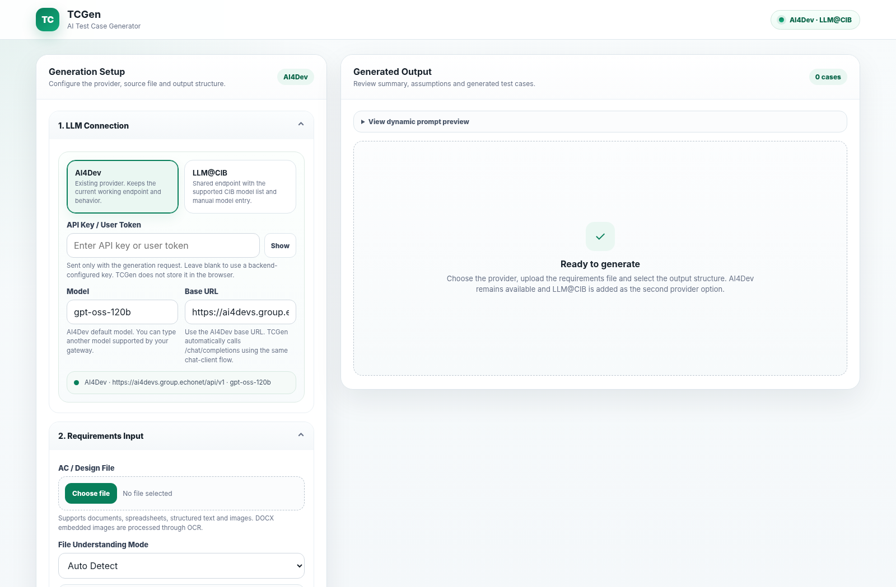
TCGen
AI Test Case
Generator
Complete tool overview, usage guide, architecture and Reset All workflow
AI4Dev
LLM@CIB
Professional green design

Slide 2
What TCGen does
Turns requirement artefacts into structured, reviewable test cases and Excel output.
1. Understand requirements
2. Design test coverage
3. Standardise output
Documents, spreadsheets, structured text and images. DOCX embedded images can be OCR processed.
Manual, API, BDD and regression templates with editable additional instructions.
Dynamic columns, Excel-driven schemas, custom columns and XLSX export.
Core outcomes
✓
Faster preparation
✓
Reviewable reasoning
✓
Team-aligned schema
✓
Repeatable runs
Generate a first-pass test set from common requirement and design artefacts.
Summary, follow-up questions and assumptions are shown with the test cases.
Load the expected column set from Excel or tailor it in the UI.
Reset the workspace without re-entering the LLM connection.
Current improvement
“Refresh Prompt” has been removed. Prompt preview updates automatically; “Reset All” restores the complete working area to its initial state while preserving provider, token, model and base URL.

Slide 3
End-to-end working pattern
A six-step flow keeps setup, generation, review and cleanup simple.
1
2
3
4
5
6
Connect
Upload
Guide
Shape
Generate
Export / Reset
Provider, token, model and base URL
Requirement source + optional schema Excel
Understanding mode + test template
Prompt additions + output columns
Review summary, questions, assumptions, cases
Download Excel, then Reset All for the next run
Key operating principle
Configure the LLM once. Reset All cleans the workspace between requirements but leaves the LLM details intact.

Slide 4
Solution architecture
Java 17 Spring Boot backend, static browser UI, focused services and OpenAI-compatible LLM calls.
Browser UI
REST API
Generation Service
LLM Client
HTML / CSS / JavaScript
/api/testcases/*
orchestrates workflow
OpenAI-compatible chat
File extraction
Excel / DOCX
OCR
Prompt + JSON
Export
Apache Tika
Apache POI
Tess4J / Tesseract
PromptBuilder + parser
XLSX
Runtime flow
Resolve columns → extract text/OCR → build focused prompt → call selected provider/model → parse strict JSON → render + export

Slide 5
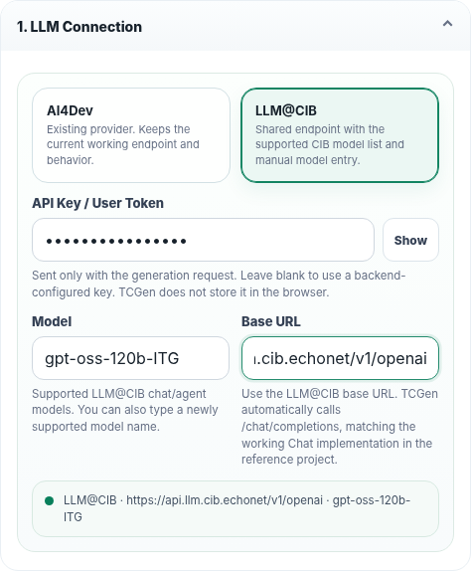
Usage 1 - Configure the LLM connection
AI4Dev and LLM@CIB are available; model and base URL remain editable.
Provider
Choose AI4Dev or LLM@CIB. The provider selection updates defaults and the connection summary.
Token
Enter a request-specific API key/user token only when needed. Blank input can use backend configuration.
Model + Base URL
Both fields are editable, allowing new supported models or gateway endpoints without code changes.
Security: UI-entered token is not persisted in browser storage.

Slide 6
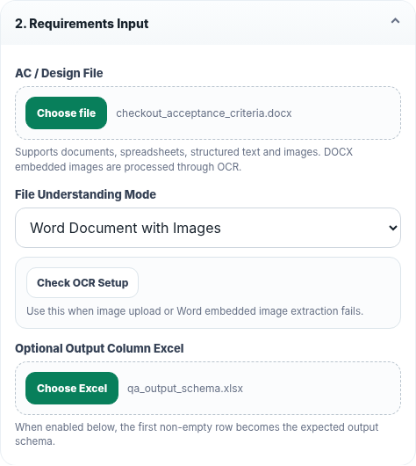
Usage 2 - Upload and interpret requirements
Use a normal document, workbook, structured file, image or Word document with embedded images.
File Understanding Mode
Auto Detect
General default
Document / Excel AC
Primary text requirements
Image with AC Text
Screenshot with readable AC
UI Design / Figma Screenshot
UI labels / validation ideas
Word Document with Images
DOCX text + OCR of embedded pictures
Optional schema Excel
Upload an XLS/XLSX whose first non-empty row represents the expected output columns.

Slide 7
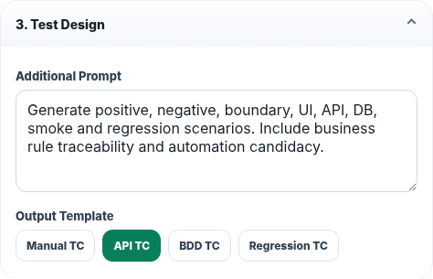
Usage 3 - Choose the test design style
The Additional Prompt supplements built-in test-architect rules; templates change the expected test structure.
Manual TC
API TC
End-to-end functional cases with steps, data, expected results, priority and automation candidate.
Adds method, endpoint, request payload, status code and DB validation.
BDD TC
Regression TC
Feature, Scenario, Given, When, Then, Examples and Tags.
Impact-focused coverage for reusable regression packs.
Prompt preview is dynamic
It refreshes automatically when prompt, mode or selected columns change — no separate Refresh Prompt action is required.

Slide 8
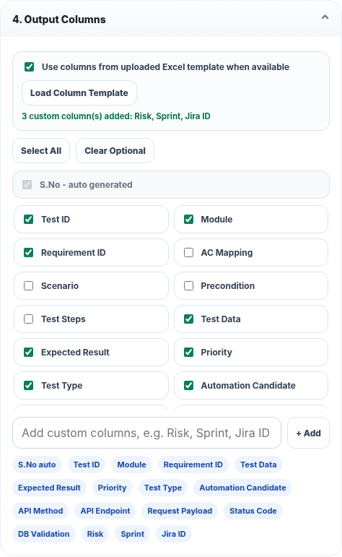
Usage 4 - Output columns and Excel schema
Select defaults, load a team schema from Excel, or add custom columns such as Risk, Sprint or Jira ID.
A. Default set
B. Load Excel
C. Customise
Start from the template’s selected columns.
Detect headers from the uploaded schema workbook.
Add/remove optional or custom fields in the UI.
Column resolution priority
Separate expected-column Excel (when enabled)
Requirement workbook schema
UI-selected columns
Built-in defaults
S.No is auto-generated in Excel and is ignored when detected as an input schema column.

Slide 9
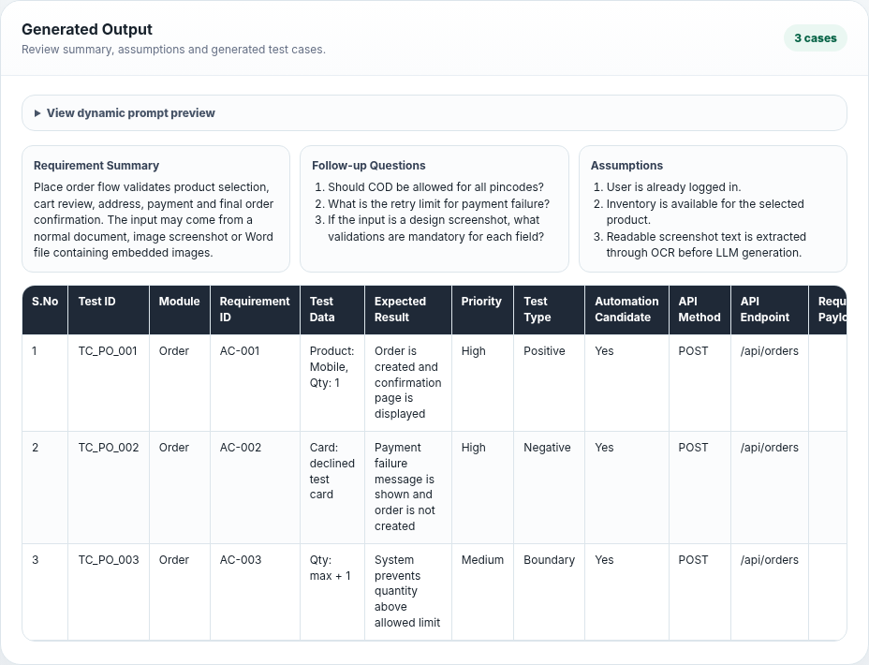
Usage 5 - Generate, review and export
The model response is reviewed as context + test cases before you download the workbook.
Requirement Summary
Quickly confirm the model understood the core business flow.
Follow-up Questions
Expose missing or ambiguous details before accepting coverage.
Assumptions
Make inferred business rules visible for review.
Download Excel → Test Cases + Follow Up Questions + Assumptions

Slide 10
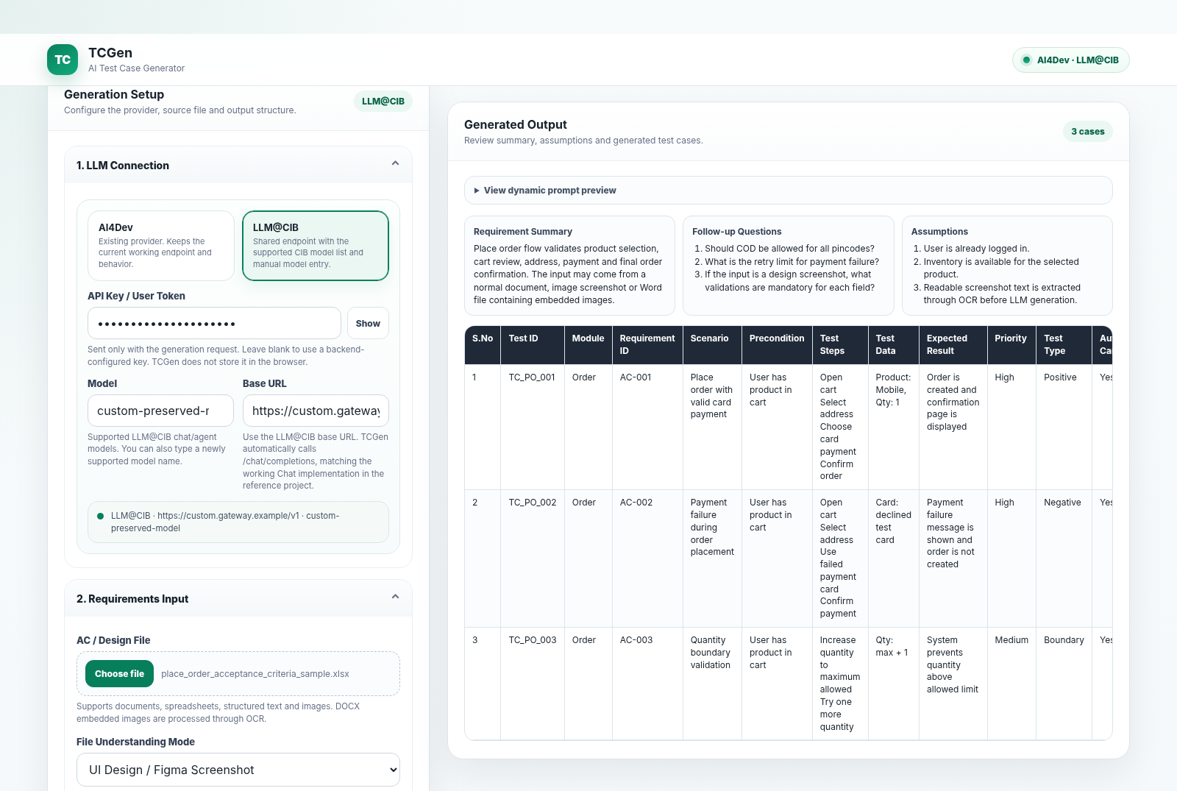
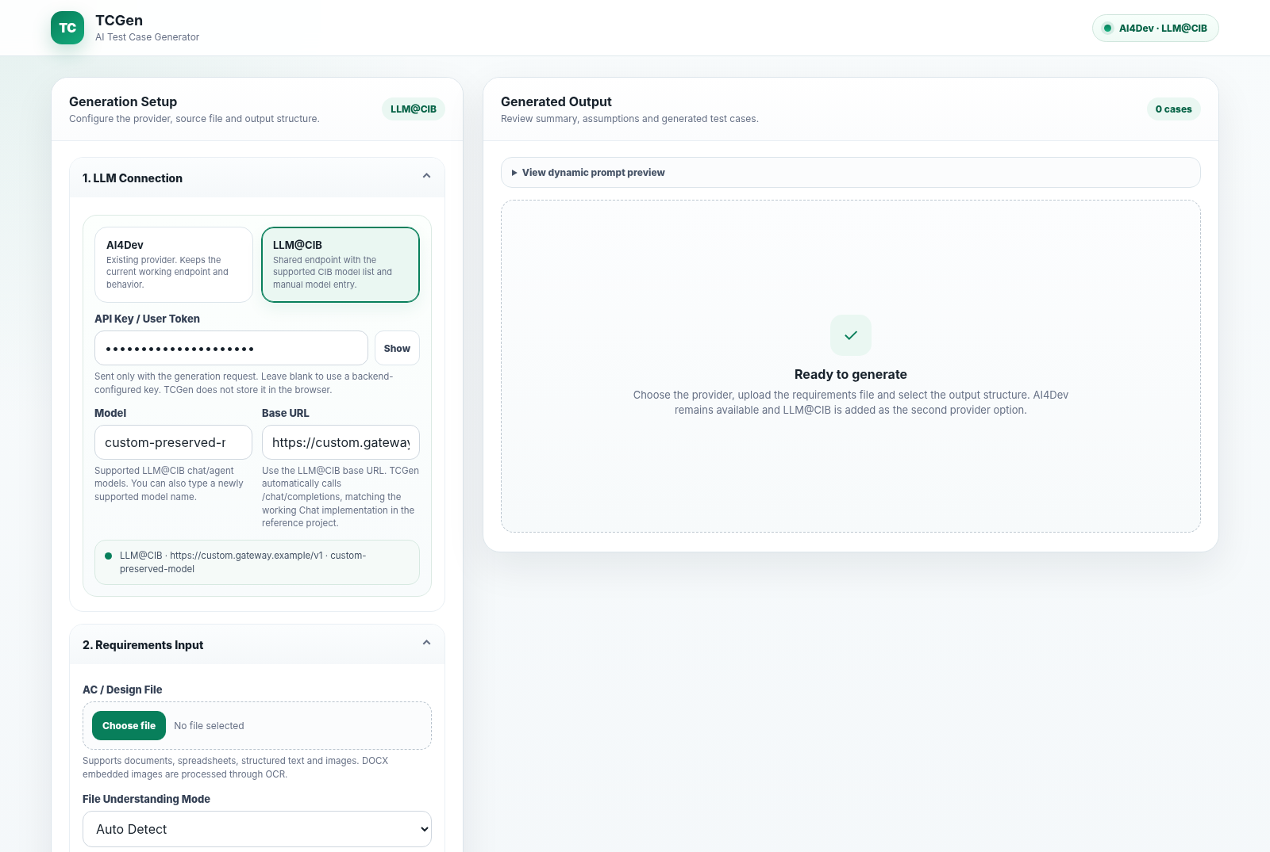
Reset All - clean workspace, preserve LLM details
The old Refresh Prompt action is removed; Reset All is the single workspace cleanup action.
RESET
Before Reset All
After Reset All
Cleared: files, mode, prompt, template, custom/output columns, OCR/Excel status, generated results, errors, count and export state.
Preserved: selected provider, API key/user token, model name and base URL.

Slide 11
OCR and Word-with-image processing
Direct images and embedded DOCX pictures can be converted to text before the LLM prompt is built.
Requirement
Extract
OCR
Merge
Prompt
Image / DOCX
Tika + POI
Tess4J / Tesseract
Document + OCR text
LLM input
Key defaults
Use “Check OCR Setup” when
OCR enabled
true
DOCX image OCR
enabled
Image upload text is not extracted
Word embedded image processing fails
Tessdata path or language needs diagnosis
Language
eng
Max embedded images
20
Minimum image
900 × 600
Bundled tessdata
enabled

Slide 12
LLM request and response behavior
Focused, structured calls keep the generation path predictable.
1. OpenAI-compatible chat
2. JSON-first response
3. Gateway compatibility
TCGen calls /chat/completions with the selected provider, model and bearer token.
The request initially asks for response_format=json_object to obtain structured output.
If the gateway explicitly rejects JSON mode, TCGen retries once without response_format.
4. Strict parse
5. One strict JSON retry
Response is parsed into summary, questions, assumptions, selected columns and testCases.
Only when JSON parsing fails; the same provider/model is used.
Operational guardrails
HTTP request timeout: 4 minutes • max_tokens omitted by default when configured as 0 • same-model retry preserves context and avoids provider drift

Slide 13
REST APIs, runtime and deployment
The browser uses a small API surface on a Spring Boot service running on port 8090.
API surface
Runtime
Libraries
GET
/api/testcases/health
service status
Java 17
Spring Boot 3.1.5
Default port 8090
Apache Tika
Apache POI
Tess4J / Tesseract
GET
/api/testcases/ocr/status
OCR diagnostics
GET
/api/testcases/columns/defaults
default columns
Build & run
POST
/api/testcases/columns/from-excel
detect schema
mvn clean package
java -jar target/tcgen-service-0.0.7-SNAPSHOT.jar
POST
/api/testcases/prompt-preview
build preview
POST
/api/testcases/generate
generate test cases
Environment configuration
POST
/api/testcases/export
XLSX output
Provider keys, model names and base URLs can be supplied through environment variables; generation limits and OCR behavior are configurable as well.

Slide 14
Validation, security and troubleshooting
What was verified for this package and what to check in a production deployment.
Reset All validation
✓
Provider preserved
✓
Prompt reset
Production security notes
Use HTTPS at ingress/reverse proxy
Externalise secrets and restrict network egress
Restrict CORS to approved origins
Use only approved artefacts with the selected LLM endpoint
✓
Token preserved
✓
Template reset
✓
Model preserved
✓
Columns reset
✓
Base URL preserved
✓
Results cleared
Common checks
✓
Files cleared
✓
Export disabled
401/403 → token / entitlement • 404 → base URL • 429 → quota/rate limit • OCR failure → /ocr/status • Excel schema issue → first non-empty row
✓
Mode reset
✓
No UI JavaScript errors
Packaging note: browser Reset All behavior and JavaScript syntax were validated. Maven is not installed in the packaging environment, so a full Maven build could not be executed; no Java source was changed for this enhancement.

Slide 15
Recommended operating pattern
Configure once, generate consistently, review visibly, export, then reset safely.
CONNECT
LOAD
DESIGN
GENERATE
EXPORT
RESET
Provider + model + URL
Requirement + schema
Mode + template + columns
Review context + cases
Excel workbook
Clean workspace; retain LLM
Reset All is now the clean boundary between requirements.
No Refresh Prompt button. No need to re-enter LLM details. No stale file, prompt, column or result state carried into the next run.
TCGen • AI Test Case Generator

