Slide 1
ITPS VIBIUM
MCP Framework
Agentic browser automation with Vibium MCP, LangGraph orchestration, self-healing, parallel execution, recording and auditable reporting
JAVA 17
SPRING BOOT
VIBIUM MCP
LANGGRAPH4J
Complete architecture, feature walkthrough and demo
Prepared from the current source package

Slide 2
Presentation roadmap
From Vibium fundamentals to live framework demo
01
Vibium & rationale
02
Solution architecture
What Vibium is and why it fits agentic automation
How Spring Boot, LangGraph, MCP and the browser connect
03
Execution mechanics
04
Operations & controls
Scenario parsing, browser modes, self-healing and validation
Recorder, cookies, security, reports and diagnostics
05
Demo
06
Quality & roadmap
Connection → configure → execute → investigate results
Unit tests, limitations and next improvements

Slide 3
What is Vibium?
The browser-control layer underneath this framework
V
Official positioning
Vibium describes itself as a verification layer for coding agents. It provides browser automation through simple CLI commands, an MCP server, and client libraries. The browser-control path is built on WebDriver BiDi.
AI / Agent
Vibium MCP
WebDriver BiDi
Browser
Structured browser tools are easy for an agent to call.
Visible browser interaction can be observed and audited.
MCP allows the framework to keep browser execution separate from LLM reasoning.
The current framework uses Vibium as the actuation layer, not as the test-management layer.
Source: VibiumDev/vibium official GitHub README and WebDriver BiDi documentation (accessed Sep 2026).

Slide 4
Why Vibium in this framework?
Agent-friendly browser control without moving test orchestration into the browser library
M
MCP-native
B
Standards-based
O
Observable
Structured tool calls fit naturally into LLM planning and healing.
Vibium is built around WebDriver BiDi for browser automation.
Screenshots, page maps, text and DOM probes support evidence-based validation.
F
Flexible execution
D
Deterministic + agentic
A
Auditable
Shared browser, direct MCP processes and parallel workers can be orchestrated by Java.
The framework can prefer exact selectors first, then use LLM planning only when needed.
JSON-RPC transcripts and artifacts make agent decisions easier to investigate.
Vibium capability statements sourced from the official Vibium repository; framework behavior sourced from the current project codebase.

Slide 5
The problem this tool solves
Traditional UI automation is reliable when locators and flows are stable; real applications are not always stable.
Common automation pain points
Framework response
Locator drift and dynamic UI components cause avoidable failures.
Generated locators may be syntactically valid but semantically wrong.
A successful click/fill call does not prove the intended state changed.
Parallel browser execution can create lifecycle, session and port conflicts.
Recovery logic is often scattered across tests instead of centralized.
Investigating failures requires screenshots, tool logs and attempt history.
Deterministic-first action resolution with agentic fallback.
Closed-loop Plan → Execute → Validate → Heal orchestration.
Fixed 2/3/4-browser worker pool for controlled parallelism.
Evidence checks after actions instead of trusting tool success alone.
Built-in recorder, cookies, reruns, reports and MCP diagnostics.
AI connection gate so endpoint/model/key are validated before use.

Slide 6
Solution overview
A local Spring Boot application that combines deterministic automation with bounded agentic recovery
Scenario
Excel / JSON
Spring Boot
UI + APIs
LangGraph
Agentic Step
Vibium
MCP
Browser
AUT
Reports &
Diagnostics
1
Configure
2
Execute
3
Investigate
Validate AI connection, choose scenario sheets, browser, parallelism, zoom, screenshots, retries and cookies.
Each step is orchestrated through LangGraph with deterministic-first action handling and Vibium MCP.
Live status, rerun controls, detailed HTML/Excel/JSON, screenshot report and MCP diagnostics.

Slide 7
Current capability map
What is implemented in the current source package
1
Input & authoring
2
Execution
3
Agentic
• Excel / JSON scenarios
• Multi-sheet selection
• Run-column filtering
• Data substitution
• UI action recorder
• Shared browser
• Separate browser/test
• 2–4 browser pool
• Headless / headed
• Immediate scenario reruns
• LangGraph4j state machine
• LLM planning
• Fresh-observation healing
• Confidence threshold
• Strict evidence validation
4
Controls
5
Observability
6
Safety
• Cookie replacement
• Additional cookies
• Self-signed cert recovery
• Optional custom zoom
• Automatic maximize
• Live KPIs
• HTML / Outlook report
• Excel / JSON
• Screenshot report / ZIP
• MCP manifest / transcript / logs
• AI connection gate
• API key masking
• Cookie value redaction
• Bounded healing retries
• Unsupported zoom fallback to 100%

Slide 8
Architecture
How the local application, agentic engine, Vibium MCP and browser fit together
ITPS VIBIUM Framework

Slide 9
High-level architecture
The Java application owns orchestration; Vibium owns browser actuation
QA / Automation User
Spring Boot Web UI
TestRunService / Runner
LangGraph4j Agentic Step
OpenAI-compatible LLM
Endpoint • Model • Key
MCP Client
Vibium MCP
WebDriver BiDi
Chrome / Browser
Application Under Test
Reports & Diagnostics
Scenario files & recorder feed the Java orchestration layer. Browser actions travel through MCP → Vibium → WebDriver BiDi. Results flow back into reports and diagnostics.

Slide 10
Component architecture
Main source modules and their responsibilities
Web UI
Controllers
Core services
Integration services
Connection gate
Recorder
Run configuration
Live results
ConnectionController
RunController
RecorderController
BrowserController
TestRunService
ItpsMcpRunner
AgenticActionGraph
ScenarioFileParser
ReportService
McpClient / ToolCatalog
LlmClient
CookieSessionManager
BrowserZoomSupport
InsecureCertificateRecovery
Cross-cutting models: RunConfig • RunStatus • TestScenario • ScenarioResult • ScenarioAttemptResult • StepResult

Slide 11
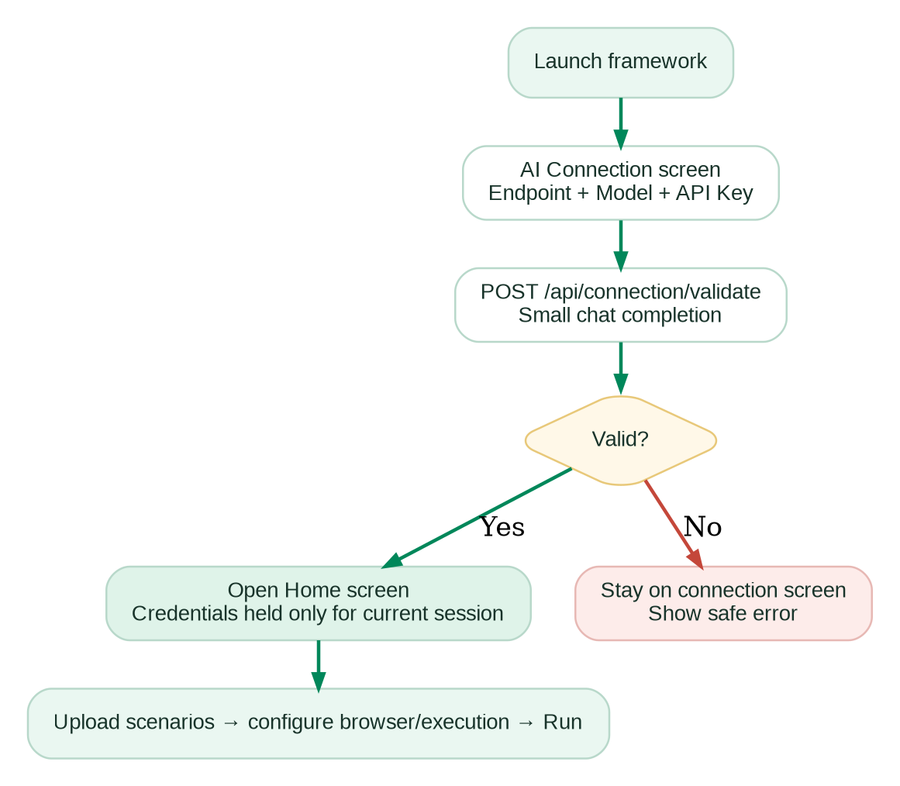
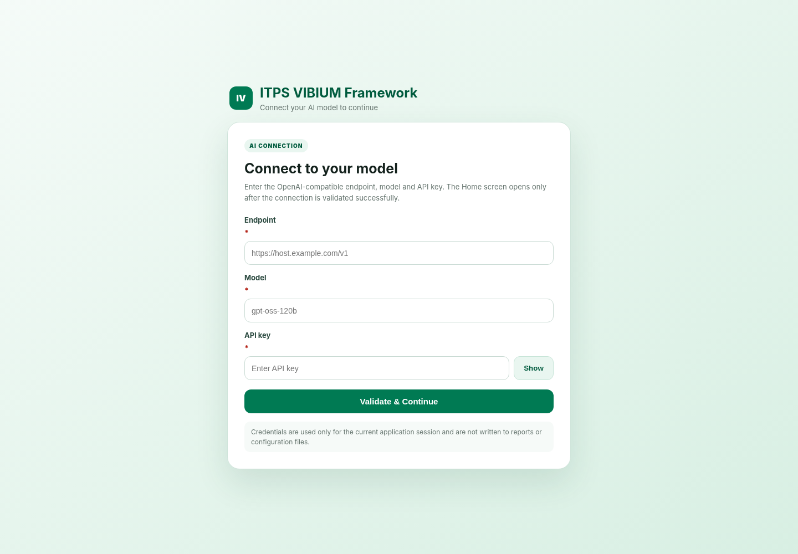
Startup AI connection gate
Home is inaccessible until endpoint, model and API key are validated
Current implementation: POST /api/connection/validate; 10 s connect timeout, 30 s read timeout; OpenAI-compatible chat completion required.

Slide 12
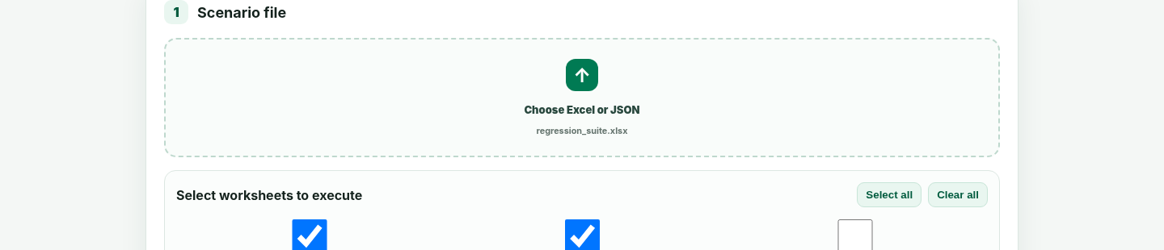
End-to-end user journey
A guided path from connection validation to downloadable evidence
1
2
3
4
5
6
7
Connect AI
Choose tests
Choose browser
Configure run
Execute
Review
Download
Endpoint + model + key
Excel/JSON + sheets
Managed/installed + zoom
Parallelism, healing, screenshots, cookies
LangGraph + Vibium MCP
Live status + reruns
Reports + diagnostics

Slide 13
Scenario input and data model
Designed for non-code test authoring while preserving deterministic selectors when available
I
Excel / JSON
D
Row & data handling
S
Step styles
Supported inputs:
• .xlsx / .xls
• JSON array
• { scenarios: [...] }
• Multiple Excel worksheets
• Duplicate test IDs made unique when sheets are combined
Optional Run column accepts true / yes / y / 1 / run / execute / enabled.
Data columns can be supplied with data.* or JSON test-data objects. Placeholders such as {{username}} and ${accountId} are resolved before execution.
Steps may be natural-language instructions, explicit XPath/CSS, or direct MCP JSON calls. Deterministic selectors get first priority; natural-language steps can be planned through the connected LLM.

Slide 14
Browser and session modes
Choose state continuity or isolation based on the test design
1
Shared browser
2
Separate browser/test
3
Parallel browser pool
One browser for the complete run. Tests execute sequentially and preserve cookies, storage, tabs and authenticated state. Best when scenarios depend on one session.
Sequential mode only. Each scenario gets a fresh MCP process and browser. Best for independent tests that need hard isolation.
Creates only the selected 2, 3 or 4 worker browsers and reuses them across the scenario queue. Immediate scenario reruns stay on the same worker.
Shared = stateful
Separate = isolated
Parallel = bounded pool

Slide 15
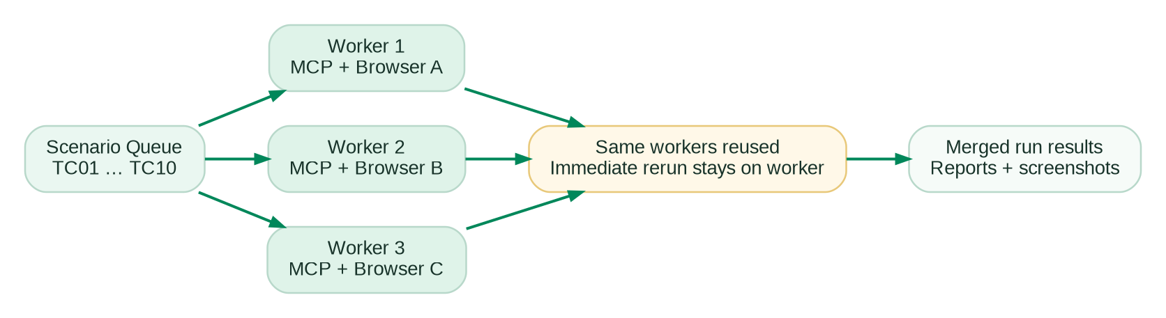
Parallel execution design
Bounded concurrency avoids one-browser-per-test explosion
P
Why this matters
Ten scenarios with three browsers create three MCP/browser workers—not ten. Workers pull scenarios from the queue and are reused.
R
Rerun behavior
A failed scenario can be rerun immediately inside the same worker/browser, preserving the worker lifecycle and avoiding another browser startup.
C
Capacity
UI intentionally limits the pool to 2 / 3 / 4 browsers.

Slide 16
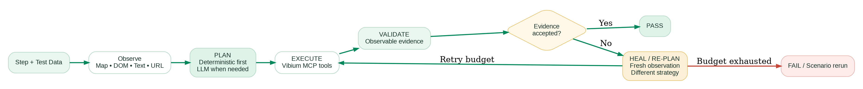
Agentic execution engine
LangGraph4j is the only step-orchestration engine in the current build
Two retry levels: step healing retries one failed action • scenario rerun restarts the complete scenario only after it still ends in failure

Slide 17
Deterministic-first action strategy
Use exact evidence when the step already tells us what to target
1
Explicit XPath / CSS
Resolve against current DOM first
2
Focused-input / visible text
Use purpose-built deterministic executors
3
Enterprise dropdown flow
Open → re-observe → select → verify
4
Vibium page map / semantic refs
Use live mapped element references
5
LLM plan
Only when the instruction needs reasoning or recovery
Result: recorder-generated or hand-authored exact locators are not needlessly “reinterpreted” by the LLM.

Slide 18
Self-healing behavior
Recovery must be evidence-driven and materially different from the failed strategy
1
Fresh observation
2
Ranked candidates
3
Different strategy
Re-read DOM/page map/text after failure rather than healing from stale context.
Consider accessible names, refs, selectors, ancestors, visibility and hit-test evidence.
Healing prompt explicitly tells the model not to repeat the same failed selector or strategy.
4
Confidence gate
5
Bounded retries
6
No browser restart
Healing plan must meet the configured confidence threshold before execution.
retryCount limits step-level healing; maxAgentTurns limits the graph.
Self-healing is prohibited from calling browser_start.

Slide 19
Evidence and validation
A tool returning success is not enough to mark a step as passed
What may be checked
Closed-loop principle
URL or navigation state
Current DOM / element state
Visible text/content
Input/select value
Screenshot difference/evidence
Application-specific expected result
Action call succeeds
Observe result
Validate intent
If evidence does not match the intended state, the graph heals or fails even when the MCP tool itself returned successfully.

Slide 20
Cookie and session controls
Optional native-cookie workflows for test environments
R
Replace one session cookie
+
Add up to 10 cookies
S
Safety behavior
After the home page opens, the framework reads cookies, matches the configured name, preserves supported attributes, clears cookies, restores that cookie with the new value, refreshes and verifies. Rollback is attempted if setting fails.
Additional name/value pairs are added without clearing existing cookies. The framework derives domain/path scope from the current page, refreshes once and verifies all requested values.
Cookie values are redacted from framework reports and MCP transcripts. If native MCP cookie tools are unavailable, normal browser testing still works when cookie setup is disabled.

Slide 21
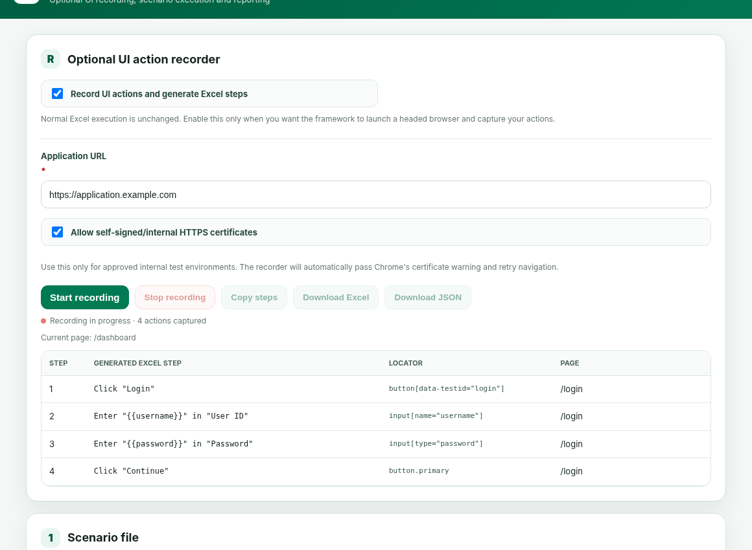
UI action recorder
Capture user interactions and turn them into reusable Excel/JSON steps
1
Capture
Headed browser records click, typing, selection, checkbox, keyboard and upload actions.
2
Review
Captured steps show generated text, locator and page. Individual actions can be deleted.
3
Export
Copy steps or download recorded Excel / JSON.

Slide 22
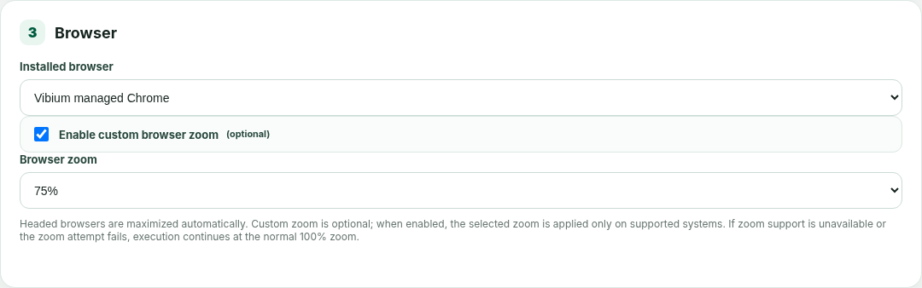
Browser behavior and platform fallback
Maximize is automatic for headed browsers; custom zoom is deliberately optional
OS
Current platform behavior
Windows: native custom zoom is attempted only when PowerShell/pwsh plus WScript support is detected.
macOS/Linux: custom zoom is currently treated as unsupported and execution continues at 100%.
Failure to apply zoom never fails the test run.
M
Maximize
Z
Custom zoom
The framework attempts to maximize headed browser windows automatically. This path is independent of custom zoom.
User may enable 50%–200%. 100% is the default and incurs no native zoom work.

Slide 23
Security and secret handling
Designed to avoid accidental credential exposure while keeping the workflow simple
AI key
Not written to application.properties, generated reports or UI status messages. Home screen does not display it.
Connection validation
Endpoint, model and key are validated before Home opens. 401/403/404/400 responses are converted to safe user messages.
Cookie values
Replacement/additional cookie values are redacted from report/transcript artifacts.
Insecure certificates
Bypass is explicitly configurable and intended only for approved internal/self-signed test environments.
Runtime boundary
Credentials still exist in current browser page state and in-memory RunConfig during execution; this is not a full secret vault.

Slide 24
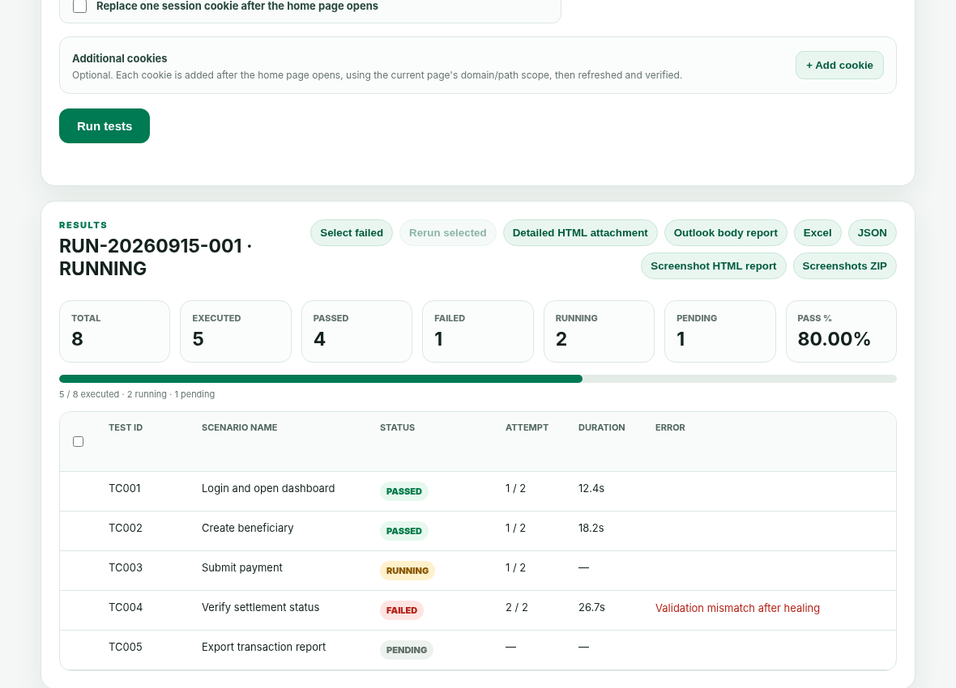
Live execution and rerun controls
The Home screen doubles as a lightweight run console
K
Live KPIs
Total, executed, passed, failed, running, pending and pass percentage update during the run.
L
Scenario lifecycle
PENDING → RUNNING / RERUNNING → PASSED / FAILED / PASSED_AFTER_RERUN.
R
Manual rerun
Select failed or individual scenarios and rerun them from the UI.

Slide 25
Reports and generated artifacts
Each run produces human-readable evidence and machine-readable diagnostics
report.html
outlook-report.html
report.xlsx
Detailed attachment report
Email-body report
Excel report
All scenarios, attempts, steps, filters and evidence
Compact summary + up to 25 scenario rows
Structured execution/attempt data
report.json
screenshots-report.html
screenshots.zip
JSON report
Screenshot report
Screenshot archive
Machine-readable full result
Standalone embedded failure/screenshot view
Downloadable image bundle
mcp-tools.json
mcp-transcript.json
mcp-process.log
Tool manifest
JSON-RPC transcript
Process log
Capabilities exposed by the active Vibium MCP
Redacted request/response trail
MCP/bridge diagnostics

Slide 26
MCP diagnostics and observability
The framework keeps enough context to answer “what did the browser tool actually do?”
T
Tool manifest
J
Transcript
L
Per-session logs
Captures the active MCP tool schemas. This lets the framework adapt behavior to the Vibium build instead of assuming every tool is available.
Redacted JSON-RPC traffic can be inspected for tool name, arguments, errors and responses. Useful for comparing deterministic and healed attempts.
Process/bridge logs and isolated browser session diagnostics help investigate startup failures, timeouts and parallel worker problems.

Slide 27
Demo
A practical walkthrough using the current Home screen and execution flow
ITPS VIBIUM Framework

Slide 28
Demo storyline
Recommended 8–10 minute walkthrough
00:00
Launch
Start the JAR / application.
00:30
Connect AI
Enter endpoint, model and key; validate.
01:30
Load scenarios
Upload Excel and select Smoke + Regression sheets.
02:30
Configure browser
Choose managed Chrome; optionally set zoom; select 3-browser parallel pool.
03:30
Run
Start execution and show three browser workers.
05:00
Healing
Demonstrate one locator/action failure and a recovery attempt.
06:30
Live results
Show KPIs, attempts and manual rerun control.
07:30
Artifacts
Open detailed report, screenshot report and MCP transcript.
09:00
Recorder
Record a short flow and export Excel/JSON.

Slide 29
Demo 1 — connect the AI model
The application will not expose Home until the connection is validated
1
Narrate
“Endpoint, model and API key are runtime inputs. We do not hard-code them into the application.”
2
Show failure path
Use an invalid key or model route once. Home remains hidden and a safe error is displayed.
3
Then validate
Use valid credentials and continue to Home. The key is no longer shown.

Slide 30
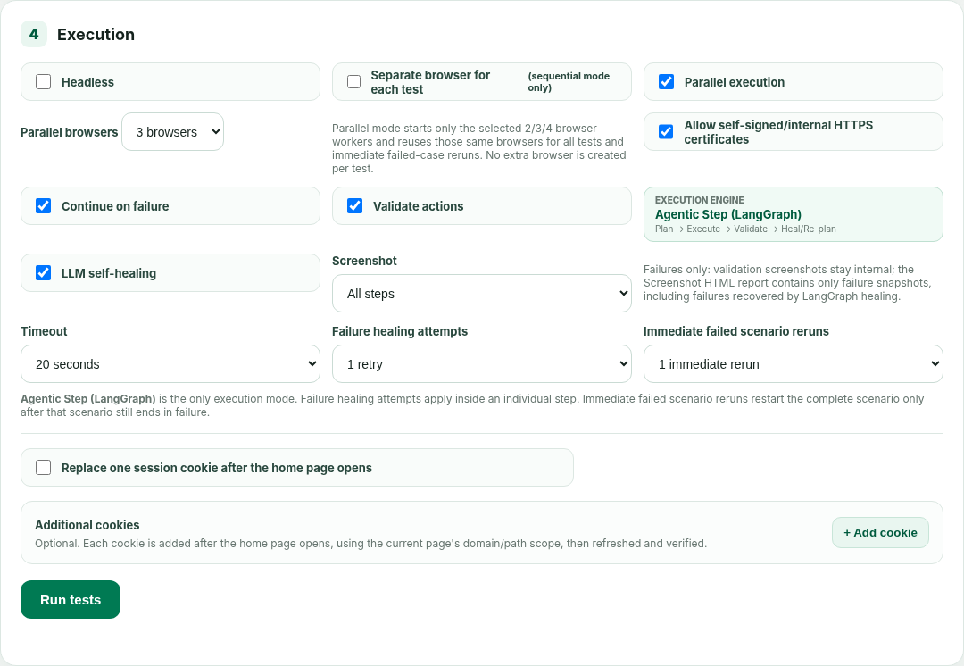
Demo 2 — configure and start the run
Show the user-controlled knobs before execution
Select the required worksheets.
Choose shared / isolated / parallel execution.
Set screenshot mode, timeout, healing attempts and scenario reruns.
Optional: session-cookie replacement or additional cookies.
Click Run tests.

Slide 31
Demo 3 — watch execution and investigate results
Live status is designed for both execution monitoring and first-line triage
Point out RUNNING / PENDING / FAILED / PASSED states.
Show attempt counts and immediate scenario rerun behavior.
Select a failed test and rerun it manually.
Open detailed HTML, screenshot report and MCP transcript.
Explain that report artifacts remain even though live run history is in memory.
Demo tip: force one safe locator failure to show healing

Slide 32
Build and deployment model
Local-first execution with a Spring Boot JAR and Vibium runtime
P
Prerequisites
B
Build
R
Run modes
• Java 17+
• Maven for source build
• Vibium available globally or under tools/vibium-portable
• Node.js for the local TCP bridge used by shared-browser mode
• Network access to AUT and LLM endpoint
Windows: build-windows.cmd
macOS/Linux: build-mac.sh
Direct: mvn clean package
Output: executable Spring Boot JAR under target/.
Shared-browser / recorder use the localhost TCP bridge. Separate-browser and parallel modes launch direct Vibium stdio processes and do not depend on port 8765.

Slide 33
Quality and automated test coverage
The current source includes 13 test classes and 45 @Test methods
Agentic graph
Plan/execute/validate/heal transitions
Parallel pool
Worker reuse and same-worker reruns
Connection gate
Success, rejected key, invalid endpoint
Cookies
Replacement, addition and safety
Browser zoom
Optional/default configuration
Executors
XPath, focused input, dropdown behavior
Certificate recovery
Internal HTTPS interstitial handling
Recorder
Prompt/export behavior
Reporting
Standalone report and screenshot attachment rules
MCP catalog
Tool discovery / capability handling
Release gate recommendation: run mvn clean test (or clean package) on CI before distributing the JAR.

Slide 34
Current limitations / missed areas
Important boundaries to make explicit before wider rollout
Platform browser discovery
Installed Chrome/Edge/Chromium discovery is currently Windows-oriented; macOS/Linux rely mainly on Vibium-managed browser behavior.
Custom zoom
Native custom zoom is currently Windows-only and depends on PowerShell/pwsh + WScript; other platforms use 100%.
Persistent history
RunStore is in-memory. Live run metadata disappears after application restart even though generated files remain on disk.
Framework authentication
The local UI has no application-level RBAC/login beyond the AI connection gate.
Secret vault
API key is not persisted, but there is no Key Vault/OS keychain integration or server-side secret tokenization.
Provider contract
LLM integration expects an OpenAI-compatible /chat/completions response shape.
Browser security boundaries
Closed shadow roots, cross-origin frame internals, CAPTCHA, canvas-only controls and native OS dialogs may need custom support.
Distributed execution
No remote worker/grid scheduler; parallelism is local workstation capacity.

Slide 35
Recommended roadmap
Highest-value improvements for broader team adoption
Now
Next
Later
Stability & portability
Enterprise hardening
Scale & intelligence
Update stale README parallel-mode text
macOS/Linux browser discovery
Cross-platform zoom abstraction or remove native zoom dependency
CI build + full Maven test gate
Persist run history (SQLite/Postgres)
Framework authentication / RBAC
Secret vault or OS keychain integration
Audit/event retention policy
Remote worker execution
Model routing / planner-executor models
Token/cost telemetry
Optional video artifact
Smarter locator ranking / app-map memory

Slide 36
What this framework delivers
A practical bridge between conventional automation discipline and agentic recovery
1
Faster authoring
2
Resilience
3
Controlled scale
Recorder + Excel/JSON reduce code-only dependency
Self-healing is bounded, evidence-driven and auditable
Fixed browser pool adds parallelism without uncontrolled browser creation
4
Operational clarity
5
Flexibility
6
Extensibility
Live KPIs, reruns and rich artifacts shorten triage
OpenAI-compatible model connection is runtime-configurable
Java/Spring/MCP architecture leaves room for enterprise controls

Slide 37
References and Q&A
Primary references used for the Vibium overview
V
Vibium official repository
I
Current ITPS source package
VibiumDev/vibium — README, MCP server documentation and WebDriver BiDi explanation.
Used for: what Vibium is, MCP positioning, WebDriver BiDi foundation and core browser-tool capabilities.
Vibium08_ai_connection_gate_updated source.
Used for: architecture, UI, execution modes, connection gate, LangGraph flow, reports, zoom behavior, APIs and unit-test coverage.
Questions?
Suggested discussion: demo environment • rollout model • CI integration • roadmap priorities
Official Vibium source: github.com/VibiumDev/vibium (accessed Sep 2026).

