Slide 1






Machine Learning
[Product Analysis]
Krishna Pal Tiwari
krishnap152@gmail.com

Slide 2

Brief Synopsis
ABCD Company wants to expand its product portfolio and decided to introduce a new product.
The company has 23 products and wants to introduce a new product variant based on past 9 year data.
It has 2 branches and 78 service centres all over india.

Slide 3
First Problem was to develop a solution architecture for identifying the product variant which will be launched in the market for enhanced profit margin(X%), customer segmentation etc? Also detail out the estimated profit margin of the new-variant product ?
What should be the selling cost of this new variant of a product considering a profit margin of X%?
What should be the fixed Service Charges (this will exclude the parts cost and labour cost ) for this new variant of a product. The company will demand this charge (cost) from the Customers.
What would be the estimated service cost ? The company has to bear for servicing related expenditure (viz. repair, parts replacement etc.) for the expected service requests during warranty period of new-variant product? Warranty period should be assumed as 1 Year.
Problem being solved

Slide 4
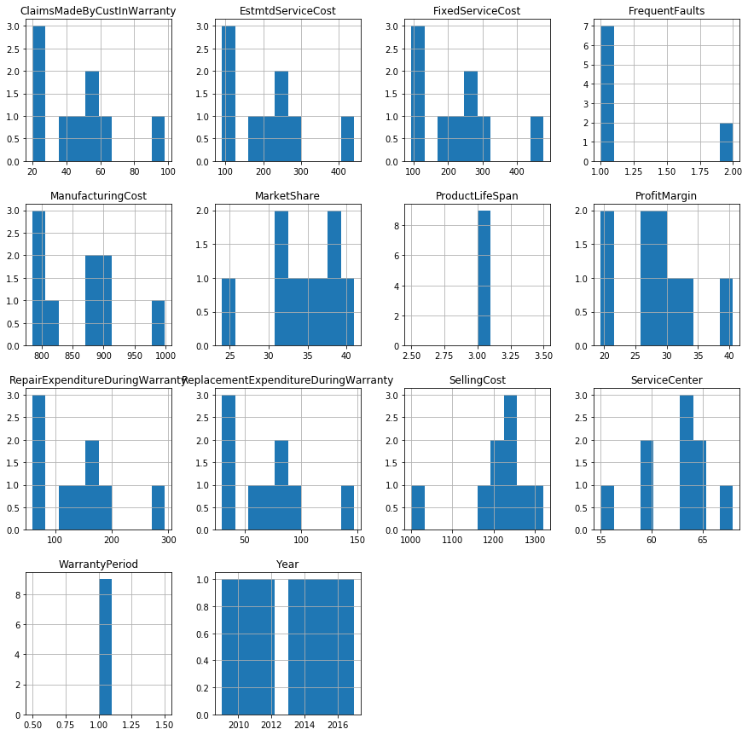
For the first problem statement
  First we developed the sample dataset for past 9 years including all the features.
  Then we plotted the histogram for every variable to get the distribution of each attribute.
High level solution Architecture

Slide 5
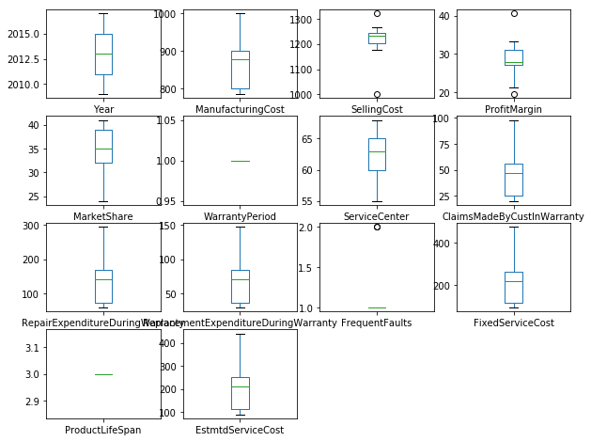
For the first problem statement
  3. Then we plotted the boxplot for every variable to get the distribution of each attribute.Boxplots summarize the distribution of each attribute, drawing a line for the median (middle value) and a box around the 25th and 75th percentiles (the middle 50% of the data). The whiskers give an idea of the spread of the data and dots outside of the whiskers show candidate outlier values
High level solution Architecture

Slide 6
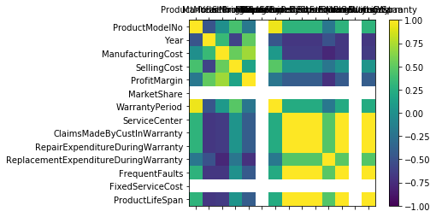
For the first problem statement
  4. Then we plotted the correlation matrix plot for every variable.Correlation gives an indication of how related the changes are between two variables. If two variables change in the same direction they are positively correlated. If the change in opposite directions together, then they are negatively correlated.You can calculate the correlation between each pair of attributes. This is called a correlation matrix. You can then plot the correlation matrix and get an idea of which variables have a high correlation with each other.
High level solution Architecture

Slide 7
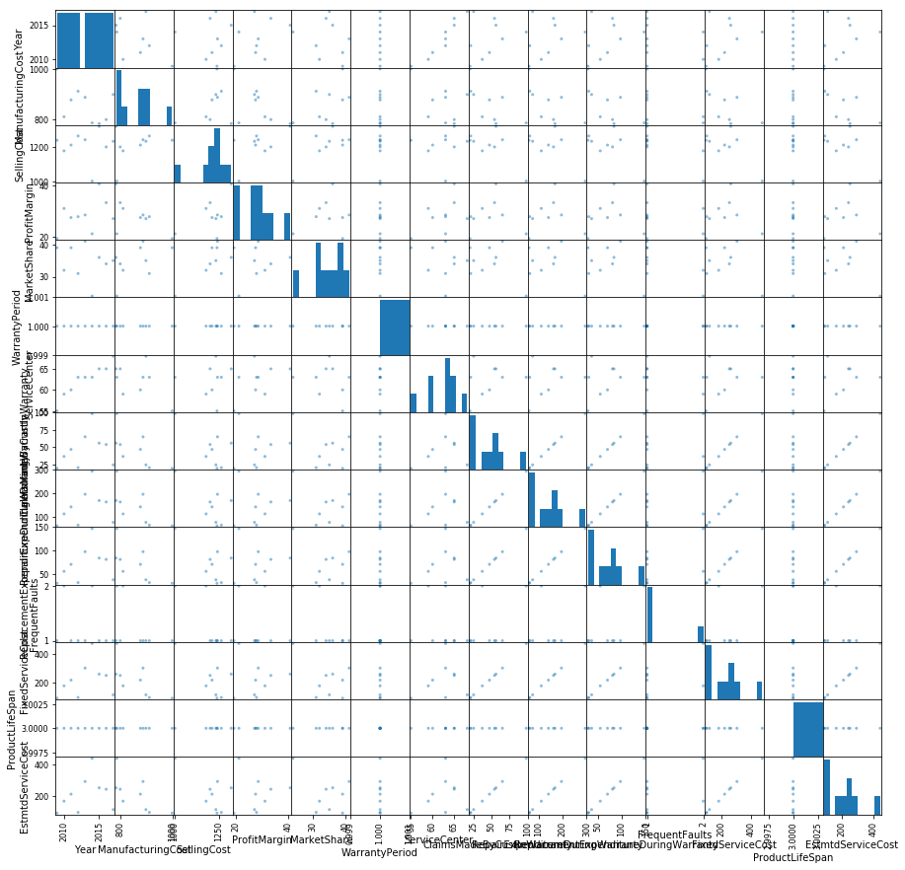
For the first problem statement
  4. Then we plotted the scatter plot for every variable.A scatterplot shows the relationship between two variables as dots in two dimensions, one axis for each attribute. Scatter plots are useful for spotting structured relationships between variables, like whether you could summarize the relationship between two variables with a line. Attributes with structured relationships may also be correlated and good candidates for removal from your dataset.This is useful to look at the pair-wise relationships from different perspectives
High level solution Architecture

Slide 8
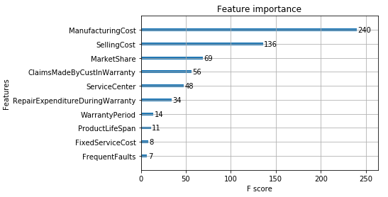
For the first problem statement
  5. After that we calculated the mean of every products for past 9 years,
  6. Then we applied feature selection on the dataset to select which feature are important for predicting the profit margin. Using XGBoost we got the following feature importance graph.
  7. After descriptive analysis we move on to model creation. We applied this descriptive analysis approach for each of the problem statements.
High level solution Architecture

Slide 9
So finally we came to conclusion that product abcd_23 will be the new variant of product for launching in the market with profit margin of approx 28.53
We also created the three model for prediction of profit margin on past data target variable was profit margin
Linear Regressor : divided the data into train and testing the for test data we got the approx same value for 2 row which is having less difference
  Mean squared error: 2.21
  Variance score: 0.6047792305915647
KNN : it predicted the one row approx same having less difference for other two row diff was little bit more
  Mean Square Error 8.555613199869791
  Variance score: 0.528693377088242
XGBoostRegressor : it successfully able to predict the one row correctly out of 3 row
  Mean Square Error 32.809834798177086
  Variance score: 4.862371208735267
  Linear regression gave the best accuracy for profit margin prediction
High level solution Architecture

Slide 10
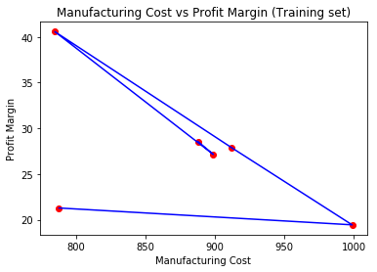
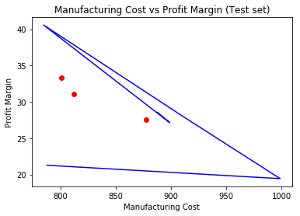
1. For the First problem statement
- Visualising the Training and Test Result for Manufacturing Cost vs Profit Margin using Linear Regresion , where Manufacturing Cost is contributing the most.
High level solution Architecture

Slide 11
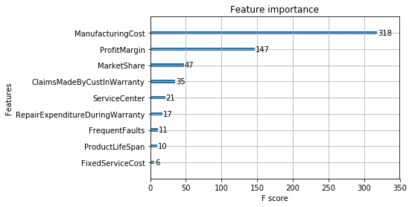
High level solution Architecture
2. For the second problem statement we calculated the selling cost of the product by using 3 model having the selling cost as the target variable. Here is the feature importance for predicting sellign cost
Linear Regressor : divided the data into train and testing the for test data we got the approx same value for 2 row which is having less difference
  Mean squared error: 1600.54 Variance score: 6.976096802139511
KNN : it predicted the one row approx same having less difference for other two row diff was little bit more
  Mean squared error: 1294.15 Variance score: 5.449227672082642
XGBoostRegressor : it successfully able to predict the one row correctly out of 3 row
  Mean squared error: 3206.33 Variance score: 14.978405315614618
If we want to predict the selling cost for new variant of product than we have to provide the some details for test, we can take random data for predicting the selling cost.
KNN gave the good accuracy for prediction.

Slide 12
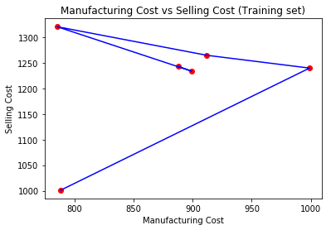
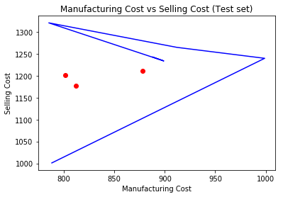
2. For the Second problem statement
- Visualising the Training and Test Result for Manufacturing Cost vs Selling Cost using Linear Regresion , where Manufacturing Cost is contributing the most.
High level solution Architecture

Slide 13
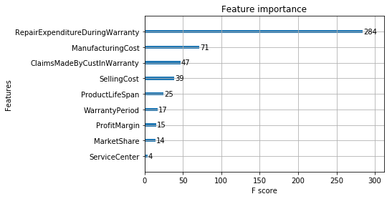
3. For the third problem statement we calculated the fixed service charge of the product by using 3 model having the fixed service charge as the target label, here is the feature importance for predicting the fixed service cost.
Linear Regressor : divided the data into train and testing the for test data we got the approx same value for 3 row which is having less differences between actual and predicted.
  Mean squared error: 20.32 Variance score: 0.9771372940946602
KNN : it predicted the one row approx same having less difference for other two row diff was little bit more
  Mean squared error: 48.95 Variance score: 0.9449272562642429
XGBoostRegressor : it successfully able to predict the one row correctly out of 3 row
  Mean squared error: 3710.11 Variance score: -3.1744801400630127
If we want to predict the fixed service cost for new variant of product than we have to provide the some details for test, we can take random data for predicting the fixed service cost.
for predicting the fixed service cost linear regression gave the best accuracy.
High level solution Architecture

Slide 14
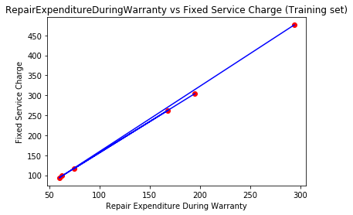
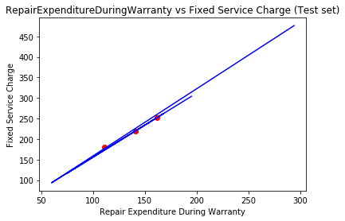
3. For the Third problem statement
- Visualising the Training and Test Result for Repair Expenditure During Warranty vs Fixed Service Charge using Linear Regresion , where Repair Expenditure During Warranty is contributing the most.
High level solution Architecture

Slide 15
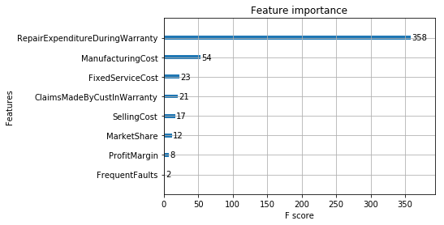
4. For the last problem statement we calculated the estimated service cost of the product by using 3 model having the estimated service cost as the target label.
Linear Regressor : divided the data into train and testing the for test data we got the approx same value for 3 row which is having less differences between actual and predicted.
  Mean squared error: 7.00 Variance score: 0.9928926426301602
KNN : it predicted the one row approx same having less difference for other two row diff was little bit more
  Mean squared error: 46.17 Variance score: 0.9531507167682296
XGBoostRegressor : it successfully able to predict the one row correctly out of 3 row
  Mean squared error: 3186.00 Variance score: -2.232876712328767
If we want to predict the estimated service cost for new variant of product than we have to provide the some details for test, we can take random data for predicting the estimated service cost.
test_model = [[789,1099,28.20746133,25,1,67,12,45,23,2,232,3]] where warranty period = 1
for this test result the estimated service cost prediction is : 154.554
For predicting the estimated service cost linear regression gave the best accuracy.
High level solution Architecture

Slide 16
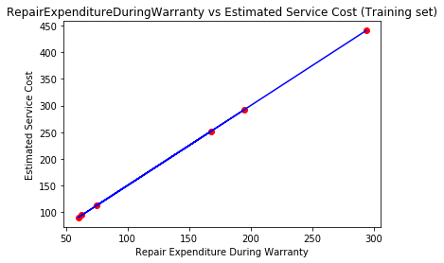
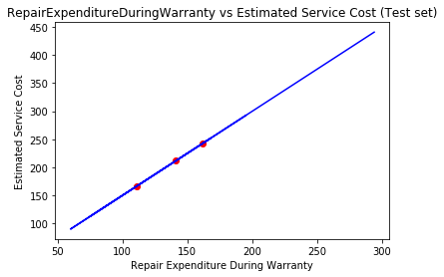
4. For the Fourth problem statement
- Visualising the Training and Test Result for Repair Expenditure During Warranty vs Estimated Service Cost using Linear Regresion , where Repair Expenditure During Warranty is contributing the most.
High level solution Architecture

Slide 17
Always fill the missing values
Split the whole data into train test and validation
If necessary add new calculated columns
Do not overfit the model
Try to tune the hyperparameter.
If any outliers value is present in the data try to remove that sometime for regression it is the major challenge for prediction
If sometime the model is misbehaving then try to normalize the data.
Best Practices

Slide 18
The major challenge was to create the dataset for past 9 years.
Second challenge was to select the appropriate model for prediction
and third challenge was to hypertune the model
Normalizing the dataset
Removal of outliers if any
Challenges faced

Slide 19
Possible Improvement
01
Tuninig the hyperparameter of model so that accuracy and error can be improved
02
Selection of best mcdel

Slide 20


