Slide 1
Session II Part I – BPMN, BPEL and WS*
Umesh Bellur
IIT Bombay
umesh[at]it.iitb.ac.in

Slide 2
What is BPEL?
SalesDB
start
Duplicate
Number!
Billing
Router
end
Markup language for composing a set of discrete services into an end-to-end process flow

Slide 3
The Top Down Perspective
Notation Layer
BPMN or UML
Business Analyst
Activity
Activity
Activity
Executable Layer
XML, XQuery, BPEL, Rules
Integration Developer
assign
invoke
receive
assign
Business Services
Adapters, Java, Struts, JSF
Service Developer
Existing Systems
DATABASE
PACKAGED
APPLICATIONS
JAVA
MAINFRAME

Slide 4
Existing Solutions
Build your own 1-off orchestration
Process flow is implicit and hard coded
(Very difficult to change)
Expensive and risky development project
No out-of-the-box management and monitoring
?
Traditional EAI
Proprietary (metadata, data, process, security, UI)
Intrusive application model
Separate infrastructure
Expensive

Slide 5


The SOA Alternative
An umbrella of standards and technology to reduce the cost and complexity of developing, deploying and managing this new class of connected applications.
Portal and B2B Gateway
JSR-168, CDL, WS-Security
Process Orchestration
BPEL, XSLT, XML Query
Business Services
XML, XML Schema, SOAP, WSDL, WSIF, JCA
Existing Systems
DATABASE
PACKAGED
APPLICATIONS
JAVA
MAINFRAME

Slide 6
The SOA/BPEL Alternative
Build your own 1-off orchestration
Traditional EAI
?
The SOA/BPEL Alternative
Rich metadata (XML Schema, WSDL)
Sophisticated binding framework (WSDL)
Internet scale connectivity
Support for both sync and async interactions (BPEL)
Sophisticated flow coordination (BPEL)
Advanced exception management (BPEL)
Extensible
Composable
Convergence of application development and integration

Slide 7
Why use BPEL?
Used to standardize enterprise application integration as well as to extend the integration to previously isolated systems
Between enterprises, BPEL enables easier and more effective integration with business partners
Definitions of business processes described in BPEL do not affect existing systems
Is the key technology in environments where functionalities are already or will be exposed via Web services.

Slide 8
Orchestration
Usually used in private business processes
A central process (which can be another Web service) takes control of the involved Web services
Coordinates the execution of different operations on the Web services involved in the operation.

Slide 9
Orchestration
The involved Web services do not "know" (and do not need to know) that they are involved in a composition process and that they are taking part in a higher-level business process.
Only the central coordinator of the orchestration is aware of this goal, so the orchestration is centralized with explicit definitions of operations and the order of invocation of Web services

Slide 10
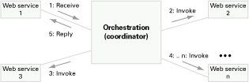
Orchestration

Slide 11
Choreography
Does not rely on a central coordinator
Each Web service involved in the choreography knows exactly when to execute its operations and with whom to interact
Collaborative effort focusing on the exchange of messages in public business processes
All participants in the choreography need to be aware of the business process, operations to execute, messages to exchange, and the timing of message exchanges.

Slide 12
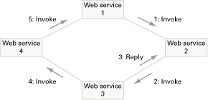
Choreography
5. Invoke
1. Invoke
3. Reply
4. Invoke
2. Invoke

Slide 13
Orchestration versus Choreography
From the perspective of composing Web services to execute business processes, orchestration is a more flexible paradigm and has the following advantages over choreography:
  The coordination of component processes is centrally managed by a known coordinator.
  Web services can be incorporated without their being aware that they are taking part in a larger business process.
  Alternative scenarios can be put in place in case faults occur.

Slide 14
Orchestration versus Choreography
BPEL supports two different ways of describing business processes that support orchestration and choreography:
  Executable processes allow you to specify the exact details of business processes. They follow the orchestration paradigm and can be executed by an orchestration engine.
  Abstract business protocols allow specification of the public message exchange between parties only. They do not include the internal details of process flows and are not executable. They follow the choreography paradigm.

Slide 15
Building a Business Process
Specifies the exact order in which participating Web services should be invoked
  sequentially or in parallel.
Express conditional behaviors.
  an invocation of a Web service can depend on the value of a previous invocation.
Construct loops, declare variables, copy and assign values, define fault handlers, etc.

Slide 16
Building a BP (2)
By combining all these constructs, you can define complex business processes in an algorithmic manner
Because business processes are essentially graphs of activities, it might be useful to express them using Unified Modeling Language (UML) activity diagrams.

Slide 17
BPEL Steps
consists of steps; each step is called an "activity."
supports primitive as well as structure activities.

Slide 18
Primitive Activities
Primitive activities represent basic constructs and are used for common tasks, such as the following:
  Invoking other Web services, using <invoke>
  Waiting for the client to invoke the business process by sending a message, using <receive> (receiving a request)
  Generating a response for synchronous operations, using <reply>
  Manipulating data variables, using <assign>
  Indicating faults and exceptions, using <throw>
  Waiting for some time, using <wait>
  Terminating the entire process, using <terminate>

Slide 19
Combining Primitives
Combine these and other primitive activities to define complex algorithms that specify exactly the steps of business processes
To combine primitive activities, BPEL supports several structure activities. The most important are:
  Sequence (<sequence>), which allows us definition of a set of activities that will be invoked in an ordered sequence
  Flow (<flow>) for defining a set of activities that will be invoked in parallel

Slide 20
Structure Activities
  Case-switch construct (<switch>) for implementing branches
  While (<while>) for defining loops
  The ability to select one of several alternative paths, using <pick>
  Each BPEL process will also define partner links, using <partnerLink>, and declare variables, using <variable>.

Slide 21
Defining a process
You define a new Web service that is a composite of existing services.
The interface of the new BPEL composite Web service uses a set of port types through which it provides operations like any other Web service.
To invoke a business process described in BPEL, you have to invoke the resulting composite Web service.

Slide 22
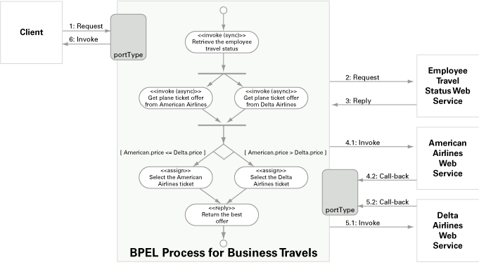
Schematic view

Slide 23
Causes of Faults
Faults in BPEL can be from various sources:
  A BPEL process can explicitly signal (throw) a fault.
  A fault can occur when the BPEL process invokes a Web service operation. The operation might return a WSDL fault message, which results in a BPEL fault.
  A fault can be thrown automatically by the BPEL runtime environment, either due to a certain condition in the BPEL process itself (such as a join failure), as a consequence of error conditions in the runtime environment, or related to network communication or other reasons. For such situations, BPEL defines several standard faults.

Slide 24
Signaling
Signaling Faults
  A business process sometimes needs to signal a fault explicitly. Therefore, BPEL provides the <throw> activity, which has the following syntax:
  <throw faultName="name" />

Slide 25
Handling Faults
When a fault occurs within a business process, the process may not complete successfully.
It can complete successfully if the fault is handled within a scope, which enables you to divide a complex process into several parts; more on scopes later.

Slide 26
Handling Faults
The business process can handle the fault through one or more fault handlers.
Within a fault handler, the business process defines custom activities that should recover from the fault and possibly reverse the partial (unsuccessful) work of the activity where the fault has occurred.

Slide 27
Scopes
Scopes are hierarchically organized parts into which a complex business process can be divided.
They provide behavioral contexts for activities.
  scopes enable you to define different fault handlers for different activities (or sets of activities gathered under a common structured activity such as <sequence> or <flow>).

Slide 28
Scopes (2)
In addition to defining fault handlers, you can declare variables that are visible only within a scope.
Scopes also let you define local correlation sets, compensation handlers, and event handlers.

Slide 29
Events
BPEL supports two types of events:
  Message events are triggered by incoming messages through operation invocation on port types.
  Alarm events are time-related and are triggered either after a certain duration or at a specific time.
Managing message events is particularly important when the business process is waiting for callbacks from partner Web services.

Slide 30
Events (2)
Often, however, it is more useful to wait for more than one message, of which only one will occur.
Alarm events are useful when you want the process to wait for a callback for a certain period of time, such as 15 minutes.
  If no callback is received, the process flow continues as designed.
  Useful in loosely coupled service-oriented architectures, where you cannot rely on Web services being available all the time.

Slide 31
BPEL by Example
<variable>
<process>
BPEL Flow
10:00am
start
Credit Rating
<faultHandlers>
Get Rating
<invoke>
Handle Negative
Credit Exception
<flow>
<partnerLink>
Send Loan Application
Send Loan Application
United Loan
<invoke>
Star Loan
<receive>
<partnerLink>
<partnerLink>
Receive Loan Offer
Receive Loan Offer
</flow>
<switch>
?
Select Lowest Offer
</process>
end
03:00pm

Slide 32
BPEL Interaction Patterns
receive
receive
receive
…
Step 1
4 hours
…
reply
step N
invoke
1. Sync Request Response
2. Fire and Forget
3. Async. Request Response
scope
receive
receive
receive
2 seconds
validate
1 day
validate
…
reply
invoke
2 days
2 days
On event A
…
…
Handle change
invoke
invoke
4. Partial Processing
5. Progress Observer
6. Change Handler

Slide 33
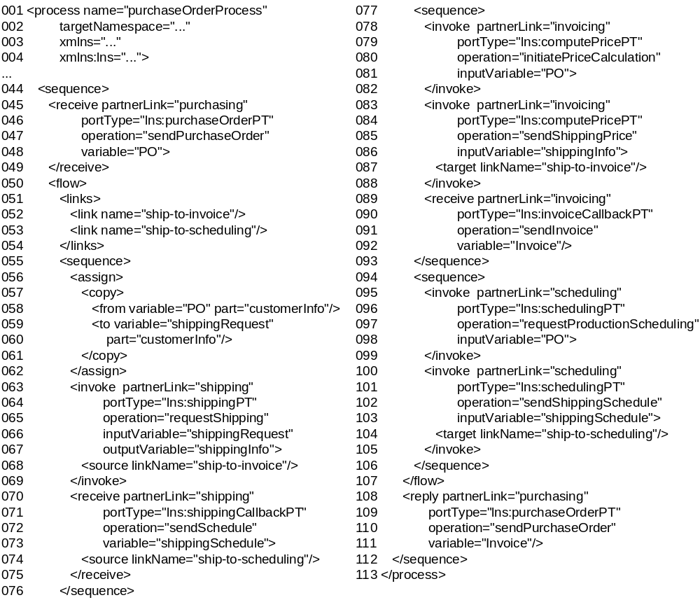
A BPEL Process

Slide 34
Structured Activities

Slide 35
Primitive Activities

Slide 36
Data Flow

Slide 37
Partner Links

Slide 38
BPMN
The primary goal of BPMN is to provide a notation that is readily understandable by all business users, from the business analysts that create the initial drafts of the processes, to the technical developers responsible for implementing the technology that will perform those processes, and finally, to the business people who will manage and monitor those processes. Thus, BPMN creates a standardized bridge for the gap between the business process design and process implementation.
Another goal, but no less important, is to ensure that XML languages designed for the execution of business processes, such as BPEL4WS (Business Process Execution Language for Web Services), can be visualized with a business-oriented notation.

Slide 39
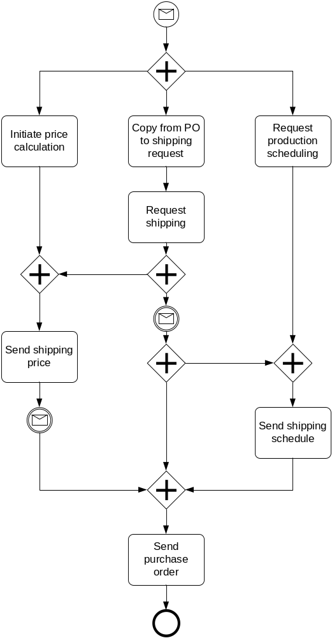
The BPEL Process in BPMN

Slide 40
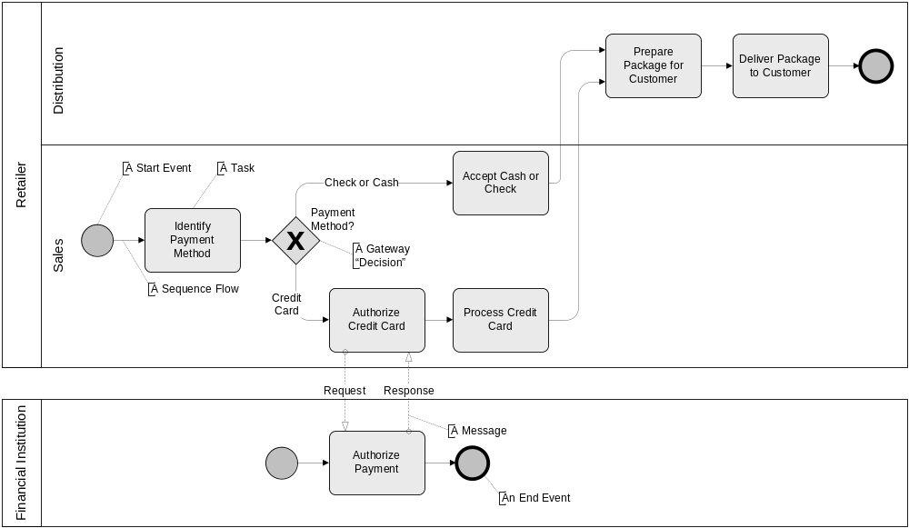
BPMN explained

Slide 41
BPMN Vs BPEL
BPMN is richer than BPEL
Transformation from BPEL to BPMN less a problem
From BPMN to BPEL
  Loss of information
  Loss of design considerations
Potential Solutions
  Restriction to a subset of BPMN
  Extension of BPEL

Slide 42
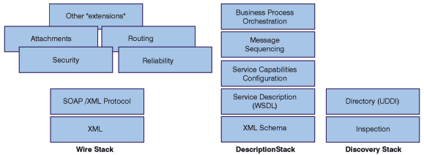
WS* Stack (partial)

Slide 43
Introduction to some WS - * specifications
Web Service Addressing
Web Service Policy
Web Service Transactions
  WS – Coordination
  WS – AtomicTransaction
  WS - BusinessActivity
Web Service Reliable Messaging
  WS – ReliableMessaging
  WS – ReliableMessaging Policy
Web Service Security

Slide 44
WS Addressing and Policy
Web Service Addressing
  provides transport-neutral mechanisms to address Web Services and messages.
Web Service Policy Framework
  defines a base set of constructs that can be used and extended by other Web Services specifications to describe a broad range of service requirements and capabilities.

Slide 45
WS Coordination and Transactions
WS – Coordination
  Describes an extensible framework for providing protocols that coordinate the actions of distributed applications
WS – AtomicTransaction
WS – BusinessActivity
  BusinessAgreementWithParticipantCompletion: BusinessAgreementWithCoordinatorCompletion:

Slide 46
Introduction to the WS - * specifications
Web Service Reliable Messaging
  Describes a protocol that allows messages to be delivered reliably between distributed applications in the presence of software component, system or network failures. The protocol is described in a transport-independent manner.

Slide 47
Introduction to the WS* Specifications
Web Service Security
  Provides comprehensive solutions to secure Web Service communication. In general these issues are addressed:
    Authentication
    Authorization
    Secure Messaging
    Secure data access
    Denial of service

