Slide 1
Cloud Computing with MapReduce and Hadoop

Slide 2
What is Cloud Computing?
“Cloud” refers to large Internet services like Google, Yahoo, etc that run on 10,000’s of machines
More recently, “cloud computing” refers to services by these companies that let external customers rent computing cycles on their clusters
  Amazon EC2: virtual machines at 10¢/hour, billed hourly
  Amazon S3: storage at 15¢/GB/month
Attractive features:
  Scale: up to 100’s of nodes
  Fine-grained billing: pay only for what you use
  Ease of use: sign up with credit card, get root access

Slide 3

What is MapReduce?
Simple data-parallel programming model designed for scalability and fault-tolerance
Pioneered by Google
  Processes 20 petabytes of data per day
Popularized by open-source Hadoop project
  Used at Yahoo!, Facebook, Amazon, …

Slide 4
What is MapReduce used for?
At Google:
  Index construction for Google Search
  Article clustering for Google News
  Statistical machine translation
At Yahoo!:
  “Web map” powering Yahoo! Search
  Spam detection for Yahoo! Mail
At Facebook:
  Data mining
  Ad optimization
  Spam detection

Slide 5
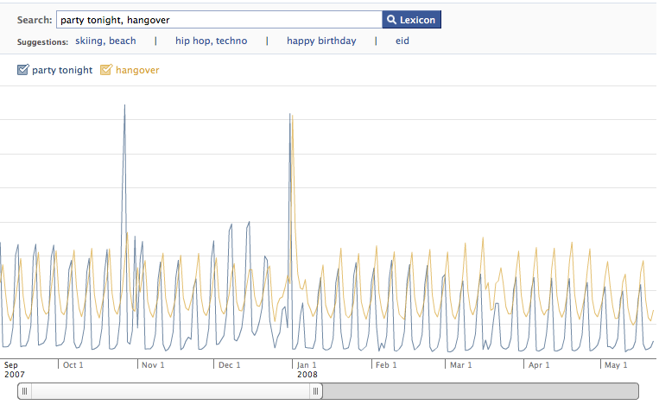
Example: Facebook Lexicon
www.facebook.com/lexicon

Slide 6
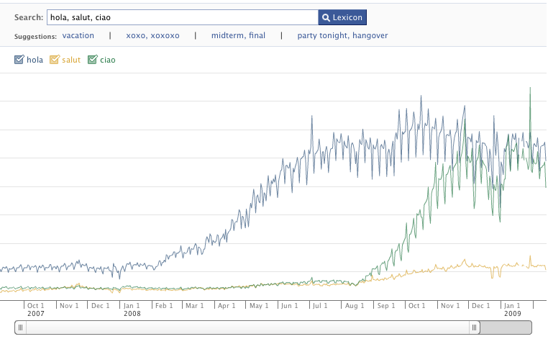
Example: Facebook Lexicon
www.facebook.com/lexicon

Slide 7
What is MapReduce used for?
In research:
  Astronomical image analysis (Washington)
  Bioinformatics (Maryland)
  Analyzing Wikipedia conflicts (PARC)
  Natural language processing (CMU)
  Particle physics (Nebraska)
  Ocean climate simulation (Washington)
  <Your application here>

Slide 8
Outline
MapReduce architecture
Example applications
Getting started with Hadoop
Higher-level languages over Hadoop: Pig and Hive
Amazon Elastic MapReduce

Slide 9
MapReduce Design Goals
Scalability to large data volumes:
  1000’s of machines, 10,000’s of disks
Cost-efficiency:
  Commodity machines (cheap, but unreliable)
  Commodity network
  Automatic fault-tolerance (fewer administrators)
  Easy to use (fewer programmers)

Slide 10
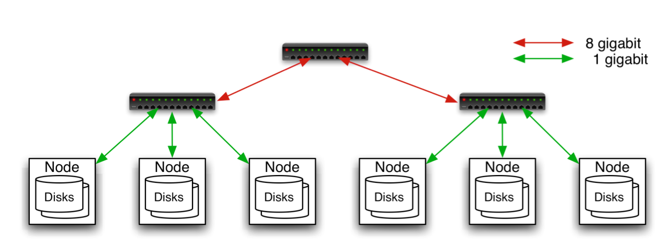
Typical Hadoop Cluster
Aggregation switch
Rack switch
40 nodes/rack, 1000-4000 nodes in cluster
1 Gbps bandwidth within rack, 8 Gbps out of rack
Node specs (Yahoo terasort):
8 x 2GHz cores, 8 GB RAM, 4 disks (= 4 TB?)
Image from http://wiki.apache.org/hadoop-data/attachments/HadoopPresentations/attachments/YahooHadoopIntro-apachecon-us-2008.pdf

Slide 11

Typical Hadoop Cluster
Image from http://wiki.apache.org/hadoop-data/attachments/HadoopPresentations/attachments/aw-apachecon-eu-2009.pdf

Slide 12
Challenges
Cheap nodes fail, especially if you have many
  Mean time between failures for 1 node = 3 years
  Mean time between failures for 1000 nodes = 1 day
  Solution: Build fault-tolerance into system
Commodity network = low bandwidth
  Solution: Push computation to the data
Programming distributed systems is hard
  Solution: Data-parallel programming model: users write “map” & “reduce” functions, system distributes work and handles faults

Slide 13
Hadoop Components
Distributed file system (HDFS)
  Single namespace for entire cluster
  Replicates data 3x for fault-tolerance
MapReduce framework
  Executes user jobs specified as “map” and “reduce” functions
  Manages work distribution & fault-tolerance

Slide 14

Hadoop Distributed File System
Files split into 128MB blocks
Blocks replicated across several datanodes (usually 3)
Single namenode stores metadata (file names, block locations, etc)
Optimized for large files, sequential reads
Files are append-only
Namenode
File1
1
2
3
4
1
2
1
3
2
1
4
2
4
3
3
4
Datanodes

Slide 15
MapReduce Programming Model
Data type: key-value records
Map function:
(K_{in}, V_{in}) ➔ list(K_{inter}, V_{inter})
Reduce function:
(K_{inter}, list(V_{inter})) ➔ list(K_{out}, V_{out})

Slide 16
Example: Word Count
def mapper(line):
foreach word in line.split():
output(word, 1)
def reducer(key, values):
output(key, sum(values))

Slide 17
Word Count Execution
Input
Map
Shuffle & Sort
Reduce
Output
the, 1
brown, 1
fox, 1
the quick
brown fox
Map
brown, 2
fox, 2
how, 1
now, 1
the, 3
Reduce
the, 1
fox, 1
the, 1
the fox ate
the mouse
Map
quick, 1
how, 1
now, 1
brown, 1
ate, 1
mouse, 1
ate, 1
cow, 1
mouse, 1
quick, 1
Reduce
how now
brown cow
Map
cow, 1

Slide 18
MapReduce Execution Details
Single master controls job execution on multiple slaves
Mappers preferentially placed on same node or same rack as their input block
  Minimizes network usage
Mappers save outputs to local disk before serving them to reducers
  Allows recovery if a reducer crashes
  Allows having more reducers than nodes

Slide 19
An Optimization: The Combiner
A combiner is a local aggregation function for repeated keys produced by same map
Works for associative functions like sum, count, max
Decreases size of intermediate data
Example: map-side aggregation for Word Count:
def combiner(key, values):
output(key, sum(values))

Slide 20
Word Count with Combiner
Input
Map & Combine
Shuffle & Sort
Reduce
Output
the, 1
brown, 1
fox, 1
the quick
brown fox
Map
brown, 2
fox, 2
how, 1
now, 1
the, 3
Reduce
the, 2
fox, 1
the fox ate
the mouse
Map
quick, 1
how, 1
now, 1
brown, 1
ate, 1
mouse, 1
ate, 1
cow, 1
mouse, 1
quick, 1
Reduce
how now
brown cow
Map
cow, 1

Slide 21
Fault Tolerance in MapReduce
1. If a task crashes:
  Retry on another node
    OK for a map because it has no dependencies
    OK for reduce because map outputs are on disk
  If the same task fails repeatedly, fail the job or ignore that input block (user-controlled)
Note: For these fault tolerance features to work, your map and reduce tasks must be side-effect-free

Slide 22
Fault Tolerance in MapReduce
2. If a node crashes:
  Re-launch its current tasks on other nodes
  Re-run any maps the node previously ran
    Necessary because their output files were lost along with the crashed node

Slide 23
Fault Tolerance in MapReduce
3. If a task is going slowly (straggler):
  Launch second copy of task on another node (“speculative execution”)
  Take the output of whichever copy finishes first, and kill the other
Surprisingly important in large clusters
  Stragglers occur frequently due to failing hardware, software bugs, misconfiguration, etc
  Single straggler may noticeably slow down a job

Slide 24
Takeaways
By providing a data-parallel programming model, MapReduce can control job execution in useful ways:
  Automatic division of job into tasks
  Automatic placement of computation near data
  Automatic load balancing
  Recovery from failures & stragglers
User focuses on application, not on complexities of distributed computing

Slide 25
Outline
MapReduce architecture
Example applications
Getting started with Hadoop
Higher-level languages over Hadoop: Pig and Hive
Amazon Elastic MapReduce

Slide 26
1. Search
Input: (lineNumber, line) records
Output: lines matching a given pattern
Map:
if(line matches pattern):
output(line)
Reduce: identify function
  Alternative: no reducer (map-only job)

Slide 27
2. Sort
Input: (key, value) records
Output: same records, sorted by key
Map: identity function
Reduce: identify function
Trick: Pick partitioning
function h such that
k₁<k₂ => h(k₁)<h(k₂)
Map
ant, bee
Reduce
[A-M]
zebra
aardvark
ant
bee
cow
elephant
cow
Map
pig
Reduce
[N-Z]
aardvark,
elephant
pig
sheep
yak
zebra
Map
sheep, yak

Slide 28
3. Inverted Index
Input: (filename, text) records
Output: list of files containing each word
Map:
foreach word in text.split():
output(word, filename)
Combine: uniquify filenames for each word
Reduce:
def reduce(word, filenames):
output(word, sort(filenames))

Slide 29
Inverted Index Example
hamlet.txt
to, hamlet.txt
be, hamlet.txt
or, hamlet.txt
not, hamlet.txt
to be or not to be
afraid, (12th.txt)
be, (12th.txt, hamlet.txt)
greatness, (12th.txt)
not, (12th.txt, hamlet.txt)
of, (12th.txt)
or, (hamlet.txt)
to, (hamlet.txt)
12th.txt
be, 12th.txt
not, 12th.txt
afraid, 12th.txt
of, 12th.txt
greatness, 12th.txt
be not afraid of greatness

Slide 30
4. Most Popular Words
Input: (filename, text) records
Output: top 100 words occurring in the most files
Two-stage solution:
  Job 1:
    Create inverted index, giving (word, list(file)) records
  Job 2:
    Map each (word, list(file)) to (count, word)
    Sort these records by count as in sort job
Optimizations:
  Map to (word, 1) instead of (word, file) in Job 1
  Count files in job 1’s reducer rather than job 2’s mapper
  Estimate count distribution in advance and drop rare words

Slide 31
5. Numerical Integration
Input: (start, end) records for sub-ranges to integrate
  Easy using custom InputFormat
Output: integral of f(x) dx over entire range
Map:
def map(start, end):
sum = 0
for(x = start; x < end; x += step):
sum += f(x) * step
output(“”, sum)
Reduce:
def reduce(key, values):
output(key, sum(values))

Slide 32
Outline
MapReduce architecture
Example applications
Getting started with Hadoop
Higher-level languages over Hadoop: Pig and Hive
Amazon Elastic MapReduce

Slide 33
Getting Started with Hadoop
Download from hadoop.apache.org
To install locally, unzip and set JAVA_HOME
Details: hadoop.apache.org/core/docs/current/quickstart.html
Three ways to write jobs:
  Java API
  Hadoop Streaming (for Python, Perl, etc)
  Pipes API (C++)

Slide 34
Word Count in Java
public class MapClass extends MapReduceBase
implements Mapper<LongWritable, Text, Text, IntWritable> {
private final static IntWritable ONE = new IntWritable(1);
public void map(LongWritable key, Text value,
OutputCollector<Text, IntWritable> out,
Reporter reporter) throws IOException {
String line = value.toString();
StringTokenizer itr = new StringTokenizer(line);
while (itr.hasMoreTokens()) {
out.collect(new text(itr.nextToken()), ONE);
}
}
}

Slide 35
Word Count in Java
public class ReduceClass extends MapReduceBase
implements Reducer<Text, IntWritable, Text, IntWritable> {
public void reduce(Text key, Iterator<IntWritable> values,
OutputCollector<Text, IntWritable> out,
Reporter reporter) throws IOException {
int sum = 0;
while (values.hasNext()) {
sum += values.next().get();
}
out.collect(key, new IntWritable(sum));
}
}

Slide 36
Word Count in Java
public static void main(String[] args) throws Exception {
JobConf conf = new JobConf(WordCount.class);
conf.setJobName("wordcount");
conf.setMapperClass(MapClass.class);
conf.setCombinerClass(ReduceClass.class);
conf.setReducerClass(ReduceClass.class);
FileInputFormat.setInputPaths(conf, args[0]);
FileOutputFormat.setOutputPath(conf, new Path(args[1]));
conf.setOutputKeyClass(Text.class); // out keys are words (strings)
conf.setOutputValueClass(IntWritable.class); // values are counts
JobClient.runJob(conf);
}

Slide 37
Word Count in Python with Hadoop Streaming
Mapper.py:
import sys
for line in sys.stdin:
for word in line.split():
print(word.lower() + "\t" + 1)
Reducer.py:
import sys
counts = {}
for line in sys.stdin:
word, count = line.split("\t”)
dict[word] = dict.get(word, 0) + int(count)
for word, count in counts:
print(word.lower() + "\t" + 1)

Slide 38
Outline
MapReduce architecture
Example applications
Getting started with Hadoop
Higher-level languages over Hadoop: Pig and Hive
Amazon Elastic MapReduce

Slide 39
Motivation
Many parallel algorithms can be expressed by a series of MapReduce jobs
But MapReduce is fairly low-level: must think about keys, values, partitioning, etc
Can we capture common “job building blocks”?

Slide 40

Pig
Started at Yahoo! Research
Runs about 30% of Yahoo!’s jobs
Features:
  Expresses sequences of MapReduce jobs
  Data model: nested “bags” of items
  Provides relational (SQL) operators (JOIN, GROUP BY, etc)
  Easy to plug in Java functions
  Pig Pen development environment for Eclipse

Slide 41
An Example Problem
Suppose you have user data in one file, page view data in another, and you need to find the top 5 most visited pages by users aged 18 - 25.
Load Users
Load Pages
Filter by age
Join on name
Group on url
Count clicks
Order by clicks
Take top 5
Example from http://wiki.apache.org/pig-data/attachments/PigTalksPapers/attachments/ApacheConEurope09.ppt

Slide 42
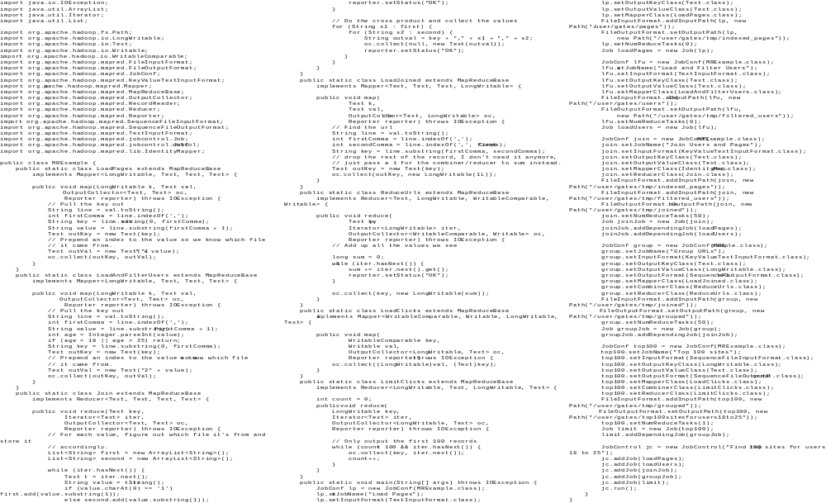
In MapReduce
Example from http://wiki.apache.org/pig-data/attachments/PigTalksPapers/attachments/ApacheConEurope09.ppt
Notes:
My point in putting in the java code isn’t too actually walk through it. It’s just to show that you have to hand code a fair amount of java. That way I can just point and say “look how much java you’d have to write to accomplish this”

Slide 43
In Pig Latin
Users = load ‘users’ as (name, age);
Filtered = filter Users by
age >= 18 and age <= 25;
Pages = load ‘pages’ as (user, url);
Joined = join Filtered by name, Pages by user;
Grouped = group Joined by url;
Summed = foreach Grouped generate group,
count(Joined) as clicks;
Sorted = order Summed by clicks desc;
Top5 = limit Sorted 5;
store Top5 into ‘top5sites’;
Example from http://wiki.apache.org/pig-data/attachments/PigTalksPapers/attachments/ApacheConEurope09.ppt
Notes:
Rather than using capital letters, which makes Pig Latin look like SQL, I added Eclipse style highlighting instead. Hopefully this makes clear what are the key words without making it look like a Matisse painting.

Slide 44
Ease of Translation
Notice how naturally the components of the job translate into Pig Latin.
Load Users
Load Pages
Users = load …
Filtered = filter …
Pages = load …
Joined = join …
Grouped = group …
Summed = … count()…
Sorted = order …
Top5 = limit …
Filter by age
Join on name
Group on url
Count clicks
Order by clicks
Take top 5
Example from http://wiki.apache.org/pig-data/attachments/PigTalksPapers/attachments/ApacheConEurope09.ppt
Notes:
No need to think about how many map reduce jobs this decomposes into, or connecting data flows between map reduces jobs, or even that this is taking place on top of map reduce at all.

Slide 45
Ease of Translation
Notice how naturally the components of the job translate into Pig Latin.
Load Users
Load Pages
Users = load …
Filtered = filter …
Pages = load …
Joined = join …
Grouped = group …
Summed = … count()…
Sorted = order …
Top5 = limit …
Filter by age
Join on name
Job 1
Group on url
Job 2
Count clicks
Order by clicks
Job 3
Take top 5
Example from http://wiki.apache.org/pig-data/attachments/PigTalksPapers/attachments/ApacheConEurope09.ppt
Notes:
No need to think about how many map reduce jobs this decomposes into, or connecting data flows between map reduces jobs, or even that this is taking place on top of map reduce at all.

Slide 46

Hive
Developed at Facebook
Used for majority of Facebook jobs
“Relational database” built on Hadoop
  Maintains list of table schemas
  SQL-like query language (HQL)
  Can call Hadoop Streaming scripts from HQL
  Supports table partitioning, clustering, complex
  data types, some optimizations

Slide 47
Sample Hive Queries
Find top 5 pages visited by users aged 18-25:
SELECT p.url, COUNT(1) as clicks
FROM users u JOIN page_views p ON (u.name = p.user)
WHERE u.age >= 18 AND u.age <= 25
GROUP BY p.url
ORDER BY clicks
LIMIT 5;
Filter page views through Python script:
SELECT TRANSFORM(p.user, p.date)
USING 'map_script.py'
AS dt, uid CLUSTER BY dt
FROM page_views p;

Slide 48
Outline
MapReduce architecture
Example applications
Getting started with Hadoop
Higher-level languages over Hadoop: Pig and Hive
Amazon Elastic MapReduce

Slide 49
Amazon Elastic MapReduce
Provides a web-based interface and command-line tools for running Hadoop jobs on Amazon EC2
Data stored in Amazon S3
Monitors job and shuts down machines after use
Small extra charge on top of EC2 pricing
If you want more control over how you Hadoop runs, you can launch a Hadoop cluster on EC2 manually using the scripts in src/contrib/ec2

Slide 50
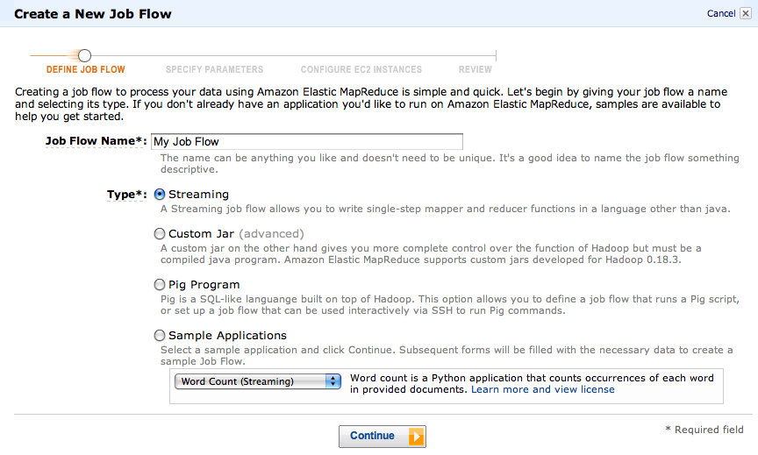
Elastic MapReduce Workflow

Slide 51
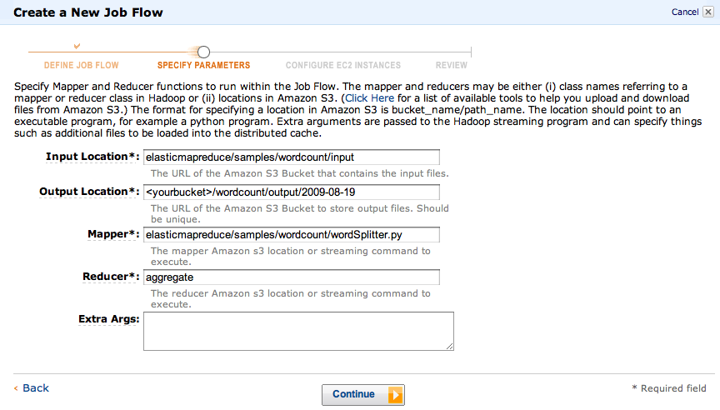
Elastic MapReduce Workflow

Slide 52
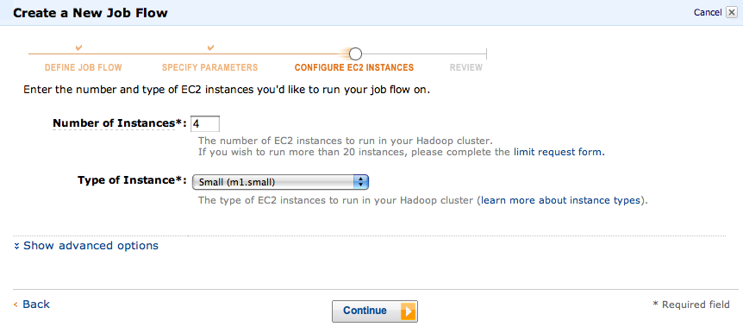
Elastic MapReduce Workflow

Slide 53
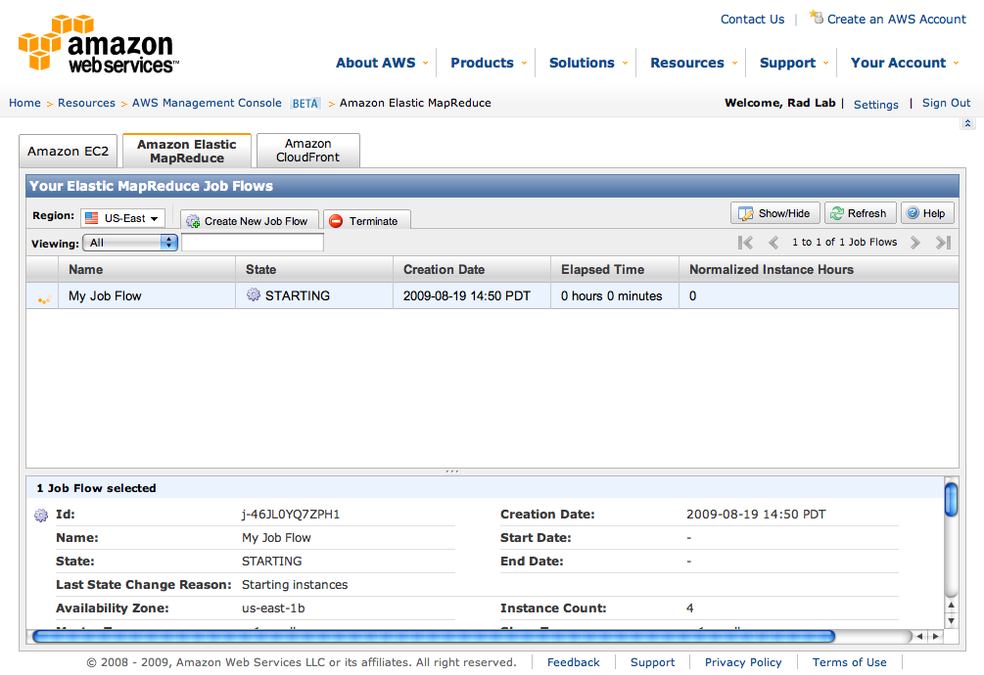
Elastic MapReduce Workflow

Slide 54
Conclusions
MapReduce programming model hides the complexity of work distribution and fault tolerance
Principal design philosophies:
  Make it scalable, so you can throw hardware at problems
  Make it cheap, lowering hardware, programming and admin costs
MapReduce is not suitable for all problems, but when it works, it may save you quite a bit of time
Cloud computing makes it straightforward to start using Hadoop (or other parallel software) at scale

Slide 55
Resources
Hadoop: http://hadoop.apache.org/core/
Pig: http://hadoop.apache.org/pig
Hive: http://hadoop.apache.org/hive
Video tutorials: http://www.cloudera.com/hadoop-training
Amazon Web Services: http://aws.amazon.com/
Amazon Elastic MapReduce guide:
http://docs.amazonwebservices.com/ElasticMapReduce/latest/GettingStartedGuide/

