Slide 1
X-Machinia
What gets Measured, Gets Managed

Slide 2
What is Data?
Data are the facts and statistics collected for analysing the data
Then What is Data Analysis? – Analysis of the Data is Data Analysis :’)

Slide 3
Importance of Data Analysis
Data Science is like the most demanding jobs of the 21st Century as whatever we do from waking up in the morning to sleeping at night, everything can be comprised to a Dataset.
Your Life is a DataSet studied by those Cool Spy Agents you don’t even Know ( Kya aapne apna Aadhar Link kiya?)
Depending on the Data, Machines and programs predict what you are going to do next
The Most notable Examples are the Youtube Recommended Video, Spam and Non-spam Email Check, Movie Recommending Websites and Trivago (Kya aapne kabhi Online Hotel search kiya hai?)

Slide 4
Enough Talk! Lets Get Down to Business

Slide 5
Basic Steps of any Data Prediction
Collecting the Dataset or Generating it
Analysing it
Visualize the Dataset
Preprocess the Dataset
Train the Dataset to a Machine Learning Model
Test the Dataset for Accuracy
Prediction Begins!!!!!

Slide 6
Collecting the Dataset
We have already provided you the Dataset

Slide 7
Understanding The Data Set Given
So, what you saw was an ugly looking Excel Sheet containing many values . That’s Messy Data for you!
This is the Housing Price Dataset. It contains 80 columns having information on the type of house a person has and the last column showing the Sale Price of the House
Your Job is to Clean this Dataset, Analyse it, Train it and Predict the Sale Price for another sample whose Sale price you don’t know. The better the prediction, the better you score though many others things would be considered for marking
We’ ll show you an example on how to go about this process

Slide 8
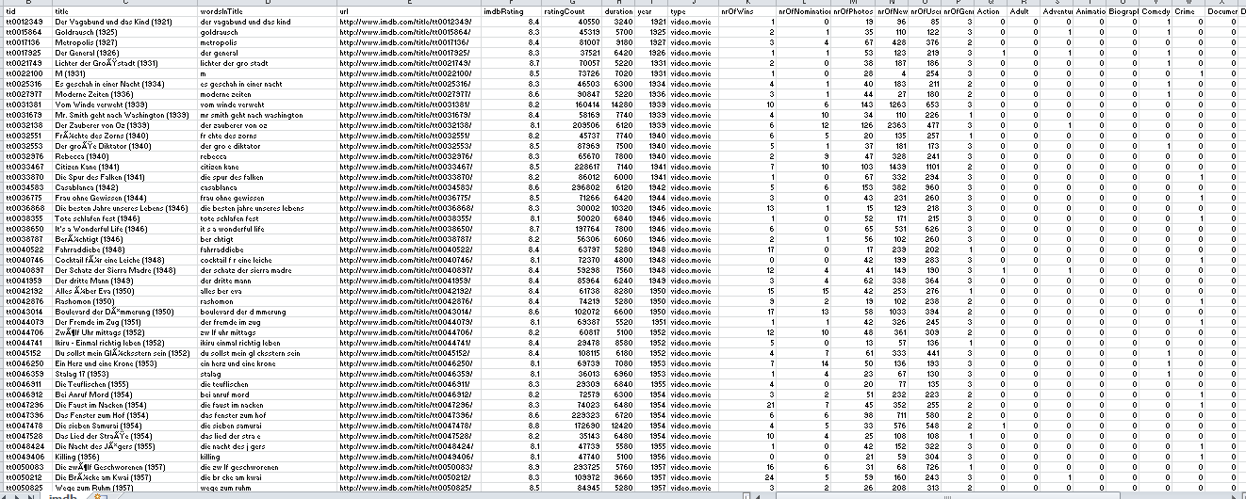
IMDB Movie Data Set

Slide 9
>>Enter Video of Showing the Data Set
>>Record yourself moving in the dataset using Kazam and show them how some data are not needed but some are very important
>>Also show them the conversion of string to values by adding a new column containing Good, bad, Poor
>>Show them which columns need to be dropped, which columns need to be normalised, which columns contain NULL values and how to handle them
>>Showing them the Graphs of the Dataset and how can Graphs help in judging the Dataset and we will add Slides accordingly

Slide 10
So, The Data set analysis is done. Now we have a data ready to train and test. This part is implemented by us so you just have to run the model on the data set <<Enter the Video showing how to run the Model>>

Slide 11
What is this Model we are Talking about so much? What is Training?
Here comes the State-of-the-art topic that has revolutionized the whole tech industry….Wait for it…
MACHINE LEARNING
Well, we all learn but do machines learn? Yes, they do just like us. You just learned how to handle datasets; in the same way a machine learns to understand this dataset
Human learning and Machine Learning don’t differ much just we program the Machines on how to learn

Slide 12
Alright, how does a Machine Learn?
So there are many algorithms that were developed by Researchers over the years like the one you will implement – Linear Regression
There are many other algorithms like Logistic Regression, Support Vector Machine, Neural Networks( Involved in Artificial Intelligence)
We’ll tell you about Linear Regression only as of now

Slide 13
Linear Regression
Linear Regression creates a Linear Fit spanning the Dataset
It tries to create the best Straight Line possible which is closest to all of the datapoints
The Dataset you saw are to be converted to Matrices and are divided into two sets namely the Training Set and the Test Set.
All the Preprocessing is done in both the sets
Then there are two matrices known as X_train and Y_train. X_train contains all the data except the value the machine would predict while Y_train would have the data of the predicted value

Slide 14
X_train and Y_train are made form the Training Set
X_test is made from the Test Set
You must have seen that there is no IMDB Rating or the SalePrice Column in the Test set . This is what we will predict . So this while set is X_test
The machine will have to predict the Y_test
Then we would see how much difference there is between Y_test and the Original Predictions and depending on that the Test Accuracy is calculated which is the most important part of any Machine Learning Project
Gettiing exactly same values is a feat on its own. It all depends on how one organise the data, how does he analyze and process it and how well he knows to fit the algorithm

Slide 15
The ALGORITHM
<< Slide not made, will be done later >>

