Slide 1
Active-RIS-Assisted RSMA–ISAC Under Imperfect CSI
Group Members:
Rukshanshi Patel
Darshi Jain
Devshree Patel
Krishna Patel
Payal Mishra

Slide 2
Research Objectives
Formulate the active-RIS-assisted RSMA–ISAC system.
Implement the main communication and sensing models.
Develop an alternating optimization (AO) workflow.
Evaluate sum rate, radar SINR, and power consumption.
Verify the implementation using tests and saved simulation results.
Identify gaps that remain before claiming full reproduction.
| ‹#›

Slide 3
Research Problem
Integrated sensing and communication (ISAC) shares radio resources between user communication and target sensing.
RSMA separates messages into common and private streams to manage multi-user interference.
An active RIS can amplify reflected signals, but also consumes power and introduces amplifier noise.
Imperfect channel state information (CSI) creates uncertainty in both communication and sensing.
The beamforming and RIS-design variables are coupled, making the joint optimization non-convex.

Slide 4
System model and assumptions
Base station (BS) transmits common and private communication streams.
Active RIS modifies and amplifies the reflected signal.
Multiple users receive the RSMA streams.
A sensing target reflects the BS signal back toward the sensing receiver.
Channel estimation errors are included in the imperfect-CSI model.
BS power, RIS output power, and RIS amplitude are constrained.

Slide 5
Research gap and motivation
Communication-only beamforming may not meet sensing requirements.
Active RIS amplification improves signal strength but introduces noise and power costs.
RSMA offers additional interference-management flexibility.
Imperfect CSI complicates rate and radar performance evaluation.
The project focuses on implementing and checking a joint optimization approach.
Research gap: A joint design must balance communication performance, sensing constraints, active-RIS power, and imperfect CSI.

Slide 6

Mathematical Formulation
Maximize the RSMA sum rate, subject to the system’s sensing and hardware constraints.
Objective: maximize total achievable communication rate.
Sensing constraint: radar SINR must exceed its required threshold.
BS constraint: transmit power must remain within the configured budget.
RIS constraint: output power must remain within its configured budget.
Hardware constraint: RIS reflection coefficients must respect their amplitude cap.
Design variables: BS precoders and active-RIS coefficients.
| ‹#›

Slide 7
Optimization Methodology
Initialize channel estimates, BS precoders, and RIS coefficients.
Optimize the BS communication variables while holding the RIS fixed.
Use the selected semidefinite relaxation (SDR) and convex-concave procedure (CCCP) techniques for the BS subproblem.
Optimize RIS coefficients using successive convex approximation (RIS-SCA).
Recalculate the actual sum rate, radar SINR, and power metrics.
Stop according to the convergence tolerance or iteration limit.

Slide 8
Algorithm details: AO, SDR, CCCP and RIS-SCA
Role of each technique
AO: divides the joint problem into alternating optimization blocks.
SDR: relaxes selected matrix constraints to make a subproblem more tractable.
CCCP: optimizes a sequence of convex surrogate problems for the BS update.
Rank-one recovery: uses Gaussian randomization to obtain candidate precoders.
RIS-SCA: approximates the non-convex RIS update with successive convex subproblems.
Key limitation: These techniques do not automatically guarantee a globally optimal solution. Each approximation and recovered solution still needs feasibility checks.

Slide 9
Software implementation
Project architecture
config.py — configuration and system parameters.
channel_model.py — channel generation and CSI uncertainty.
model.py — communication model and rate calculations.
radar_model.py — radar SINR evaluation.
optimization/ao.py — alternating optimization and subproblem updates.
Experiment scripts and tests — execution, saved metrics, and basic verification.

Slide 10
Verification and reproducibility
Verification performed / evidence available
Core model and optimization modules were inspected.
Development notes report 15 passing tests.
A limited AO run produced a saved metrics summary.
Saved CCCP and RIS-SCA histories are available.
A random-precoder diagnostic power sweep is available.
Still required
Rerun tests and experiment scripts.
Check the mathematical equations against the foundation paper.
Verify constraints independently from saved solution arrays.
Record solver status, software versions, random seeds, and complete logs.

Slide 11
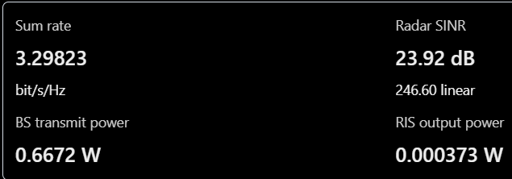
Preliminary optimization results
Metrics from the saved AO run
Maximum RIS coefficient magnitude: approximately 5.99997, against a configured cap of 6.
Saved run status: max_iterations.
Only one outer AO iteration was recorded.
The reported feasibility flag reflects the code’s checks, not independent verification against the foundation paper.

Slide 12
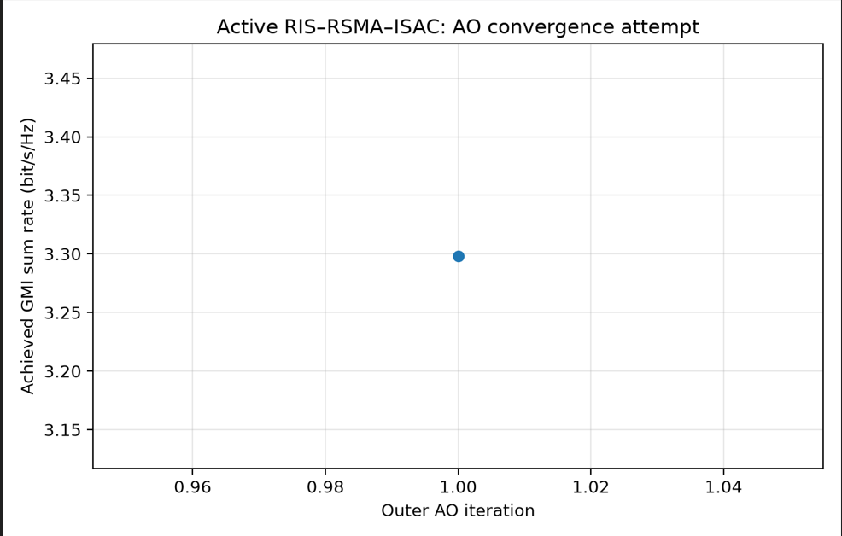
one outer AO iteration

Slide 13
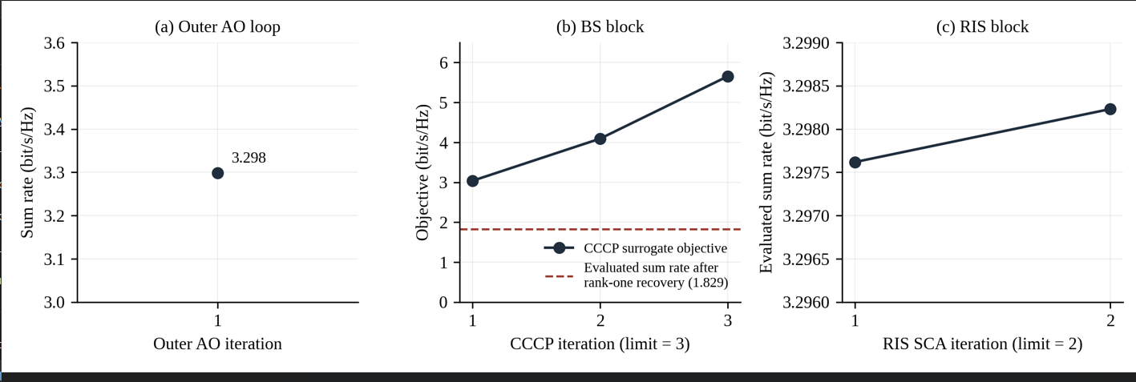
Optimization traces

Slide 14
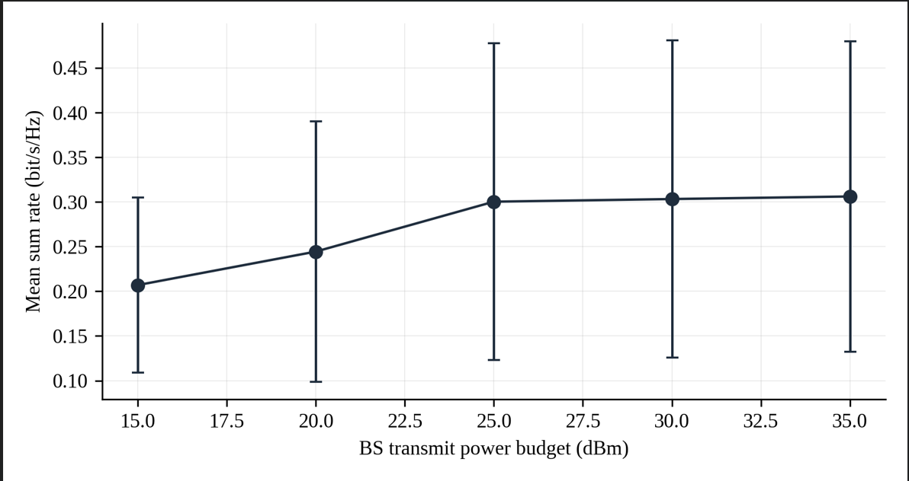
Diagnostic baseline: BS power sweep
Random/fixed precoders were used.
Ten trials were recorded per BS power point.
Mean sum rate rises from approximately 0.207 to 0.306 bit/s/Hz over the 15–35 dBm range.
The trial variability is high.
This is not an AO-optimized result and must not be presented as a foundation-paper reproduction.

Slide 15
Evaluation plan
Run AO with enough outer iterations to evaluate the stopping condition.
Repeat simulations across multiple channel realizations and seeds.
Record objective, radar SINR, BS power, RIS power, and constraint residuals.
Compare with appropriate optimized baselines, such as passive RIS or no RIS, only after implementing them consistently.
Validate the beampattern and power-sweep calculations against the foundation paper.
Archive solver logs, settings, and output files.

Slide 16
Limitations and risks
1. Limited AO convergence evidence
Saved run stopped at max_iterations after one outer AO iteration; convergence is not established.
2. Constraint validation
Independently recompute BS power, RIS output power, and RIS amplitude limits from saved optimization variables.
3. Baseline comparison
Current BS power sweep uses random/fixed precoders; optimized AO performance has not yet been compared under the same conditions.
4. Reference-result validation
Quantitatively compare the implementation with the foundation paper's reported results using matching simulation parameters and assumptions.

Slide 17
Reference
1. Parihar, A. S., Chen, C.-H., & Li, C.-P. (2026). Beamforming design for enhanced sum rate in active RIS-RSMA-assisted ISAC systems under imperfect CSIT/CSIR. IEEE Transactions on Vehicular Technology, 75(6), 10918–10932. https://doi.org/10.1109/TVT.2025.3648447
2. Niu, H., Lin, Z., An, K., Wang, J., Zheng, G., Al-Dhahir, N., & Wong, K.-K. (2023). Active RIS assisted rate-splitting multiple access network: Spectral and energy efficiency tradeoff. IEEE Journal on Selected Areas in Communications, 41(5), 1452–1467. https://doi.org/10.1109/JSAC.2023.3240718
3. Ye, J., Rihan, M., Zhang, P., Huang, L., Buzzi, S., & Chen, Z. (2025). Energy efficiency optimization in active reconfigurable intelligent surface-aided integrated sensing and communication systems. IEEE Transactions on Vehicular Technology, 74(1), 1180–1195. https://doi.org/10.1109/TVT.2024.3465897
4. Truong, T. P., Nguyen, T. M. T., Nguyen, T. V., Dao, N. N., & Cho, S. (2025). Energy efficiency in RSMA-enhanced active RIS-aided quantized downlink systems. IEEE Journal on Selected Areas in Communications, 43(3), 834–850. https://doi.org/10.1109/JSAC.2025.3531522

Slide 18
THANK YOU !

