Slide 1
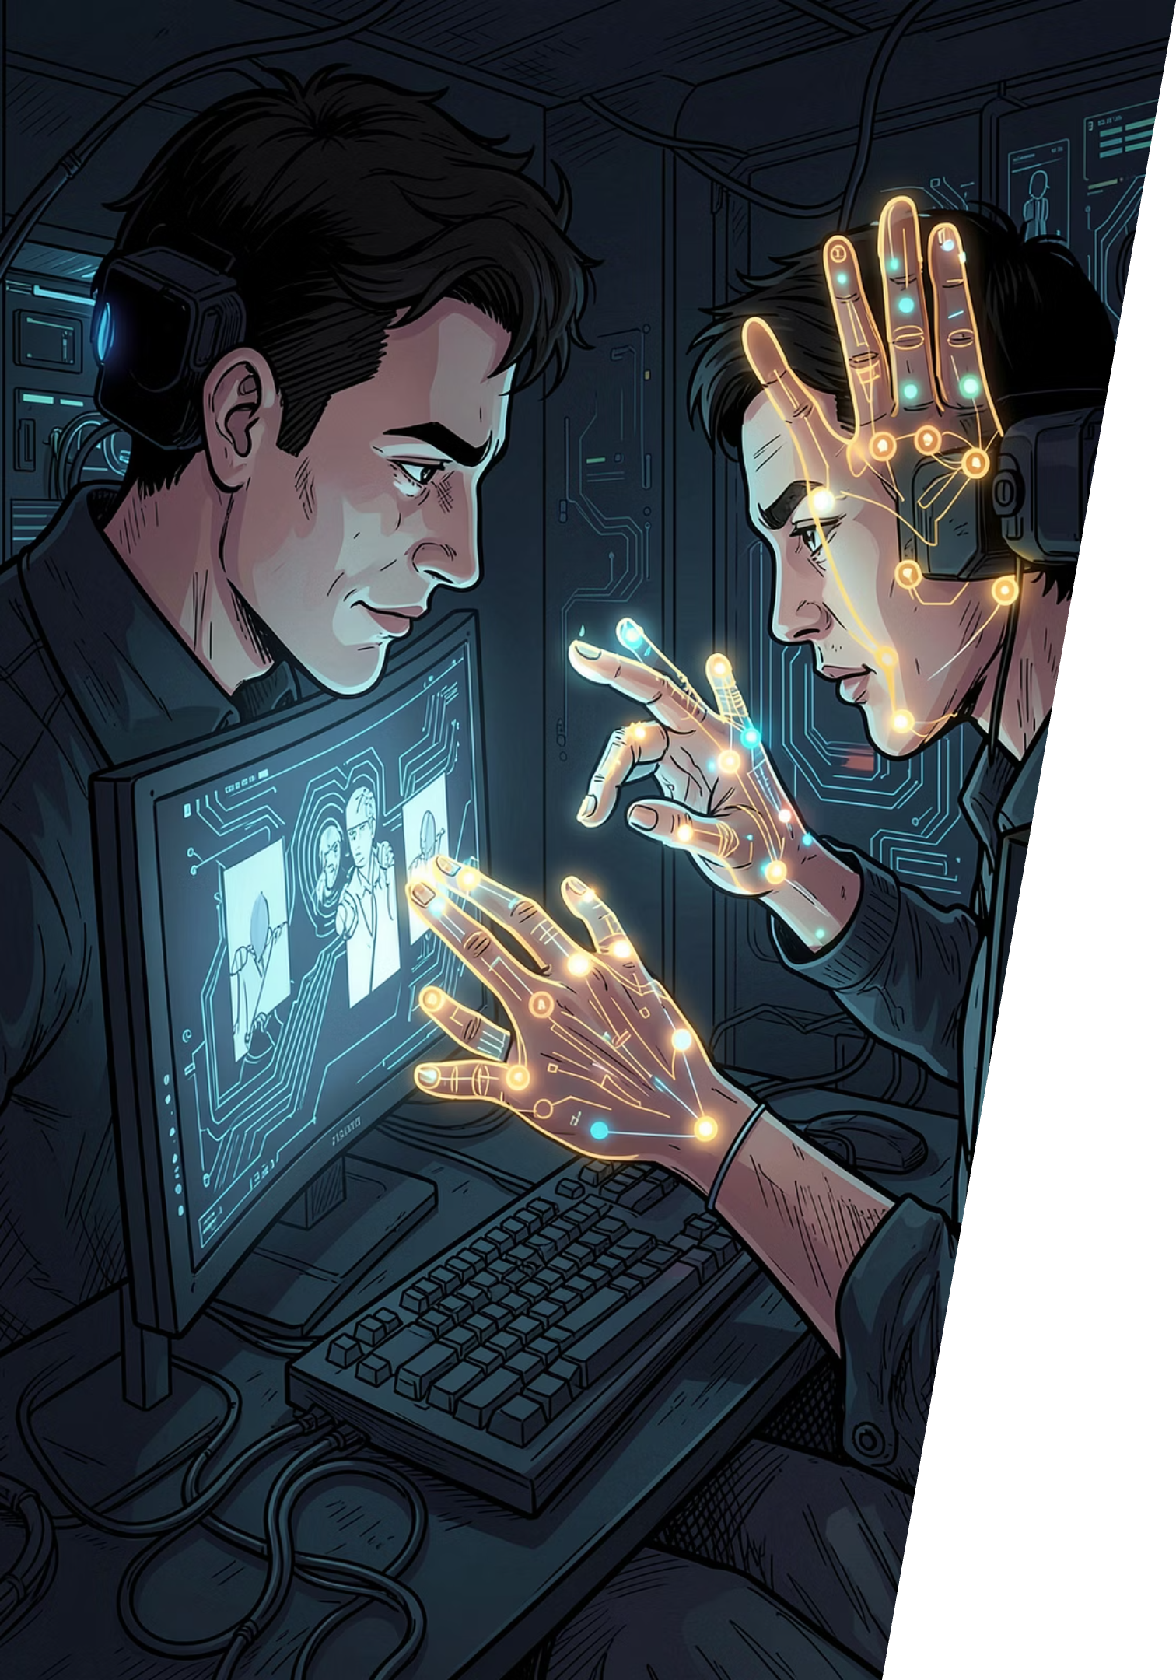
AI Virtual Mouse Using Hand Gestures
A real-time, touchless human-computer interaction system powered by Computer Vision and Artificial Intelligence.
React
ELECTRON
MEDIAPIPE
ROBOTJS
AI

Slide 2
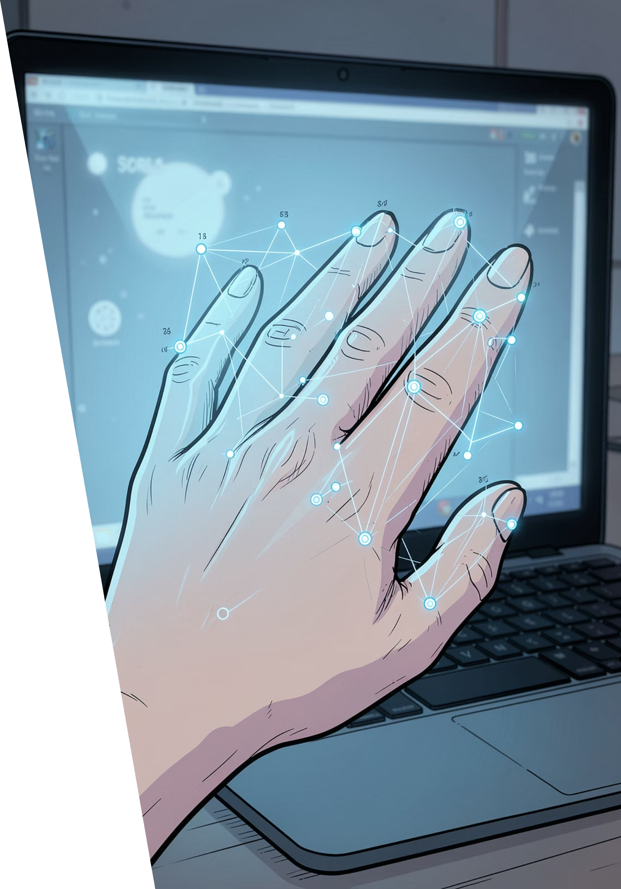
Introduction
The AI Virtual Mouse is a Computer Vision project that replaces the physical mouse with hand gestures captured through a standard webcam. By combining AI-powered gesture recognition with real-time cursor control, it creates a fully touchless human-computer interaction system.
🖱 Move Cursor
Index finger directs pointer position
👆 Click
Pinch gestures trigger clicks
🔄 Scroll
Open palm controls scrolling
⚡ Touchless
Zero physical contact required

Slide 3
Problem Statement
Why Traditional Mouse Fall Short
Our Solution
Physical pointing devices create barriers in modern computing environments — from accessibility challenges to hygiene concerns in shared spaces.
This project delivers a fully touchless, AI-driven alternative — enabling cursor control, clicks, and scrolling through natural hand gestures alone.
Physical Dependency
Accessibility Gaps
Smart Environment Limits
Requires direct hardware contact
Difficult for users with motor limitations
Incompatible with touchless setups

Slide 4
Technologies Used
React
Frontend UI and gesture visualization layer
Electron
Cross-platform desktop application wrapper
MediaPipe
Google's AI framework for real-time hand tracking
RobotJS
Native mouse and keyboard control via Node.js
Node.js
Runtime environment for backend logic
Tailwind CSS
Rapid, utility-first UI styling

Slide 5
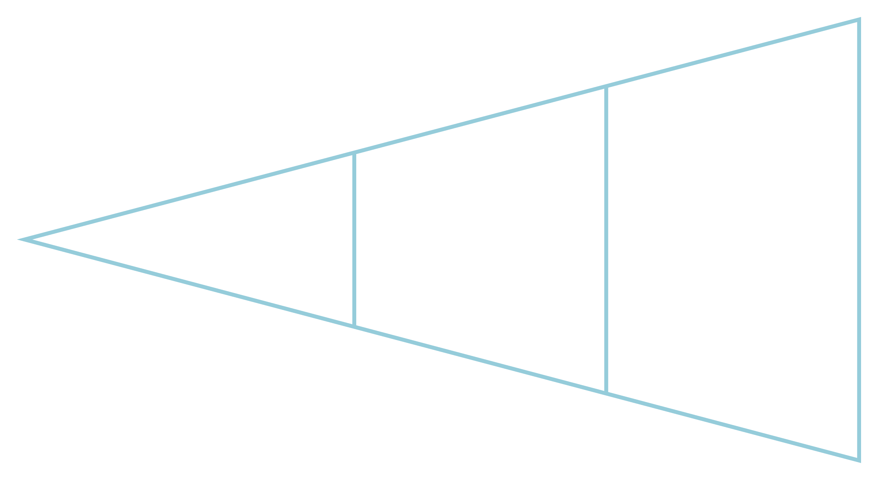
System Architecture
The pipeline transforms raw webcam input into precise mouse actions in under 30ms — a seamless, real-time loop powered entirely by on-device AI.
Webcam Input
Landmark Tracking
Hand Detection
Each stage operates in a continuous loop — as the hand moves, landmarks update, gestures are re-evaluated, and mouse actions respond instantly.

Slide 6

Gesture Mapping
Each gesture is mapped to a specific mouse action. MediaPipe's 21 landmark points enable the system to distinguish subtle finger positions reliably.
Gesture
Mouse Action
Index Finger Up
Move Cursor
Thumb + Index Pinch
Left Click
Two Fingers Up
Right Click
Open Palm
Scroll
Fist
Pause Mouse

Slide 7
Features & Project Structure
Core Features
Hand Detection
Cursor & Click
Instant recognition in any lighting
Smooth movement with left/right click
Scroll Control
Gesture Customization
Open palm gesture for page scrolling
Adaptable mappings per user

Slide 8
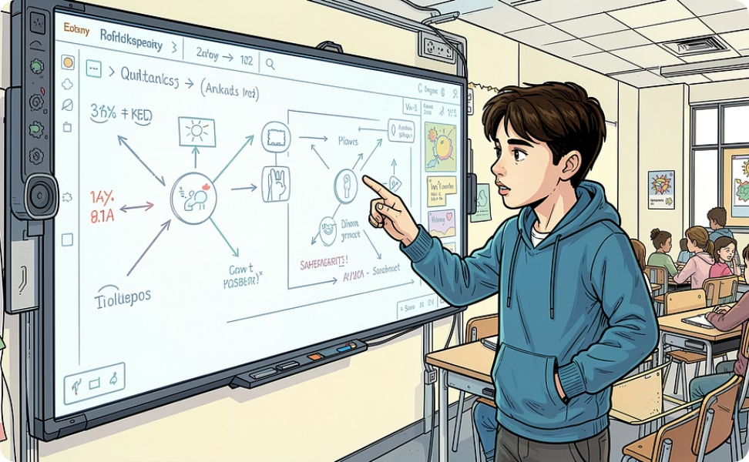
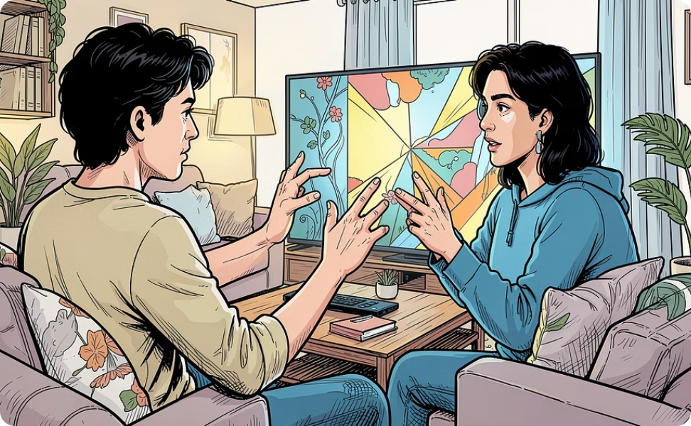
Applications & Advantages
Smart Classrooms
Smart Home & TV
Touchless control of presentations and digital boards
Navigate devices without a remote

Slide 9
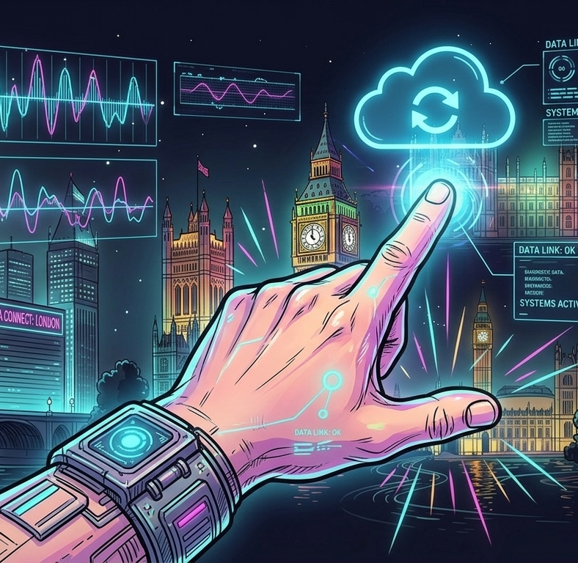
Future Roadmap & Conclusion
Voice Commands
Combine speech + gesture for multimodal control
Custom Gesture Learning
AI learns personalized gestures per user
Multi-Hand Detection
Support complex two-hand gesture combinations
Cloud & Mobile
Cross-device sync and mobile app support

Slide 10
Thank You!

