Slide 1
Google Ads Campaign
Topic:SEO for User Intent
Imaginary Website Name: My Erudition Insights
URL: https://myeruditioninsights.blogspot.com/2026/04/seo-for-user-intent.html

Slide 2
Campaign Objective
Increase website traffic
Improve user engagement
Target SEO learners
Notes:
Goal is to bring relevant users who want to learn SEO.

Slide 3
Landing Page Overview
Topic: SEO for User Intent
Type: Informational content
Audience: Beginners & students
Notes:
Content focuses on explaining user intent clearly.

Slide 4
Campaign Strategy
Campaign Type: Search Ads
Focus: High intent users
Location: India
Device: Mobile-first
Notes:
Search ads capture users actively searching for SEO topics.

Slide 5
Target Audience
Students (18–30)
Bloggers
Digital marketing beginners
Notes:
Audience selected based on interest in learning SEO.

Slide 6
Keyword Strategy
what is user intent in SEO
search intent explained
SEO for beginners
intent based SEO
Notes:
Keywords are informational and intent-focused.

Slide 7
Ad Copy Strategy
Learn SEO the Smart Way
Why Your SEO Isn’t Working
Master Search Intent Today
Notes:
Curiosity-based headlines improve CTR.

Slide 8
Negative Keywords
course
agency
services
hire
Notes:
Helps avoid irrelevant traffic and save budget.

Slide 9
Budget & Bidding
Strategy: Maximize Clicks
Daily Budget: ₹300–₹500
Expected CPC: ₹5–₹12
Notes:
Focus is on traffic generation.

Slide 10
Expected Results
CTR: 4–7%
Clicks/day: 50–120
Better engagement with optimized content
Notes:
Results are estimated based on assumptions.

Slide 11
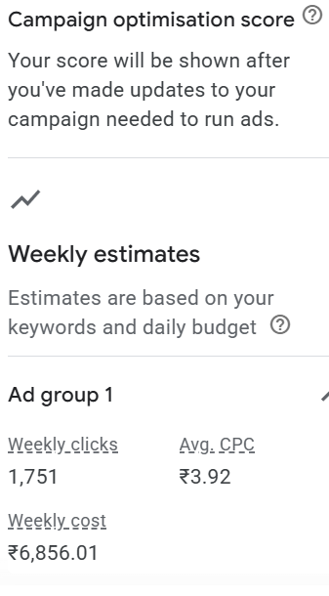
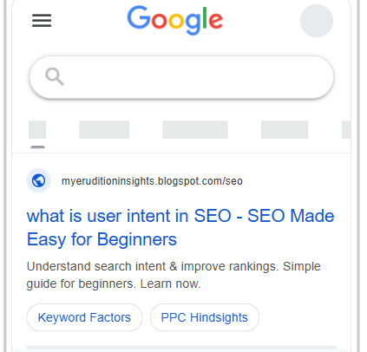
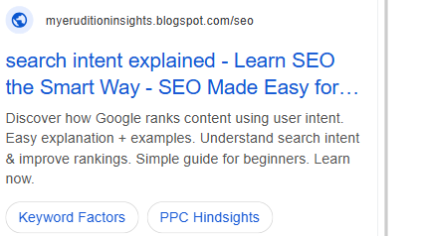
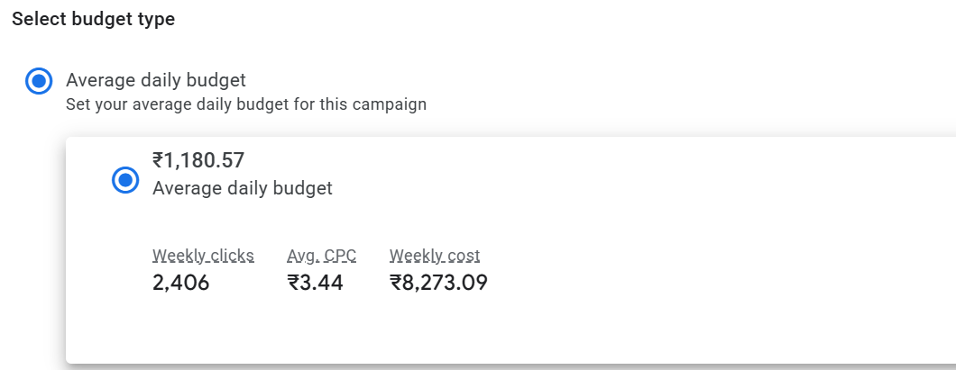
Ad Copy & Estimation Screenshots

Slide 12
Challenges Faced
No real performance data
High competition
Audience assumptions
Notes:
Handled using research and logical planning.

Slide 13
Key Learnings
User intent is crucial
Keywords alone are not enough
Strategy improves performance
Notes:
Main takeaway: intent > keywords.

Slide 14
Conclusion
Gained practical experience
Understood campaign structure
Improved digital marketing skills
Notes:
This project simulates real campaign planning.

