Slide 1
An Investigation of Inventory Routing Problem with Carbon Emission and Sustainability Consideration
Krishna Priya Muthu
August 2021
Department of Sustainable Transportation and Logistics

Slide 2
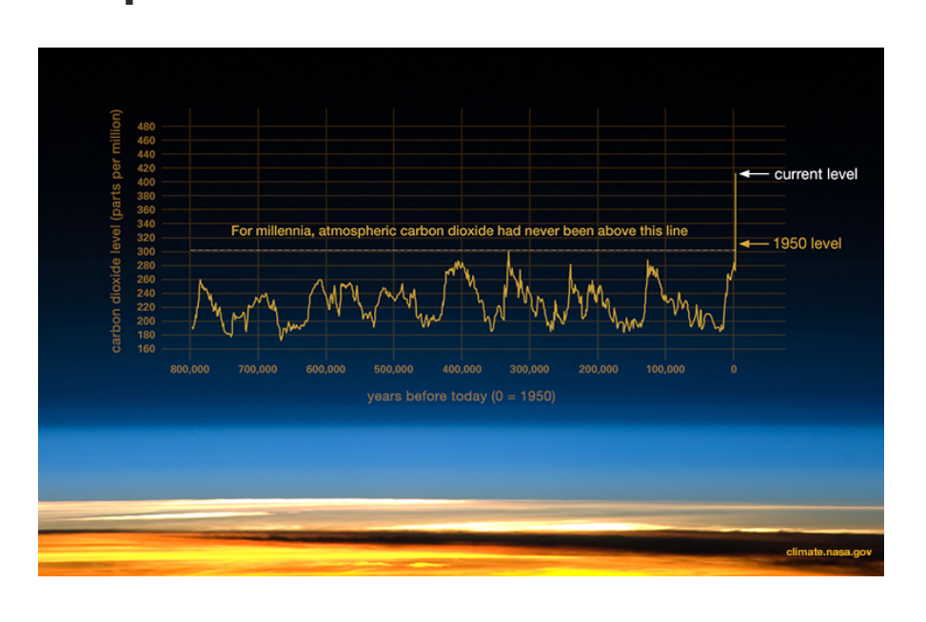
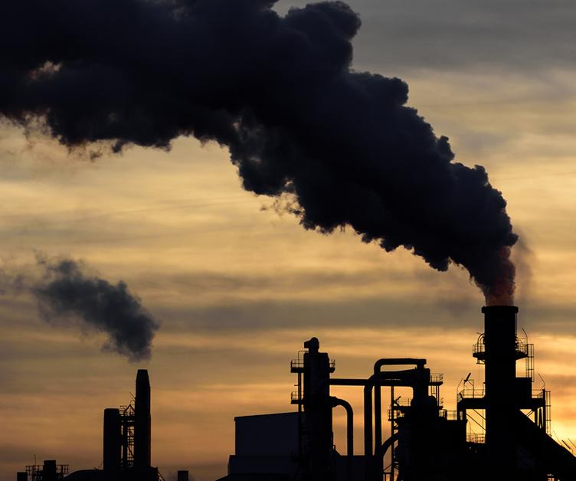
Carbon emission graph
The increase in carbon emission since industrial revolution is 48%

Slide 3
Inventory routing problem
This is a type of problem that decides how much to deliver each customer every day of the horizon, and how to organize the routes to replenish the stock such that there is no stock out.

Slide 4
Benefits of inventory routing problem
Helps a good relationship between customers and suppliers
Overall performance is improved
Helps improve business

Slide 5
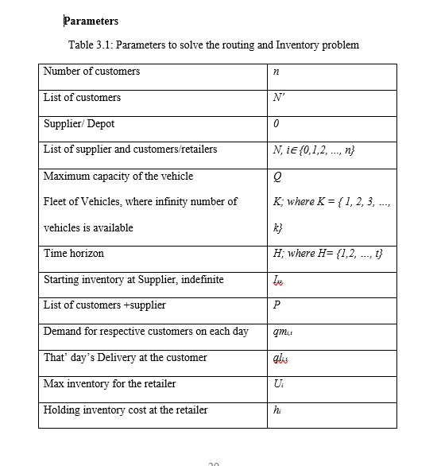
Implementation of Program - parameters

Slide 6

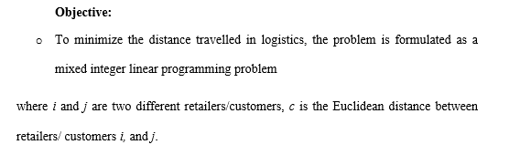
Objective function

Slide 7
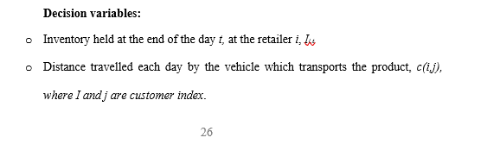

Slide 8
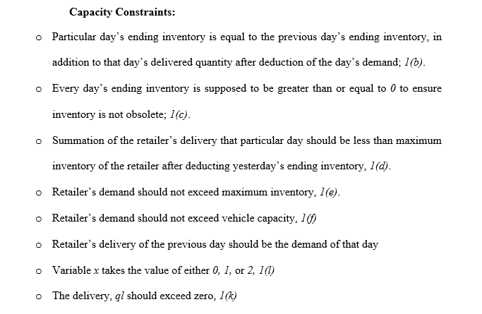

Slide 9
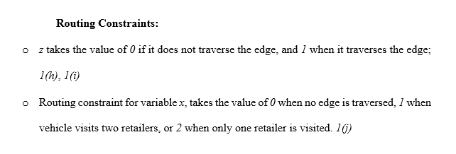

Slide 10
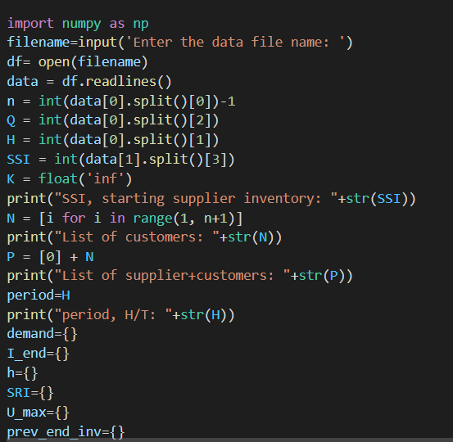
Implementation of Program

Slide 11
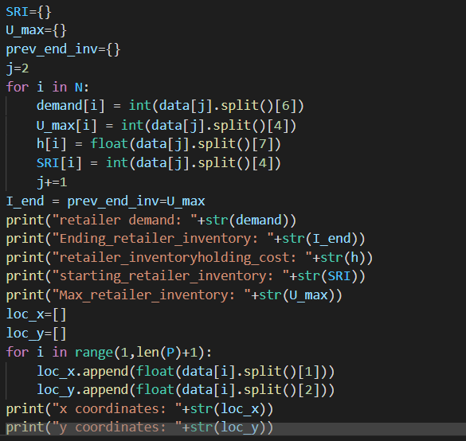
Implementation of Program

Slide 12
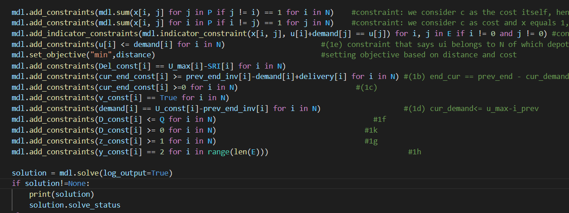
Implementation of Program (constraints)

Slide 13
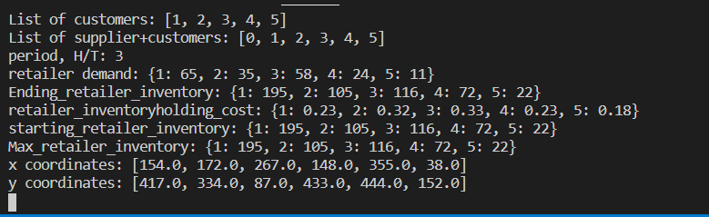
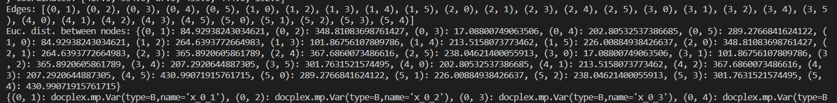
Implementation of Program - results

Slide 14
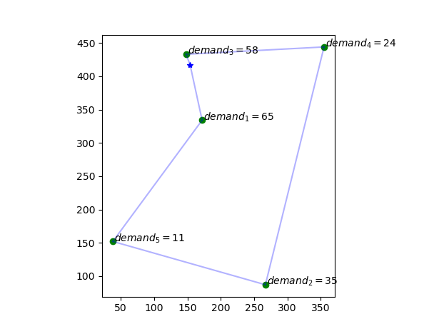
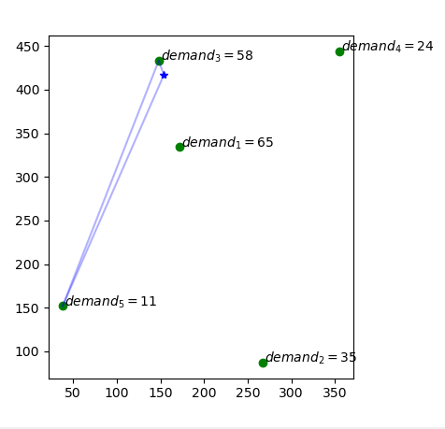
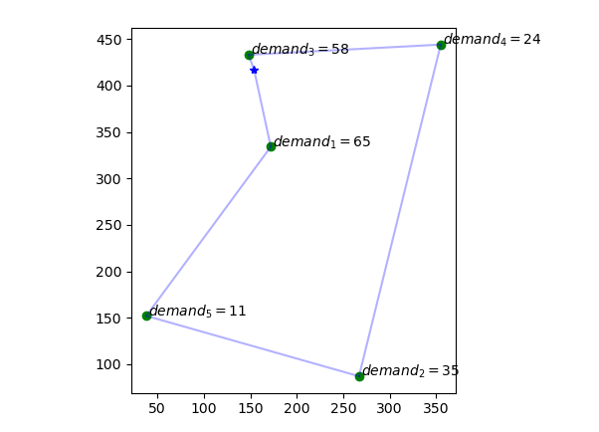
Implementation of Program - results

Slide 15
Research Questions
What is a vendor managed inventory policy?
What is a retailer managed inventory policy?
How is the distance calculated in both policies?
Is carbon emission controllable?
What is the carbon emission associated with conventional trucks, electric trucks, and hydrogen trucks?
Can a sustainable option work out by moving to a particular type of vehicle?

Slide 16
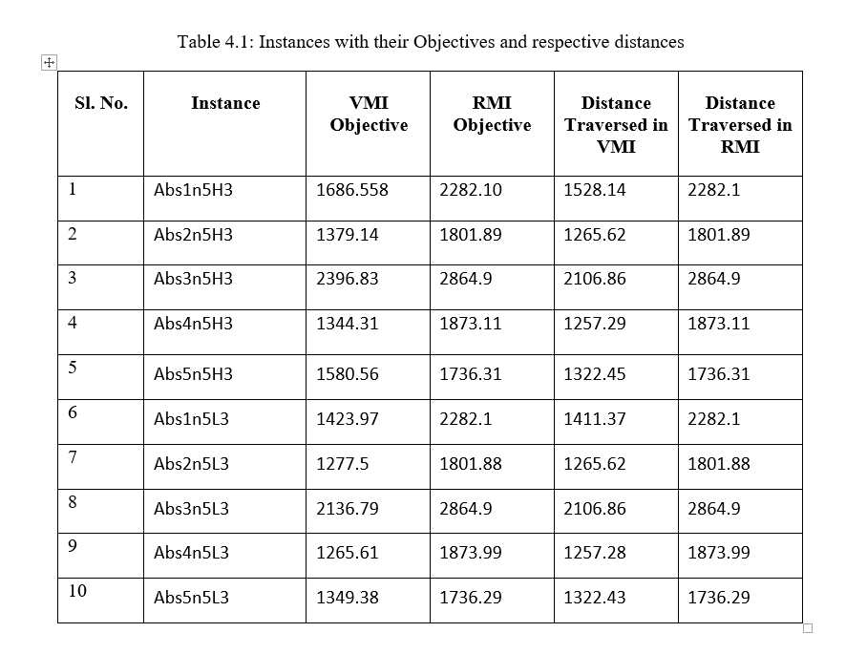
Results

Slide 17
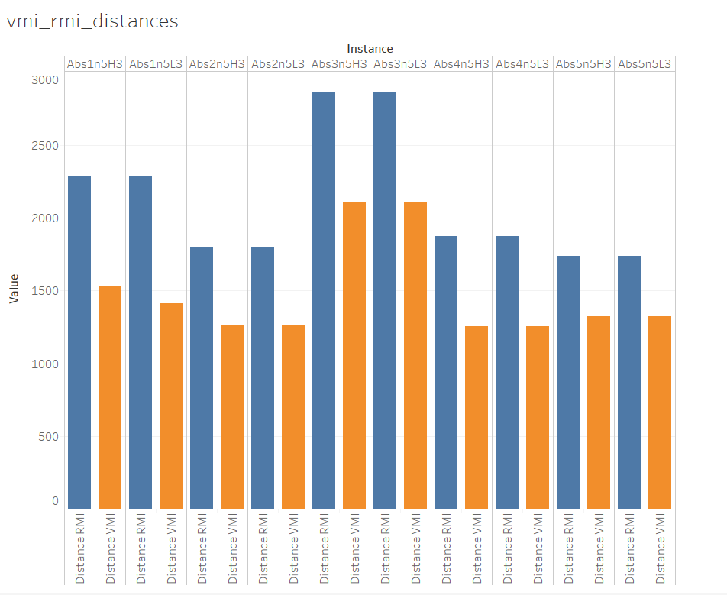
Results

Slide 18
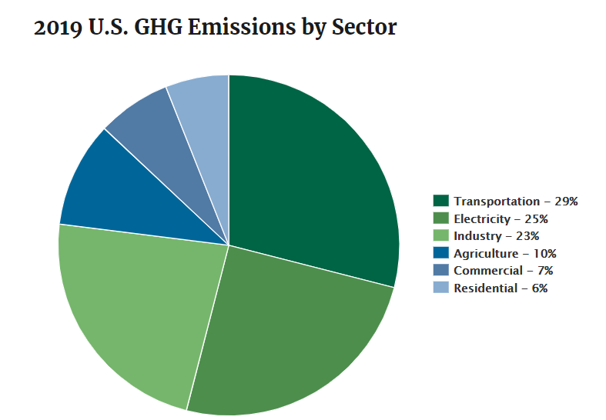
U.S. emissions from Transportation sector

Slide 19
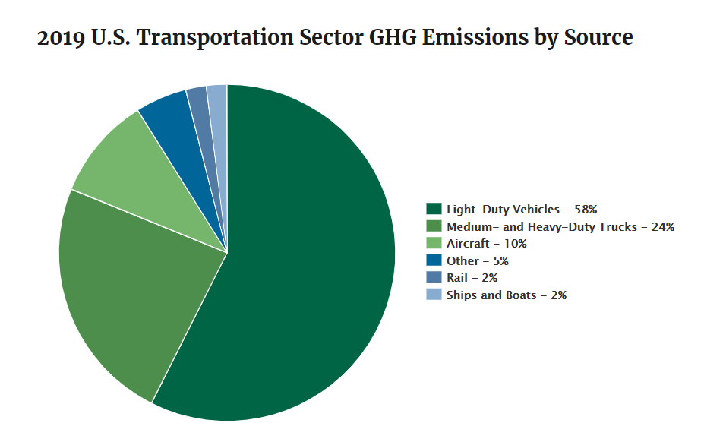
Transportation sector emissions by source, from EPA
neque dignissim, and in aliquet nisl et umis varius.

Slide 20
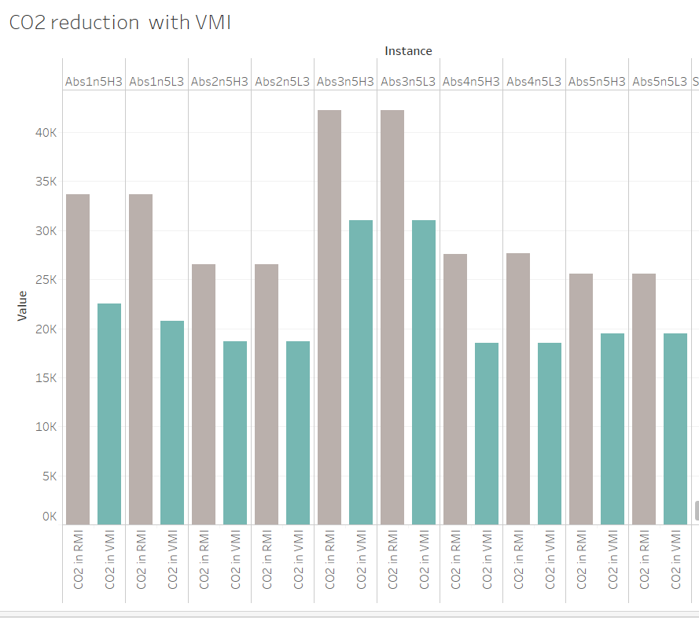
Comparison of CO2 emission in RMI and VMI

Slide 21
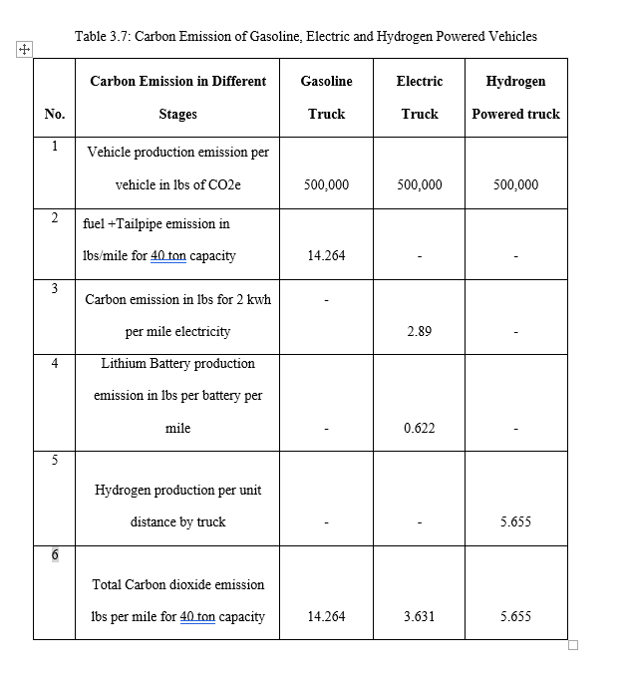
Comparison of CO2 emission from vehicles

Slide 22
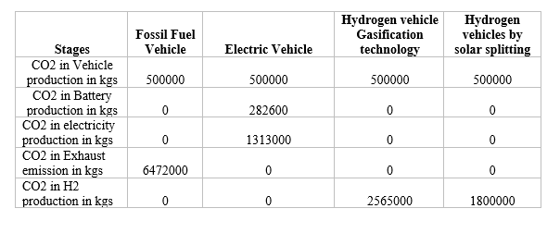
Vehicle emission comparison

Slide 23
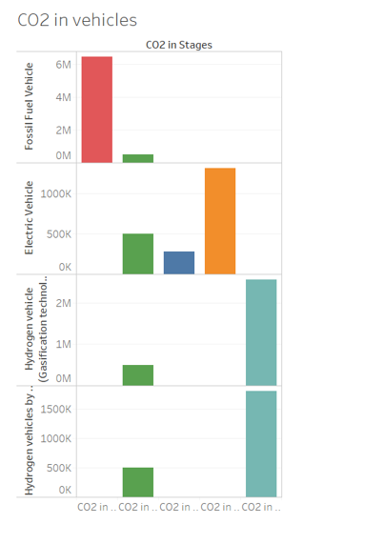
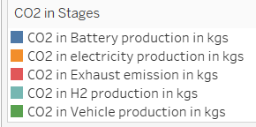
Lifecycle CO2 emission of Gasoline truck, Electric truck and Hydrogen truck

Slide 24
Limitations and assumptions
This software cannot be connected with live data for updated traffic.
Free CPLEX edition allows only a thousand variables and a thousand constraints
Takes time to run bigger models with many constraints.
An availability of unlimited supply of goods at depot seems unrealistic.
The distance calculated between depot and customers or amongst customers is assumed to be Euclidean.
Euclidean distances cannot be applied for real scenario to get exact results.
Note: neque digni and in aliquet nisl et a umis varius.

Slide 25
How could this software help transportation managers?
This research could help inventory and transportation managers:
in decision making and freight planning.
Inventory management by minimizing cost

Slide 26
Future extensions
The problem could be extended to a wider network of customers.
Evaluation of emissions could be perfected by including various other elements such as logistics of vehicle manufacturing,
Repurposing of lithium batteries.

Slide 27
References
https://www.bbc.com/news/av/world-europe-58093275
https://climate.nasa.gov/climate_resources/24/graphic-the-relentless-rise-of-carbon-dioxide/
https://abcnews.go.com/International/people-flee-fires-greece-trapped-plead/story?id=79337249
https://www.corporatecomplianceinsights.com/compliance-lessons-australian-bushfires/

