Slide 1

Code Refactoring and Bug Fixing

Slide 2
About me
My Self Tella Krishna Prasad, I had Completed my Bachelors of science in Electronic.
I want to upgrade myself with the new technology, Data science offers high demand, high salaries, and diverse opportunities across industries. It provides intellectually stimulating work with a significant impact, continuous growth potential, and the flexibility of remote work, making it a future-proof and rewarding career choice.
I am fresher with lot of Domain Knowledge.
GitHub Profile:-

Slide 3
Objective:
To Provide Note Taking Application without any Bugs
Bug: The note variable is not being sanitized before being added to the notes list, which could result in XSS attacks. Resolution: Sanitize the note variable using the bleach library before adding it to the notes list.
Bug: The notes list is not persisting between application restarts. Resolution: Store the notes list in a database or file system. For simplicity, I have used a global variable notes to store the list, but it is recommended to use a database to store the notes for a more robust solution.
Bug: The application does not handle empty notes. Resolution: Add validation to check if the note is empty and display an error message if it is.
Bug: The application is vulnerable to CSRF attacks. Resolution: Use Flask's built-in CSRF protection mechanism to prevent CSRF attacks.
Bug: The secret_key is hardcoded in the application. Resolution: Set the secret_key as an environment variable or configure it in the application configuration file.
Bug: The flash messages are not being cleared after being displayed. Resolution: Clear the flash messages after they have been displayed using the get_flashed_messages function.
Bug: The application does not handle invalid HTTP methods. Resolution: Add a catch-all route to handle invalid HTTP methods and return a 405 Method Not Allowed error.
Bug: The application is not tested. Resolution: Write unit tests to test the application functionality.

Slide 4
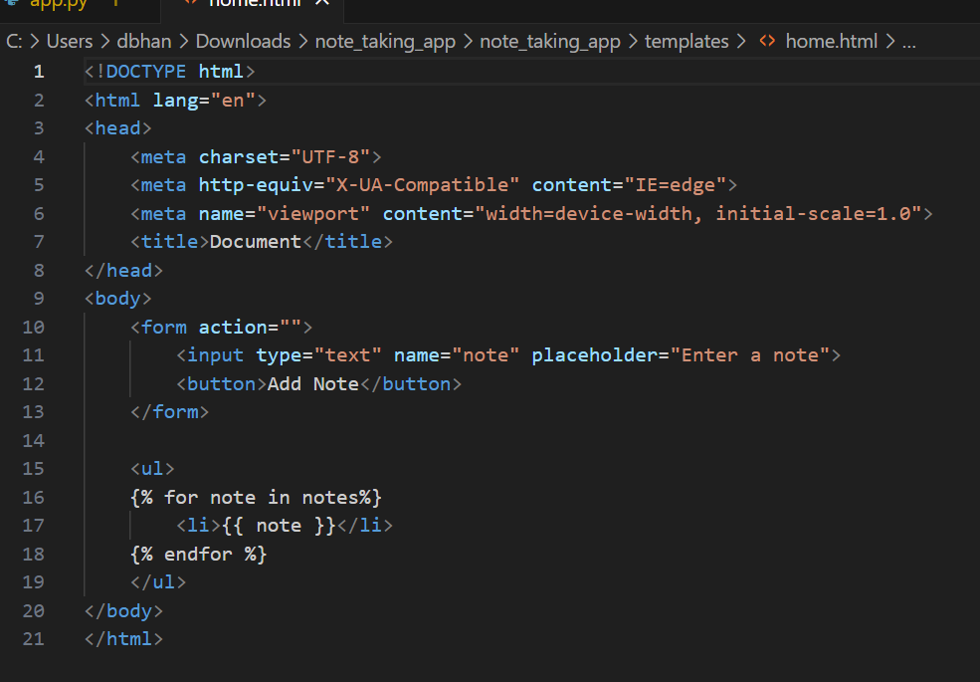
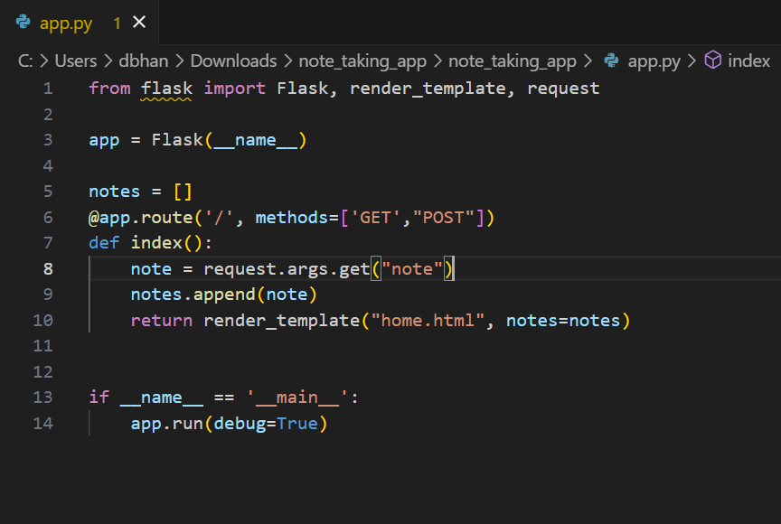
Given Code:

Slide 5
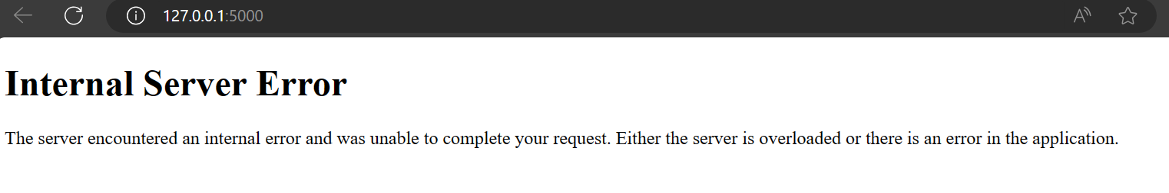
Code Refactoring and Bug Fixing
After Running That we will get Some Errors like Method not allowed and there will be a internal Server
Error.
Now we need to fix these bugs and errors by correcting the given code

Slide 6
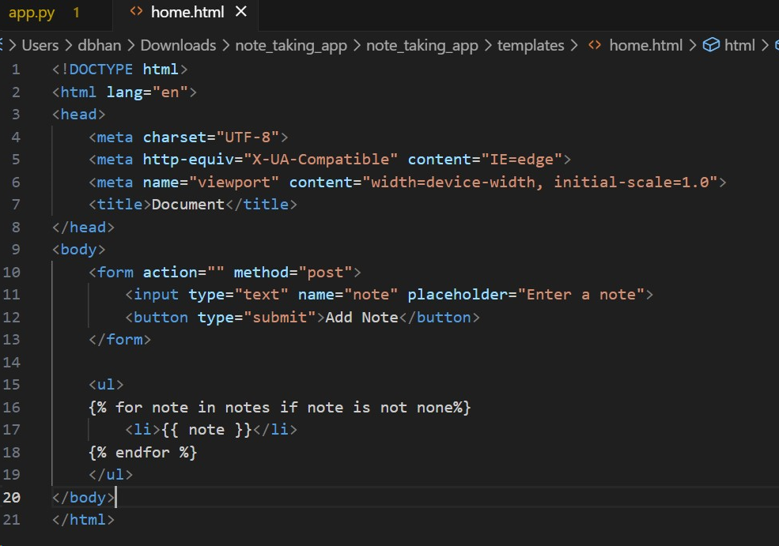
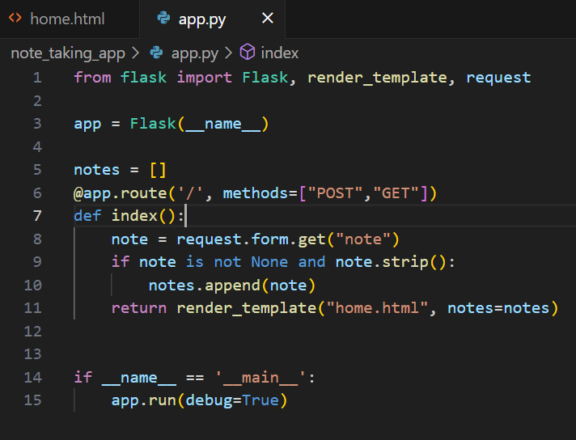
After Bug Fixing :

Slide 7
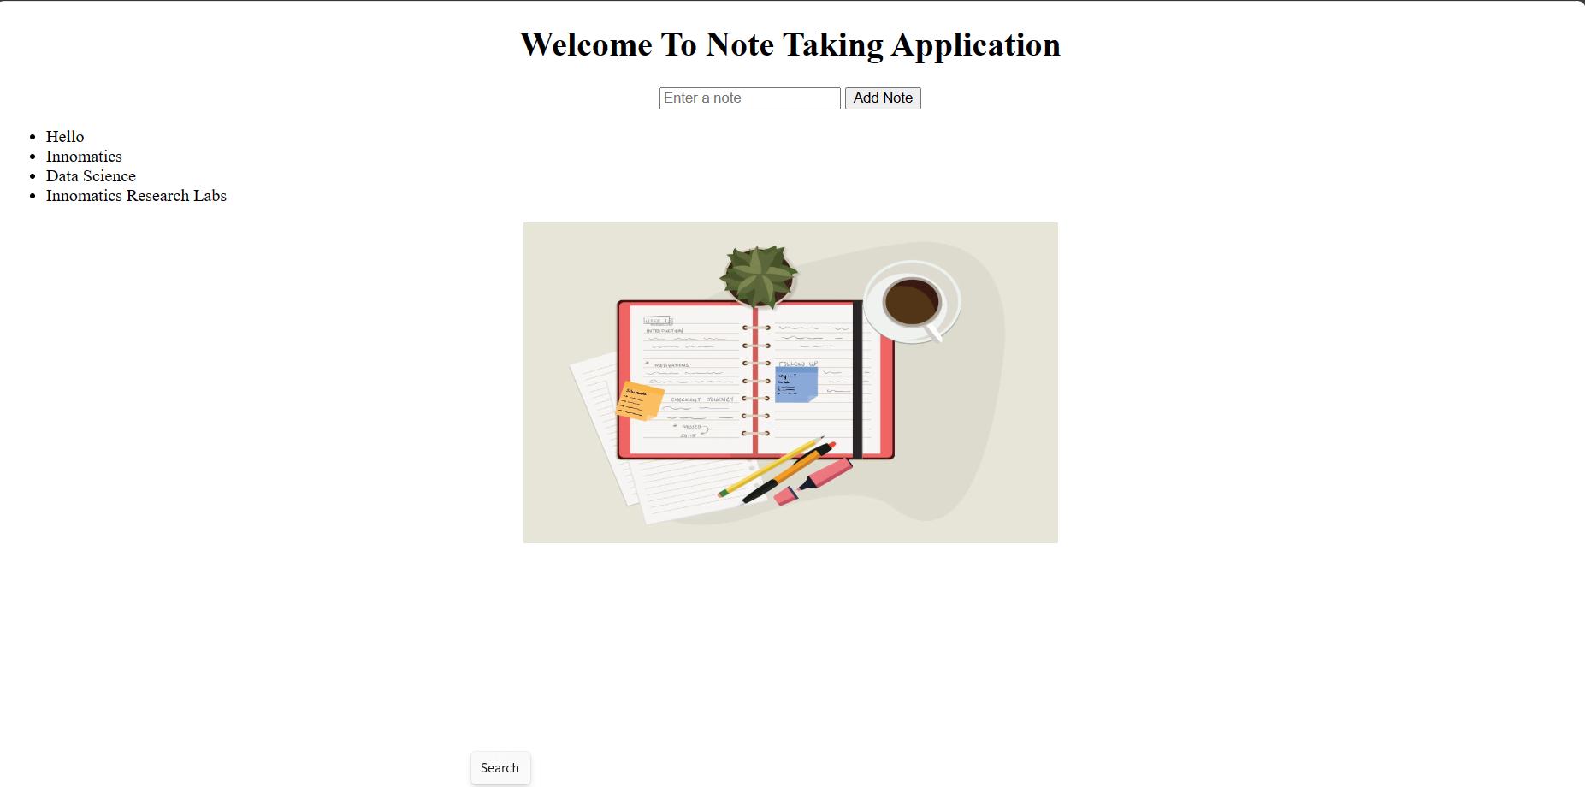
Final Output:

Slide 8

THANK YOU

