Slide 1
Case Study Round 2 – Author Classification
By
Krishna Priya
Final year
Integrated M. Tech Geophysical Technology
Indian Institute of Technology, Roorkee

Slide 2
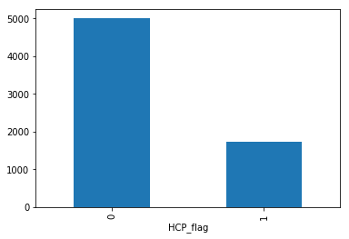
Quality checks performed / Errors found:
1) Description column contained several languages including English, Spanish and Italian. So had to convert few few letters like ó, é, ú, è, ü to normal words.
2) Also not only english stopwords but stopwords of these languages were also removed.
3) Location column had around 2400 missing values but this column was of no use for prediction.
4) Data was biased, this was taken care in prediction by using class weights = balanced in the SVC classifier.

Slide 3
Data preprocessing steps:
1) Removed stopwords of english, spanish and italian. Only 2 rows had urdu description which were eliminated in the process of removing every thing except english letters.
2) Removed urls and punctuations from the description column.
3) Stemming of the text data was done and finally description column was made using description, follower and following count. Wanted to make ratio of follower and following but couldn’t because a substantial number of rows had 0 values.
4) Words with size less than 2 were removed.
5) Finally a sparse matrix(to combine hetrogenous data) of stacked tfidf word analyzer having 10000 features and character analyzer having 50000 features was created for description column.

Slide 4
Key observations / Trends:
1) Most of the rows with Healthcare Professions = 1, had (follower / following) ratio greater than 1 which was not the case for Non HCPs.
Journey:
1) Initially tried Bag of Words, Tfidf (word analyzer only) and word2vec wih no noise removal.
2) Then tried them after removing columns which were noise according to intution and then my hypothesis was verified as the Roc_Auc score improved by 2%. So Location, Name and handle were of no use in this particular problem statement of classification.
3) word2vec and Tfidf were almost performing similarly upon tuning but due to time limitations, the latter was chosen.
4) Then I tried this feature engineering with noise removal where I stacked word and character tfidfvectorizer and the results were very good. Score improved by 4%.

Slide 5
Model choice explanation:
1) Tfidf was performing equivalent or in some cases better than word2vec because, for this particular problem statement aspect was not required.
For example, if we needed to find the effect of a drug from a text review then we would require the model to learn the context of the words. That can be achieved through the use of Word2Vec.
2) Manual model comparison of Naive Bias , SVC, Random Forest and XGBoost was showing similar Auc_Roc score.
3) But after tuning, Linear SVC was showing the best accuracy.

Slide 6
Conclusion & Expected error for submission:
1) Tpot tried various algorithms (13 total - see documentation for models) and their parameter tuning and finally suggested Linear SVC and the best parameters of the model.
2) Instead of tuning each classification model and comparing, TPOT is a good idea considering you have good time at your hand.
3) Here as you can see I have only taken 60 pipelines but if I had time I would have taken more. As they have default pipeline size of 10000. But in the problems I have tried generally a pipeline size of 700-1000 which provides good scores and models incuding stacked and ensemble models.
Number of pipelines = (population size * generation) + population size
Best Performing model : LinearSVC
roc_auc score: 95.8746 %
variance: 0.0000145 on 5 fold cross validation. So the model is not overfitting.

