Slide 1

E- Airlines
KRISHNAPRIYA pARUMANCHALA – 1808721
* An iOS app for Flight Enquiries.

Slide 2
Contents
Application Scope
MVC Design
Frameworks
Contributions
Conclusions

Slide 3
Application scope
The scope of this application is to provide a simple iOS interface to execute Flight Travel related tasks. The following are the features of Flighty.
Get Flight Status:
By Flight Number: Provide Flight Number and Flight Date to get that particular flight details
By Flight Route: Provide IATA codes of Origin Airport, Destination Airport and Search Date to get list of FlightNumbers scheduled between those airports up to 5 months in advance.
By Arrival Airport: Provide Arrival Airport IATA code and particular date, time to get flight number list of all the flights arriving at that airport in the next 5 hours.
Get Flight Schedules: Provide IATA codes of Origin Airport, Destination Airport and Search Date to get list of FlightNumbers scheduled between those airports up to next 4 hours.
Get Nearest Airports: Provide the geographical longitude and longitude information to get the 5 nearest airports to that location.

Slide 4
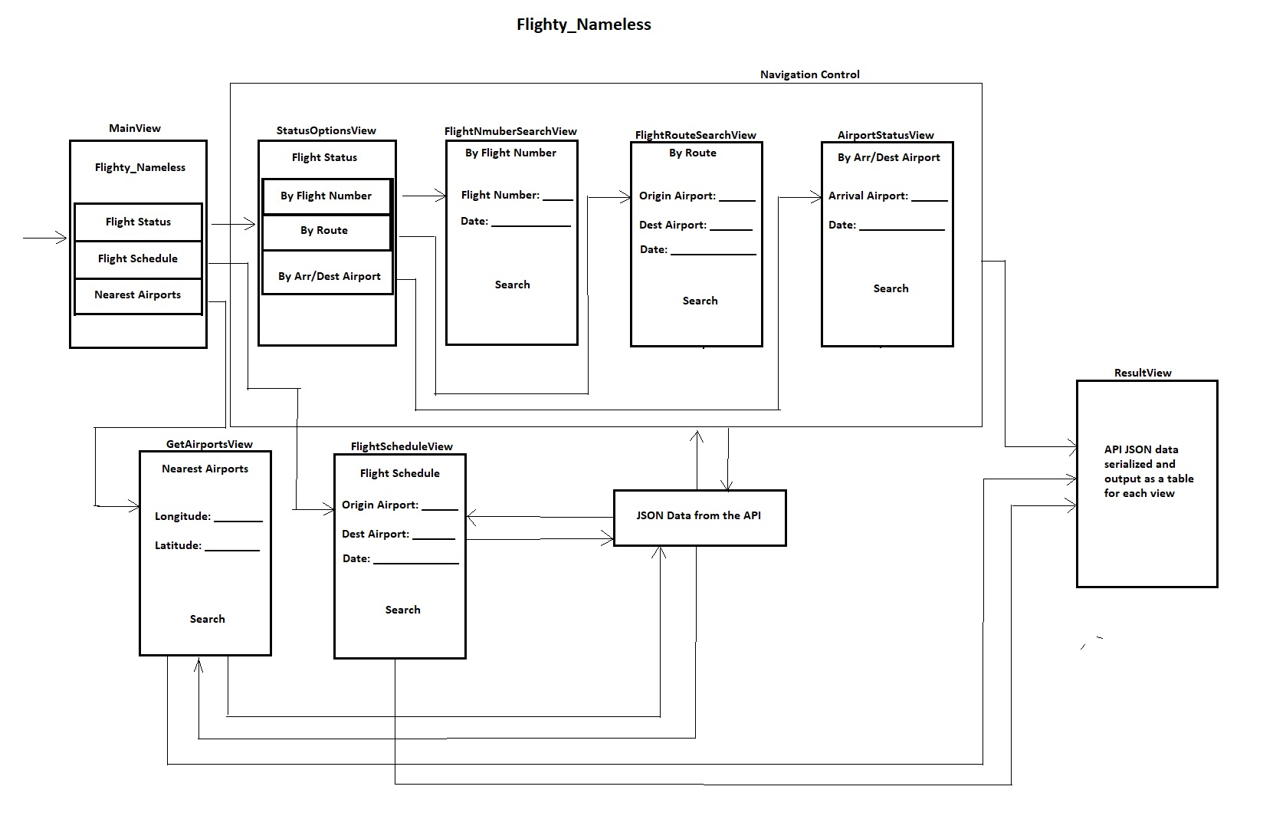
MVC Design

Slide 5
Frameworks in use
Foundation
UI Kit

Slide 6
API’S in use
This application uses the API provided by Lufthansa.
https://developer.lufthansa.com/docs/read/api_basics/Getting_Started
Get Flight Status:
By Flight Number: https://api.lufthansa.com/v1/operations/flightstatus/LH2039/2019-12-11
By Flight Route: https://api.lufthansa.com/v1/operations/flightstatus/route/MUC/FRA/2019-12-11?serviceType=passenger
By Arrival Airport: https://api.lufthansa.com/v1/operations/flightstatus/arrivals/FRA/2019-12-12T05:00
Get Flight Schedules: https://api.lufthansa.com/v1/operations/schedules/MUC/FRA/2019-12-12?directFlights=0
Get Nearest Airports: https://api.lufthansa.com/v1/references/airports/nearest/51.5,-0.142

Slide 7
Resultant json data
FlightStatusResource | Root element of flight status response.
.Flights
..Flight[] (or) ..Flight | 1 – n flights matching the request. (in case of single flight in response, "Flight" is object, not array)
...Departure | Information on departure of the flight.
....AirportCode | 3 letter IATA airport code of the place of origin, e.g. “FRA”.
....ScheduledTimeLocal
.....DateTime | Scheduled time of departure in local time of the departure airport.
 | Format: yyyy-MM-ddTHH:mm.
....ScheduledTimeUTC
.....DateTime | Scheduled time of departure in UTC time.
 | Format: yyyy-MM-ddTHH:mmZ.
....EstimatedTimeLocal or | Depending on whether the specified flight has already departed (ActualTimeLocal) or
....ActualTimeLocal | is estimated to depart (EstimatedTimeLocal), the corresponding element will be returned.
.....DateTime | Estimated time of departure in local time of the departure airport.
 | Format: yyyy-MM-ddTHH:mm.
....EstimatedTimeUTC or | Depending on whether the specified flight has already departed (ActualTimeUTC) or
....ActualTimeUTC | is estimated to depart (EstimatedTimeUTC), the corresponding element will be returned.
.....DateTime | Estimated time of departure in local time of the departure airport.
 | Format: yyyy-MM-ddTHH:mmZ.
The resultant JSON data is a complex structured information about a number of flights, airports, arrivals, destinations, time, delays etc..,
A sample JSON structure can be seen in the figure.
Each API has a unique JSON structure and needs to be parsed independently.

Slide 8
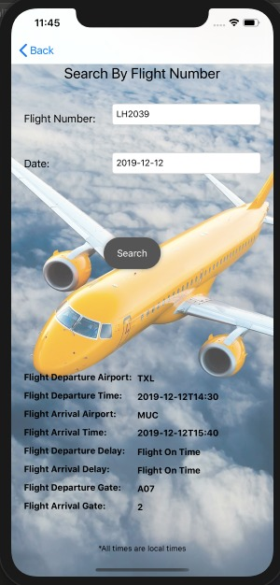
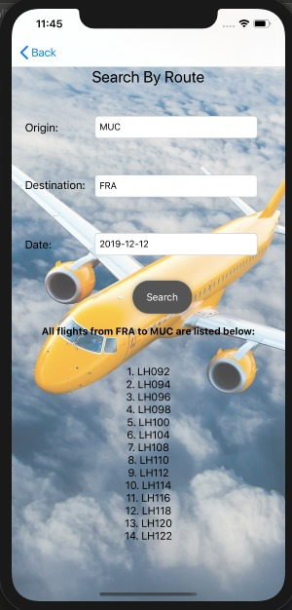
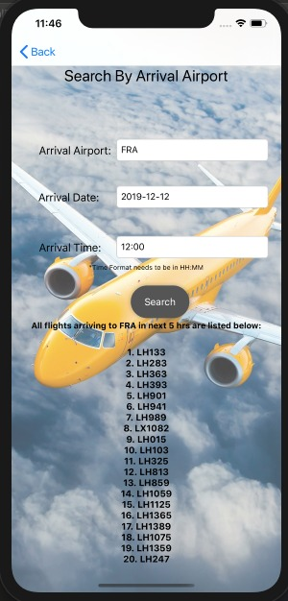
Output Screenshots

Slide 9
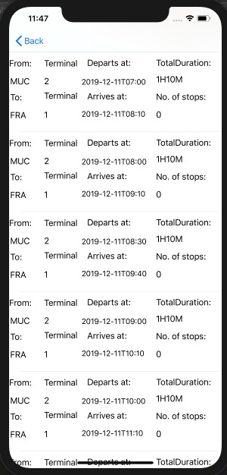
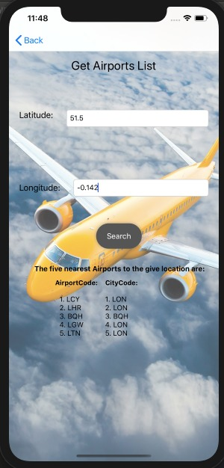
Output Screenshots

Slide 10
Problems faced
Constructing a dynamic URL.
Parsing complex JSON data and storing the parsed data to a local object.
Using completion handlers to send parsed JSON data to a view controller.
Standardizing the names and providing auto layouts

Slide 11

Lessons Learnt
Constructing a dynamic URL using string interpolation.
Assigning API token to the URL using URL headers.
Parsing complex JSON data to simplified dictionaries, store them in structured arrays and pass them to respective VC’s using completion handlers.
Improved overall understanding of REST API’S, JSON, Xcode and Swift.

Slide 12

Queries??

Slide 13
Thank you
- KRISHNAPRIYA PARUMANCHALA
* An iOS app for Flight Enquiries.

