Slide 1

Arrays 2d arrays sorting
By Janjanam Krishna Priya

Slide 2
Arrays

Slide 3
Arrays
Learning Path
Step1: Need of Arrays.
Step 2: What is an Array.
Step 3: Array Declaration.
Step 4: Array Initialization.
Step 5:How to use an array.
Step 6: some example problems on arrays.
Step 7: Resources.

Slide 4
Need of Arrays
Before going to learn any new technology one must know the purpose and need of that technology. I believe that then only one can use the learned technology effectively and efficiently.
Why do we need an array?
Let’s consider the situation where we need to get 10 student’s age and store it for some calculation.
Since age is an integer type, we can store it something like below.
if we declare like above, it will be very difficult for us to manipulate the data. If more number of student joins, then it is very difficult to declare a lot of variables and keep track of it. To overcome this kind of situation, we should use Array data structure.
int age1,age2,age3,age4,age5,age6,age7,age8,age9,age10;

Slide 5
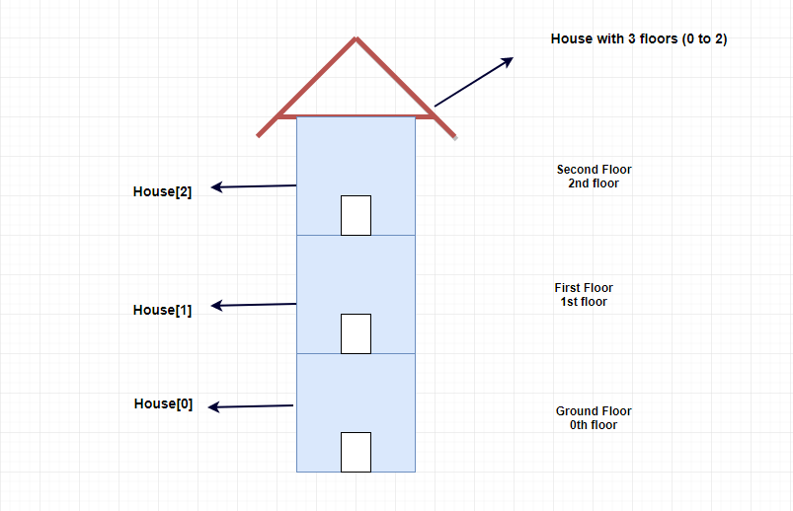
What is an Array
An array is a collection of variables in same datatype.
we can’t group different data types in array.
Like, combination of integer and char, char and float etc.
Hence Array is called as homogeneous data type.
If we consider house as a datatype then apartment is an array of house.

Slide 6
Array Declaration
Declaring an array is language-specific.
For example, in C/C++, to declare an array, you must specify, the following:
Size of the array: This defines the number of elements that can be stored in the array.
Type of array: This defines the type of each element i.e.. number, character, or any other data type
A C++ example would be:.
Above statement is used to create an array which can hold 5 integer values.
int arr[5];

Slide 7
Array Initialization
Array can be initialized either at the time of declaration or after that.
The sample format of an array that is initialized in C++, is
An array can be initialized after declaration by assigning values to each index of the array as follows.
C++ example:
int arr[5]={1,4,3,2,5};
int arr[5];
arr[2]=10;
arr[3]=20;

Slide 8
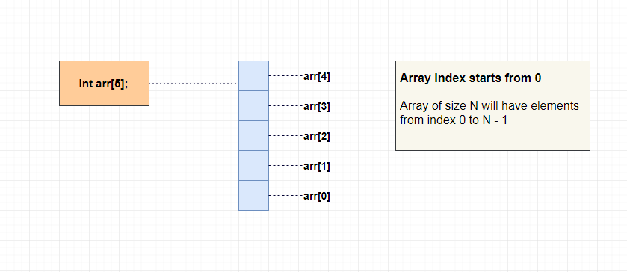
How to use an Array
To store 10 students age, we can simply declare array like below.
Array index starts from 0.
To access 1st student’s age, we can directly use index 0. i.e. age[0]
To access 5th student’s age, we can directly use index 4. i.e. age[4]
Int ages[10];

Slide 9
Array practice problems and Solutions
One can find the practice problems with solutions here
https://www.csinfo360.com/p/array-practice-problems.html

Slide 10
References
https://www.log2base2.com/C/array/arrays-in-c.html.
https://www.hackerearth.com/practice/data-structures/arrays/1-d/tutorial/
https://www.geeksforgeeks.org/top-50-array-coding-problems-for-interviews/
https://www.educba.com/arrays-in-c-programming/
https://www.hackerearth.com/practice/data-structures/arrays/1-d/practice-problems/
https://www.interviewbit.com/courses/programming/topics/arrays/

Slide 11
2D Arrays

Slide 12
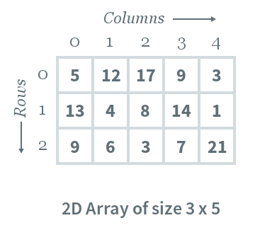
2D Arrays
The two-dimensional array can be defined as an array of arrays.
e 2D array is organized as matrices which can be represented as the collection of rows and columns.
However, 2D arrays are created to implement a relational database lookalike data structure.
It provides ease of holding the bulk of data at once which can be passed to any number of functions wherever required.

Slide 13
2D array declaration:
To declare a 2D array, you must specify the following:
Row-size: Defines the number of rows.
Column-size: Defines the number of columns.
A sample C++ array is declared as follows:
Above statement declares a 2d array with 3 rows and 5 columns.
int arr[3][5];

Slide 14
2D array initialization:
An array can either be initialized during or after declaration.
An example in C++ is given below:
A C++ example of initializing an array after declaration by assigning values to each cell of a 2D array is as follows:
int arr[3][5]={{23,3,21,43,34},{1,4,5,3,5},{8,5,4,7,1}}
int arr[3][5];
arr[0][1]=12;
arr[1][2]=22;

Slide 15
More References
For more conceptual knowledge refer
https://www.javatpoint.com/two-dimensional-array-in-c
https://www.interviewbit.com/tutorial/pointers-and-2-d-arrays/
For Practice problems refer
https://www.hackerearth.com/practice/data-structures/arrays/multi-dimensional/practice-problems/
https://leetcode.com/tag/array/

Slide 16
Sorting

Slide 17
Sorting
In ,computer science arranging in an ordered sequence is called "sorting". Sorting is a common operation in many applications, and efficient algorithms to perform it have been developed.
The most common uses of sorted sequences are:
making lookup or search efficient;
making merging of sequences efficient.
enable processing of data in a defined order.
There many sorting algorithms available. In our approach we provide 3 steps for learning sorting algorithms.
Step1: Visualizing the sorting technique using hacker earth tools.
Step2: Providing conceptual resources.
Step3: Practice problems

Slide 18
Bubble Sort
Bubble sort is based on the idea of repeatedly comparing pairs of adjacent elements and then swapping their positions if they exist in the wrong order.
Link for the visualizer
https://www.hackerearth.com/practice/algorithms/sorting/bubble-sort/visualize/
Tutorials:
https://www.geeksforgeeks.org/bubble-sort/
https://www.hackerearth.com/practice/algorithms/sorting/bubble-sort/tutorial/
Practice Problems: Solve the following problems to gain more knowledge on bubble sort
https://www.hackerearth.com/practice/algorithms/sorting/bubble-sort/practice-problems/
Solve the practice problems from easy to hard level.

Slide 19
Selection Sort
The Selection sort algorithm is based on the idea of finding the minimum or maximum element in an unsorted array and then putting it in its correct position in a sorted array.
Link for the visualizer
https://www.hackerearth.com/practice/algorithms/sorting/selection-sort/visualize/
Tutorials:
https://www.hackerearth.com/practice/algorithms/sorting/selection-sort/tutorial/
Practice problems:
https://www.hackerearth.com/practice/algorithms/sorting/selection-sort/practice-problems/

Slide 20
Insertion Sort
Insertion sort is based on the idea that one element from the input elements is consumed in each iteration to find its correct position i.e., the position to which it belongs in a sorted array.
It iterates the input elements by growing the sorted array at each iteration. It compares the current element with the largest value in the sorted array. If the current element is greater, then it leaves the element in its place and moves on to the next element else it finds its correct position in the sorted array and moves it to that position. This is done by shifting all the elements, which are larger than the current element, in the sorted array to one position ahead.
Visualizer:
https://www.hackerearth.com/practice/algorithms/sorting/insertion-sort/visualize/
Tutorial:
https://www.hackerearth.com/practice/algorithms/sorting/insertion-sort/tutorial/

Slide 21
Merge Sort
Merge sort is a divide-and-conquer algorithm based on the idea of breaking down a list into several sub-lists until each sub list consists of a single element and merging those sub lists in a manner that results into a sorted list.
Idea:
Divide the unsorted list into N sublists, each containing 1 element.
Take adjacent pairs of two singleton lists and merge them to form a list of 2 elements. N will now convert into N/2 lists of size 2.
Repeat the process till a single sorted list of obtained.
While comparing two sublists for merging, the first element of both lists is taken into consideration. While sorting in ascending order, the element that is of a lesser value becomes a new element of the sorted list. This procedure is repeated until both the smaller sublists are empty and the new combined sublist comprises all the elements of both the sublists.
Visualizer: https://www.hackerearth.com/practice/algorithms/sorting/merge-sort/visualize/
Tutorial: https://www.hackerearth.com/practice/algorithms/sorting/merge-sort/tutorial/
Problems: https://www.hackerearth.com/practice/algorithms/sorting/merge-sort/practice-problems/

Slide 22
Quick Sort
Quick sort is based on the divide-and-conquer approach based on the idea of choosing one element as a pivot element and partitioning the array around it such that: Left side of pivot contains all the elements that are less than the pivot element Right side contains all elements greater than the pivot
It reduces the space complexity and removes the use of the auxiliary array that is used in merge sort. Selecting a random pivot in an array results in an improved time complexity in most of the cases.
Visualizer: https://www.hackerearth.com/practice/algorithms/sorting/quick-sort/visualize/
Tutorial: https://www.hackerearth.com/practice/algorithms/sorting/quick-sort/tutorial/
Practice Problems: https://www.hackerearth.com/practice/algorithms/sorting/quick-sort/practice-problems/

Slide 23
References
For more Sorting algorithms refer hacker earth.
https://www.hackerearth.com/practice/algorithms/sorting/

Slide 24
Thank You

