Slide 1
DECENTRALIZED APPLICATION FOR MUSICIANS USING BLOCKCHAIN
Presented By,
KRISHNAPRIYA V M
Roll No: 11
S4_MCA_B

Slide 2
INTRODUCTION
A blockchain is a distributed, peer-to-peer database that hosts a continuously growing number of transactions.
Each transaction, referred to as a “block,” is secured through cryptography, timestamped, and validated by every authorized member of the database using consensus algorithms (i.e., a set of rules).
Blockchains will affect listeners and fans, in how they experience and interact with the music.

Slide 3
RELEVANCE OF THE TOPIC
Revenues in the music industry have reached new heights, musicians express dissatisfaction with lower royalty payouts.
A decentralized app (also known as a dApp or dapp) operates on a blockchain or peer-to-peer network of computers. It enables users to engage in transactions directly with one another as opposed to relying on a central authority.
This project introduce a business logic by developing smart contracts on the Ethereum blockchain and uses IPFS (Interplanetary File System) for decentralized file storage to make an associated web application choosing a JavaScript framework.

Slide 4
DESCRIPTION OF THE PROJECT
Revenue generation streams in the music industry has been intermittently discussed since the transition from sales to streaming started when Spotify launched in 2008.
With today’s complicated licensing agreements, money flows through a complex chain of third parties before it reaches the hand of musicians.
This project identifies core issues in the music industry, proposes a decentralized application (dApp) that attempts to solve these issues and implements the proposed solution.
The dApp works as a global copyrights database where musicians can register and license musical works. Author exploits Ethereum’s efficient transactional system to manage license purchases.

Slide 5
EXISTING SYSTEM VS PROPOSED SYSTEM
The blockchain technology was developed since its first application with Bitcoin in 2008 which is only deals with limited number of data. So that if the content increases it is difficult to manage the application.
To recover this problem, a decentralized app using blockchain was introduced which deals with large amount of data within an secure environment.
In the proposed system develop smart contracts on the Ethereum blockchain and uses IPFS (Interplanetary File System) for decentralized file storage to make an associated web application choosing a JavaScript framework.

Slide 6
MODULE DESCRIPTION
Project Consist of 3 modules;
1. Web Server: Clients
2. Web Server: Node.js Application
3. Ethereum Blockchain: Data Storage and Authentication (IPFS)

Slide 7
Web Server: Clients
Web server which is used to login purpose for clients who purchase the music from the application.
2. Web Server: Node.js Application
JavaScript Application which is used to store the information of artists.
Ethereum Blockchain: IPFS
Ethereum features something called smart contracts which uses an inter planatory file system which stores the data within the web server.

Slide 8
SYSTEM ARCHITECTURE
The dApp is divided into four separate physical nodes: client: web browser, web server: Node.js application, Ethereum blockchain, and IPFS: Data Storage and authentication.

Slide 9
First 3 available accounts are for artists, and the rest are for consumers. The numbering is given as (0,1,2) for which accounts of artists,. The numbering for users or consumers is represented as (3,4,5,6,7,8,9).
Uploading a song twice from different accounts or the same account will also be denied as this is to do with how IPFS stores and indexes the data.
InterPlanetary File System since using so generates a unique cryptographic hash, called a digital fingerprint. This method denies duplicate uploads resulting in a robust and secure platform.

Slide 10
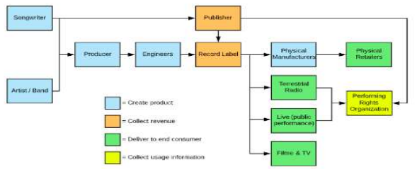

Slide 11
FRONT END & BACK END TOOLS Front end: HTML, CSS Back end: Python

Slide 12
GIT USAGE
Github is a web-based interface that uses git, the open source version control software that lets multiple people make separate changes to web pages at the same time. As carpenter notes, because it allows for real-time collaboration, github encourages teams to work together to build and edit their site content. GitHub allows multiple developers to work on a single project at the same time, reduces the risk of duplicative or conflicting work, and can help decrease production time. With GitHub, developers can build code, track changes, and innovate solutions to problems that might arise during the site development process simultaneously.

Slide 13
REFERENCES
http://www.thembj.org/2015/08/grds-failure/ for a good overview of these efforts and their failures.
http://isrc.ifpi.org. The ISRC is administered by IFPI, the international umbrella trade organization for the recording industry.
http://www.iswc.org. The ISWC is administered by CISAC, the international umbrella trade organization for composers and their rights administrators, a separate organization from IFPI.
http://www.isni.org.
http://www.billboard.com/biz/articles/news/publishing/6114215/nmpa-puts-us-publishing-revenues-at-22-billion-annually.

Slide 14
THANK YOU

