Slide 1
DECENTRALIZED APPLICATION FOR MUSICIANS USING BLOCKCHAIN
Presented By,
KRISHNAPRIYA V M
Roll No: 11
S4_MCA_B

Slide 2
INTRODUCTION
Blockchain is a distributed, peer-to-peer database that hosts a continuously growing number of transactions.
Each transaction, referred to as a “block” is secured through cryptography, timestamped, and validated by every authorized member of the database using consensus algorithms .
Blockchains will affect listeners and fans, in how they experience and interact with the music.

Slide 3
RELEVANCE OF THE TOPIC
Revenues in the music industry have reached new heights, musicians express dissatisfaction with lower royalty payouts.
A decentralized app (also known as a dApp or dapp) operates on a blockchain or peer-to-peer network of computers. It enables users to engage in transactions directly with one another as opposed to relying on a central authority.

Slide 4
DESCRIPTION OF THE PROJECT
With today’s complicated licensing agreements, money flows through a complex chain of third parties before it reaches the hand of musicians.
This project identifies core issues in the music industry, proposes a decentralized application (dApp) that attempts to solve these issues and implements the proposed solution.
The dApp works as a global copyrights database where musicians can register and license musical works. Author exploits Ethereum’s efficient transactional system to manage license purchases.

Slide 5
It is a simple but beautiful proof-of-concept of a decentralized music owning platform built with Polygon, aiming to reimagine how musicians earn a living and how fans discover new ways to connect with the music and each other.
Allows artists to sell digital songs to fans, who are then able to hold a digitally signed copy of your song (on the Polygon blockchain) that could be limited edition.
Also, encourages fans who want to support their favorite artists to support them by creating unique digital assets.

Slide 6
EXISTING SYSTEM VS PROPOSED SYSTEM
The blockchain technology was developed since its first application with Bitcoin in 2008 which is only deals with limited number of data. So that if the content increases it is difficult to manage the application.
To recover this problem, a decentralized app using blockchain was introduced which deals with large amount of data within an secure environment.
In the proposed system develop smart contracts on the Ethereum blockchain and decentralized file storage to make an associated web application choosing a JavaScript framework.

Slide 7
MODULE DESCRIPTION
Project Consist of ;
1. Web Server: Clients
2. Web Server: Creation
3. Ethereum Blockchain: Data Storage and Authentication

Slide 8
Web Server: Clients
Web server which is used to login purpose for clients who purchase the music from the application.
2. Web Server: Creation
JavaScript Application which is used to store the information of artists.
Ethereum Blockchain
Ethereum features something called smart contracts which uses an file system which stores the data within the web server.

Slide 9
SYSTEM ARCHITECTURE
Simple decentralized music owning platform built with Polygon, aiming to reimagine how musicians earn a living and how fans discover new ways to connect with the music and each other.
Allows artists to sell digital songs to fans, who are then able to hold a digitally signed copy of your song (on the Polygon blockchain) that could be limited edition and encourages fans who want to support their favorite artists to support them by creating unique digital assets.

Slide 10
Disrupt the music industry by introducing the concept of royalties, making it more possible for more people to earn a living from their music.
Built with Next.js, which offers blazing-fast server side rendering, and currently uses a Flask backend as temporary metadata storage. The smart contract is deployed on Polygon using the excellent Truffle suite, making deployments simple and easy.

Slide 11
FRONT END & BACK END TOOLS Front end: HTML,CSS, JavaScript Back end: Python Tools used: Polygon Network, Truffle, Flask

Slide 12
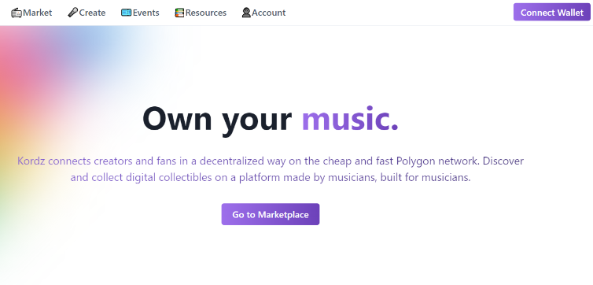
SCREENSHOT

Slide 13
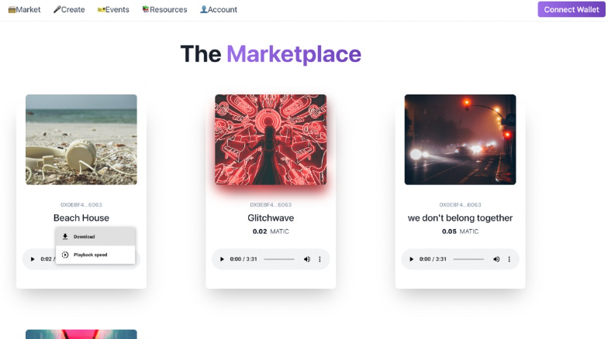

Slide 14
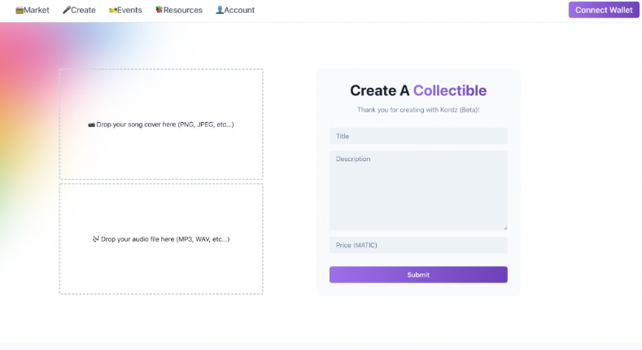

Slide 15
GIT USAGE
Github is a web-based interface that uses git, the open source version control software that lets multiple people make separate changes to web pages at the same time. As carpenter notes, because it allows for real-time collaboration, github encourages teams to work together to build and edit their site content. GitHub allows multiple developers to work on a single project at the same time, reduces the risk of duplicative or conflicting work, and can help decrease production time. With GitHub, developers can build code, track changes, and innovate solutions to problems that might arise during the site development process simultaneously.

Slide 16
REFERENCES
Davide Sciaky. 2019.The digital transformation of the music industry through applications of blockchain technology, Degree Project in Media Technology, Second Cycle, 30 Credits Stockholm, Sweden, 2019
BlockchainHub. 2017. Blockchain Explained - Intro - Beginners Guide to Blockchain [online] Available at: https://blockchainhub.net/blockchain-intro/
“Exploiting Online Music Tags for Music Emotion Classification,” TOMM, October. 2011. http://dx.doi.org/10.1145/2037676.2037683
“A semantic space for music derived from social tags,” in Proceedings of the International Conference on Music Information Retrieval (ISMIR), Vienna, Austria, 2007.

Slide 17
THANK YOU

