Slide 1
JavaScript

Slide 2
Module Design
Target web page for validation
Variable, data types, functions and scope
Array, String and Object
DOM and Form Manipulation methods
2
JavaScript Fundamentals
Introduce the Use Case to be completed
Cheat Sheet for JavaScript
let and const
Arrow Functions
Class and objects
5
S/W Requirements
Cheat Sheet for advanced JavaScript
IDE : Visual Studio
Browser: Google Chrome

Slide 3
JavaScript Fundamentals

Slide 4
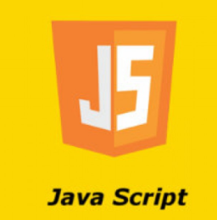
What is JavaScript
JavaScript is a cross-platform, object-oriented scripting language used to make webpages interactive.
When a JavaScript is placed inside a web page, the browser loads the page & built-in interpreter reads the JavaScript code & execute
JavaScript is case sensitive and dynamic typing, loosely typed i.e. variable data types are not declared
JavaScript is used in Web pages for
  Validating data.
  Putting dynamic content into an HTML page.
  To make them interactive

Slide 5
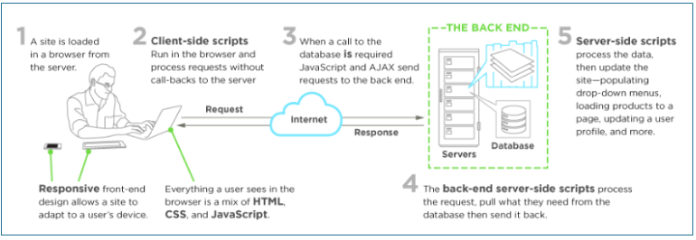
Client and Server side scripting

Slide 6
Introducing the Use Case

Slide 7
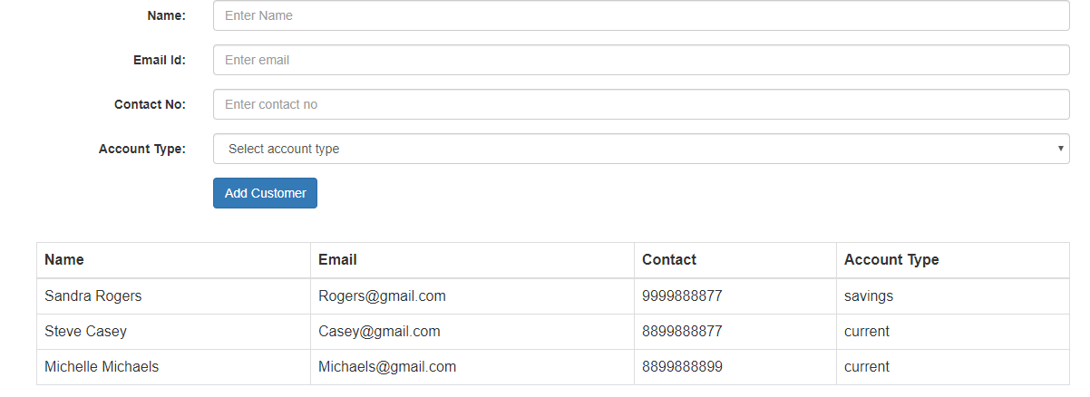
Presenting the Use Case

Slide 8
Description on Use Case
Create the page using Bootstrap. After entering the valid values, once user clicks on Add Customer button, create the customer object and display in tabular format.
Validate the fields name (alphabets allowed), email id ( valid email id), contact no( only 10 digits and first digit should be 7-9) and account type should be selected.
Whenever user inserts invalid value, show the error message next to text box for ex please enter only alphabets

Slide 9
Let us start with JS

Slide 10
Where to write java script
Inline Scripting : <script></script>
External Scripting: <script src=“myjs.js”> </script>
Html Page
<head></head>
<script>
// java script code
</script>
<body></body>

Slide 11
variables

Slide 12
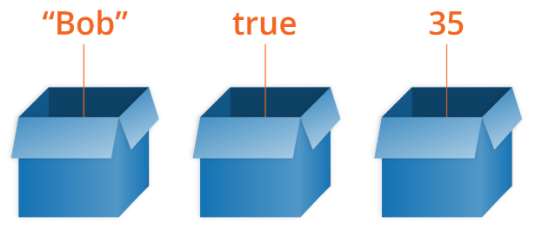
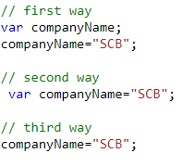
Variable and variable declarations
A variable is a container for a value, like a number we might use in a sum, or a string that we might use as part of a sentence.
Declares a variable, optionally initializing it to a value.

Slide 13
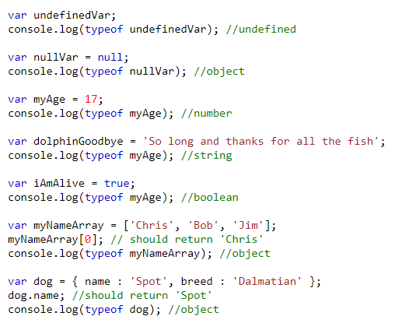
Different ways to declare a variable
undefined
null
number
string
boolean
array
object

Slide 14
Functions

Slide 15
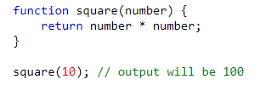

What is a Function
Function Declaration
Fundamental building blocks in JavaScript.
A set of statements that performs a task or calculates a value.
To use a function, you must define it somewhere in the scope from which you wish to call it.
Function can be created in many ways:
Function Declaration
Function Expression
Function Expression

Slide 16
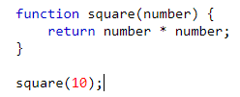
Function Declaration
A function declaration consists of the function keyword, followed by:
  The name of the function.
  A list of parameters to the function, enclosed in parentheses and separated by commas.
  The JavaScript statements that define the function, enclosed in curly brackets, { }.

Slide 17

Function Expression
Anonymous Function expression
Named Function Expression

Slide 18
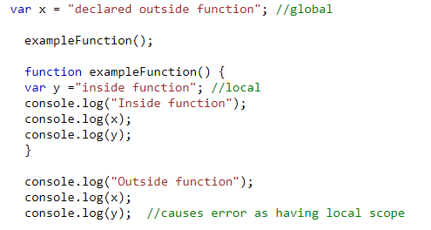
Scoping
When you declare a variable outside of any function, it is called a global variable, because it is available to any other code in the current document.
When you declare a variable within a function, it is called a local variable, because it is available only within that function.

Slide 19
Hands on variable and functions
Create a function which displays the Fibonacci series for 10 numbers: 0,1,1,2,3,5,8,13,21,25
Create a function which display the table of 8.

Slide 20
Array, String and Objects

Slide 21
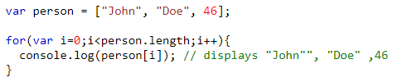
Array
An array can hold many values under a single variable name, and you can access the values by referring to an index number.
Array can consist homogenous as well as heterogenous elements.
Iteration of the array can be done using loops.
Doe
John
46
0
1
2

Slide 22
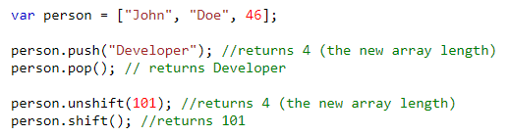
Array Methods
Below are the methods to add or delete the elements from the array (starting , ending or from some index number also)
add at the start: arr.unshift(ele)
add at the end:
arr.push(ele)
Doe
John
46
0
1
2
remove from the start arr.shift()
remove from the end
arr.pop()

Slide 23
Array Methods cont…
Scenarios | Code | Output
Reverse of an array | var arr= [24,27,20,12,28]; arr.reverse(); | 28,12,20,27,24
Sorting of an array | arr.sort() | 12,20,24,27,28
Converting an array into a string | arr.toString() | “24,27,20,12,28”

Slide 24
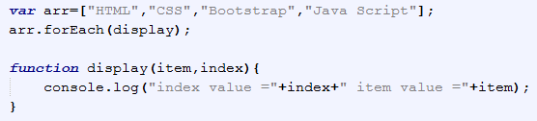
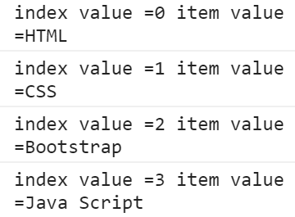
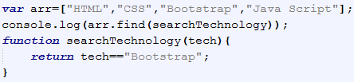

Array Methods cont…
forEach() : method calls a function once for each element in an array, in order. It is a better version of for loop.
The find() method executes the function once for each element present in the array:
  If it finds an array element where the function returns a true value, find() returns the value of that array element (and does not check the remaining values) otherwise it returns undefined

Slide 25
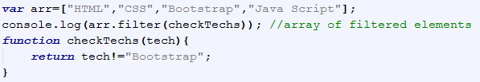
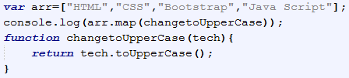
Array Methods cont…
The filter() method creates an array filled with all array elements that pass a test (provided as a function).
The map() method creates a new array with the results of calling a function for every array element. It calls the provided function once for each element in an array, in order.

Slide 26
String and String methods
JavaScript strings are used for storing and manipulating text. Below are various methods for string. Syntax:
var str=“company”;
Below are the list of methods supported in string :
Scenarios | Code | Output
Find the length of string | var str= “company”; str.length; | 7
Change to upper or lower case | str.toLowerCase(); str.toUpperCase(); | company COMPANY
To get a character at specified index | str.charAt[3]; str[3]; | p p
Trims whitespace from both sides of a string | str.trim(); | company
Finding a substring inside a string and extracting it | str.indexOf(“pan”); Str.slice(3,5); | 3 if not found then -1 pan
Notes:
https://developer.mozilla.org/en-US/docs/Web/JavaScript/Reference/Global_Objects/String

Slide 27
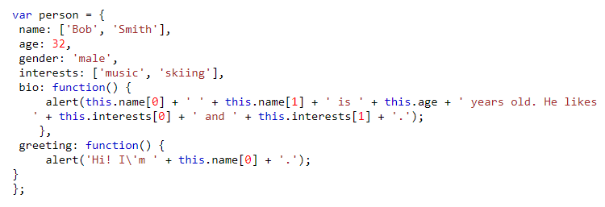
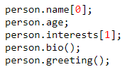
Object
An object is a collection of related data and/or functionality (which usually consists of several variables and functions — which are called properties and methods when they are inside objects.)
Declaration of object
Accessing the object properties

Slide 28
Hands on Array, String and Object
Create an array of Strings which contains the values like [“sTandarD”,”CharTered”,”banK”] then replace the array values with corresponding Uppercase values only.
[“STANDARD”,”CHARTERED”,”BANK”]

Slide 29
Event and Event Handler

Slide 30
Events
Events are actions or occurrences that happen in the system you are programming, which the system tells you about so you can respond to them in some way if desired.
For example, if the user clicks a button on a webpage, you might want to respond to that action by displaying an information box.
Below table consists types of events-
Mouse Events | Keyboard Events | Form Events | Document/Window Events
onclick | onkeypress | onsubmit | onload
ondblclick | onkeydown | onchange | onunload
onmouseenter | onkeyup | onfocus | onscroll
onmouseleave |  | onblur

Slide 31
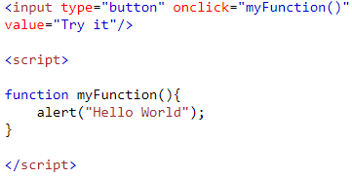
Event Handler
Each available event has an event handler, which is a block of code (usually a user-defined JavaScript function) that will be run when the event fires.
When such a block of code is defined to be run in response to an event firing, we say we are registering an event handler. Event handlers are sometimes called as event listeners
Notes:
The addEventListener() method attaches an event handler to the specified element.
The addEventListener() method attaches an event handler to an element without overwriting existing event handlers.
You can add many event handlers to one element.
You can add many event handlers of the same type to one element, i.e two "click" events.
The removeEventListener() method removes event handlers that have been attached with the addEventListener() method.

Slide 32
DOM and Form Manipulation

Slide 33
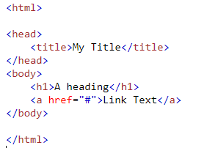
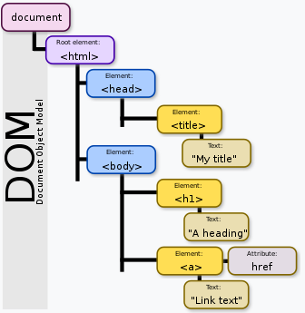
Document Object Model
The Document Object Model (DOM) is a cross-platform and language-independent application programming interface that treats an HTML document as a tree structure wherein each node is an object representing a part of the document. The DOM represents a document with a logical tree.
Notes:
Courtesy: https://upload.wikimedia.org/wikipedia/commons/thumb/5/5a/DOM-model.svg/330px-DOM-model.svg.png

Slide 34

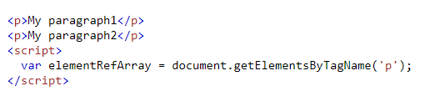



DOM Methods
document.getElementById() : returns an element with a given id attribute value.
document.getElementsByTagName() : returns an array containing all the elements on the page of a given type.
document.getElementsByClassName() : returns an array containing all the elements on the page of a given class.
document.querySelector() : returns the very first matching element as per the selector.
document.querySelectorAll() : returns the all matching elements as per the selector.

Slide 35
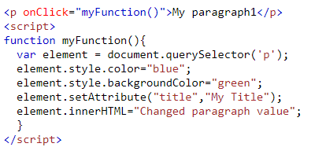
DOM Manipulation
In DOM manipulation, we can modify below fields on existing DOM tree:
Element CSS properties:
ele.style.color=“blue”;
Element Attribute values:
ele.setAttribuite(“width”,”100px”);
Element values
ele.innerHTML=“Updated value”;

Slide 36

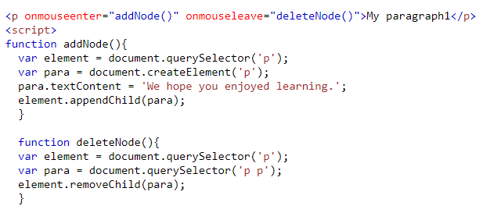
Creation or Deletion of nodes in DOM :
Let us learn how to create, add, replace or remove the node
Element creation:
Element addition in tree:
Element removal from tree:

Slide 37
Regular Expression Pattern and Quantifiers
Pattern | Description
[0-9] | Find any of the digits between the brackets
[A-Z] | Find any of the characters (capital letters) between the brackets
[0-9a-z] | Find any of the alphanumeric characters between the brackets
(x|y) | Find any of the alternatives separated with |
Example 1: To check name field can only have alphabets.
The pattern can be :
  /^[A-Za-z]+$/ or
  “^[A-Za-z]+$”
  /^[a-z]+$/i (case insensitive)
Example 2: To check contact field can only have numbers of 10 digits.
The pattern can be :
  /^[7-9]{1}[0-9]{9}$/ or
  “^[7-9]{1}[0-9]{9}$”
Quantifier | Description
[0-9]+ | Matches any string that contains at least one digit
[0-9]* | Matches any string that contains zero or more occurrences of n
[0-9]? | Matches any string that contains zero or one occurrences of n
[0-9]{3} | Matches any string that contains exactly 3 occurrences of n
[0,9]{3,6} | Matches any string that contains minimum 3 occurrences of n and max 6 occurrences

Slide 38
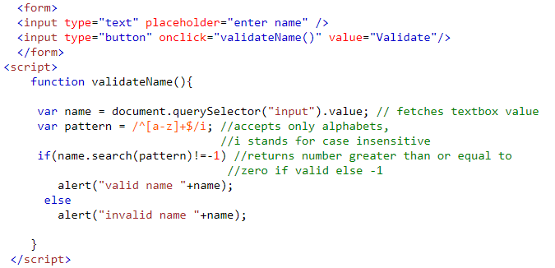
Form Validation
Fetch Form element values:
Syntax: formelement.value
The search() method that tests for a match in a string. It returns the index of the match, or -1 if the search fails.
Syntax: name.search(pattern)

Slide 39
DOM and Form validation Hands-on
Create an array of strings and display its values in list format in browser.
Take input from the name text box and validate to check if it contains only alphabets or not. If it does not contain, display the error message next to the text box “please enter only alphabets”.

Slide 40
Advanced JavaScript
Let and const keywords
Arrow functionss
class and object

Slide 41
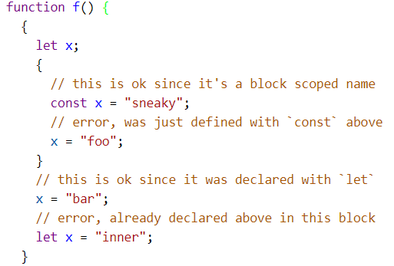
let and const keyword
Both are block scoped i.e. will be accessible only inside the block wherever they are declared.
let is the new var and const is single-assignment.
let declares a block-scoped, local variable, optionally initializing it to a value.
const declares a block-scoped, read-only named constant.

Slide 42
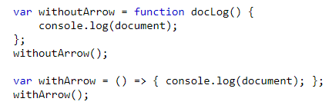
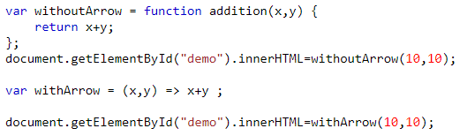
Arrow functions
Arrow functions were introduced as a new syntax for writing JavaScript functions.
They save developers time and simplify function scope.
They use a token => that looks like a fat arrow
Syntax:
(param1,param2) => { //expression statements}

Slide 43
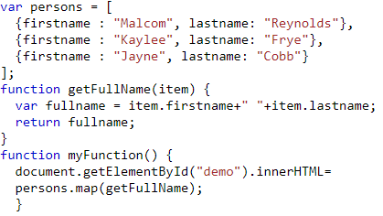
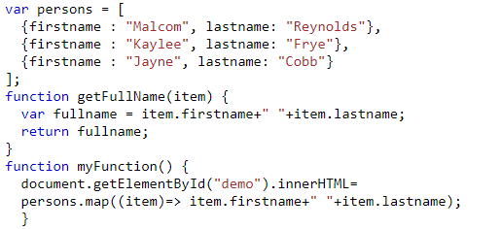
More Examples on Arrow Functions
Without Arrow Functions
With Arrow Functions

Slide 44
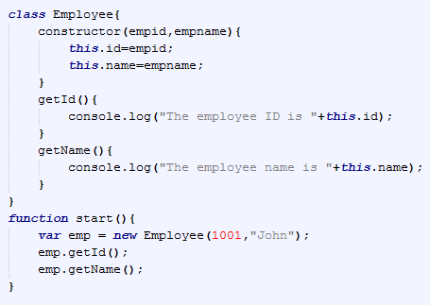
Class and Object
A class is a blueprint that contains the variables and the methods.
An object is an instance of class.
A class contains:
  Field / Data members
  Constructors
  Member functions
Notes:
Field / Data members: Any variable declared in a class. Fields represent data pertaining to objects
Constructors: Responsible for allocating memory for the objects of the class
Member Functions: Represent actions an object can take. They are also at times referred to as methods

Slide 45
Use Case on Advanced JavaScript

Slide 46
Use Case on Advanced JS

Slide 47
Description on Use Case
Create the page using Bootstrap. After entering the valid values, once user clicks on Add Customer button, create the customer object and display in tabular format.
Validate the fields name (alphabets allowed), email id ( valid email id), contact no( only 10 digits and first digit should be 7-9) and account type should be selected.
Whenever user inserts invalid value, show the error message next to text box for ex please enter only alphabets

Slide 48
Cheat Sheet references
Cheat Sheet for JavaScript : JS Cheat Sheet.doc
Cheat Sheet for Advanced JS : Advanced JS Cheat Sheet
Notes:
https://github.com/mbeaudru/modern-js-cheatsheet#class

Slide 49
Introducing the Use Case

Slide 50
Presenting the Use Case

Slide 51
Description on Use Case
Create the page using Bootstrap. After entering the valid values, once user clicks on Add Customer button, create the customer object and display in tabular format.
Validate the fields name (alphabets allowed), email id ( valid email id), contact no( only 10 digits and first digit should be 7-9) and account type should be selected.
Whenever user inserts invalid value, show the error message next to text box for ex please enter only alphabets

Slide 52
Thank You

