Slide 1
JSON

Slide 2
Module design
Provide the cheat sheet
Introduce the use case
JSON Overview
JSON value data types
JSON methods
Display use case
S/W Requirements
IDE :Visual Studio Code
Browser: Chrome

Slide 3
Introduce the Use Case on JSON

Slide 4
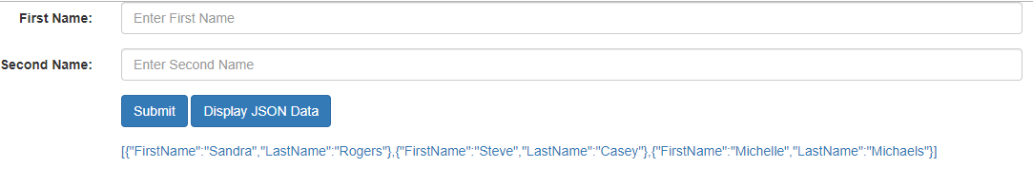
Presenting the Use case on JSON
Design the below page using bootstrap. Once the user clicks on submit button the entries get saved into JSON array and on click of Display JSON data , it should display the JSON array.

Slide 5
Overview of JSON

Slide 6

JSON
JSON (JavaScript Object Notation) is a lightweight data-interchange format. It is easy for humans to read and write. It is easy for machines to parse and generate that is the reason it works as the replacement of XML
JSON is a language-independent data format. It was derived from JavaScript, but as of 2017 many programming languages include code to generate and parse JSON-format data.
The JSON syntax is a subset of the JavaScript syntax.
The JSON format is almost identical to JavaScript objects.
The file type for JSON files is ".json"
In JSON, keys must be strings, written with double quotes.
Syntax:
JSON Object:
{"name":"John", "age":31, "city":"New York"}
JSON array of objects:
{“arr”: [{"name":"John","age":30},{"name":"Jack","age":25}] }

Slide 7
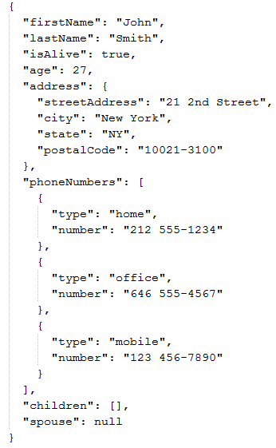
JSON value data types
In JSON, values must be one of the following data types:
a string
a number
an object (JSON object)
an array
a boolean
null
JSON values cannot be one of the following data types:
a function
a date
undefined
sample.json

Slide 8
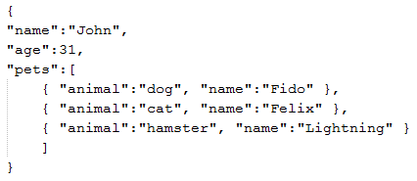
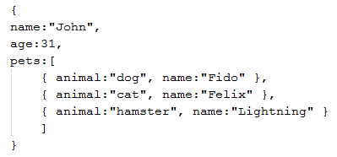
JSON Methods
A common use of JSON is to exchange data to/from a web server.
When receiving data from a web server, the data is always a string.
  Parse the data with JSON.parse() and the data becomes a JavaScript object.
When sending data to a web server, the data has to be a string.
  Convert a JavaScript object into a string with JSON.stringify() method.
JSON.parse(str)
JSON.stringify(obj)
JSON data (str)
Java Script Object (obj)

Slide 9
Let us work on use case on JSON

Slide 10
Presenting the Use case on JSON
Design the below page using bootstrap. Once the user clicks on submit button the entries get saved into JSON array and on click of Display JSON data , it should display the JSON array down.

Slide 11
Cheat Sheet references
Cheat Sheet for JSON : JSON Cheat Sheet

Slide 12
Thank You

