Slide 1
PostgreSQL

Slide 2
PostgreSQL module design
Provide Cheat sheet
Overview of PostgreSQL
How to use pgAdmin
Demonstrate how to work with database, schema and tables
S/W Requirements
pgAdmin4 :PostgreSQL

Slide 3
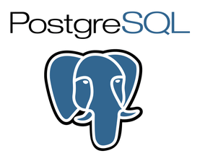
Overview of PostgreSQL
PostgreSQL, also known as Postgres, is a free and open-source relational database management system (RDBMS) emphasizing extensibility and technical standards compliance.
PostgreSQL can run dynamic websites and web apps.
PostgreSQL's write-ahead logging makes it a highly fault-tolerant database
PostgreSQL source code is freely available under an open source license. This allows you the freedom to use, modify, and implement it as per your business needs.
PostgreSQL supports geographic objects so you can use it for location-based services and geographic information systems

Slide 4
PostgreSQL Usage
Financial Industry
  PostgreSQL is an ideal DBMS system for the financial industry. Moreover, It is fully ACID compliant which makes it an ideal choice for OLTP (Online Transaction Processing). It is also capable of performing database analytics. It can be integrated with mathematical software like Matlab and R.
Web technology and NoSQL
  If your website requires to deal with hundreds or even thousands request per second at that time, scalability is a surely big issue. Here, PostgreSQL proves the best solution. PostgreSQL works fine with all modern web frameworks like Django, Node.js,
Scientific data
  You need to generate terabytes of data if you are working on research and scientific project. Therefore, it is important to handle in the most efficient way as possible. For that, PostgreSQL offers wonderful analytical capabilities and powerful SQL engine. This helps you to manage a large amount of data with ease.

Slide 5
Supported Data Types
PostgreSQL supports the following data types:
Text Types (char(4),text)
Numeric Types (decimal, integer, numeric)
Dates and Times (timestamp/time with/without time zone, date)
Boolean (boolean)
XML
JSON
Bits
Binary Data
Network
Arrays
Create your Data Type
Temporal
UUID
Array
JSON
Special Data types for storing a network address and geometric data.

Slide 6
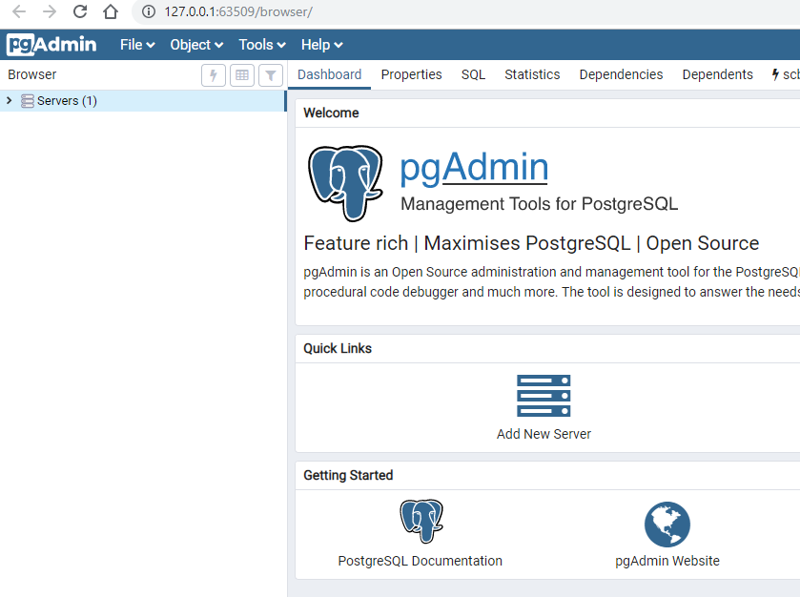
Steps to database server connection
To use PostgreSQL in your machine, you need to install:
PostgreSQL Database Server
A graphical tool to administer and manage the DB. pgAdmin is the most popular tool GUI Tool for PostgreSQL
Visit https://www.postgresql.org/download
After successful installation, to launch PostgreSQL go to Start Menu and search pgAdmin 4 and once you select this, it will open pgAdmin homepage
pgAdmin homepage

Slide 7

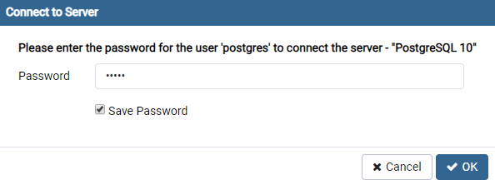
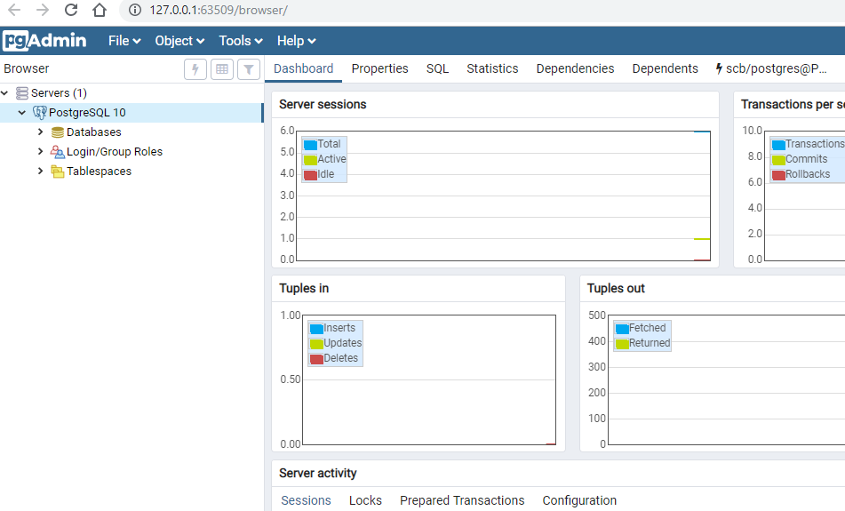
Steps to database server connection cont…
Click on Servers > Postgre SQL 10 in the left tree
Enter super user password set during installation and click OK.
You will see the Dashboard

Slide 8
Let us start with dashboard

Slide 9
Demo
Create Database
Create Schema
Create Table
Perform CRUD operations ( Insert rows, Remove rows, Update rows and Display Rows)
Notes:
A database contains one or more named schemas, which in turn contain tables. Schemas also contain other kinds of named objects, including data types, functions, and operators. The same object name can be used in different schemas without conflict; for example, both schema1 and myschema may contain tables named mytable.

Slide 10
Cheat Sheet references
Cheat Sheet for PostgreSQL : PostgreSQL Cheat Sheet

Slide 11
Thank You

