Slide 1
XML

Slide 2
Module design
Provide the cheat sheet
Introduce the use case
XML Overview
XML elements
XML attributes
XML Namespace
XML Well Formness
XML Syntax Rules
Display use case
S/W Requirements
IDE :Visual Studio Code
Browser: Chrome

Slide 3
Introduce the Use Case on XML

Slide 4
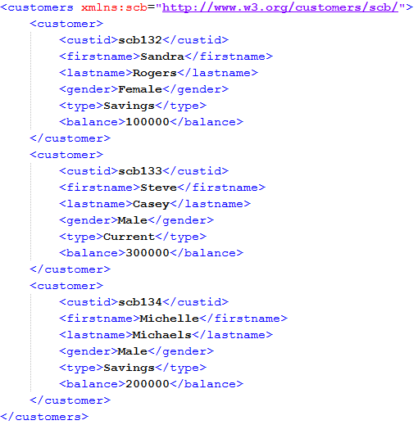
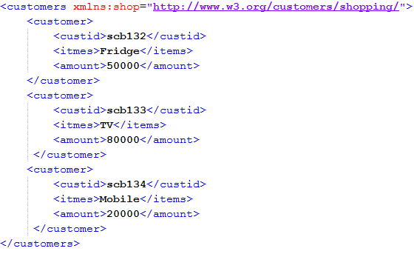
Presenting the Use case on XML
Scenario: We have bank customers holding savings or current account and bank is providing them discounts in amazon shopping. Finally we need to display the data in xml format which shows the customer details with shopping items.

Slide 5
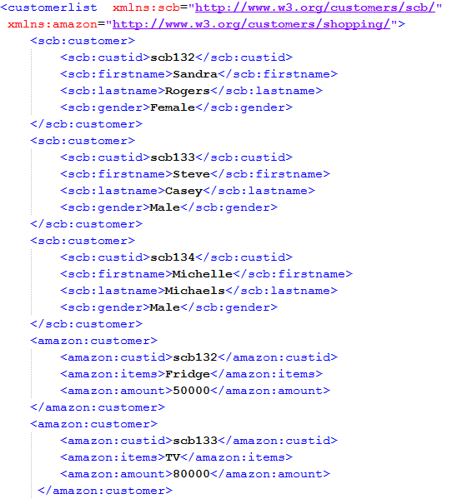
Presenting the Use case on XML…

Slide 6
XML

Slide 7
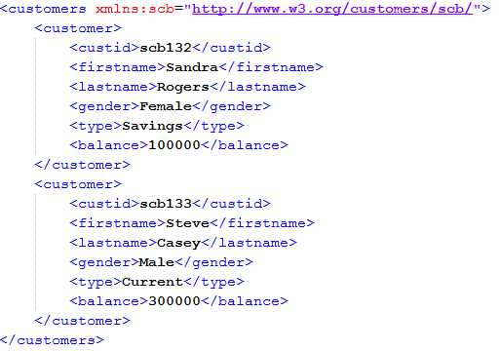
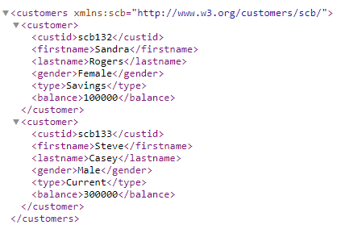
XML
XML is a software- and hardware-independent tool for storing and transporting data.
XML is not a replacement for HTML.
XML is designed to be self-descriptive.
XML is designed to carry data, not to display data.
XML tags are not predefined. You must define your own tags.
XML is platform independent and language independent.
customers.xml
XML document in browser

Slide 8
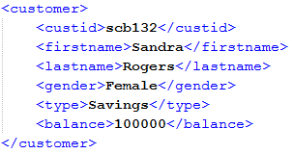
XML Element
An XML doc starts at a root element and branches from the root to child elements.
All elements can have sub elements (child elements). The terms parent, child, and sibling are used to describe the relationships between elements.
An XML element is everything from (including) the element's start tag to (including) the element's end tag. In this example custid, firstname and lastname are elements.
Element can contain:
  text
  attributes
  other elements
  or a mix of the above
Element with no content is said to be empty and it can have attributes.
Element names are case-sensitive
Element names must start with a letter or underscore
Element names cannot contain spaces

Slide 9

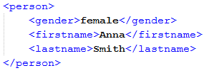
XML Attributes
Attributes are designed to contain data related to a specific element.
Attribute values must always be quoted. Either single or double quotes can be used.
Single element can have multiple attributes but that’s not a good practice.
XML elements vs attributes: In the first example gender is an attribute. In the last, gender is an element. Both examples provide the same information.
There are no rules about when to use attributes or when to use elements in XML.

Slide 10
XML Syntax Rules
XML Documents Must Have a Root Element
The XML prolog is optional. If it exists, it must come first
in the document.
XML tags are case sensitive. The tag <Book> is different from the tag <book>.
In XML, all elements must be properly nested within each other.
In XML, the attribute values must always be quoted.
XML does not truncate multiple white-spaces (HTML truncates multiple white-spaces to one single white-space).

Slide 11
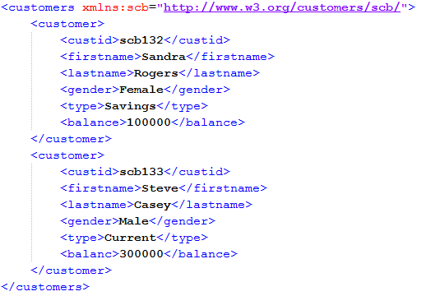
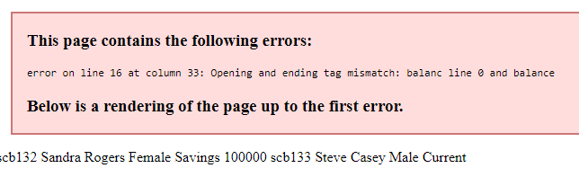
Well Formness of XML
Well Formness of XML is something if XML follows the syntax rules.
To check whether XML is well formed or not, please open XML in the browser. If you are able to open successfully XML is well formed else you will get the error.
Output in browser
balance is mis-spelled

Slide 12
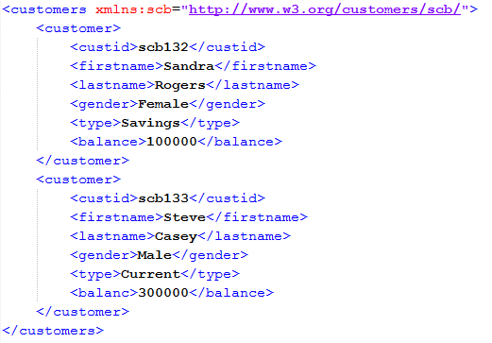
XML Namespace
XML Namespaces provide a method to avoid element name conflicts.
In XML, element names are defined by the developer. This often results in a conflict when trying to mix XML documents from different XML applications.
Suppose we are getting customer data in xmls from different places like bank customers and shopping customers then both XML’s will be having the common set of elements like: firstname, lastname. To differentiate both XML data we do need namepspace.
Syntax:
<element xmlns:prefix=“namespaceidentifier”
A Uniform Resource Identifier (URI) is a string of characters which identifies an Internet Resource.
Any arbitrary string
URI

Slide 13
Let us work on XML use case

Slide 14
Presenting the Use case on XML
Scenario: We have bank customers holding savings or current account and bank is providing them discounts in amazon shopping. Finally we need to display the data in xml format which shows the customer details with shopping items.

Slide 15
Presenting the Use case on XML…

Slide 16
Cheat Sheet references
Cheat Sheet for XML : XML Cheat Sheet

Slide 17
Thank You

